Slide 1
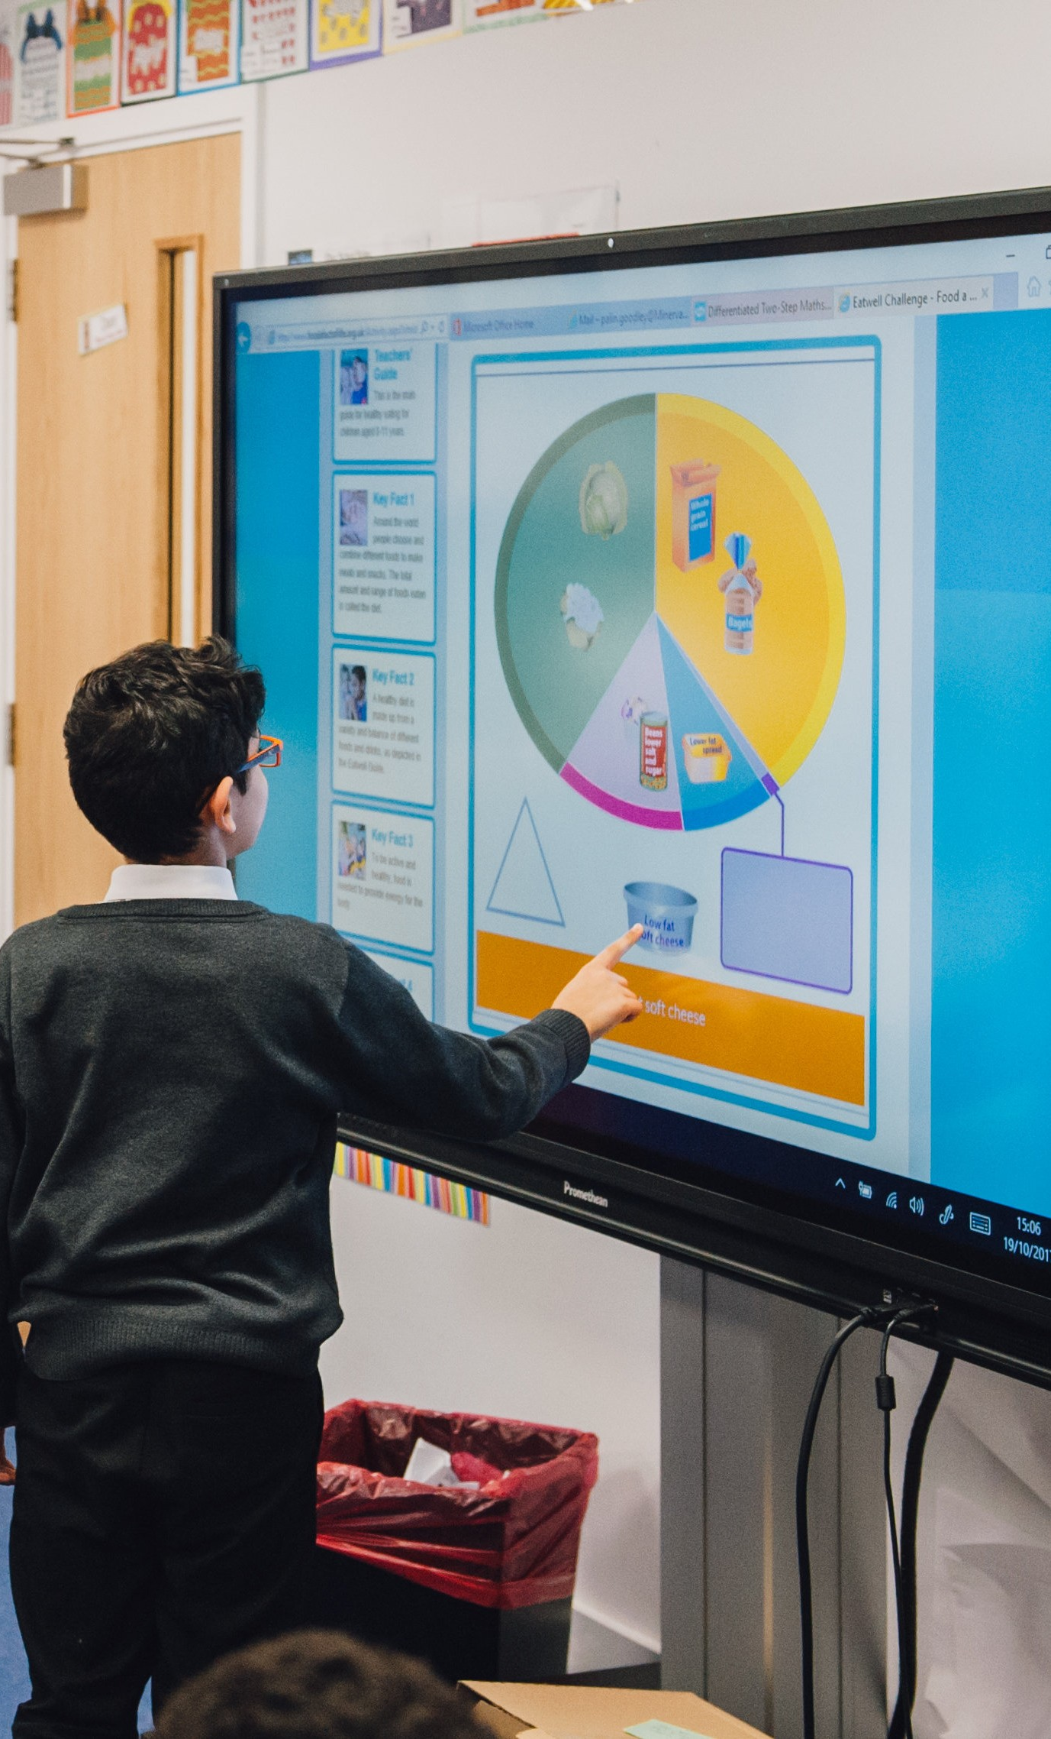
The Eatwell Guide
(7-11)

Slide 2
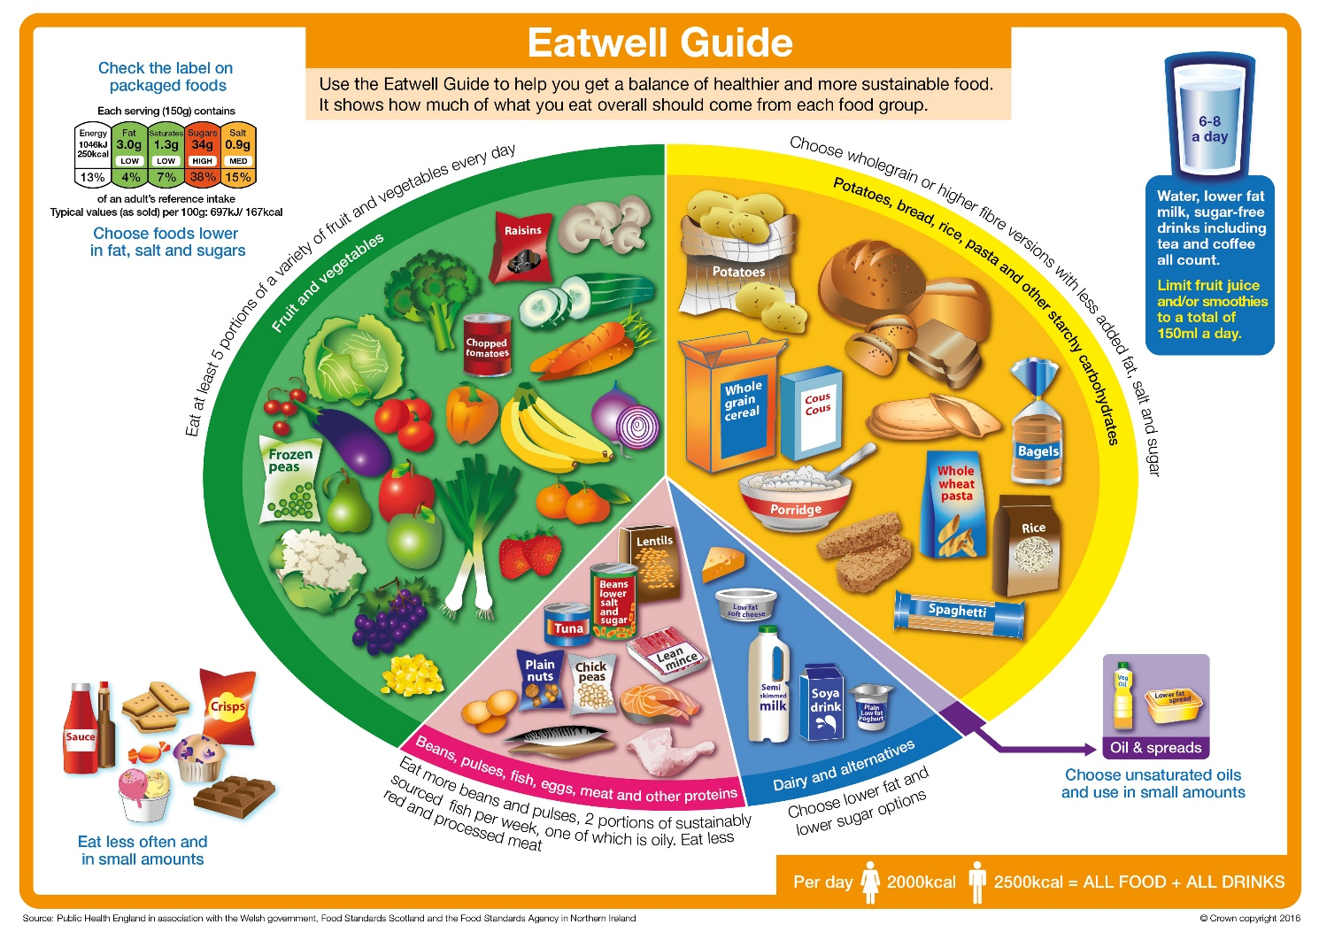
The Eatwell Guide
What can you see?
This is the Eatwell Guide.
It shows the proportions and types of food that should be eaten.
It has five main food groups.

Slide 3
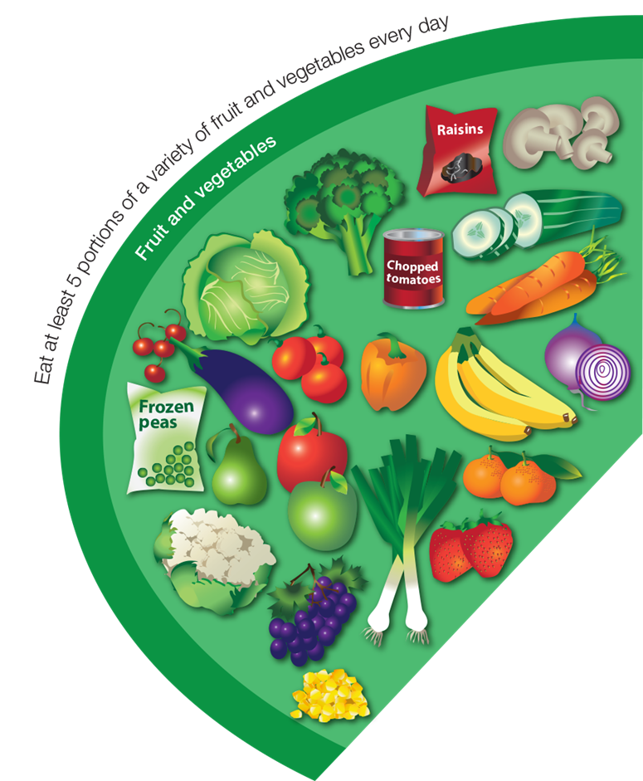
Fruit and vegetables
What foods can you see here?
How much do you need to eat from this food group?
Eat at least five portions every day.

Slide 4
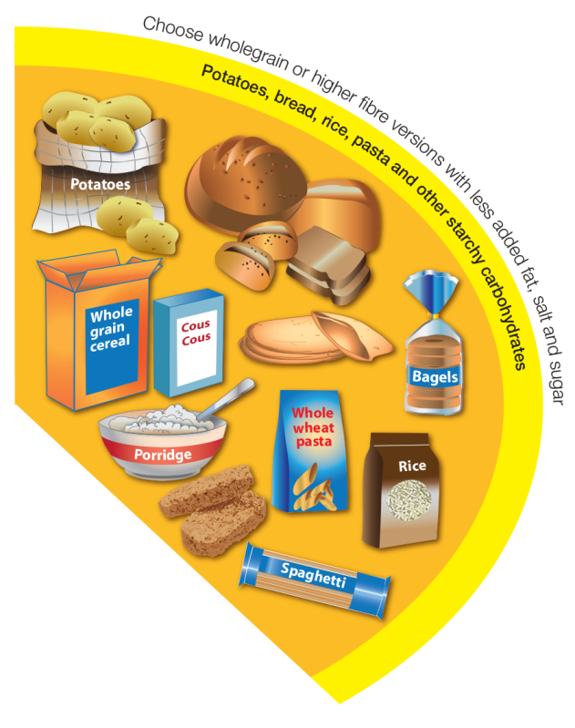
Potatoes, bread, rice, pasta
and other starchy carbohydrates
What foods can you see here?
How much do you need to eat from this food group?
Eat a food from this group at every mealtime.
Try wholegrain varieties.

Slide 5
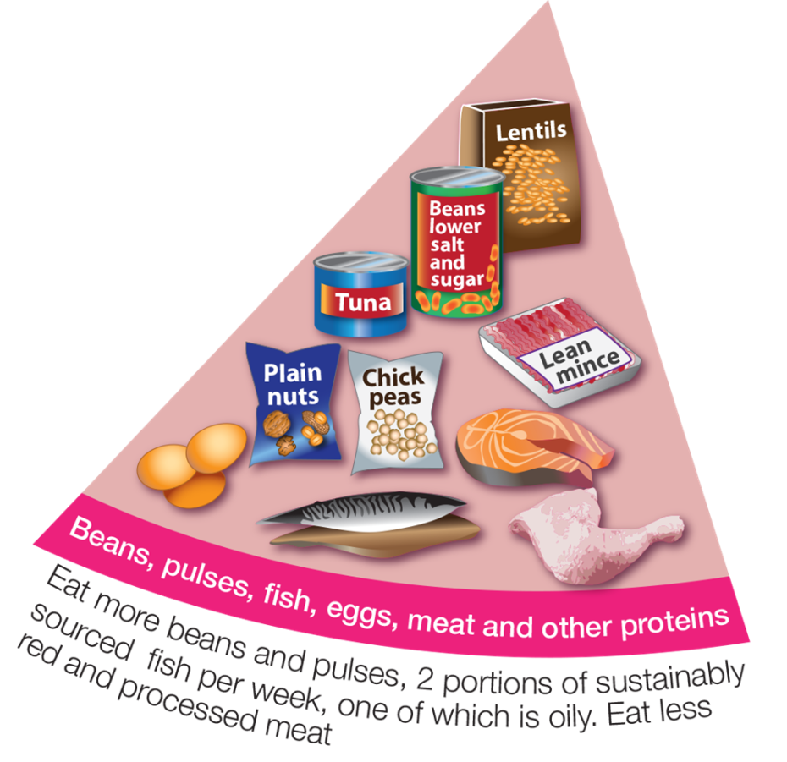
Beans, pulses, fish, eggs, meat
and other proteins
What foods can you see here?
How much do you need to eat from this food group?
Eat some foods from this group every day,
e.g. beans on toast and spaghetti Bolognese.

Slide 6
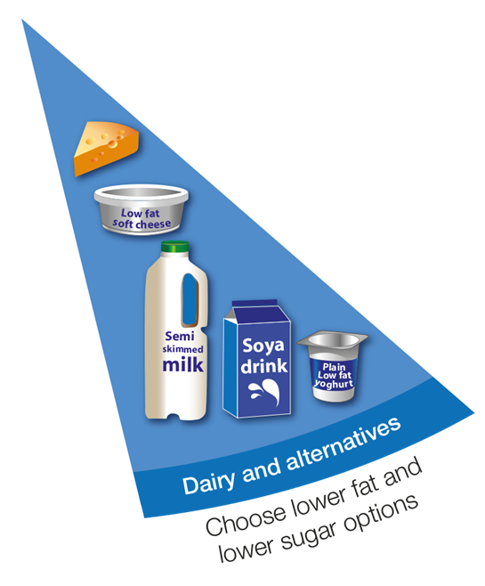
Dairy and alternatives
What foods can you see here?
How much do you need to eat from this food group?
Have some of these foods every day,
e.g. a pot of yogurt and a cheese sandwich.

Slide 7

Oil and spreads
What foods can you see here?
How much do you need to eat from this food group?
Eat in small amounts.

Slide 8

Drinks
How many drinks do you need each day?
What drinks are healthier choices?
Water and lower fat milk are healthier drink choices!

Slide 9

Foods high in fat, salt and sugars
What foods can you see here?
Do you need this type of food to be healthy?
We do not need these types of foods to be healthy. If we eat them, it should just be occasionally and in small amounts.

Slide 10
The Eatwell Guide
(7-11)

