Slide 1
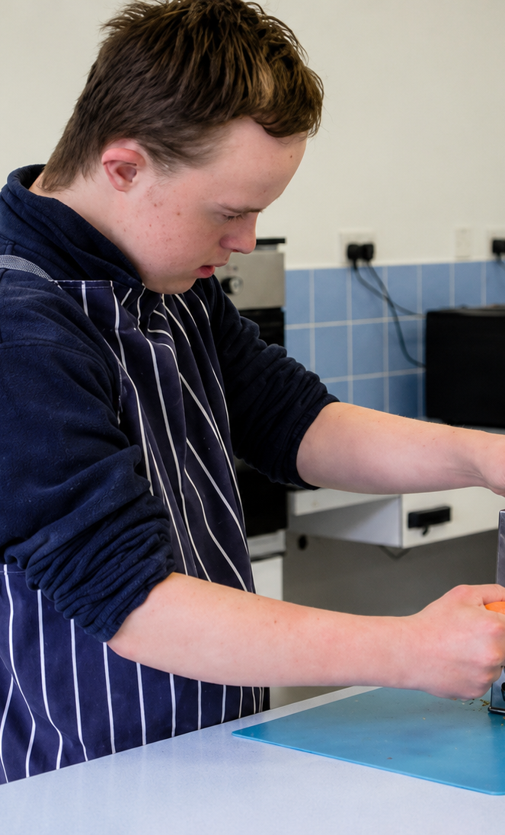
Cooking

Slide 2
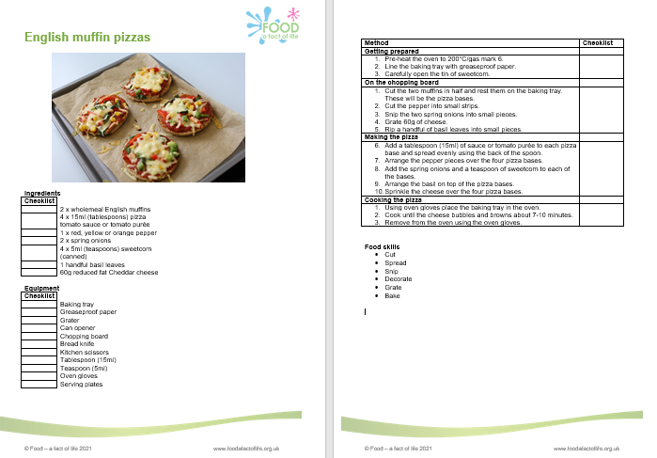
Using a recipe to make food or drink
Recipes:
are a set of instructions;
are followed to make drinks, snacks, or meals;
can be used to write shopping lists.

Slide 3
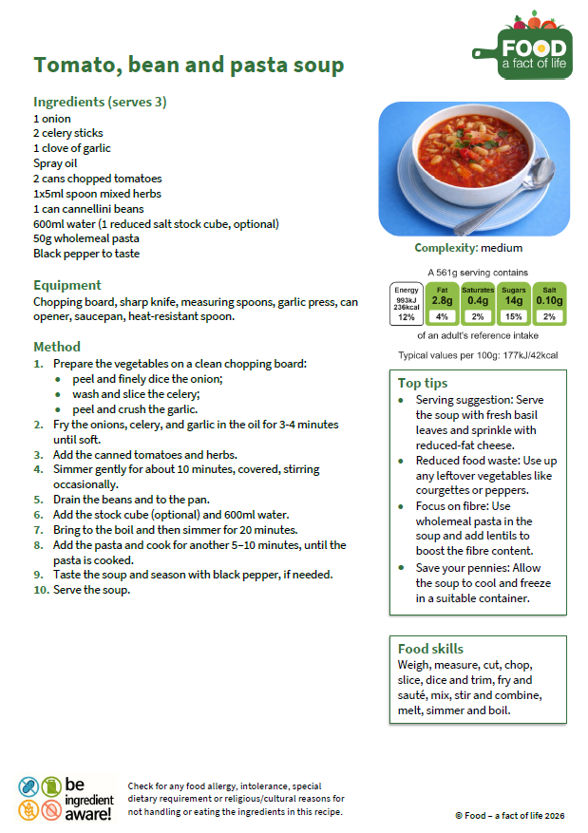
Recipes
Picture or serving instructions
Name
Ingredients
Equipment
Method

Slide 4
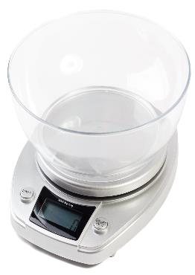
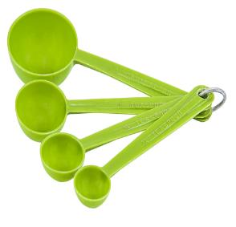
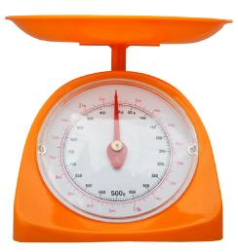
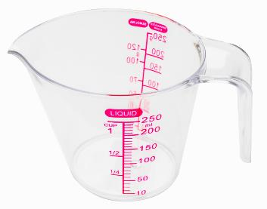
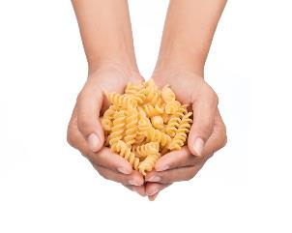
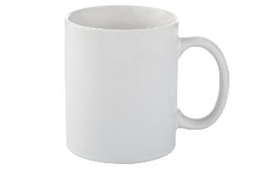
Weighing and measuring
Food can be weighed or measured in different ways.
Scales
Spoons
Scales
Jugs
Hands
Cups

Slide 5
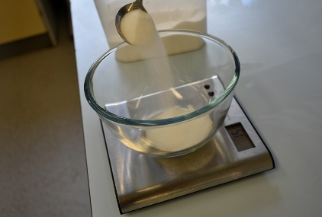
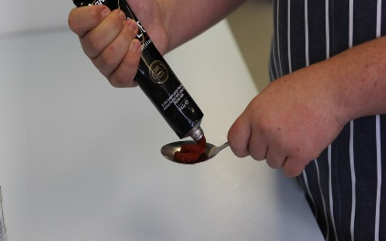
Making drinks, snacks and meals
Basic cooking skills are required.
Weigh
Measure

Slide 6
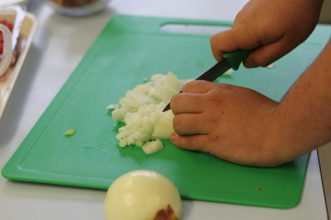
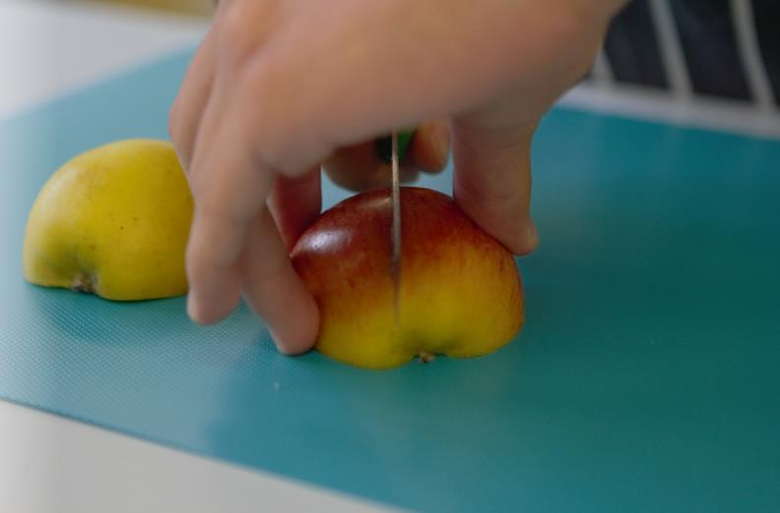
Making drinks, snacks and meals
Click on the pictures to watch videos of the bridge hold and claw grip.
Cut – claw grip
Cut - bridge hold

Slide 7
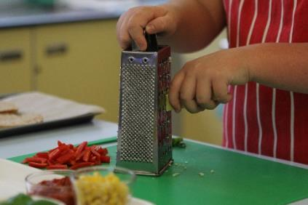
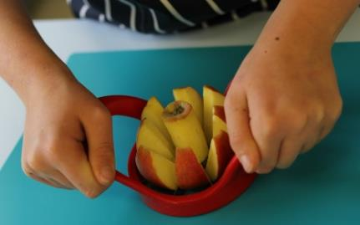
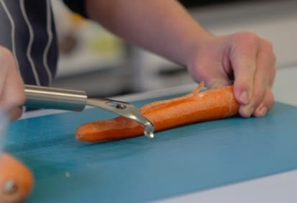
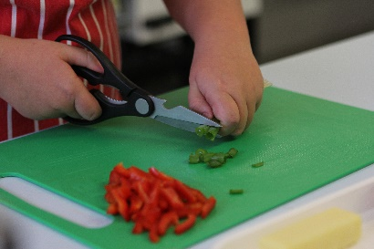
Making drinks, snacks and meals
Grate
Core
Peel
Snip

Slide 8
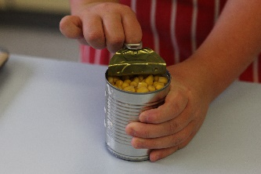
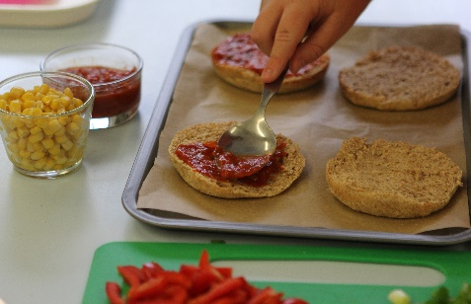
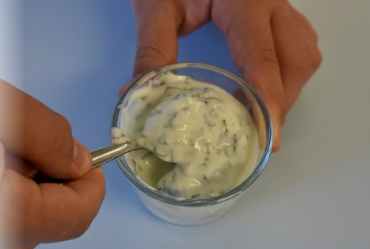
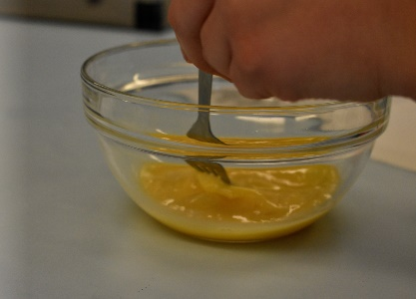
Making drinks, snacks and meals
Watch cooking skills videos here.
Opening cans, bottles and jars
Spread
Mix
Beat

Slide 9
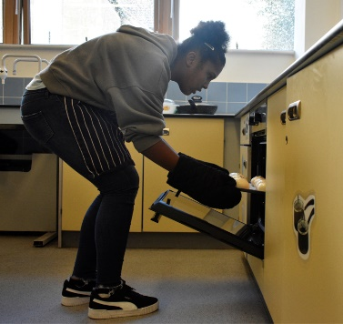
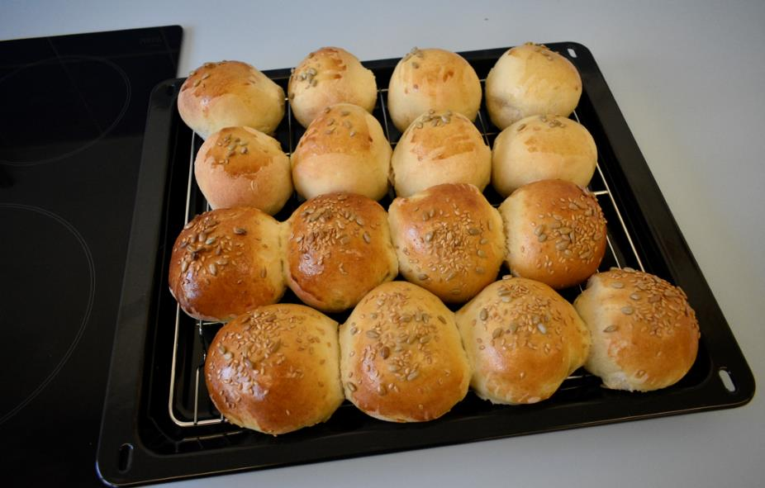
Cooking food - baking

Slide 10
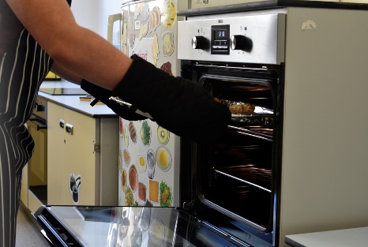
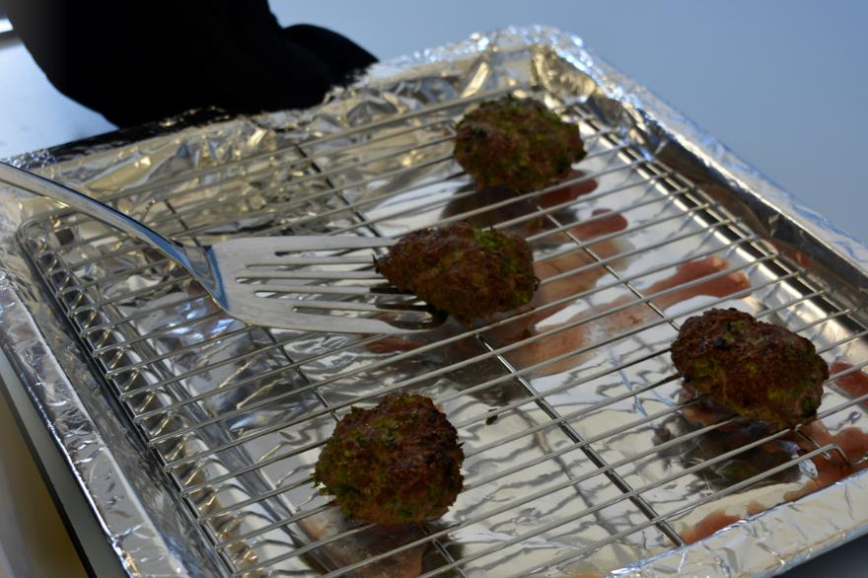
Cooking food - grilling

Slide 11
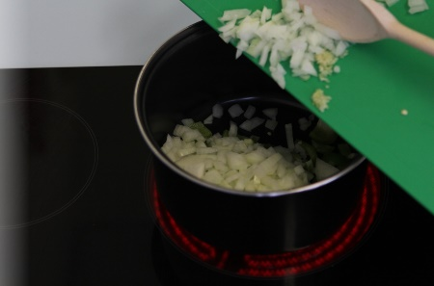
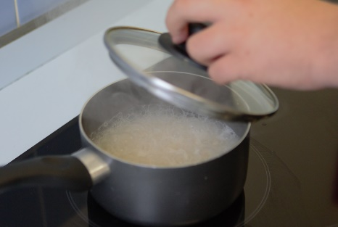
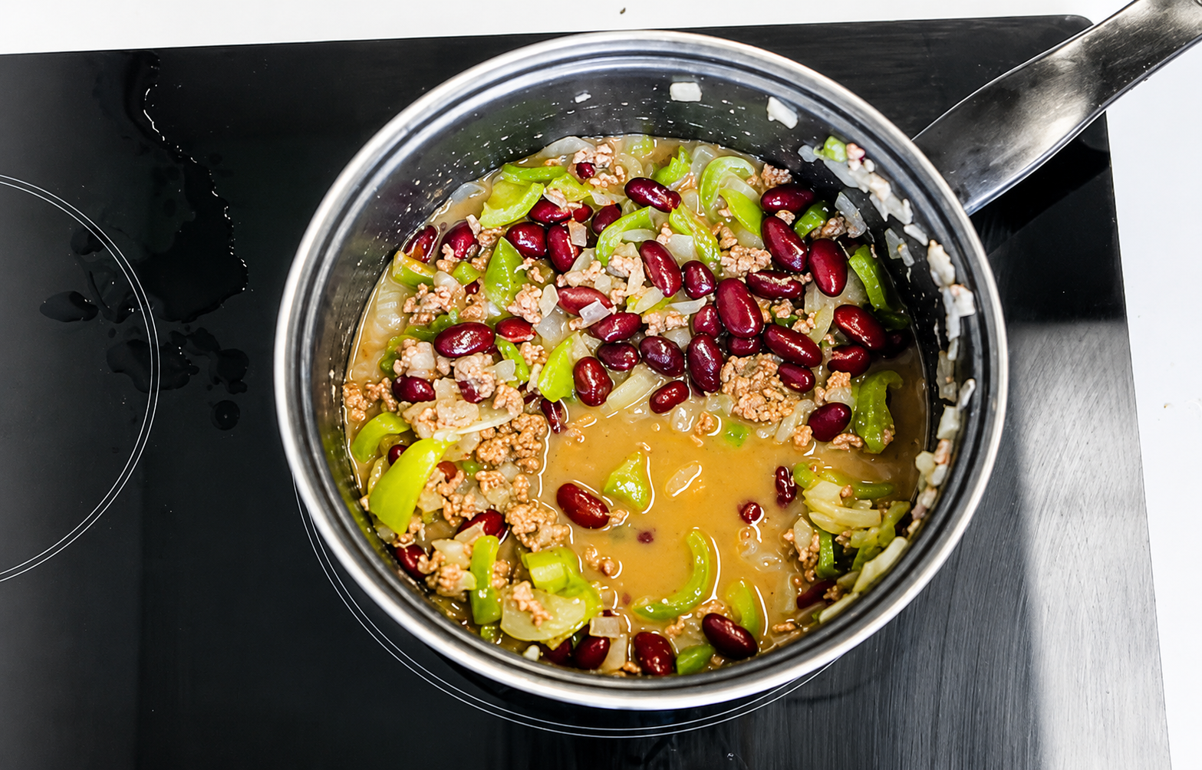
Cooking food – on the hob
Fry
Boil
Simmer

Slide 12
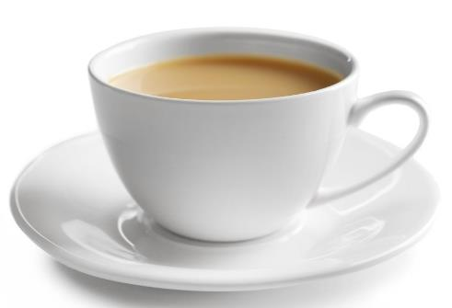
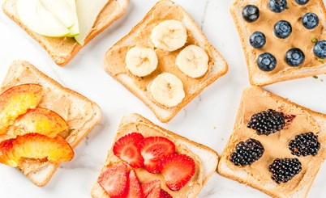
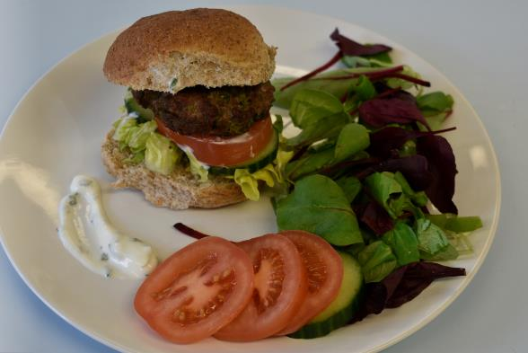
Cooking
Use your cooking skills to make drinks, snacks and meals!
Drinks
Snacks
Meals

Slide 13
Cooking

