Slide 1
This is meat

Slide 2
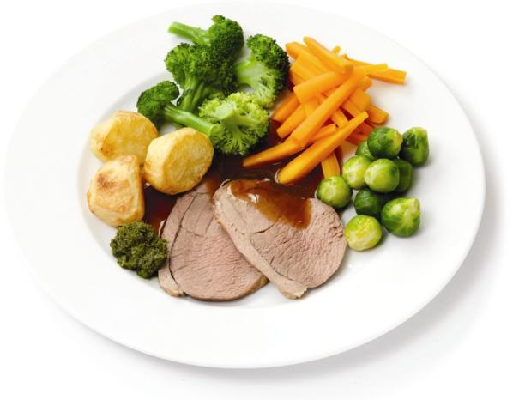
Welcome
Meat is an important food commodity which provides nutrients essential for health.
A variety of different textures, colours and flavours of meat are available for you to choose.
This presentation contains an overview of the origin, structure and composition of different types of meat.

Slide 3
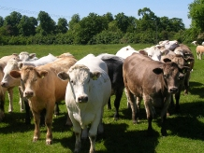
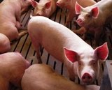
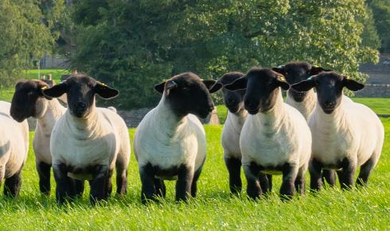
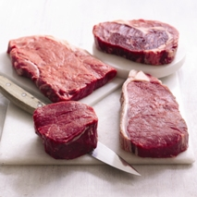
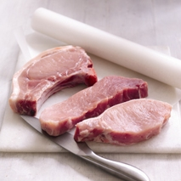
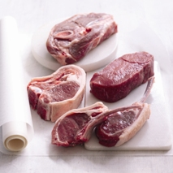
Types of meat
Red meat eaten in the UK comes mainly from:
Cattle (beef)
Pigs (pork)
Sheep (lamb)

Slide 4
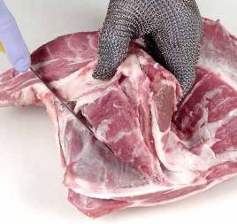
The structure of meat
Animal flesh consists of muscle tissue or fibres, connective tissue and fatty (adipose) tissue. Lean meat is the muscle tissue of animals. Muscle cells comprises:
water;
protein;
minerals;
vitamins;
the red protein called myoglobin (similar to the blood pigment haemoglobin);
fat.

Slide 5
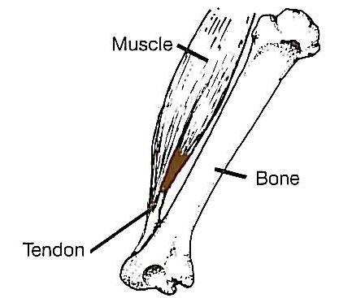
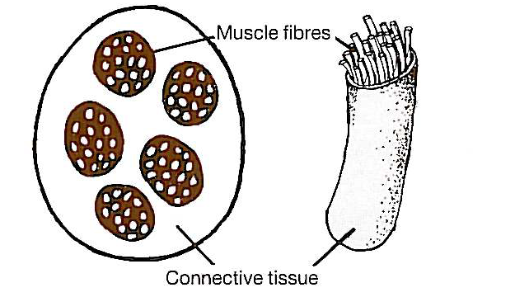
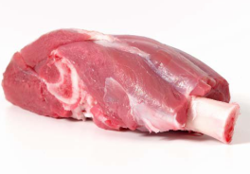
What’s the connection?
Meat muscle is made up of bundles of muscle fibres held together by creamy white connective tissue.
Tendons join the muscle (made up of bundles of muscle fibres, surrounded by connective tissue) to the bones of animals.

Slide 6
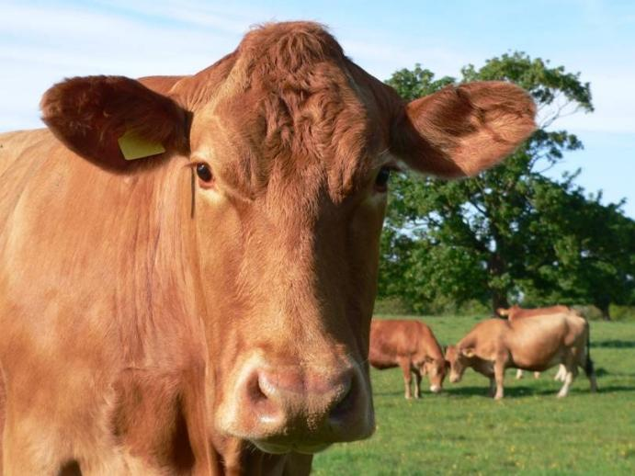
Muscle fibres in action
Individual muscle fibres are made up of cells which contain the proteins actin and myosin.
In live animals, actin and myosin work together to make the muscle contract and relax.

Slide 7
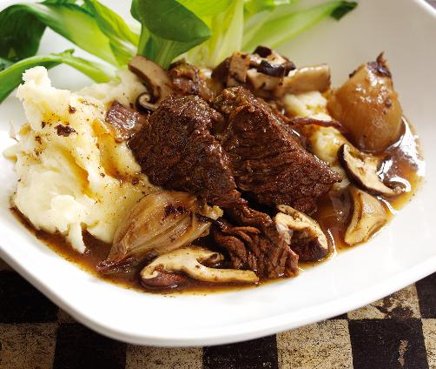
Connective tissue and cooking
Connective tissue is made up of two proteins called collagen and elastin.
Collagen
The connective tissue in and around the muscle fibres and tendons is mostly collagen.
When meat is cooked, the collagen becomes soft and soluble, and forms gelatine.

Slide 8
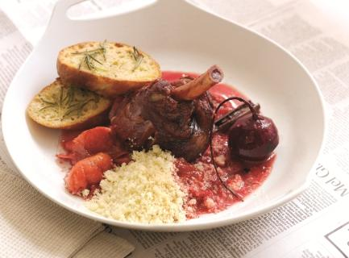
Connective tissue and cooking
Elastin
This is much more elastic connective tissue.
It is yellow in colour and remains tough, even when cooked. The ligaments which join two bones together are mostly made up of elastin.

Slide 9
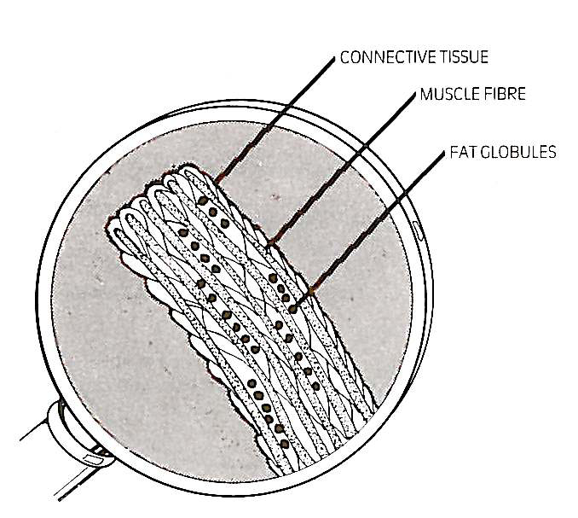
Muscle fibres
Muscle fibres are very small – and can only be seen under a microscope. The length of muscle fibres varies.
Fine muscle fibres
These tend to come from the muscles of young animals, or in older animals from the muscles which do least work.
They contain little collagen and are tender even when cooking times short, e.g. grilling.

Slide 10
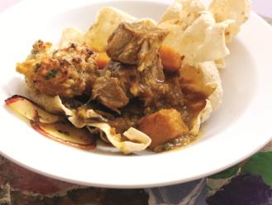
Thick muscle fibres
These tend to be from older animals and also muscles which do the most ‘work’ – such as neck and shin.
They have more connective tissue to prevent muscle damage.
This type of meat is tougher and needs long, slow cooking with moisture to make it tender, e.g. casserole.

Slide 11
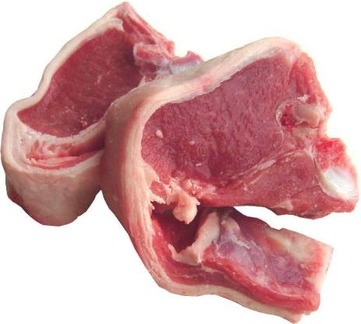
Fat – visible fat
Fat is found in meat underneath the skin (subcutaneous fat) and between the muscles (intermuscular fat) and is a creamy-white colour.
This type of fat is called visible fat.
Visible fat (called suet) is also found around the animal’s organs, such as the kidneys.

Slide 12
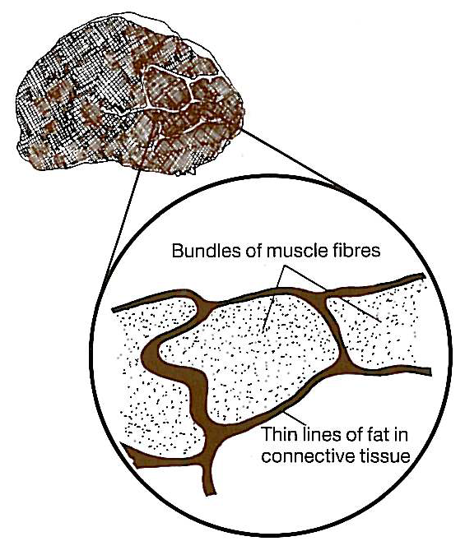
Fat – invisible fat
A small amount of fat is also found in connective tissue surrounding the bundles of muscle fibres.
This is usually not obvious to the eye, so it is known as invisible fat. Sometimes these lines of fat can be seen and give meat a ‘marbled’ look.
Many butchers trim off most or all of the visible fat. Farmers are now breeding animals which have a greater proportion of lean meat and less fat.

Slide 13
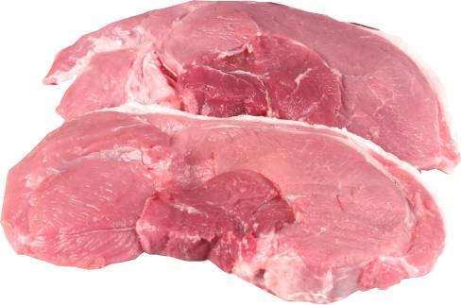
The colour of meat
The colour of meat is largely due to the red protein called myoglobin and some haemoglobin (blood) left in the muscle. Some muscles contain more of these red pigments than others.
Colour differences can be due to age and exercise, but are mainly due to the metabolism of the species and the function of the particular muscle.
Meat from muscles which have been used a lot and are from older animals is usually a darker colour.

Slide 14
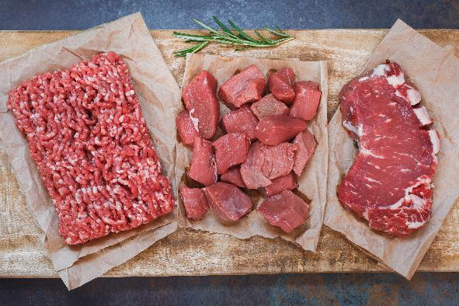
The colour of meat
During the time meat is stored the colour changes to a darker brown-red because of the formation of metmyoglobin.
When meat is cut and exposed to oxygen in the air, it takes about twenty minutes for myoglobin to change to oxymyoglobin, which is brighter red in colour.
After some time, the meat becomes a browner colour again as metmyoglobin is formed.
These colour changes do not make any difference to the taste or texture.

Slide 15
The composition of lean meat
Lean raw meat is made up of water, proteins, fats and minerals.
The exact amounts of each of these vary in any particular cut of lean meat. The variation could depend on:
the species – beef, lamb or pork;
the breed of animal;
the age of the animal;
how the animal was fed;
the particular muscle from which the cut of meat was taken.

Slide 16
Summary
Red meat eaten in the UK, comes mainly from: cattle (beef), pigs (pork) and sheep (lamb).
Lean meat is the muscle tissue of animals which is made up of bundles of muscle fibres held together by creamy white connective tissue.
Connective tissue is made up of two proteins called collagen and elastin.
Two different types of fat can be found in meat, visible and invisible.
The colour of meat varies due to the red protein called myoglobin and some haemoglobin remaining in the muscles. Exposure to oxygen increases the red colour of meat.
Lean meat comprises water, protein, fats, vitamins and minerals.

Slide 17
This is meat
For further information, go to:
www.foodafactoflife.org.uk
This resource meets the Guidelines for producers and users of school education resources about food.

