Slide 1
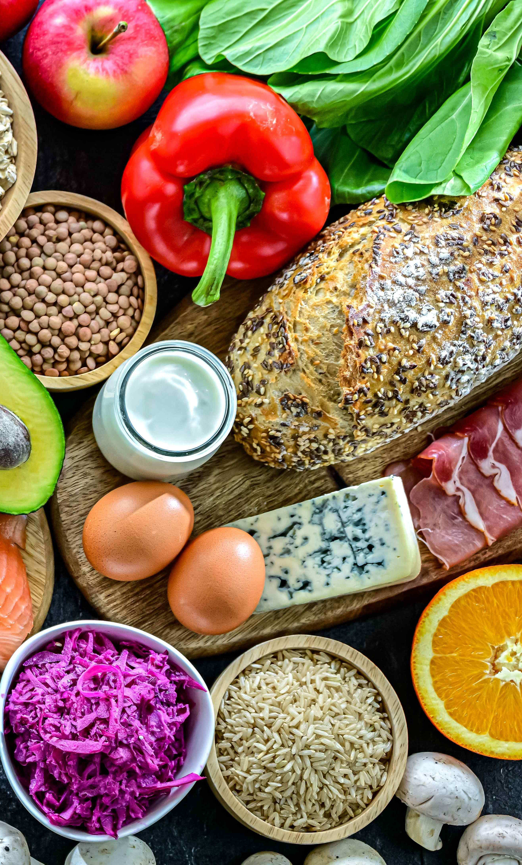
Nutrients
(11-14)

Slide 2
Nutrients
Food is eaten and digested in the body to allow the absorption of energy and nutrients.
There are two different types of nutrients:
• macronutrients;
• micronutrients.
There are three macronutrients that are essential for health.
These are:
• carbohydrate;
• protein;
• fat.
Macronutrients are measured in grams (g).

Slide 3
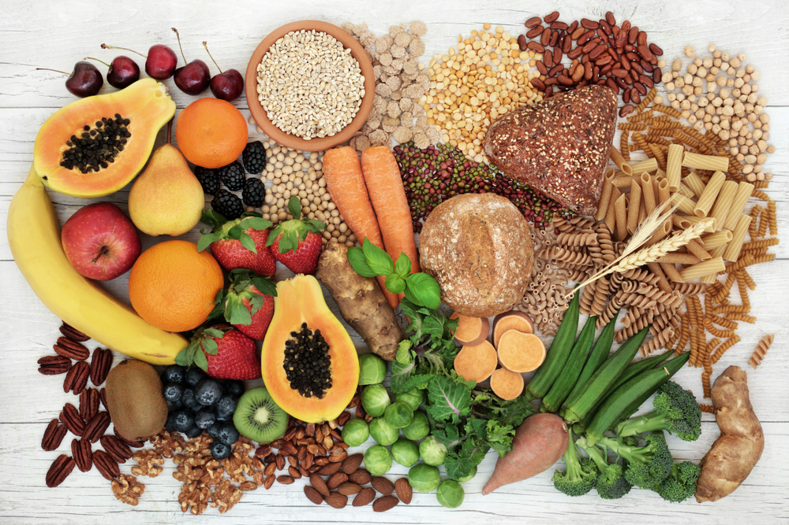
Carbohydrates
The two types of carbohydrate that provide dietary energy are starch and sugars.
Dietary fibre is also a type of carbohydrate which is not digested to provide energy.
Starchy carbohydrate is an important source of energy.
1 gram of carbohydrate provides 4kcal (17kJ).

Slide 4

Structure of carbohydrates
All types of carbohydrate are compounds of carbon, hydrogen and oxygen.
They can be classified in many different ways. One common way is according to their structure.
Sugars
Sugars come from a variety of foods. Some are within the cellular structure of the food, e.g. in fruit or vegetables.
Other sugars are not bound into the cellular structure of the food, e.g. in milk or honey.

Slide 5

Free sugars
Free sugars include all sugars added to foods plus sugars naturally present in honey, syrups and unsweetened fruit juice.
The term does not include lactose (the sugar in milk) when naturally present in milk and dairy products and the sugars contained within the cellular structure of foods (e.g. fruit and vegetables).
The recommendations state that less than 5% of total energy intake should come from free sugars.
For more information about free sugars, go to: www.nutrition.org.uk

Slide 6
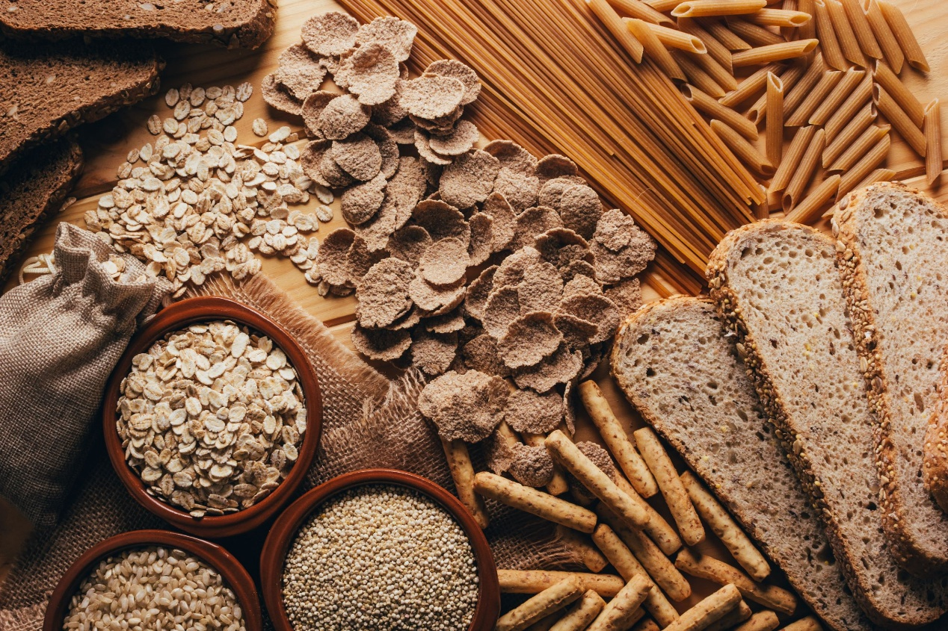
Starchy carbohydrates
Starch is found in a variety of foods. It is made up of many sugar molecules.
Can you give some examples of sources of starch in the diet?
• Potatoes
• Bread
• Rice
• Pasta
Cereal and cereal products are the main source of carbohydrate for adults in the UK.

Slide 7
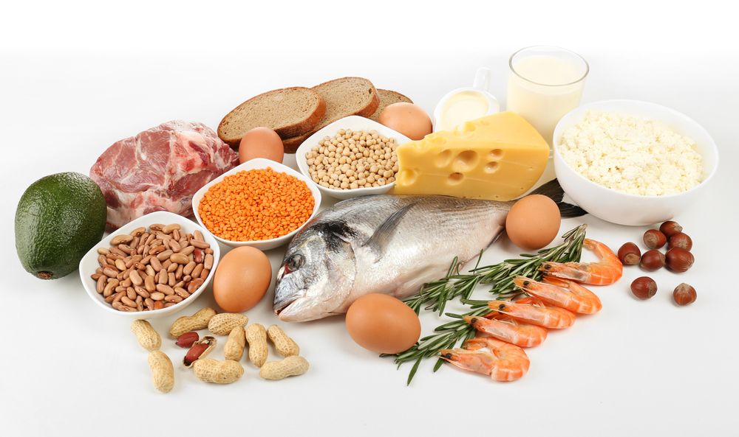
Protein
Protein is essential for growth and repair and keeping cells healthy.
Protein also provides energy:
1 gram of protein provides 4 kcal (17 kJ).

Slide 8
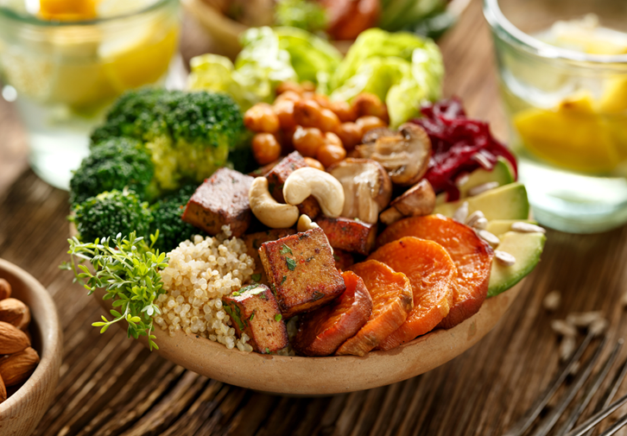
Structure of protein
Protein is made up of building blocks called amino acids. Different foods contain different amounts and different combinations of amino acids.
Protein from animal sources (e.g. meat, fish, eggs and dairy products) contains the full range of essential amino acids needed by the body.
Protein from plant sources (e.g. pulses and cereals) typically contain fewer essential amino acids.

Slide 9

Sources of protein
Animal:
• meat;
• fish;
• eggs;
• milk;
• cheese.
Plant:
• nuts;
• seeds;
• pulses, e.g. beans, lentils;
• mycoprotein;
• soya products.

Slide 10
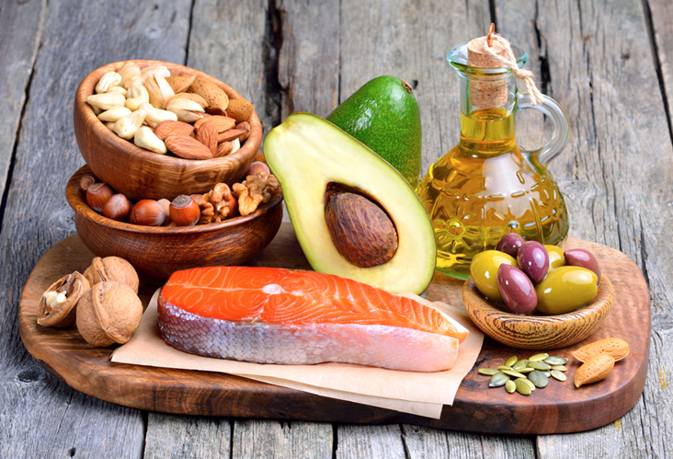
Fat
Fat provides fat-soluble vitamins A, D, E and K, and is necessary for their absorption. It is also important for essential fatty acids the body cannot make.
Fat provides a concentrated source of energy:
1 gram of fat provides 9 kcal (37 kJ) of energy.
Foods that contain a lot of fat provide a lot of energy.

Slide 11
Structure of fat
Fat is made up of different types of fatty acids and glycerol.
The structure of the fatty acids determines:
• their effect on our health;
• their characteristics, e.g. melting point.
Depending on their chemical structure, fatty acids are usually classified as:
• saturated;
• monounsaturated;
• polyunsaturated.

Slide 12
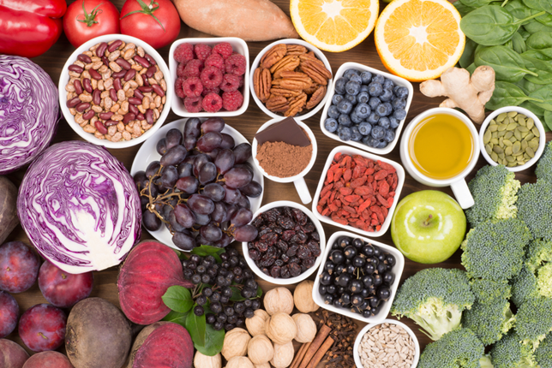
Micronutrients
There are two types of micronutrients:
• vitamins;
• minerals.
Vitamins and minerals are needed in much smaller amounts than macronutrients. Their amounts are measured in milligrams (mg) and micrograms (μg).
(1mg = 0.001g)
(1μg = 0.001mg).

Slide 13
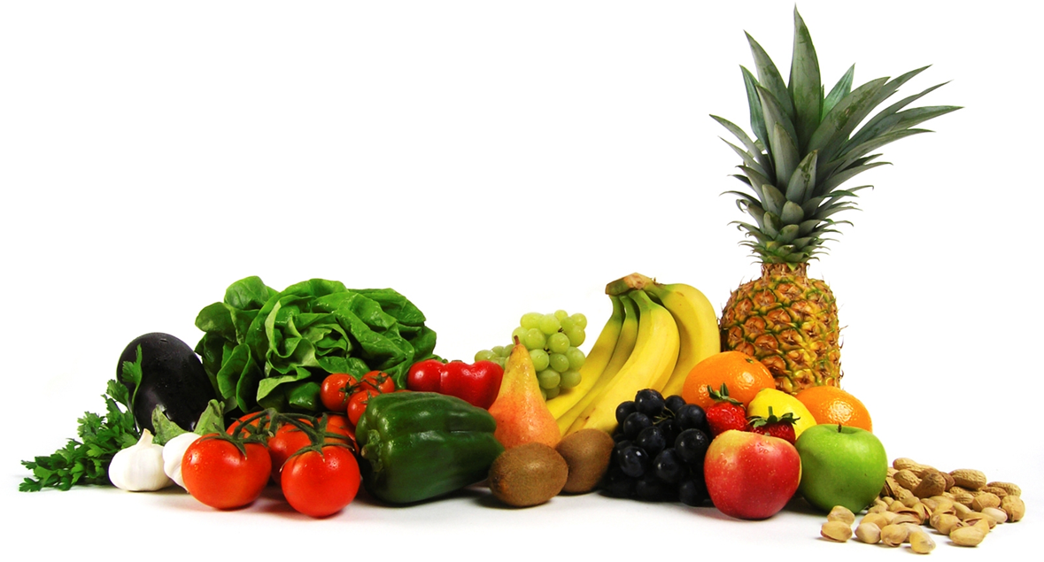
Vitamins
There are two groups of vitamins:
• fat-soluble vitamins, which can be stored in the body, e.g. vitamins A and D.
• water-soluble vitamins, which cannot be stored in the body and are therefore required daily, e.g. B vitamins and vitamin C.

Slide 14
Fat soluble vitamins
Vitamin A
Vitamin A helps the immune system to function normally, helps with vision and helps the maintenance of normal skin.
In the UK, margarine must be fortified with vitamin A and vitamin D.
Vitamin A and D are also often voluntarily added to reduced fat spreads.
Vitamin D
Vitamin D helps the body to absorb calcium and to build and maintain healthy bones and muscles. It also helps the immune system to work as it should.
We get most of our vitamin D via the sun during the summer months. Vitamin D is also provided by the diet from oily fish, meat, and eggs.

Slide 15
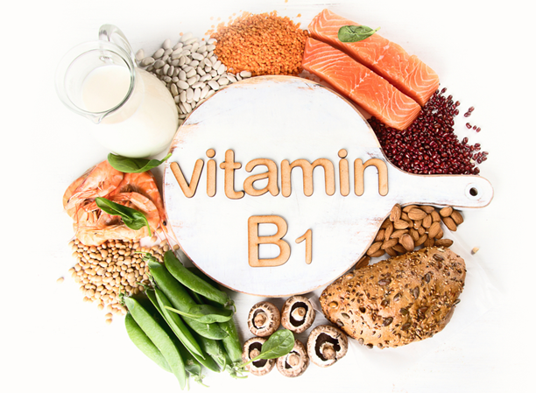
Water soluble vitamins
There are many different B vitamins, and each has a specific function in the body.
These include:
• vitamin B1 (Thiamin);
• vitamin B2 (Riboflavin);
• vitamin B3 (Niacin);
• vitamin B6;
• vitamin B12;
• folate/folic acid.

Slide 16
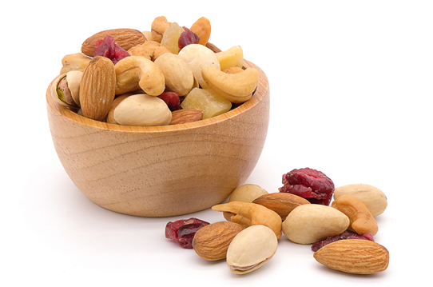
Thiamin (vitamin B1)
Thiamin helps to release energy from food. It also helps our nervous system and heart function normally.
Sources of Thiamin (vitamin B1):
• Whole grains.
• Nuts.
• Meat (especially pork).
• Fruit and vegetables.
• Fortified breakfast cereals.

Slide 17
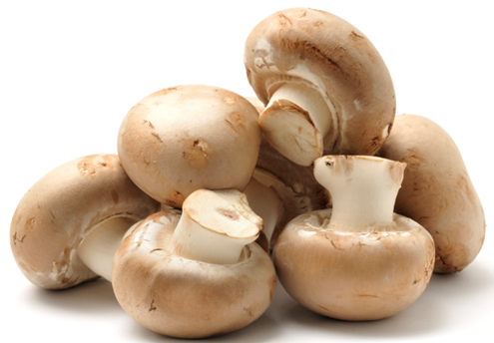
Riboflavin (vitamin B2)
Riboflavin helps to release energy from food, reduce tiredness, and helps to maintain normal skin and a normal nervous system.
Sources of Riboflavin (vitamin B2):
• Milk.
• Eggs.
• Rice.
• Fortified breakfast cereals.
• Legumes.
• Mushrooms.
• Green vegetables.

Slide 18
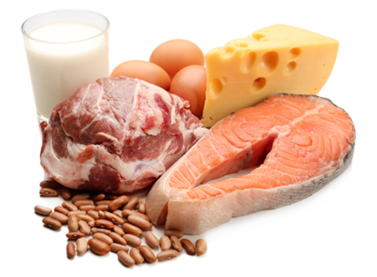
Niacin (vitamin B3)
Niacin helps to release energy from food, reduce tiredness, and helps to maintain normal skin and a normal nervous system.
Sources of Niacin:
• Meat.
• Wheat and maize flour.
• Eggs.
• Dairy products.
• Yeast.

Slide 19

Vitamin C
Vitamin C helps to protect cells from damage. It helps form collagen, which is important for normal bones, gums, teeth and skin. It also helps the immune system and the nervous system to function normally.
Sources of vitamin C:
• Fresh fruit especially citrus fruits
and berries.
• Green vegetables.
• Peppers.
• Tomatoes.
• New potatoes.

Slide 20
Minerals
Minerals are inorganic substances required by the body in small amounts for a variety of different functions.
The body requires different amounts of each mineral.
People have different requirements, according to their:
• age;
• gender;
• physiological state (e.g. pregnancy).

Slide 21
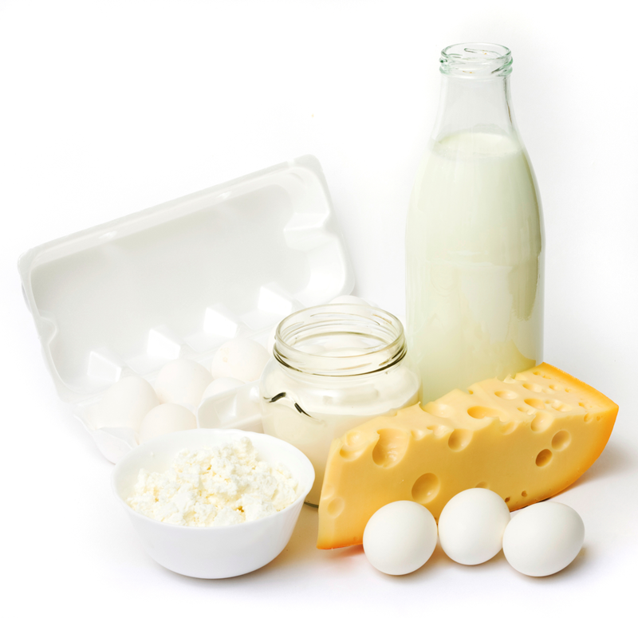
Calcium
The body contains more calcium than any other mineral. It helps to build and maintain strong bones and teeth. It helps nerves and muscles to function normally and helps blood to clot normally.
Milk, cheese and other dairy products provide about half of the calcium in the UK diet.

Slide 22
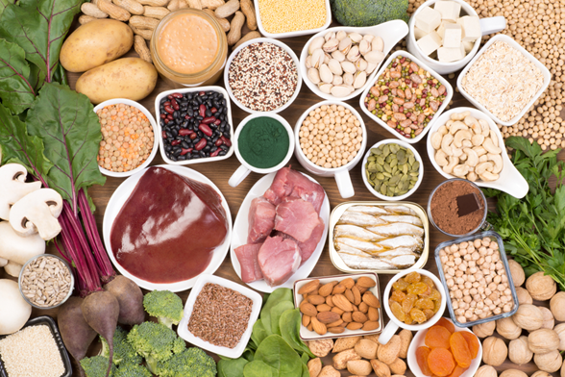
Iron
Iron helps to make red blood cells, which carry oxygen around the body. It also helps the immune system to work and helps the brain to function normally.
Did you know?
There are two types of iron; one from animals sources (e.g. liver and red meat) and the other from plant sources (e.g. pulses, dark green leafy vegetables).

Slide 23
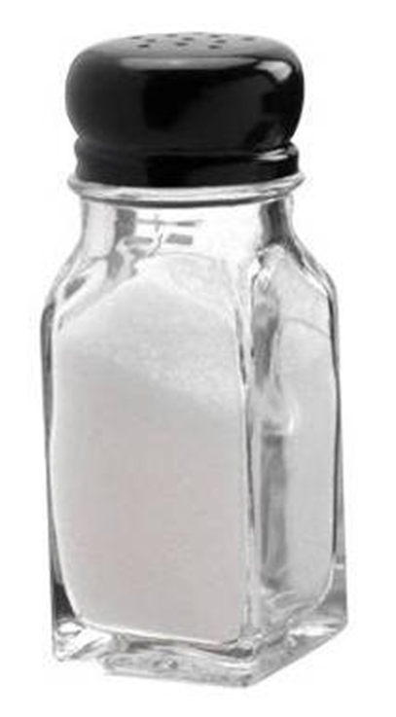
Sodium
Sodium is found in all cells and body fluids. It helps regulate the water content in the body.
Sodium is a component of table salt, known as sodium chloride (NaCl).
Sodium intakes in the UK are considered to be too high. It is recommended that adults and children 11 years and over not to have more than 6g of salt per day. Young children should eat less.
High sodium intake is considered to be one of the risk factors for high blood pressure.

Slide 24
Summary
Macronutrients include carbohydrate, protein and fat. These provide energy and are needed in large amounts.
Micronutrients include vitamins and minerals. These do not provide energy but are essential for health.

Slide 25
Kahoot quiz
Open the link below on the main screen and get students to log onto kahoot.it on their tablets or smartphones.
They can then enter the code (that will come up on the main screen when you start the game) and their own nickname.
They can then play along with the quiz choosing the multiple choice answers that correspond with the questions on the main screen. There will then be a leaderboard of the scores after each question and at the end.
https://play.kahoot.it/#/?quizId=fb67ce7b-ce4b-46fd-b843-5b3d026e0330

Slide 26
Nutrients

