Slide 1

Energy in, energy out

Slide 2
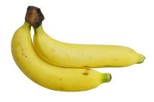
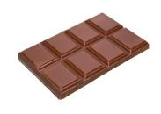



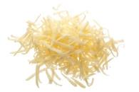

Which food provides approximately the same amount of energy as dancing for 10 minutes uses?
a) 2 bananas
b) 50g of chocolate
c) 100g of cheddar cheese
d) 2 boiled eggs
VOTE NOW!
Notes:
51 kcals

Slide 3
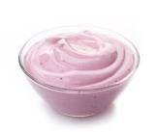


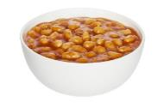
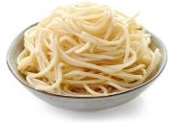
Which food provides approximately the same amount of energy as walking for 1 hour uses?
a) 50g of low fat yoghurt
b) 50g of low fat crisps
c) 100g of white pasta (boiled)
d) 100g of baked beans
VOTE NOW!
Notes:
168 kcals

Slide 4
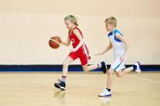
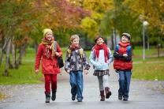
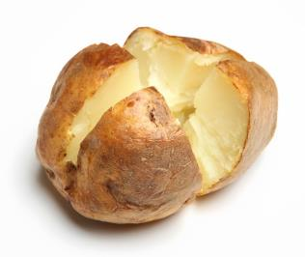
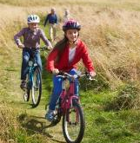
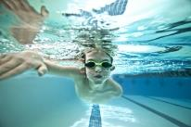
Which activity uses approximately the same amount of energy as a jacket potato (150g) provides?
a) 22 mins of basketball
b) 90 mins of walking
c) 10 mins of medium cycling
d) 12 mins of fast swimming
VOTE NOW!
Notes:
115.5 kcals

Slide 5
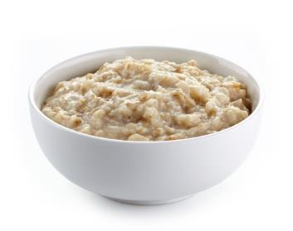


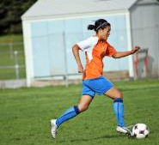
Which activity uses approximately the same amount of energy as a bowl of porridge (200g) provides?
a) 15 mins of competitive tennis
b) 20 mins of washing the car
c) 50 mins of football
d) 1 hour of cycling
VOTE NOW!
Notes:
224 kcals

Slide 6
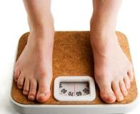
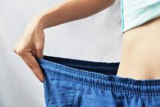
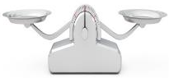
If more energy is used than consumed over time, what will happen?
a) You will gain weight
b) You will lose weight
c) You will stay the same weight
VOTE NOW!

Slide 7
If more energy is consumed than used over time, what will happen?
a) You will gain weight
b) You will lose weight
c) You will stay the same weight
VOTE NOW!

Slide 8

How long would you need to be jogging be to use 100 kcals of energy?
a) 8 mins
b) 22 mins
c) 28 mins
d) 45 mins
VOTE NOW!

Slide 9
How long would you need to be cycling at a medium pace to use 150 kcals of energy?
a) 5 mins
b) 12 mins
c) 21 mins
d) 30 mins
VOTE NOW!

Slide 10

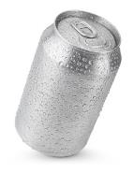
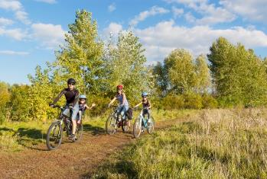


Light cycling for 30 minutes uses 113 kcals of energy.
Which drink provides approximately the same amount of energy?
a) 275ml of cola
b) 275ml of diet cola
c) 200ml of milkshake
d) 500ml of water
VOTE NOW!

Slide 11

Performing housework such as cleaning the carpet and floors for 45 minutes used 97 kcals of energy.
Which snack provides approximately the same amount of energy?
a) 50g of milk chocolate
b) 45g of crisps
c) 125ml of low fat fruit yoghurt
d) 30g of raw carrots
VOTE NOW!

Slide 12
The information in this quiz has been taken from:
https://bnf.nice.org.uk/about/approximate-conversions-and-units.html
https://www.bhf.org.uk/informationsupport/support/healthy-living/staying-active/exercise-calorie-calculator

Slide 13
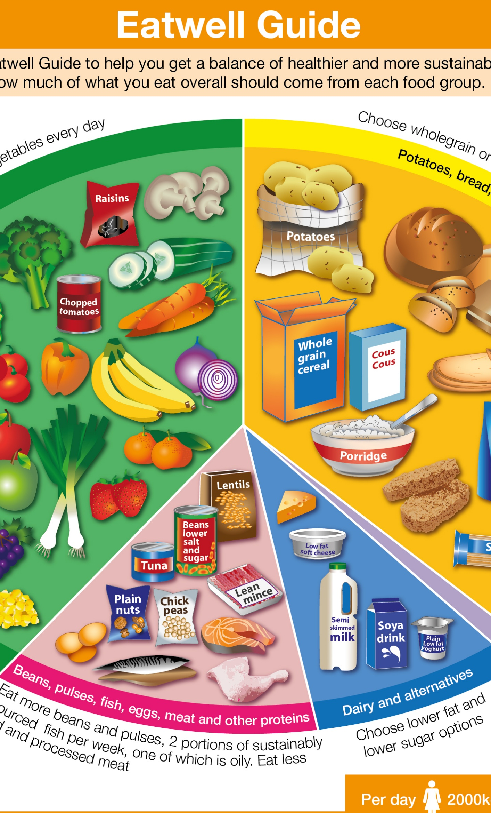
Energy in, energy out

