Slide 1
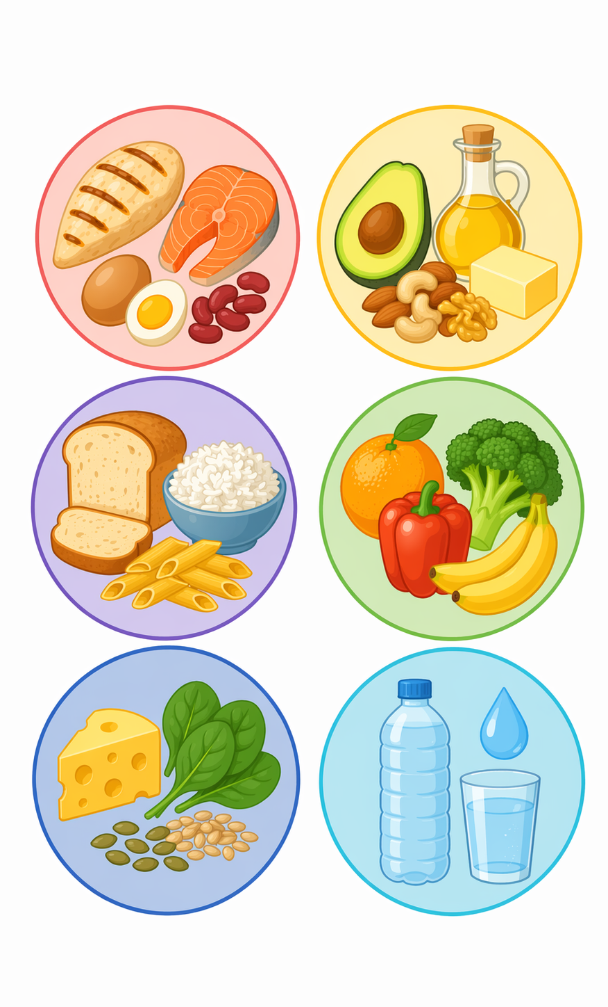
Macronutrients

Slide 2

Introduction
Food is eaten and digested in the body to allow the absorption of energy and nutrients.
There are two different types of nutrients:
macronutrients;
micronutrients.
Macronutrients provide energy and these include:
carbohydrate;
protein;
fat.
Macronutrients are measured in grams (g).

Slide 3
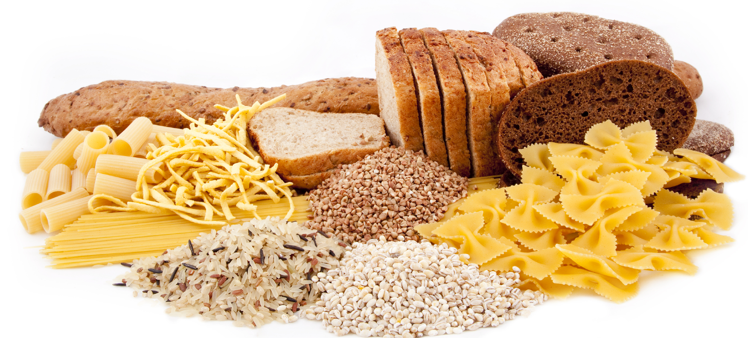
Carbohydrate
The two types main of carbohydrate that provide dietary energy are starch and sugars. Dietary fibre is also a type of carbohydrate.
Starchy carbohydrate is an important source of energy.
One gram of carbohydrate provides 3.75kcal/16kJ energy.
One gram of fibre provides 2kcal/8kJ energy.

Slide 4
Structure of carbohydrate
All types of carbohydrate are compounds of carbon, hydrogen and oxygen.
They can be classified in many different ways. One common way is according to their structure.
They can be divided into three main groups according to the size of the molecule.

Slide 5
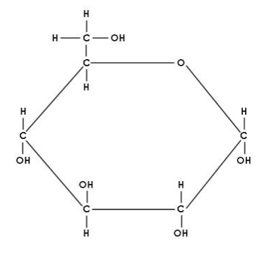
Monosaccharides
These are the simplest carbohydrate molecules.
Examples of monosaccharides are:
glucose;
fructose;
galactose.

Slide 6
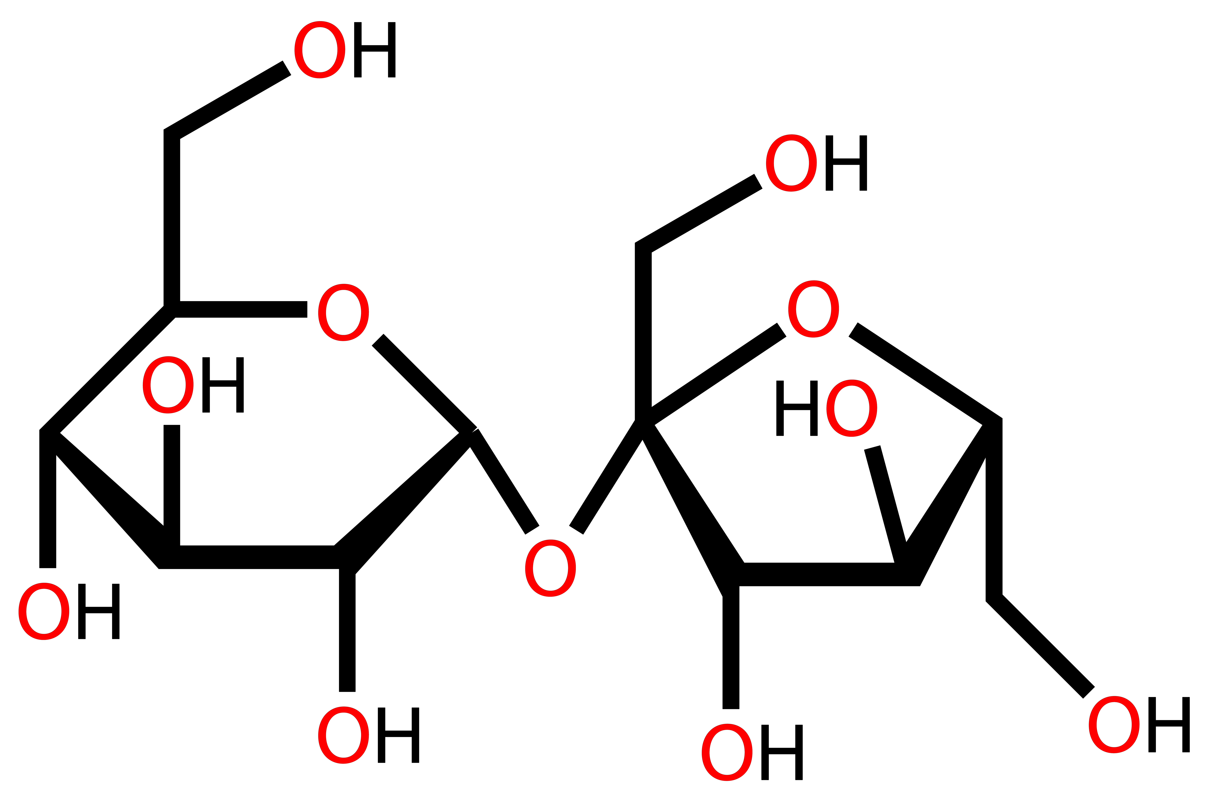
Disaccharides
These sugars are formed when two monosaccharide molecules join together with the removal of one molecule of water.
Examples of disaccharides are:
sucrose (glucose + fructose);
lactose (glucose + galactose);
maltose (glucose + glucose).
Monosaccharides and disaccharides are collectively termed as ‘sugars’.

Slide 7
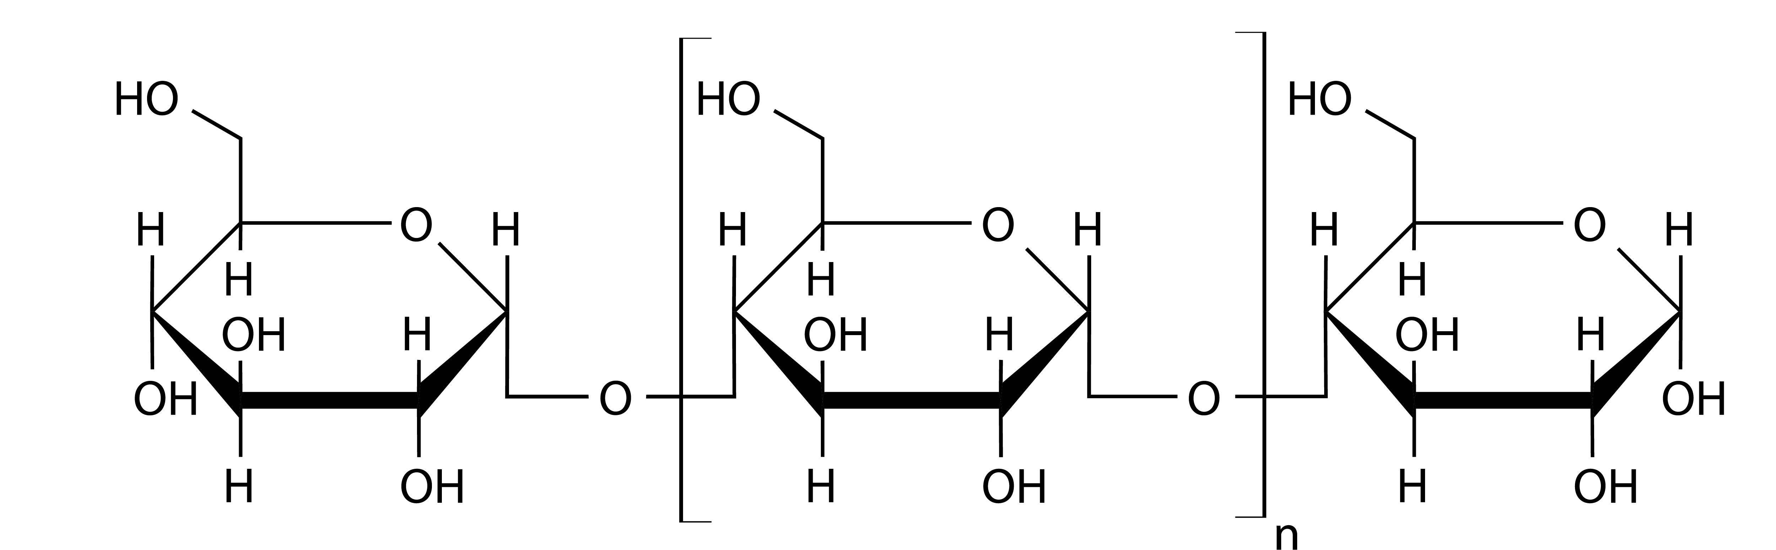
Polysaccharides
These are made up of many monosaccharide molecules (usually glucose), joined together.
Examples of polysaccharides are:
starch;
glycogen (the form in which glucose is stored in the body);
components classified as dietary fibre.

Slide 8
Carbohydrate in the diet
Carbohydrate is the only dietary source of glucose, an important fuel for the body, providing 4kcal/17kJ per gram.
The body’s tissues require a constant supply of glucose, which is used as a fuel.
We can store a small supply of glucose, in the form of glycogen. We can also make it, in the body, from protein; however, this is not the best use of protein, which should mainly be used for growth and repair of body tissues.
Dietary fibre also makes a small contribution to energy as it is digested in the large bowel by the resident bacteria into short chain fatty acids, providing 2kcal/8kJ per gram.

Slide 9
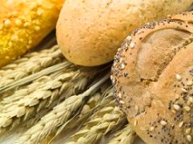
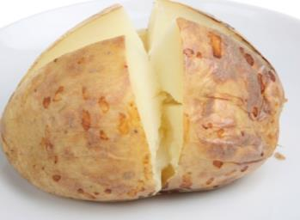
Sources of carbohydrate
Starch is found in bread, potatoes, rice, pasta, breakfast cereals, yam, cassava and other starchy food.
Can you give some other examples of sources of starch in the diet?
Cereal and cereal products are the main source of carbohydrate for adults in Britain (including 18% of carbohydrate coming from bread).

Slide 10
Sugars
Sugars can be divided into intrinsic sugars and extrinsic sugars.
Intrinsic sugars
These are within the cellular structure of the food, e.g. in whole fruit or vegetables.
Extrinsic sugars
These sugars are not bound within the cellular structure of the food, e.g. the lactose in dairy products.
Honey and table sugar are also examples. These are referred to as 'Free sugars’ which replaced the term Non Milk Extrinsic Sugars.
Free sugars are defined as; ‘all monosaccharides and disaccharides added to foods by the manufacturer, cook, or consumer, plus sugars naturally present in honey, syrups, and fruit juices’.

Slide 11
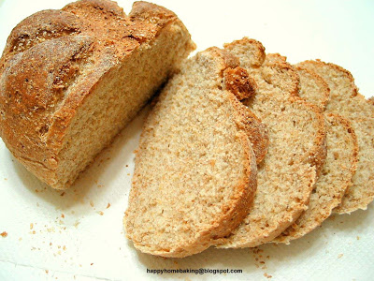
Carbohydrate per 100 grams
Which of the following provides the largest amount of carbohydrate per 100g?
Food (per 100g)
Brown rice, boiled
Spaghetti, white
Wholemeal bread
Baked potato, with skin
Peas, boiled
Honey
Banana
Raisins
g
29.2
31.5
42.0
22.6
10.0
76.4
20.3
69.3

Slide 12
Recommendations on carbohydrate
Base your meals on starchy food as these are good sources of starchy carbohydrate which is an important source of energy.
Around 50% of dietary energy should come from carbohydrate (starch and sugars combined).
The Scientific Advisory Committee on Nutrition (SACN) has updated their recommendations so that no more than 5% of dietary energy should come from free sugars.
Frequent consumption of sugar-containing food, particularly between meals, can increase the chance of tooth decay, especially in those with poor dental hygiene.

Slide 13
Protein
Protein is made up of building blocks called amino acids. There are 20 different amino acids found in proteins from plants and animals, 8 of these have to be provided by the diet. These are called essential amino acids, which cannot be made by the human body.
The essential amino acids are isoleucine, leucine, lysine, methionine, phenylalanine, threonine, tryptophan and valine.
In young children, additional amino acids, e.g. histidine and tyrosine, are sometimes considered to be essential (or ‘conditionally essential’) because they may be unable to make enough to meet their needs.

Slide 14
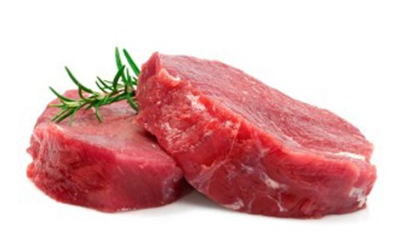
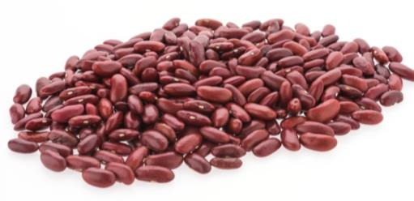
Protein quality
The biological value or ‘quality’ of the protein depends on the amount of essential amino acids that are present.
Protein from animal sources provides good amounts of all the essential amino acids needed by the body and have a higher biological value or ‘quality’ than protein from plant sources.
This is because the pattern of amino acids in animal cells is similar to the pattern in human cells.

Slide 15
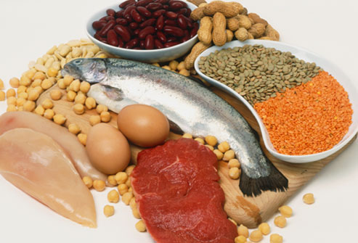
Sources of protein
Animal sources:
meat;
poultry;
fish;
eggs;
milk;
dairy food.
Plant sources:
soya;
nuts;
seeds;
pulses, e.g. beans, lentils;
mycoprotein.

Slide 16

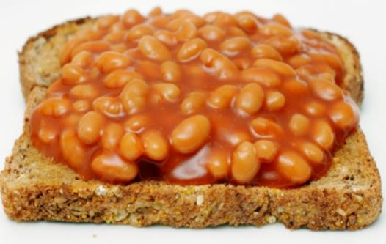
Protein complementation
Different food contains different amounts and combinations of amino acids. Vegans and vegetarians can get all the amino acids they need by combining different protein types at the same meal.
This is known as protein complementation.
Can you think some of some examples of protein complementation?
rice and peas;
beans on toast;
hummus and pitta bread;
bean chilli served with rice.

Slide 17
Protein in the diet
Protein provides amino acids, some of which we cannot make ourselves and so need to get from our diet.
It is needed for normal growth and maintenance of health.
It provides energy.
It is needed for growth and maintenance of normal muscles and maintenance of healthy bones.
Protein is the second highest compound in the body, following water. A large proportion of protein is in muscle. Protein is also present in skin and blood.

Slide 18
Recommendation on protein
Adults and children should eat a moderate amount of protein food each day.
If protein comes mainly from plant sources, it is important to make sure that different types are eaten.
For people not on a weight-reducing diet, around 15% of dietary energy should come from protein.
The Reference Nutrient Intake (RNI) is set at 0.75g of protein per kilogram bodyweight per day in adults. This equates to around 56g per day of protein for the average man and 45g per day of protein for the average women.
Some people, including athletes and older people may benefit from consuming more protein.

Slide 19
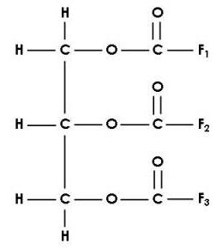
Fat
Fat is made up of fatty acids attached to a glycerol molecule backbone. This is called a triacylglycerol (or triglyceride).
Depending on their chemical structure, fatty acids are often classified as:
saturated fatty acids (also known as ‘saturated fat’ or ‘saturates’);
monounsaturated fatty acids;
polyunsaturated fatty acids (omega-3, omega-6 and omega-9).
The structure of the fatty acids determines:
their effect on our health;
their characteristics, e.g. melting point and digestibility.

Slide 20
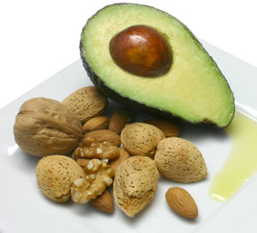
Fat
Fat is found in most food groups and fat-containing food usually provide a range of different fatty acids.
So, even foods with a high saturated fat content, e.g. butter, also provide some monounsaturates and polyunsaturates.
But in simple terms, foods are often categorised by the dominant type of fatty acid.

Slide 21
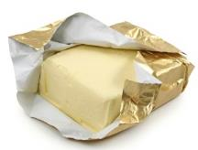
Fat
For example, butter is often described as a ‘saturated fat’ because it has more saturated fatty acids than unsaturated fatty acids.
Most vegetable oils are described as ‘unsaturated fats’ as they have more mono and polyunsaturated fatty acids than saturated.
Most saturated fats are solid at room temperature and tend to come from animal sources.
Most unsaturated fats are liquid at room temperature and are usually vegetable fats.

Slide 22
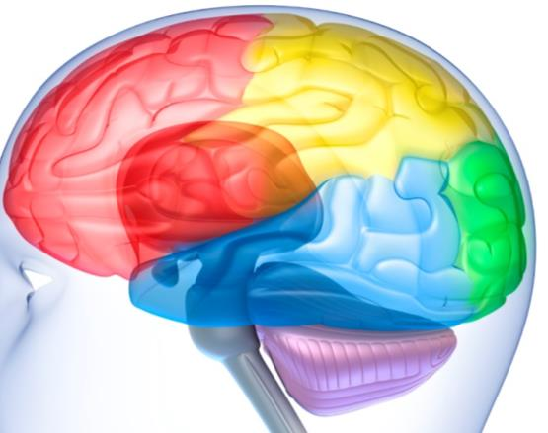
Functions of fat
provides essential fatty acids that the body cannot make itself – these are important components of cell membranes including those in the brain and nervous system;
is a component of hormones, which control biochemical reactions inside cells;
carries the fat-soluble vitamins A, D, E and K in the diet;
cushions the major organs in the body;
provides a concentrated source of energy at 9kcal/37kJ of energy per gram. Food that contain a lot of fat provide a lot of energy.

Slide 23
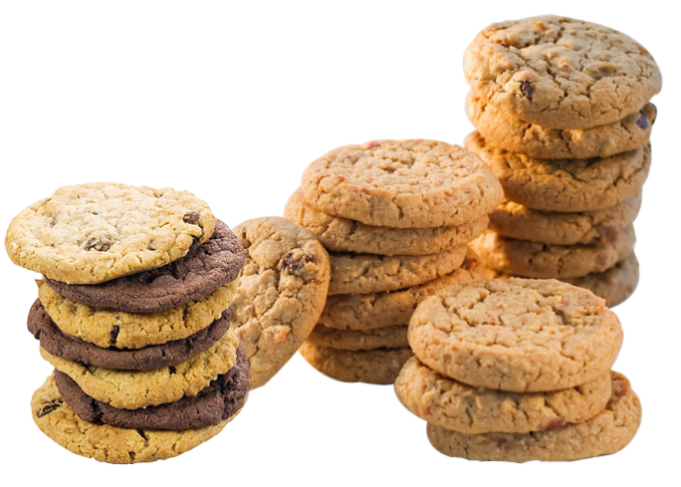
Saturated fatty acids
Eating too much food high in fat, especially saturated fat, can have adverse effects on health. There is good evidence that replacing saturated fats with unsaturated fats can help lower cholesterol, a risk factor for coronary heart disease.
Food high in saturated fat include:
fatty cuts of meat;
skin of poultry;
butter;
hard cheese;
biscuits, cakes and pastries;
chocolate.

Slide 24
Unsaturated fatty acids
Replacing saturated fatty acids in the diet with mono- or polyunsaturated fatty acids is associated with benefits to heart health.
Food high in monounsaturated fatty acids include:
edible oils especially olive oil;
avocados;
nuts.
This type of fat is also found in meat and milk.

Slide 25

Polyunsaturated fatty acids
Food high in polyunsaturated fatty acids include:
edible oils especially sunflower oil;
seeds;
margarine;
spreadable fats made from vegetable oils and oily fish.

Slide 26
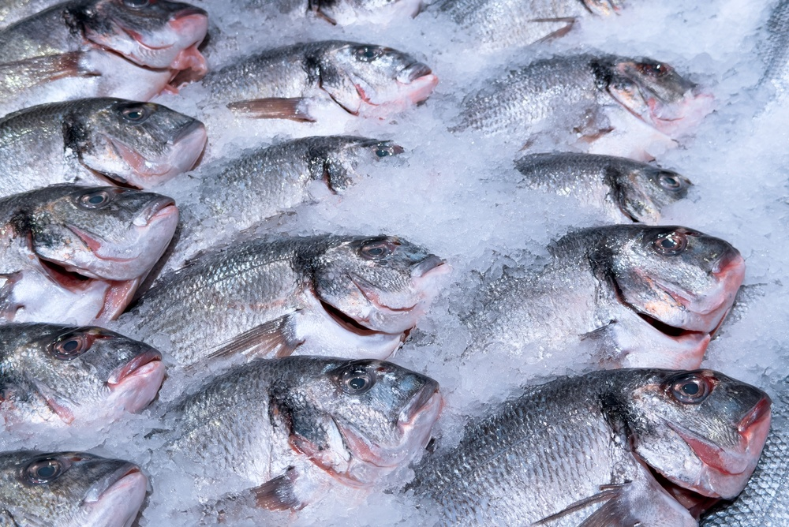
Polyunsaturated fatty acids
The most common types of polyunsaturated fatty acids are omega 3 and omega 6 (also known as n-3 and n-6).
We need to include both types in our diets. One member of each of these two families is known as an essential fatty acid as we cannot make it in the body, which help to reduce blood cholesterol levels.
They also have a number of other functions in growth, development and health.

Slide 27
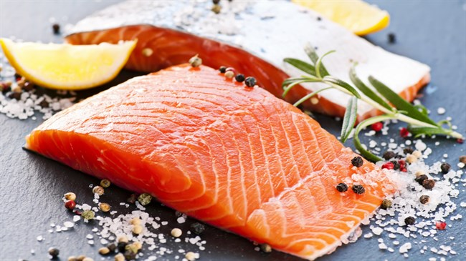
Essential fatty acids
The richest dietary source of the long-chain omega 3 fatty acids is oily fish, therefore a weekly serving is recommended.
They are also present in the meat or eggs of animals fed with diets enriched with omega 3 fatty acids, but in smaller amounts compared with oily fish.
The main sources of omega 6 fatty acids are vegetable oils and spreads made from them.

Slide 28
Recommendations on fat
Total fat should contribute no more than 35% of food energy. No more than 11% of food energy should come from saturated fatty acids and no more than 2% of food energy should come from trans fats.
Average total fat intake of UK adults is now within the recommended level. But intakes of saturated fat are currently too high.
 | Recommendations
Total fat | Not more than 35% of food energy
Saturated fat | Not more than 11% of food energy

Slide 29
Summary
Energy is provided by the macronutrients: carbohydrate, protein and fat in varying amounts.
All macronutrients are important for different functions.
There are government recommendations on how much these are needed.

Slide 30

Quiz - Kahoot
Open the link below on the main screen and get students to log onto kahoot.it on their tablets or smartphones.
They can then enter the code (that will come up on the main screen when you start the game) and their own nickname.
They can then play along with the quiz choosing the multiple choice answers that correspond with the questions on the main screen. There will then be a leaderboard of the scores after each question and at the end.
https://create.kahoot.it/share/macronutrients/636e34fd-1d79-4024-9ee1-89b791cba640

Slide 31
Nutrients
Food is eaten and digested in the body to allow the absorption of energy and nutrients.
There are two different types of nutrients:
macronutrients;
micronutrients.
There are three macronutrients that are essential for health.
These are:
carbohydrate;
protein;
fat.
Macronutrients are measured in grams (g).

Slide 32
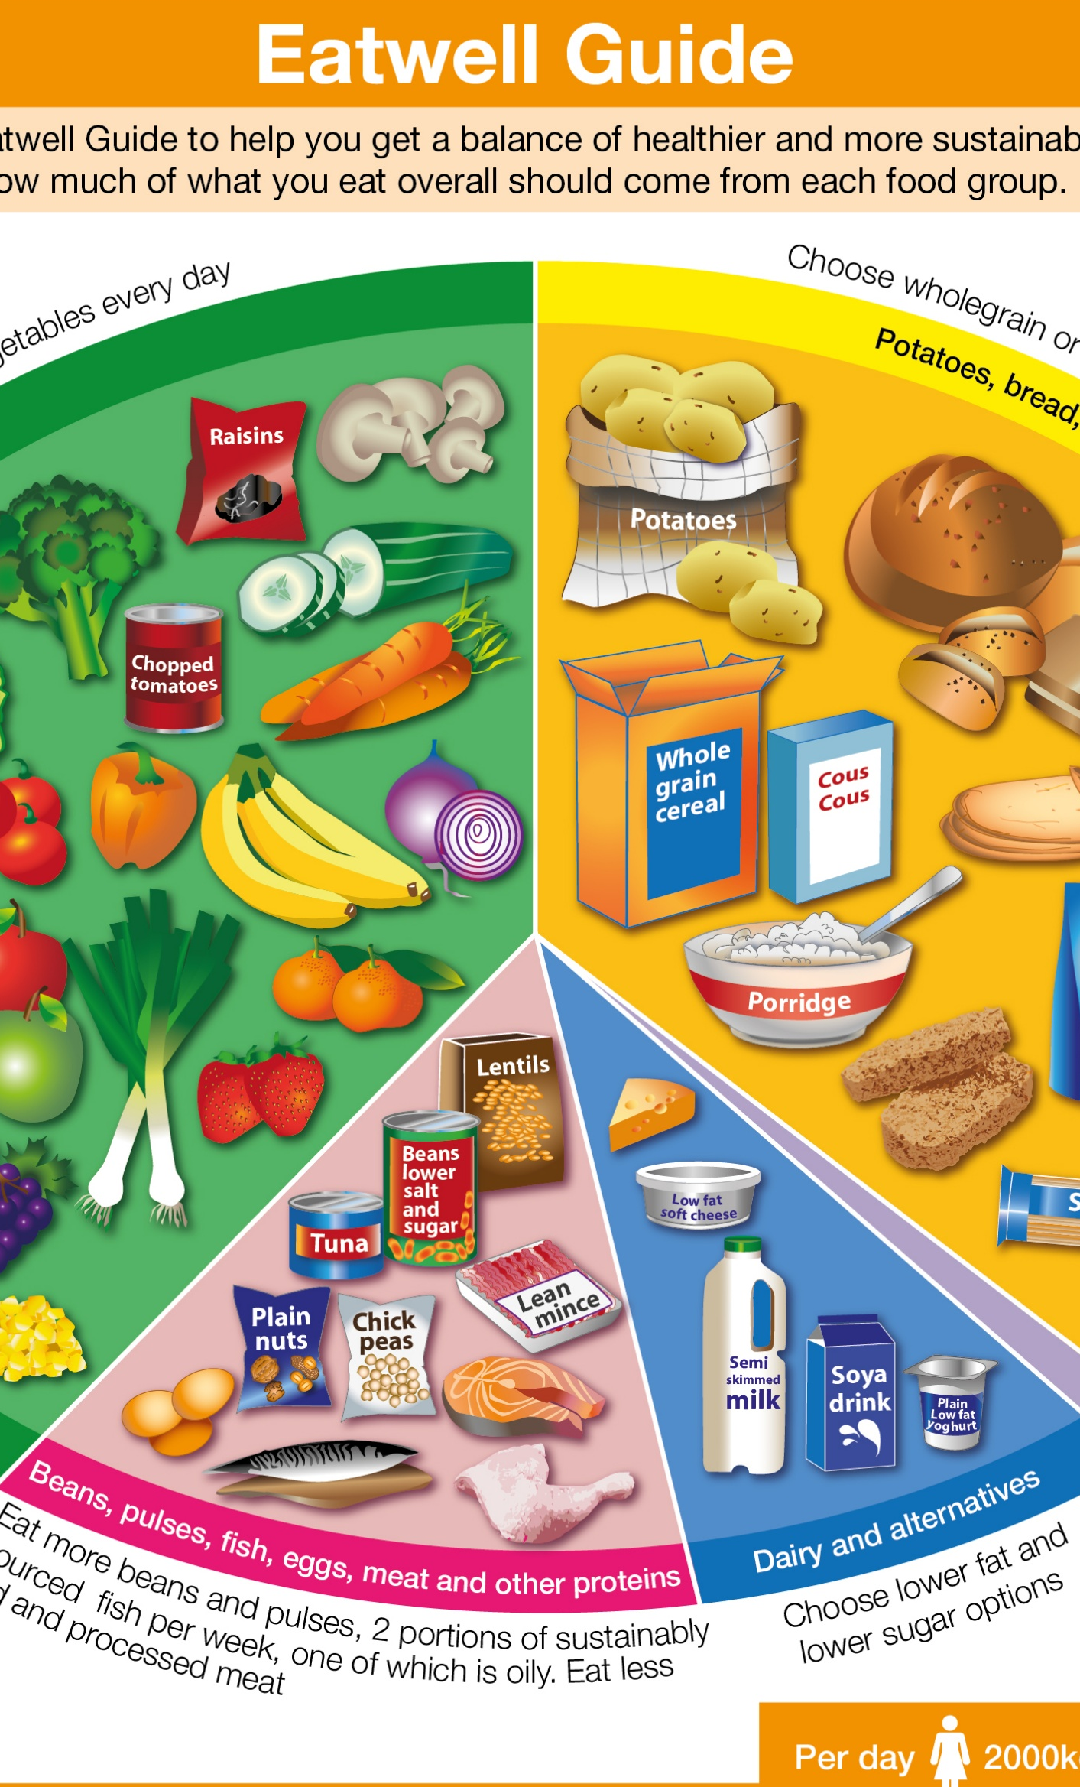
Nutrients

