Slide 1
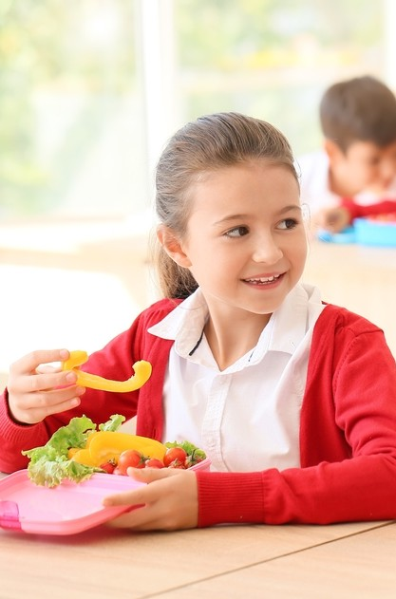
Mealtimes

Slide 2
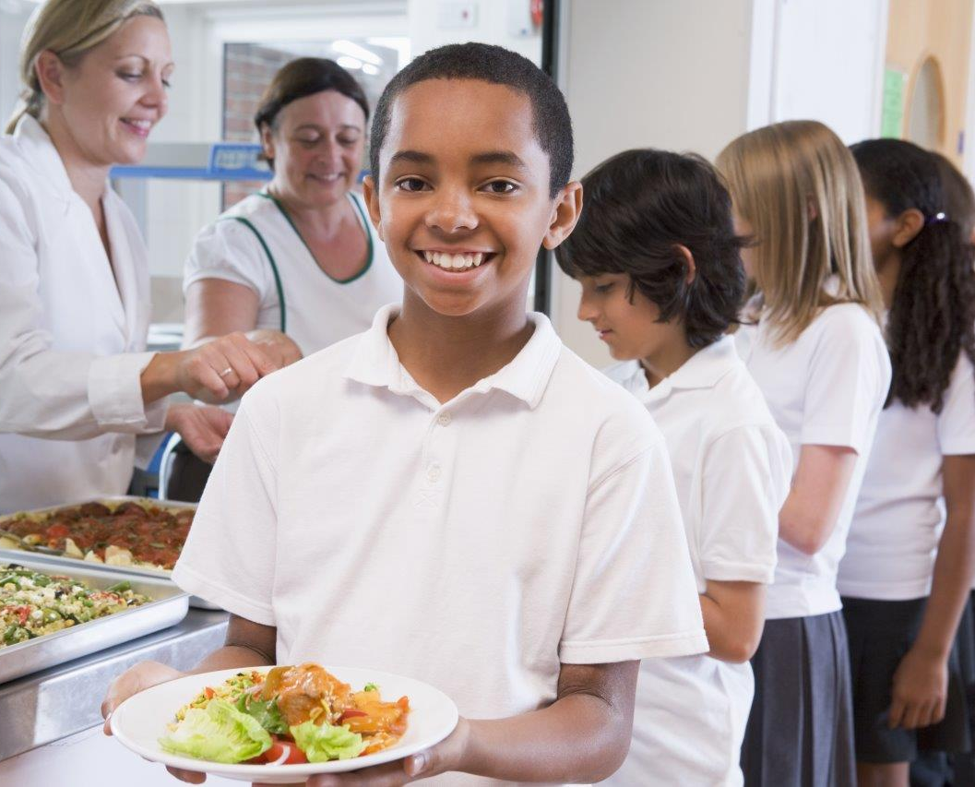
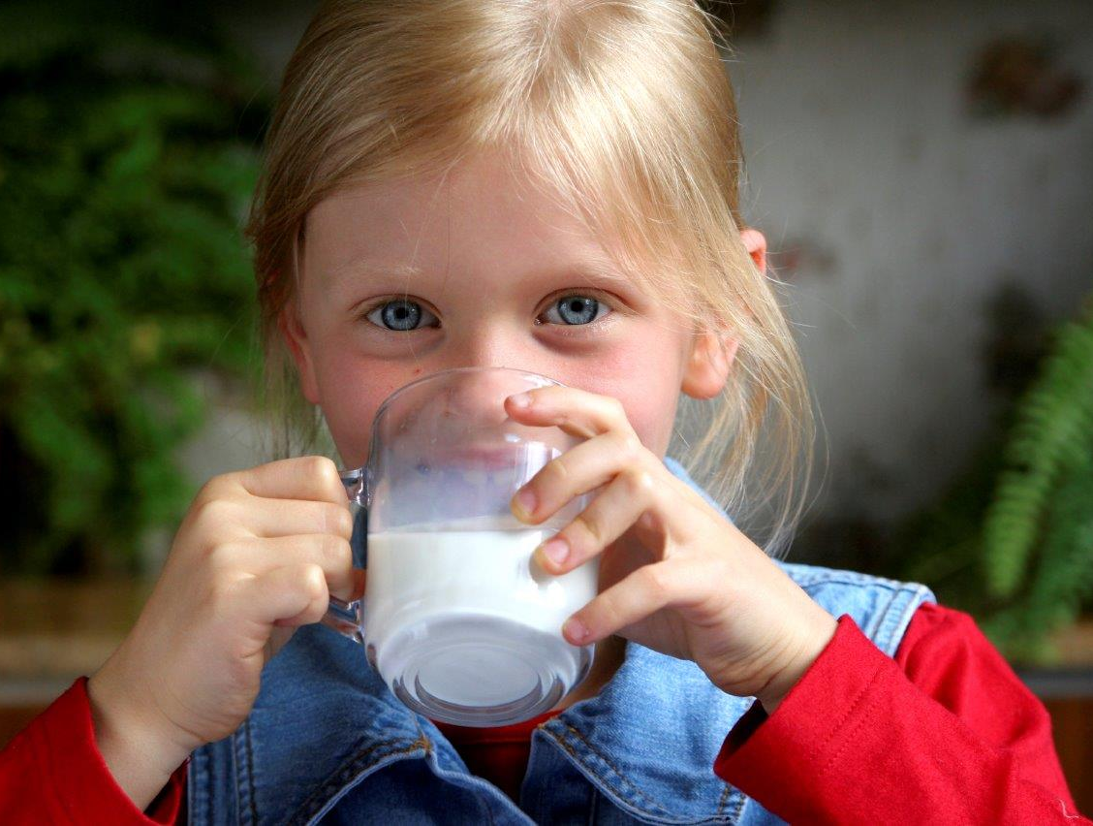
We have food and drinks at different times of the day.
When do you eat food?
When do you have drinks?

Slide 3
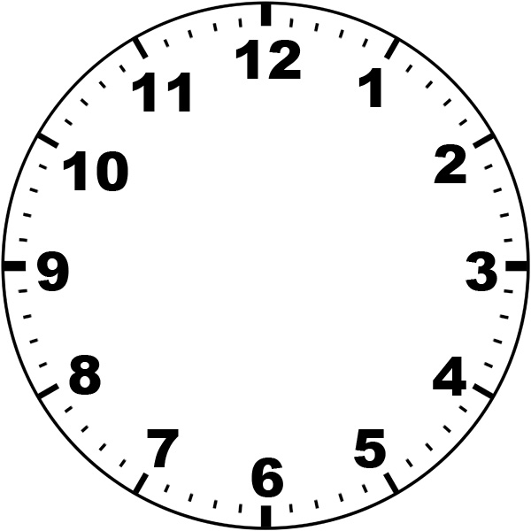
What might people eat and drink for
breakfast?
What time do people have breakfast?

Slide 4
What might people eat and drink for
lunch?
What time do people have lunch?

Slide 5
What might people eat and drink for their
evening meal?
What time do people have their evening meal?

Slide 6
What might people eat and drink for a
snack?
What time might people have a snack?

Slide 7
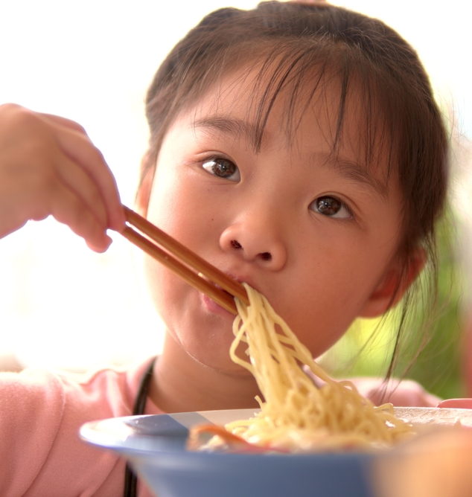
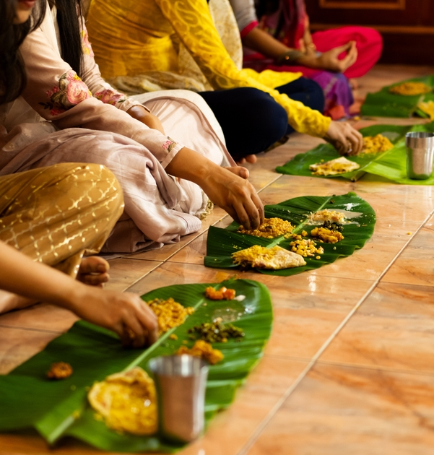
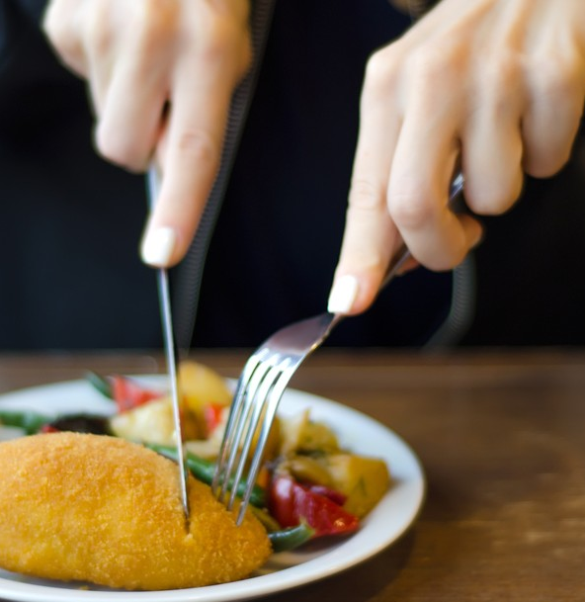
How are these meals being eaten?
How do you eat different foods?

Slide 8
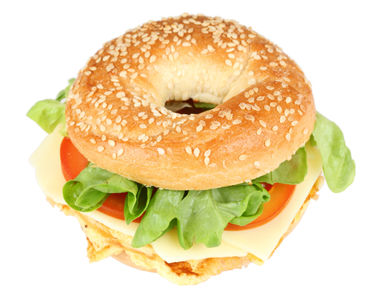
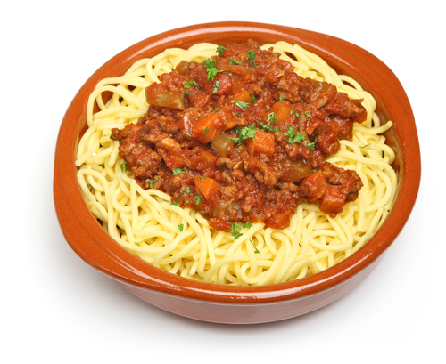
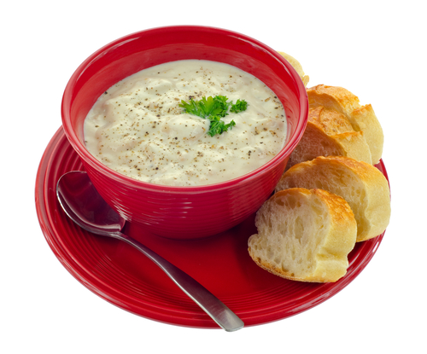
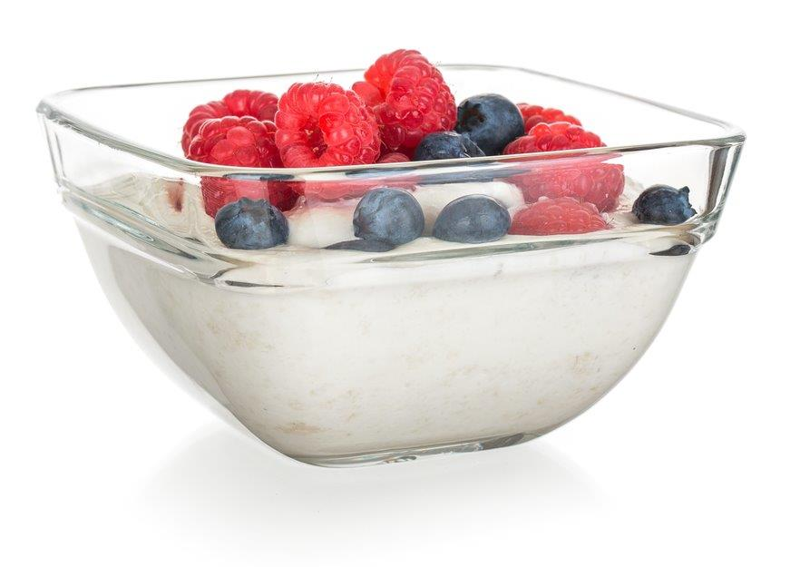
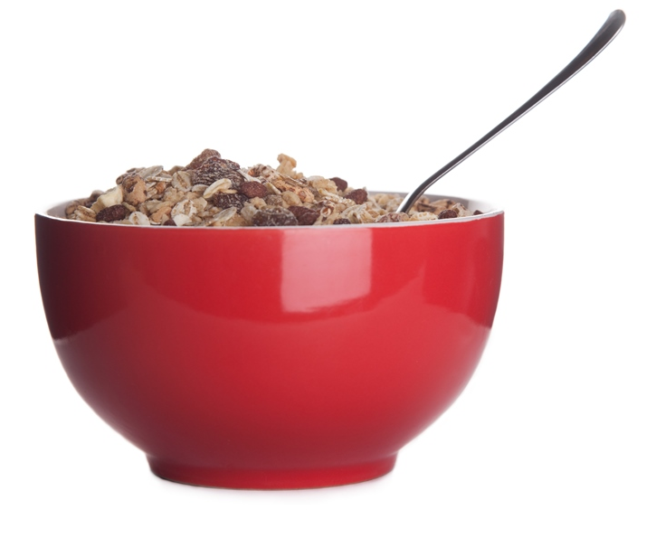
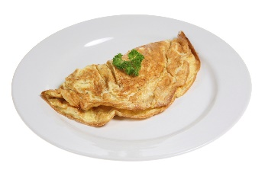
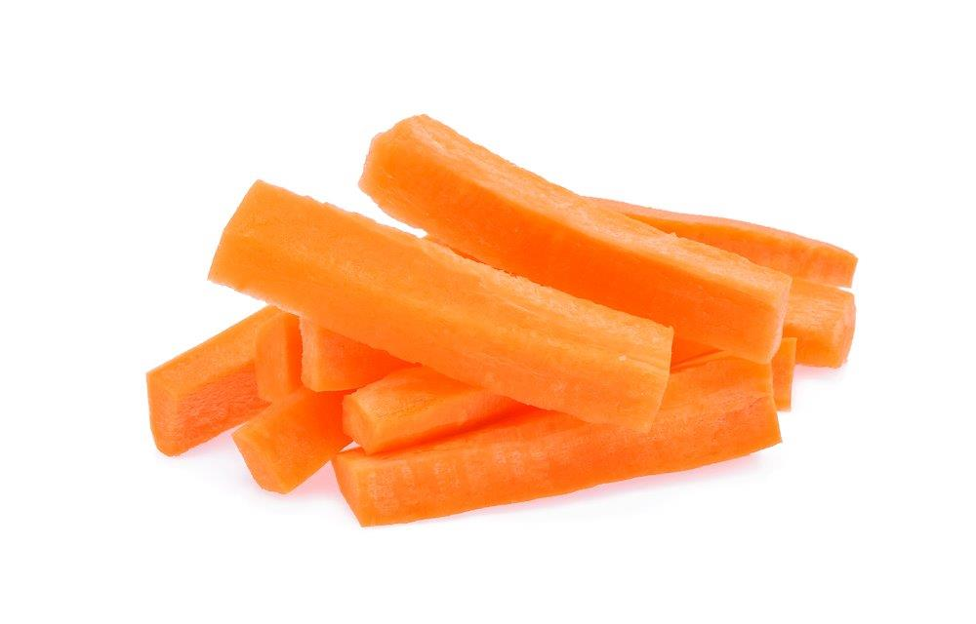
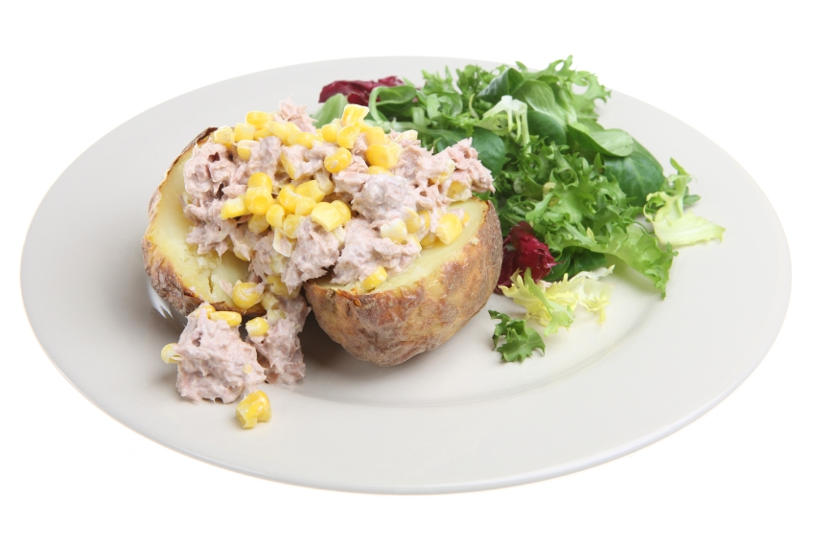
When might people eat these foods?

Slide 9
Mealtimes

