Slide 1

Food – a fact of life

Slide 2
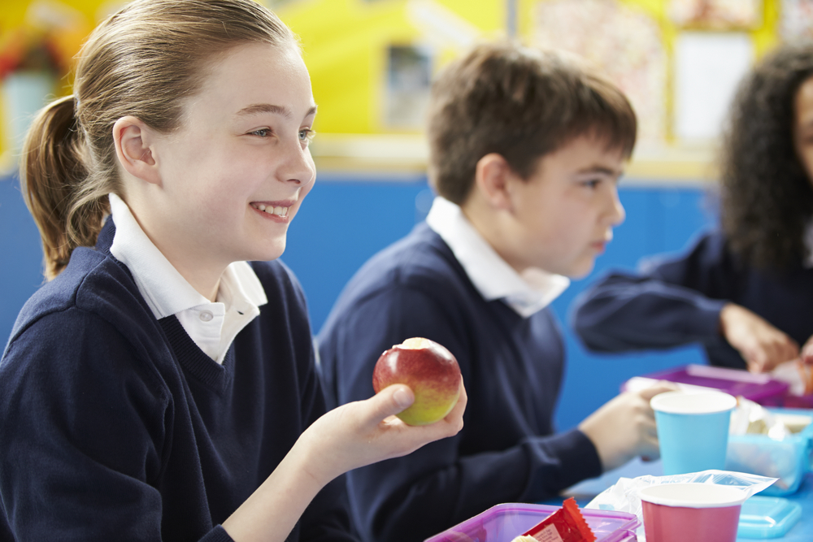
Food – a fact of life
We all need to eat and drink every day.
But why?

Slide 3
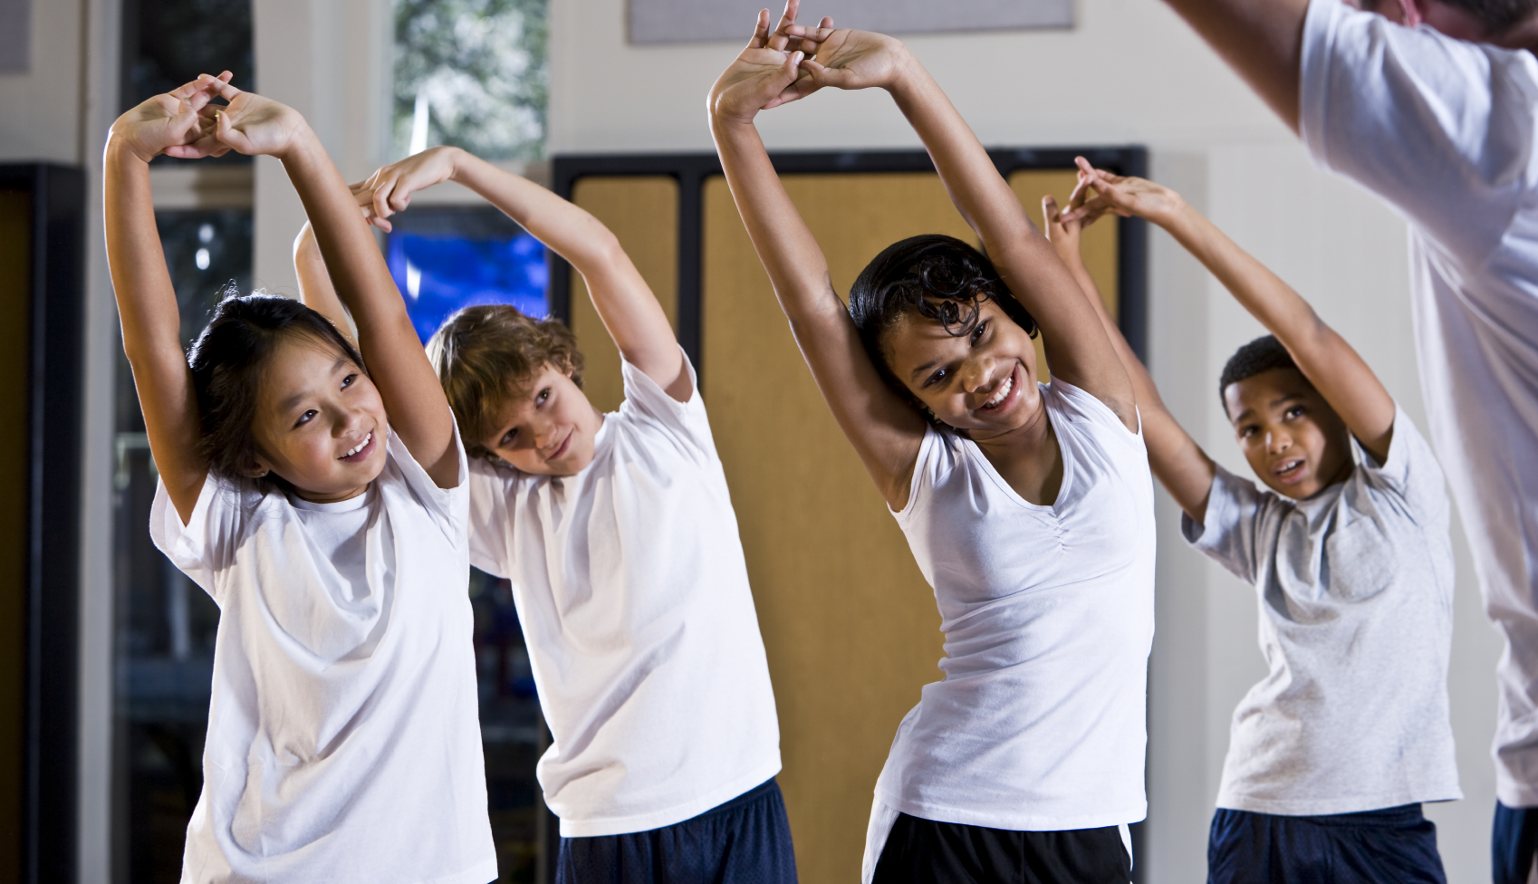
Why do we need food and drink?
We need food and drink to grow.

Slide 4
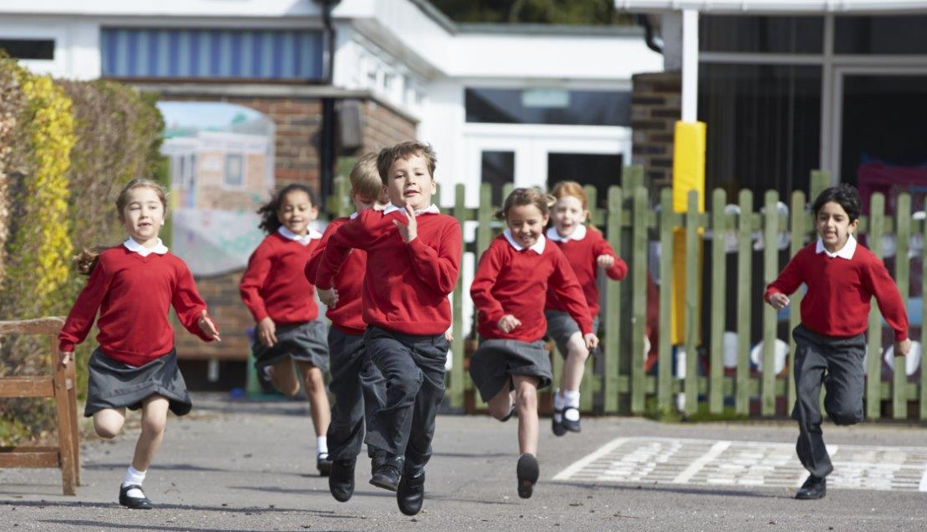
Why do we need food and drink?
We need food and drink to be active.

Slide 5
What activities do we do?

Slide 6
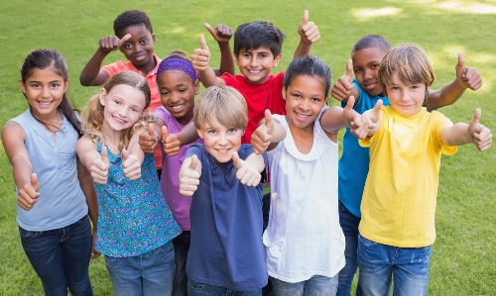
Why do we need food and drink?
We need food and drink to stay healthy.

Slide 7
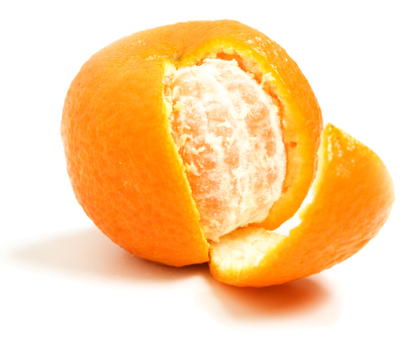
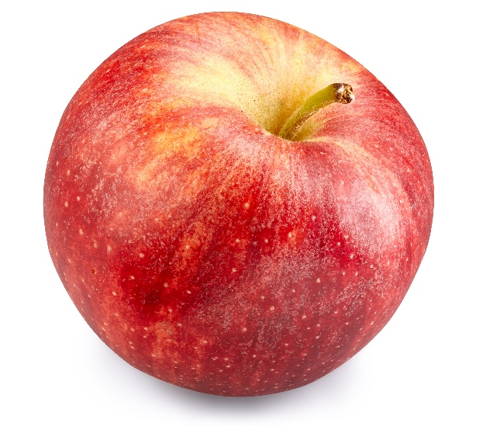
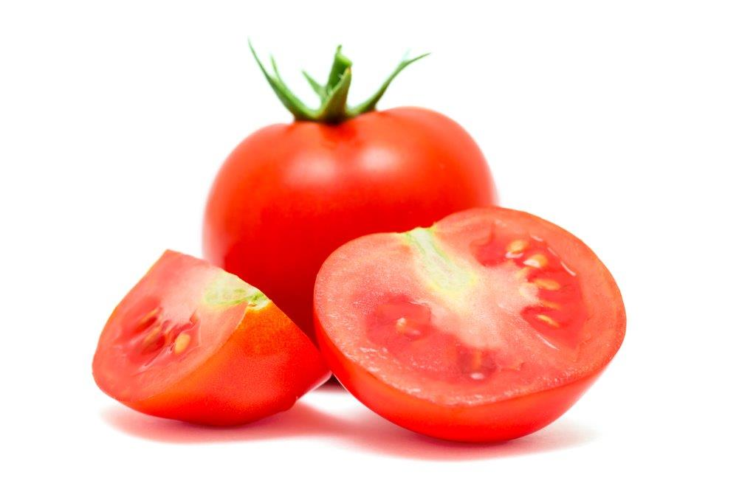
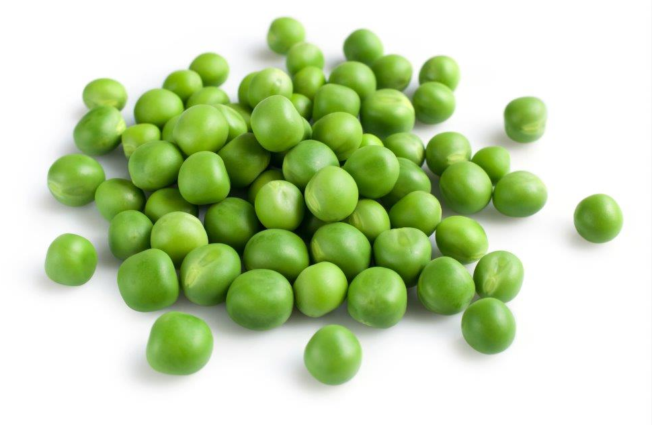
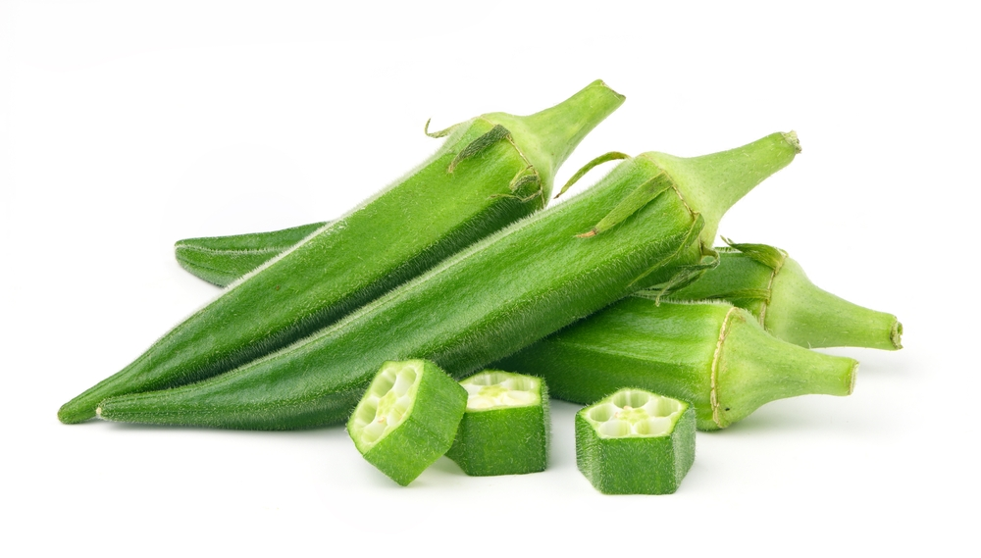
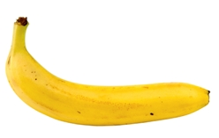
We need different types of food.
We need fruit and vegetables.
What can you see here?

Slide 8
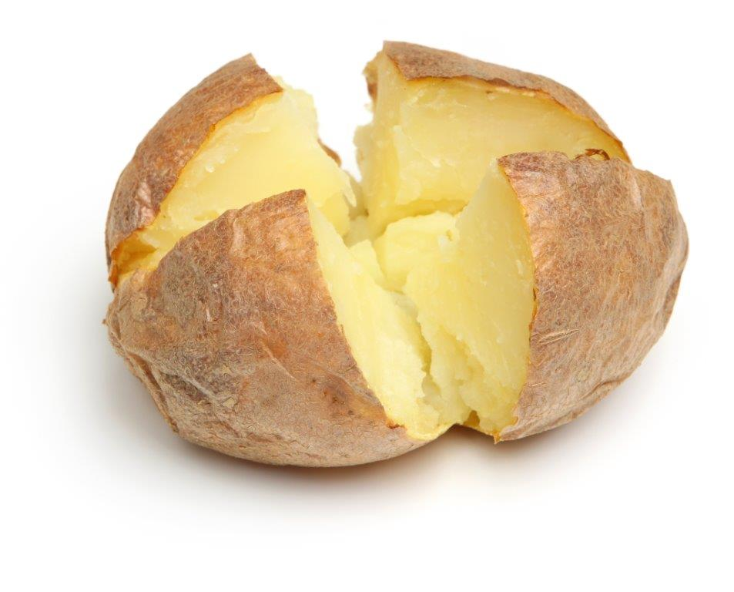
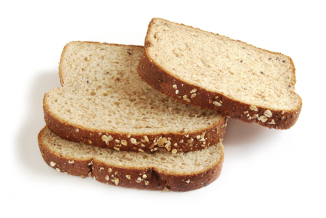
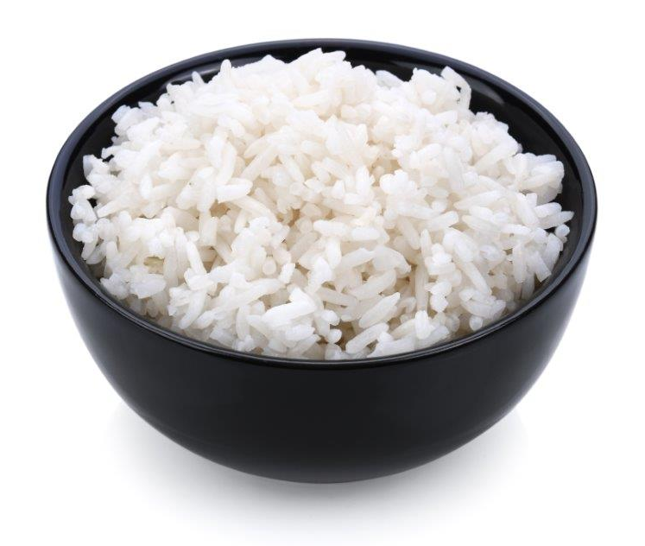
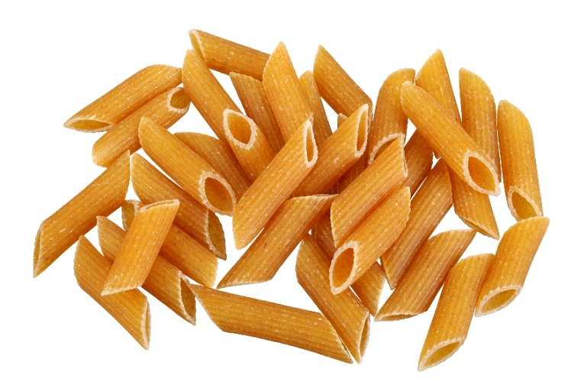
We need different types of food.
We need foods like potatoes, bread, rice and pasta.
Did you have any of these foods yesterday?

Slide 9

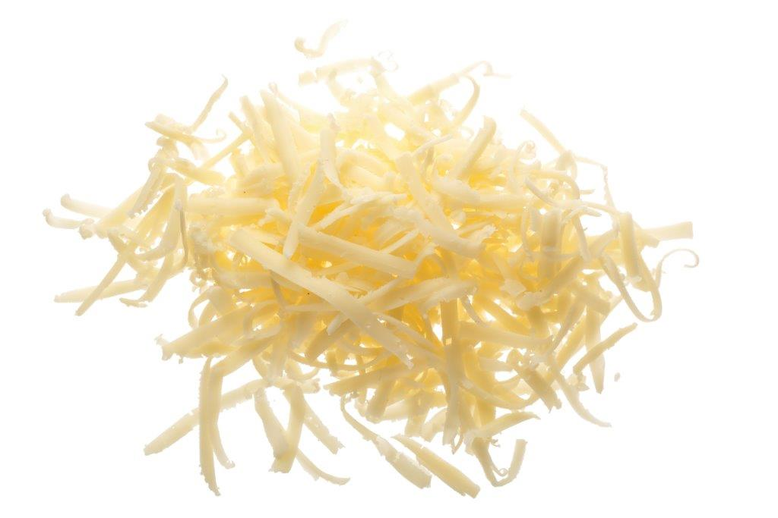
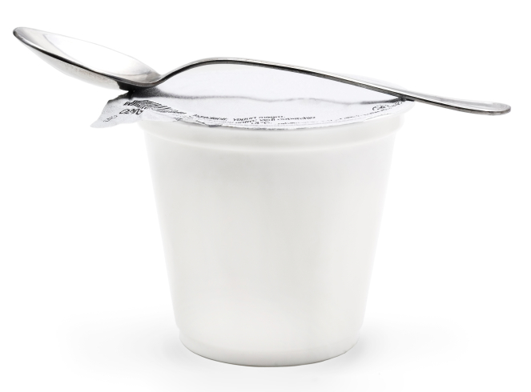
We need different types of food.
We need foods like milk, cheese and yogurt.
Which of these is your favourite?

Slide 10
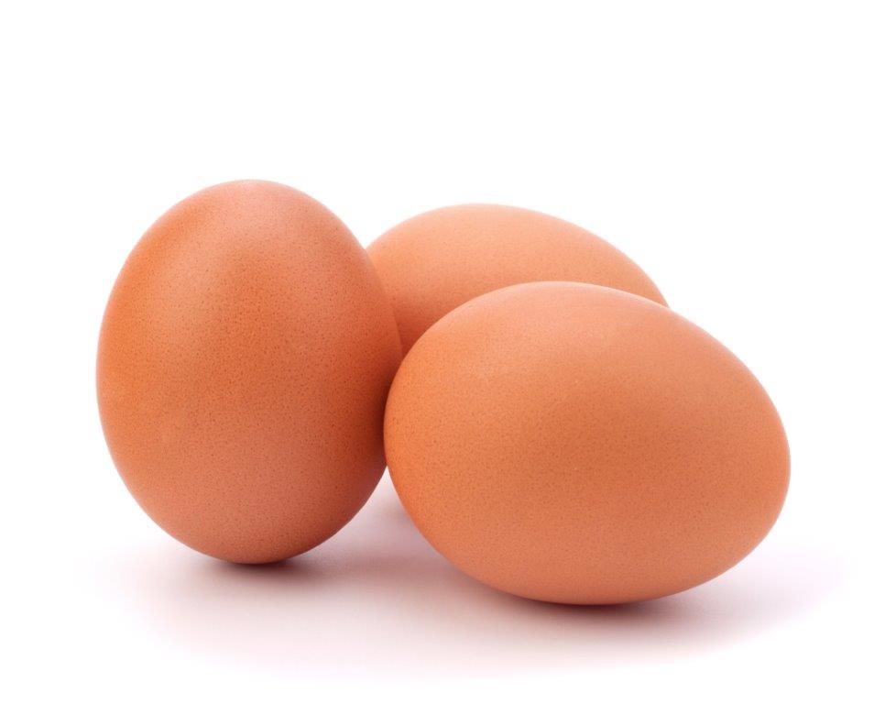
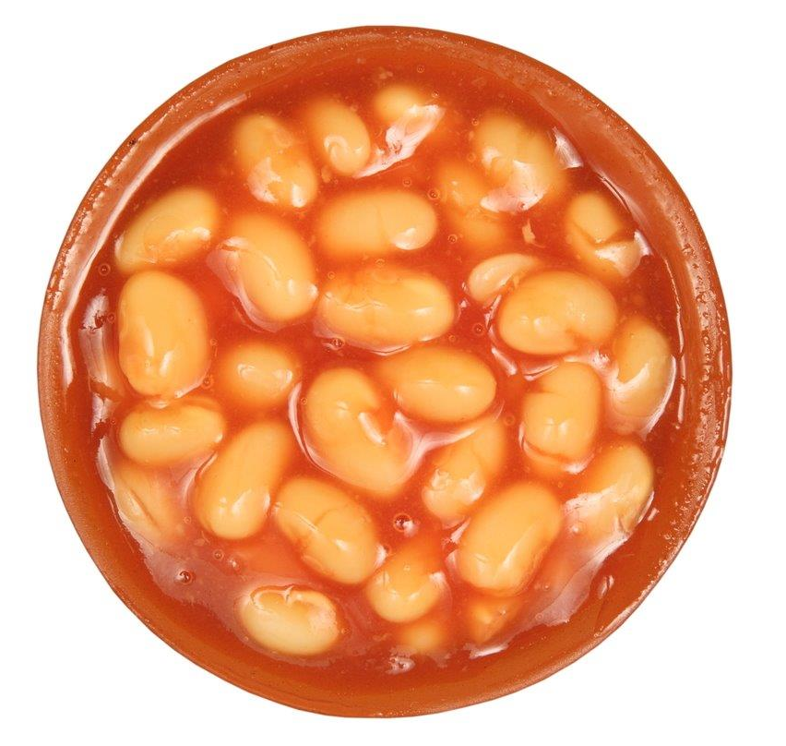
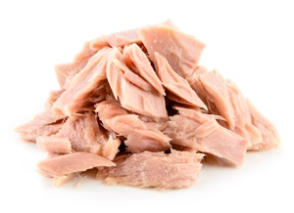
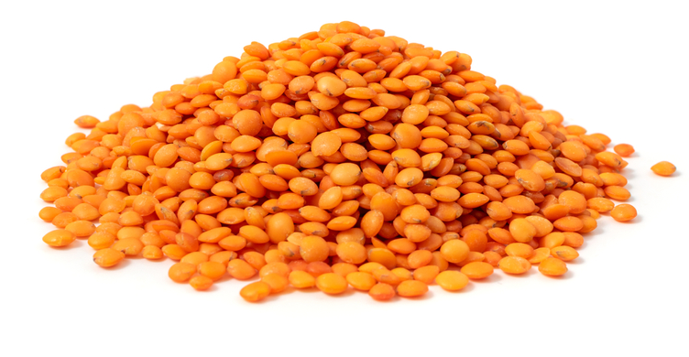
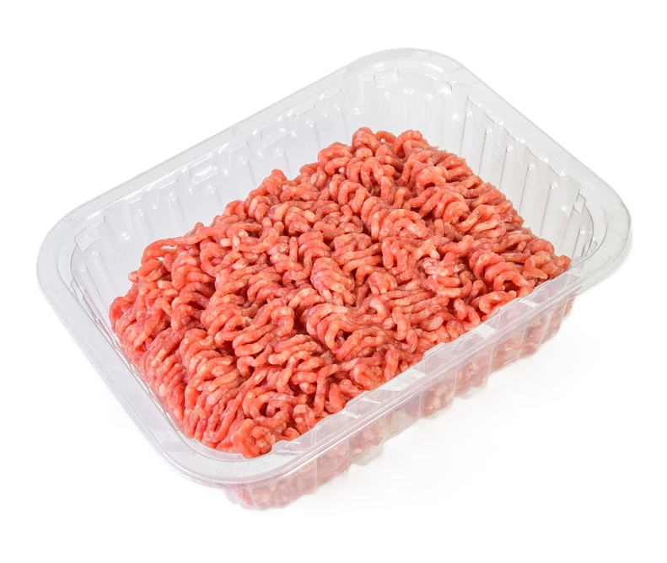
We need different types of food.
We need foods like beans, pulses, fish, eggs and meat.
Can you name each of these foods?

Slide 11

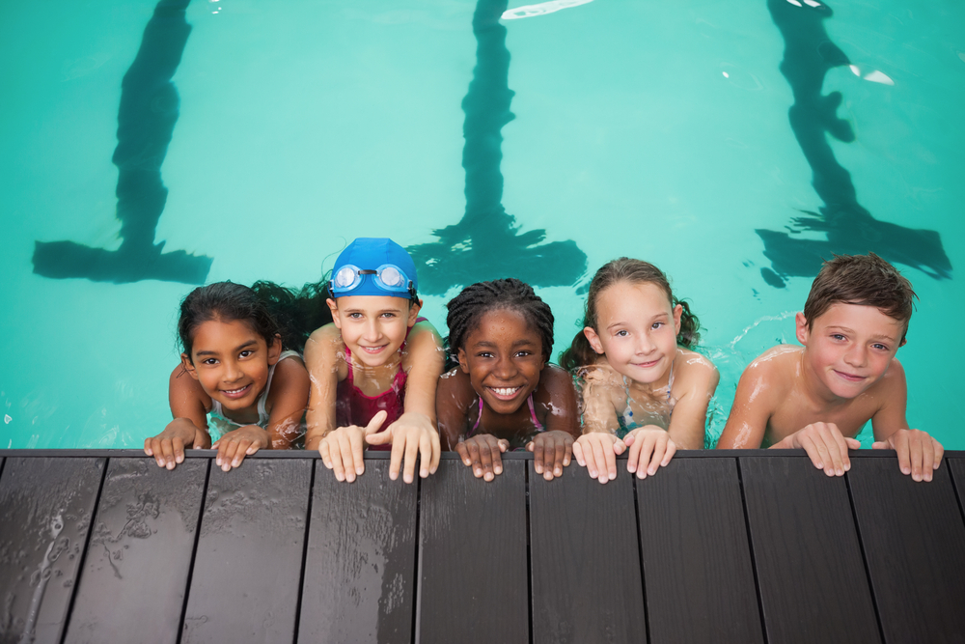
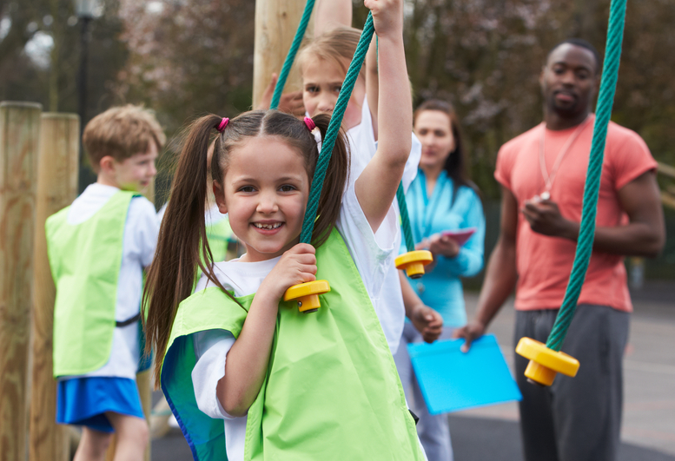
Food – a fact of life
We need different foods to…
Grow
Be active
Stay healthy

Slide 12
Food – a fact of life

