Slide 1
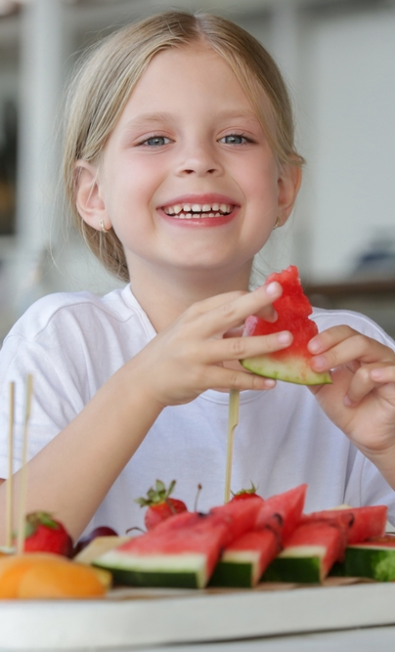
I like that

Slide 2
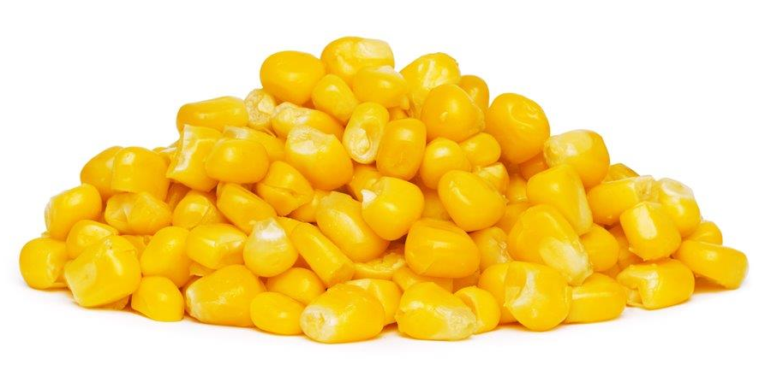
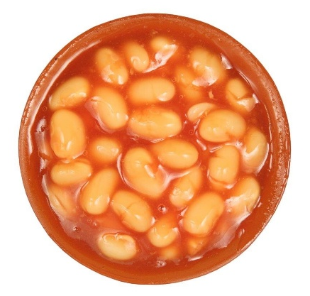
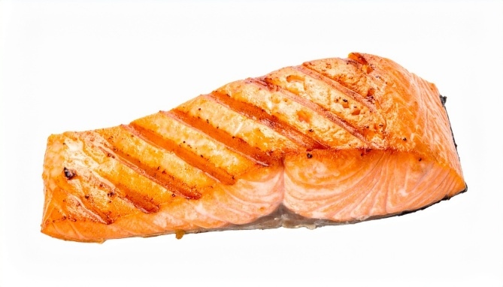
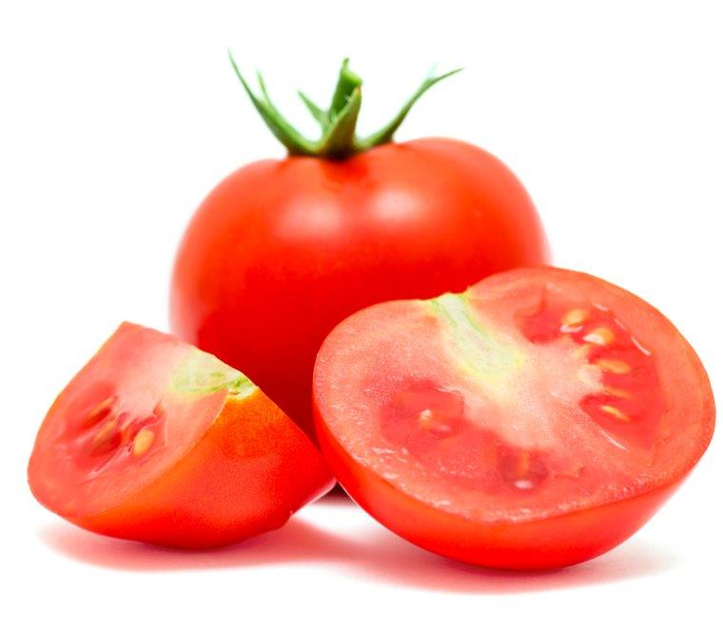
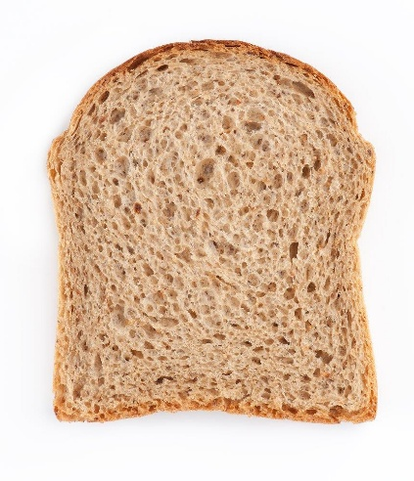
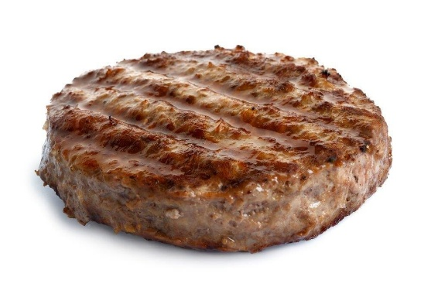
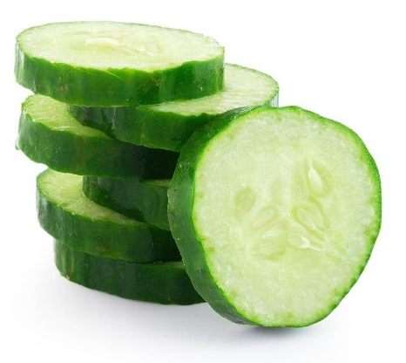
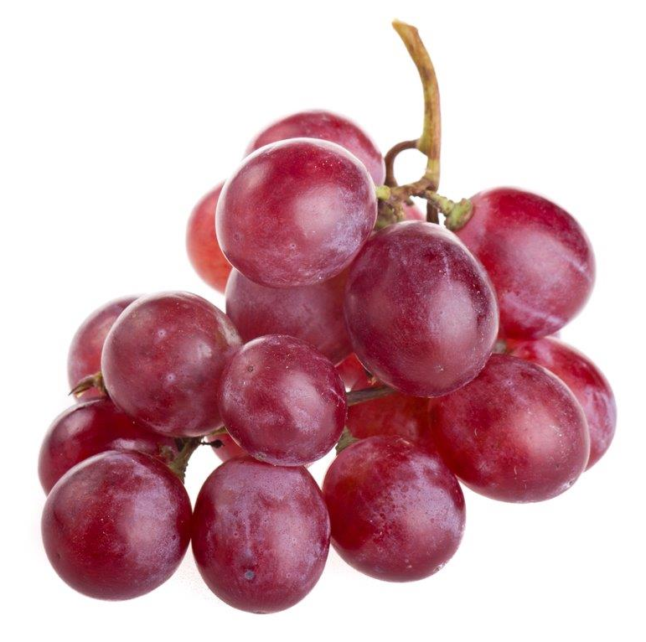
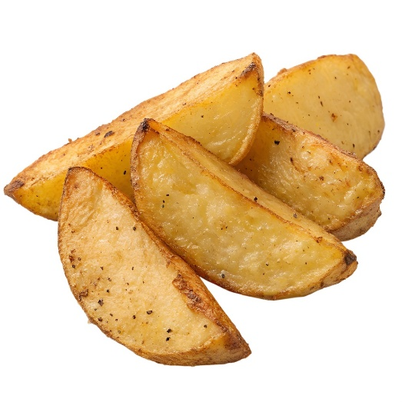
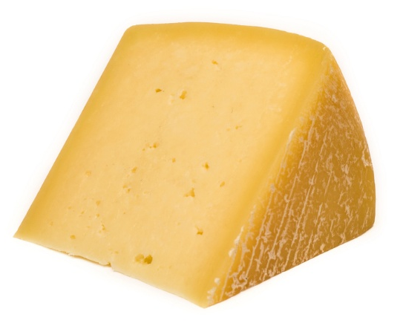
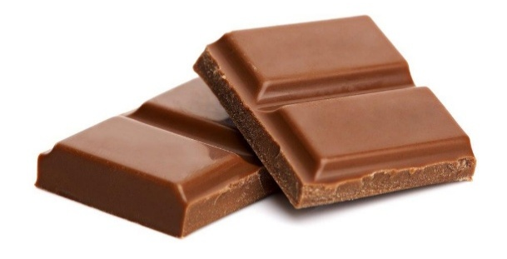
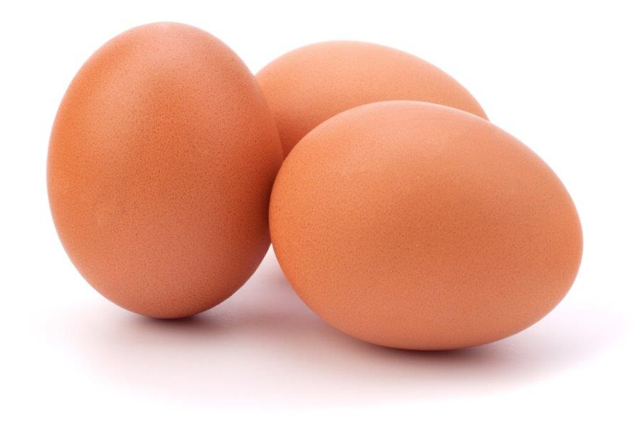
There are lots of different types of food.
What food can you see here?
What is your favourite food?
What do you not like?

Slide 3
What might make us like or dislike a food?
It might be the…
feel
sound
smell
taste
look
What foods do you like the smell of?

Slide 4
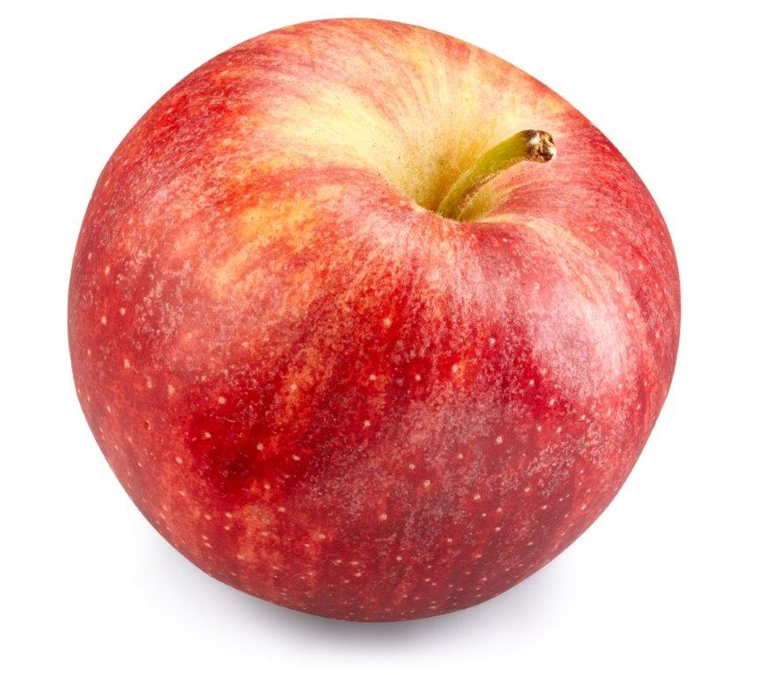
How could we describe an apple?
crunchy
juicy
crispy
Now describe the foods on the next few slides.

Slide 5
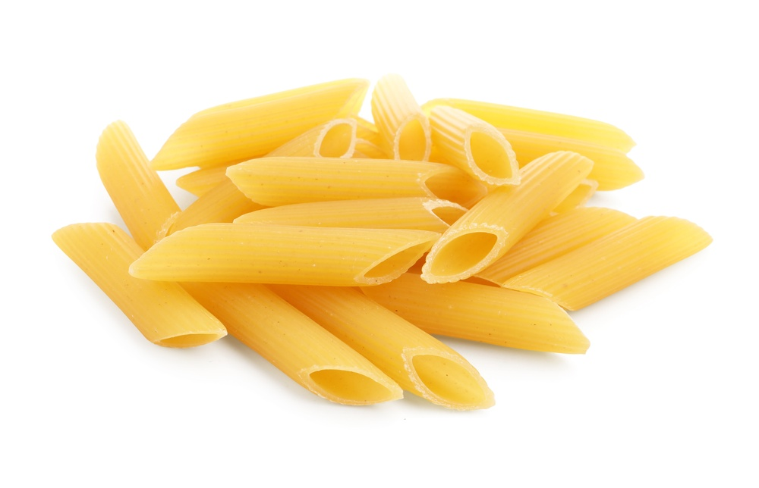
What words can you use to describe this food?
Do you like this food? Why?

Slide 6
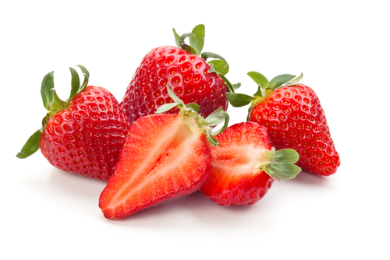
What words can you use to describe this food?
Do you like this food? Why?

Slide 7
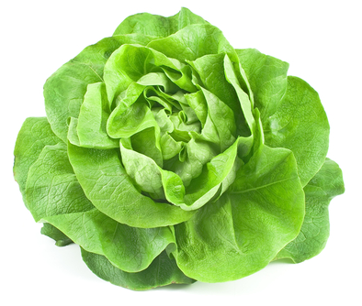
What words can you use to describe this food?
Do you like this food? Why?

Slide 8
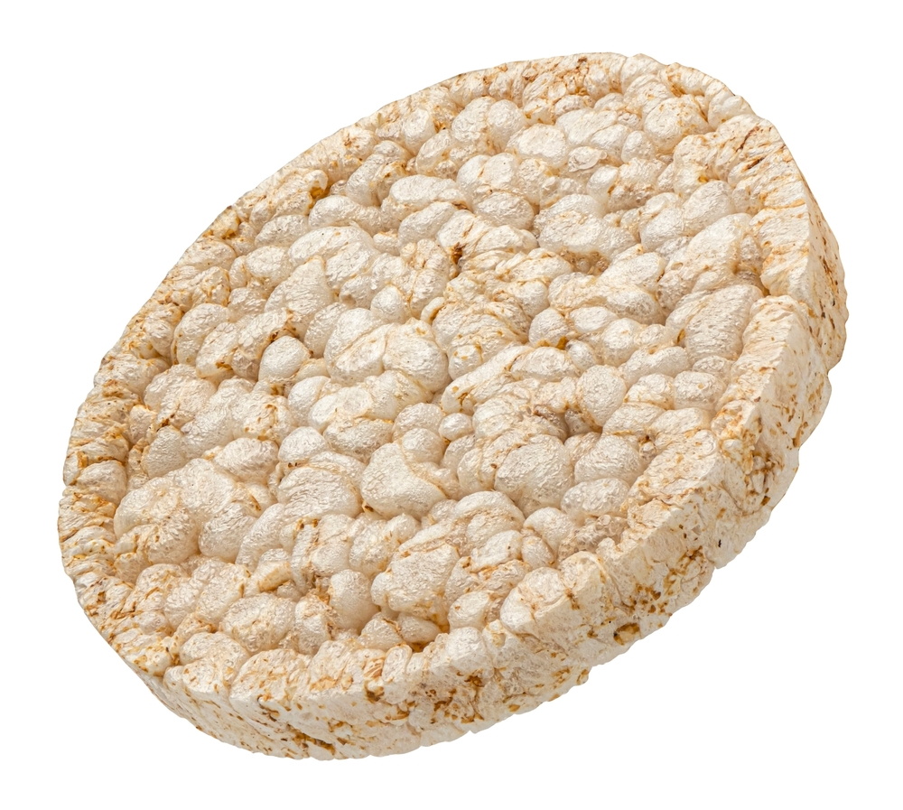
What words can you use to describe this food?
Do you like this food? Why?

Slide 9
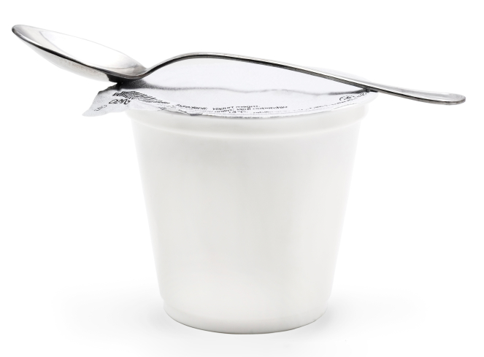
What words can you use to describe this food?
Do you like this food? Why?

Slide 10
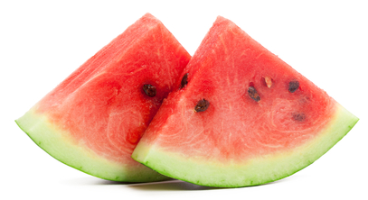
What words can you use to describe this food?
Do you like this food? Why?

Slide 11
Can you think of a food for each of these words?
bobbly
sticky
spongy

Slide 12
I like that

