Slide 1
Sustainable healthy food

Slide 2
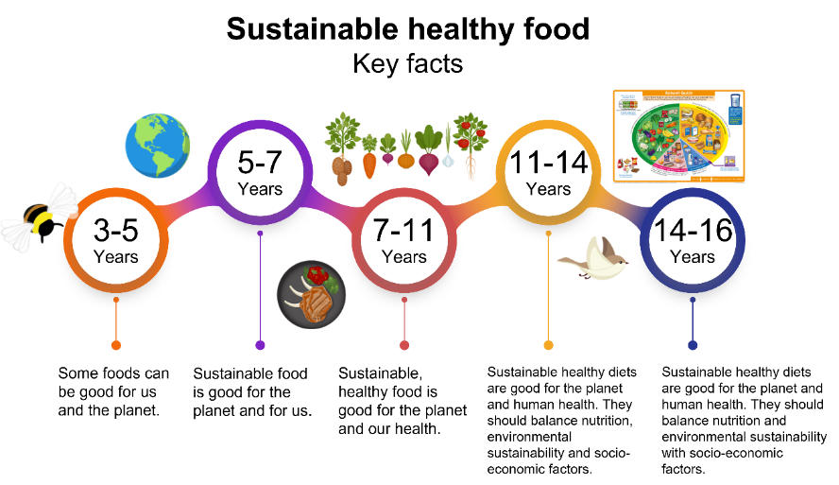
Food – a fact of life and sustainability
Leaders’ background information
The Food – a fact of life programme has identified some simple, Key Facts for learners aged 3 to 16 years, to help them build their knowledge and understanding around sustainable healthy food.
For learners aged 3-5 years the Key Fact is:
Some foods can be good for us and the planet.
This slide deck provides information and activities based on this Key Fact. There are also some separate activity sheets with tasks for children to complete.
See our Curriculum roadmaps to find out more about the Key Facts.

Slide 3
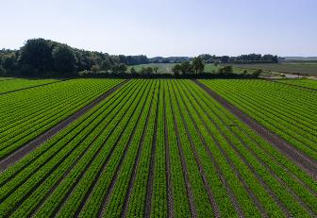
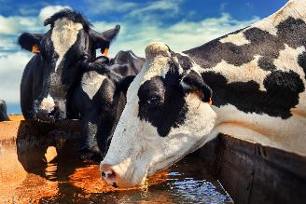
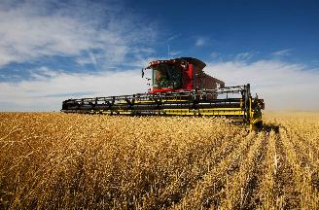
What is sustainable healthy food?
Leaders’ background information
The foods and drinks we choose are important for our health and the health of the planet.
Why?
A lot the planet’s resources go into producing our food. For example:
Land – suitable land is needed to grow crops and rear animals.
Water – fresh water is needed for animals to drink and to water crops.
Energy – fuel is needed to run farm equipment and transport our food.
Why does this matter to the planet?
Fresh water and land are limited. We can’t make anymore water or land, so we need to use what we have carefully.
The energy we need to farm and transport our food is often created from burning fossil fuels, such as petrol. This can create greenhouse gases which are harmful to our planet.

Slide 4
About our land, water and energy
Leaders’ background information
We need to look after our land, water and energy and use them wisely!
Land
It might seem that we have plenty of land on our planet for producing the food we need, i.e. growing crops and grazing animals. However, not all land is suitable for producing food, e.g. desserts, mountains. We need to use the land we have wisely, so we can produce enough food for everyone.
Water
Our planet is sometimes called the ‘blue planet’ because so much of it is water. It looks like we have lots of water, but we can’t use most of it. We need freshwater to drink, grow our food, wash, cook and other parts of our daily life. Our oceans are seawater, which we can’t use because it is salty. Only around 1% of the water on our planet is freshwater, so we need to use it carefully.
Energy
We use energy for all sorts of things. We need energy to run cars and other vehicles. We need energy to heat our homes. The energy we need can create greenhouse gases which can harm our planet. Lots of our energy is made by burning oil, coal and gas. Burning oil, coal and gas creates greenhouse gases. Greenhouse gasses go up into the sky and act like a blanket wrapped around the Earth. This traps in the sun’s heat and raises temperatures on Earth. As the Earth gets hotter over time, we get more extreme weather such as drought (not enough water) and flooding (too much water). This makes it harder to grow food.

Slide 5
What to teach young learners about sustainable healthy food
Leaders’ background information
Sustainability and food is a complex area and difficult to explain to young learners. However, there are simple actions that everyone, including young children, can take to help keep themselves and the planet healthy. This slide deck, and the separate activity sheets, focus on two themes that are actionable for young learners.
Theme | Content | Message for learners
Eat a variety of food | Different food is grown and produced in different ways, using different amounts of land, water and energy. Eating a variety of different foods helps spread the pressure on the planet's resources. It also helps us to get all the energy and different nutrients we need to be healthy. | Encourage children to eat and try lots of different foods – it’s good for them and the planet!
Reduce food waste | When food is wasted, all the resources (land, water and energy) used to make the food are wasted too. Help children to value the resources, and effort, that go into producing our food and understand the importance of minimising food waste. Food that cannot be eaten can be put in the food waste recycling and used for other purposes, such as making compost and energy. | Help children to become more aware of food waste, the ways they can reduce food waste, and that food waste bins should be used for food that can’t be eaten.
For more complex information about sustainable healthy foods, take a look at our resources for ages 5-7 years.

Slide 6
Eat a variety of food

Slide 7
Eat a variety of food
Activities
Let’s talk! Show the children slides 8-18 and ask the questions shown on the slides. While you show the slides, share the following information: Good for us Emphasise that it is good for us to eat different types of foods, so our body gets everything it needs to work properly and keep us healthy. Good for the planet Different food is grown and made in different ways. Eating a variety of different foods helps to share out the different work our planet has to do to grow and make our food. | Let’s play! Give each child a copy of the Find the food and drinks activity sheet. Provide some coloured pencils and counters and try some of the activities on the Find the food and drinks ideas sheet. Talk to the children about trying different foods. What is it like when you try new foods? What new food have you tried recently? Explain that it’s great to try new foods because we can discover new things we like, and it’s good for our body to have a variety of different foods. Cut out the images on the What are they trying sheet. Get the children to match the pictures of the children tasting foods to the images of the foods.
Let’s look! Show children the Find the food and drinks slides (16-18). Ask the questions shown to help the children identify and name different food and drinks. | More ideas Do some tasting activities with young children. Use this Tasting guide to help you set up and run you tasting session. You could give children a copy of the My food book so they can track what they taste. You could award Super taster certificates to those willing to try new foods. Teach more about eating a variety of foods and play the Eatwell game.

Slide 8
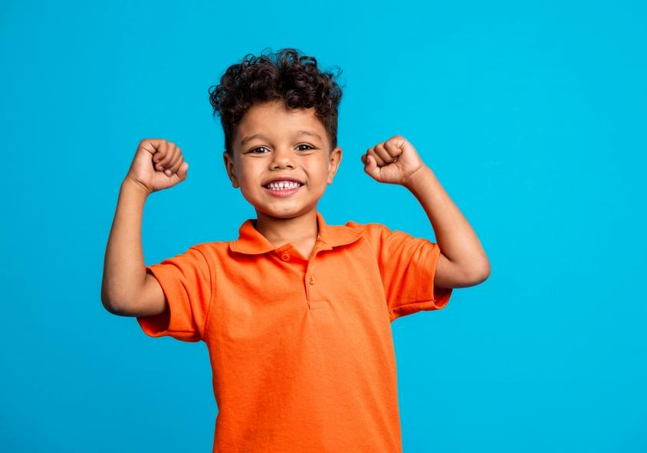
Eat a variety
We need different types of food to keep our body healthy.
Can you think of 5 different foods that you like to eat?

Slide 9
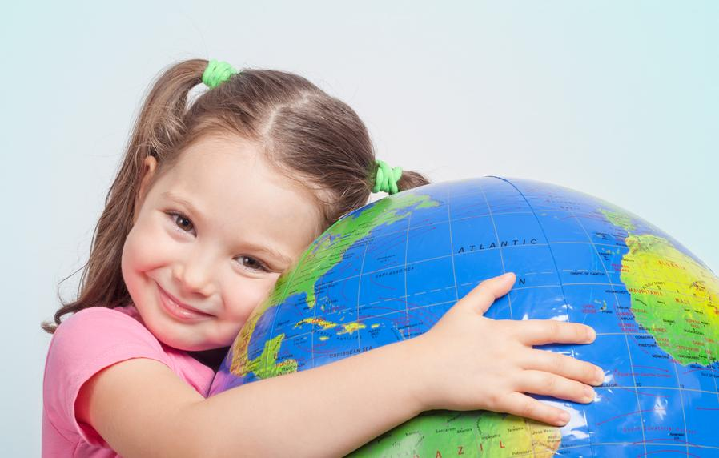
Eat a variety
Having different types of food helps to keep our planet healthy too!
What new foods would you like to try?

Slide 10
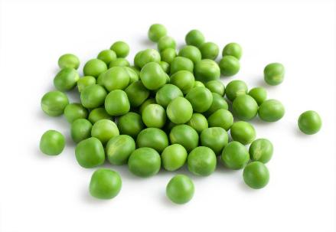
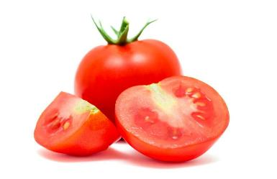
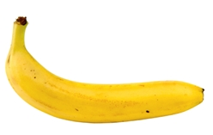
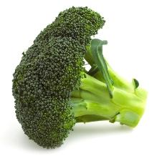
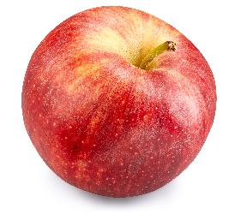
We need lots of fruit and vegetables.
What can you see here?

Slide 11
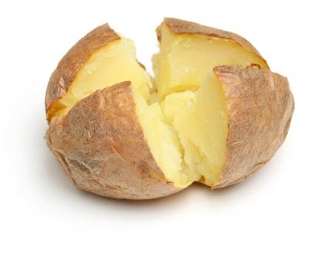
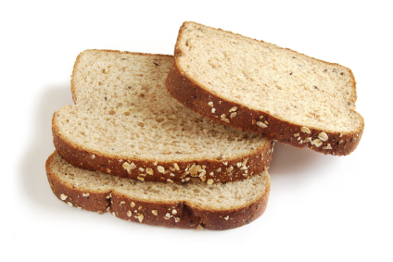
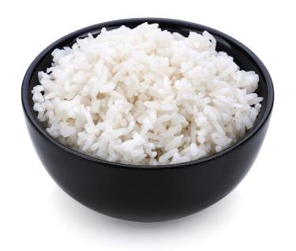
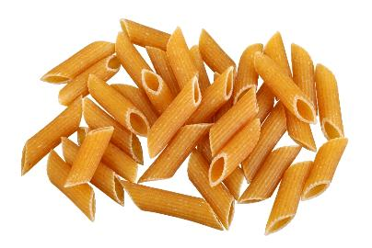
We need foods like potatoes, bread, rice and pasta.
Did you have any of these foods yesterday?

Slide 12
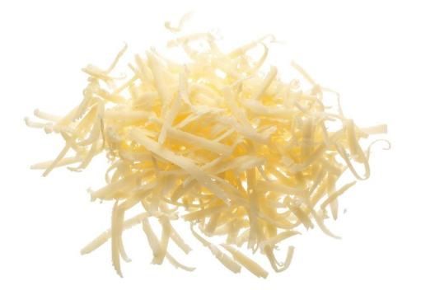
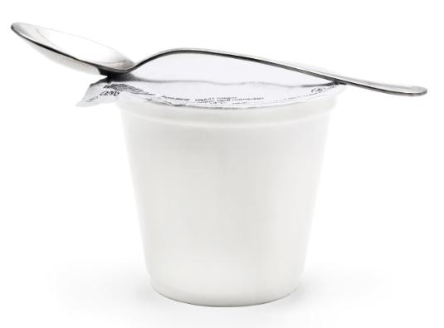
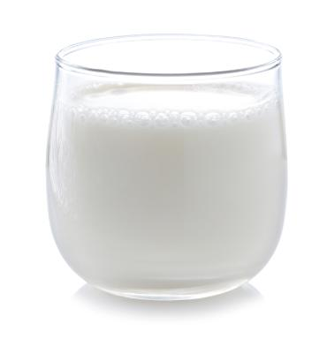
We need food like milk, cheese and yogurt.
Which of these is your favourite?

Slide 13
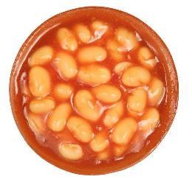
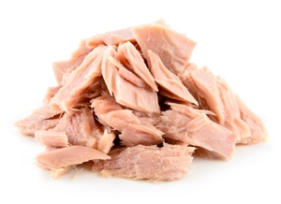
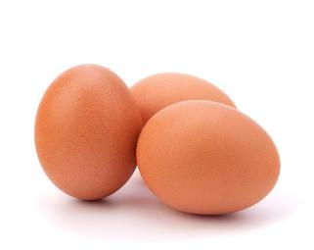
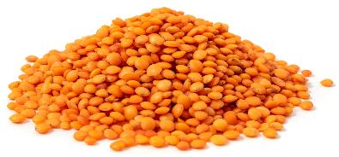
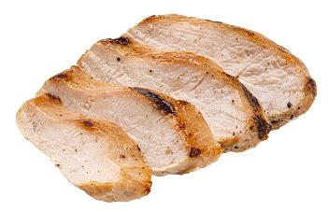
We need food like beans, pulses, fish, eggs and meat.
Can you name each food here?

Slide 14
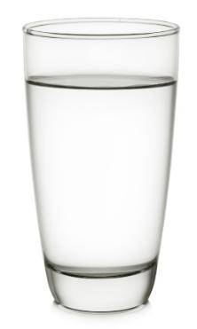
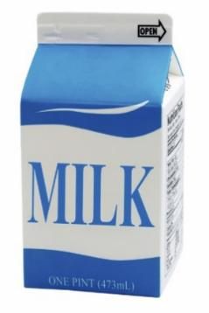
We also need drinks like water and milk.
How many drinks of water have you had today?

Slide 15
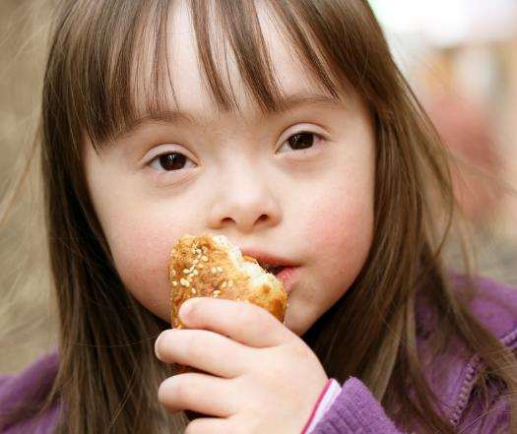
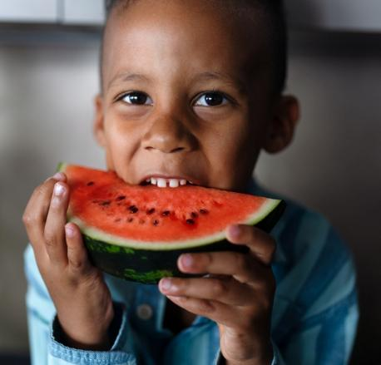
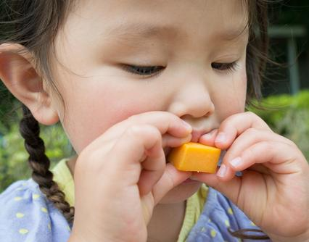
It is good to try lots of different types of food!
What are these children trying?

Slide 16

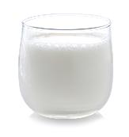
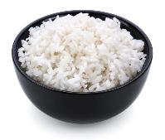
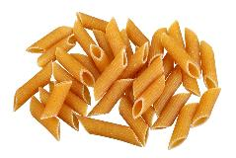

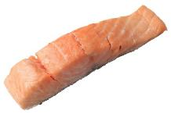



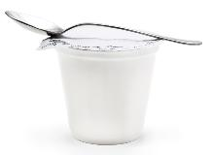


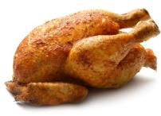

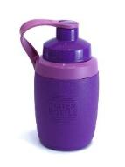
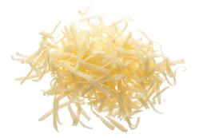

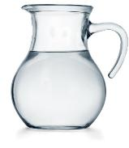


Find the food and drinks!
Find a …
white food or drink
vegetable
circular shaped food

Slide 17
Find the food and drinks!
Find some …
fish
bread
eggs

Slide 18

Find the food and drinks!
How many…
vegetables can you see?
drinks can you see?
red foods can you see?

Slide 19
Super taster
It is good to try lots of different types of food!
Has tried…
Add name of the food here.
Add a photo here!
Add a name here!
What will you try?

Slide 20
Reduce food waste

Slide 21
Reduce food waste
Activities
Let’s talk! Talk through the slides with the children, and question them, to introduce the subject of food waste. | Food waste or food wasted Give the children a copy of Where should it go? sheet. Task them to colour the food, cut it out and attached to the could have been saved plate or the food waste bin (caddy).
 | Reducing food waste in your setting Display the Food saver sheet and dedicate a few minutes each day to talking to the children about any food they have managed to save or ‘rescue’ during the day. Allow the children to add a sticky dot to the Food saver sheet if they have saved or rescued some food. (You could give the children a copy of the sheet to use at home with their family.) Make sure you have a food waste bin in your setting where children can put their food waste. Talk to them about what can go in a food waste bin. Highlight food waste by dedicating a week or two to weighing the food waste created by your setting each day. Weigh the food waste (in its bag) in front of the children and record the weight. Work with the children, and the catering staff, to decrease the weight of the waste over a week or two. This can help everyone to be more aware of trying to reduce food waste.
What farmers do Give the children a copy of the Farming our food sheet. The children can trace over the words and then draw a line to connect the correct words with the image. Alternatively, you can separate the images and words and task the children to match them up. Show children the A year on an arable farm video: https://youtu.be/LTq_86S5-nU Talk about the jobs the farmer does throughout the year.

Slide 22

Food waste
We have all thrown food away at some time.
What food have you thrown away?
Why did you throw it away?

Slide 23
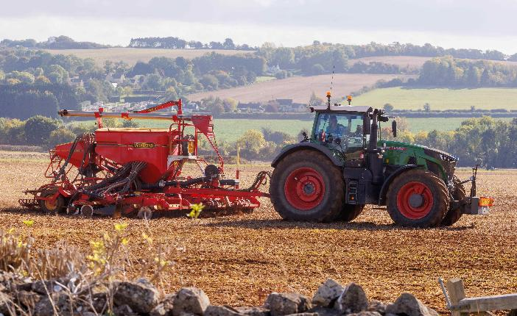
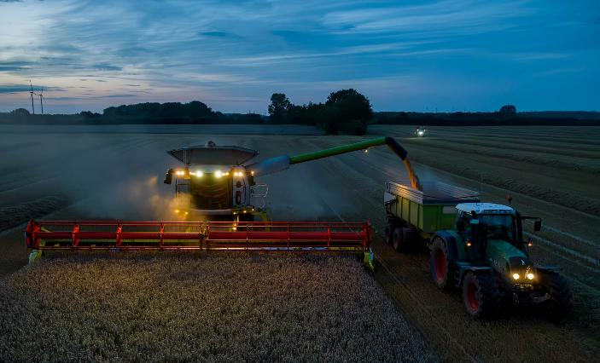
Making our food
Farmers work hard growing crops to make our food.
What is the farmer doing in these pictures?
Planting crops.
Harvesting at night.

Slide 24
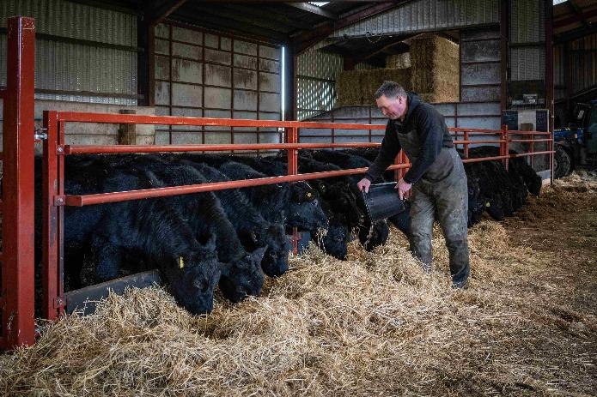
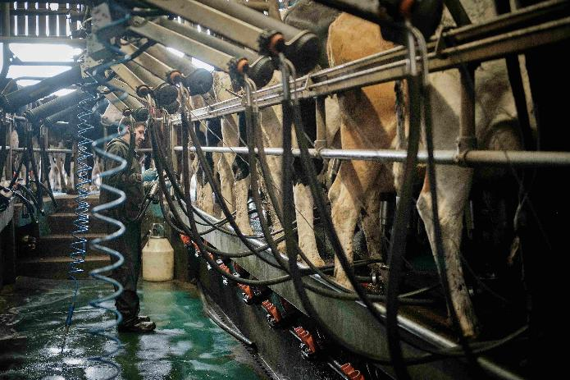
Making our food
Farmers work hard rearing animals to make our food.
What is the farmer doing in these pictures?
Feeding cattle.
Milking cows.

Slide 25
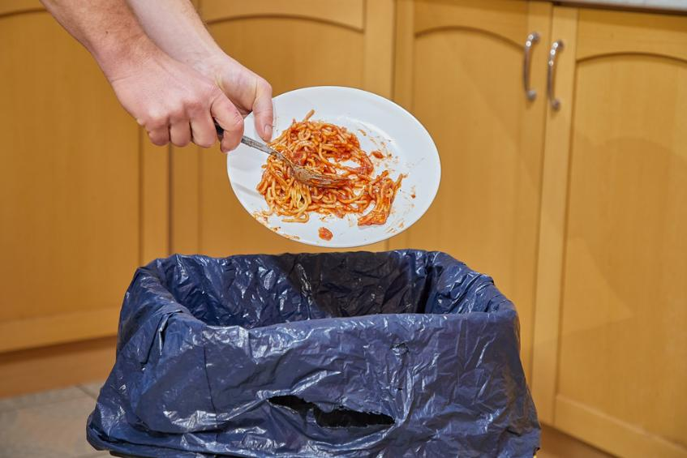
Our food
We need to care for our food and try hard not to waste it.
How can we waste less food?

Slide 26
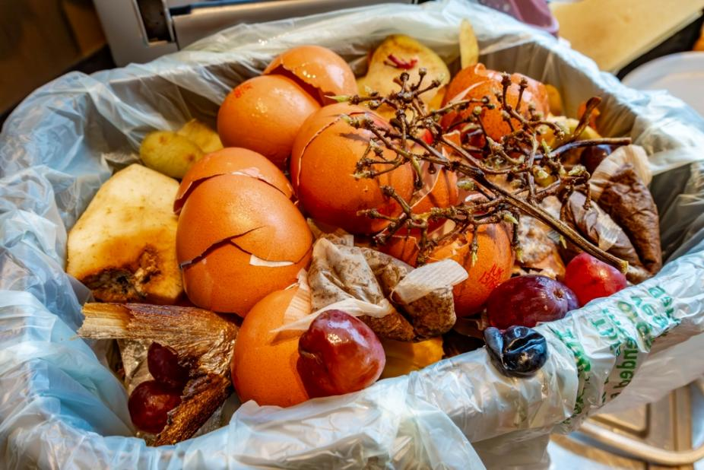
Food waste
Some parts of our food can’t be eaten.
What can you see here that can’t be eaten?

Slide 27
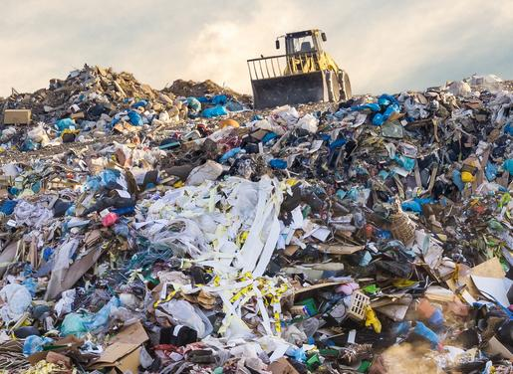
Food waste
Food waste thrown into our normal kitchen bin is buried in the ground.
This can be harmful to our planet.

Slide 28
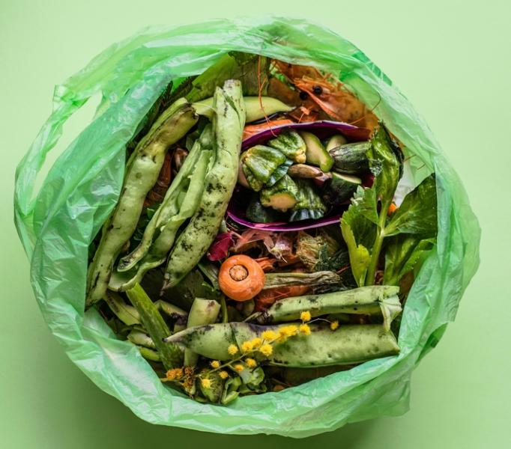
Food waste
Food that can’t be eaten should be put in a food waste bin.
Food in the food waste bin can be recycled to make compost and energy!

Slide 29
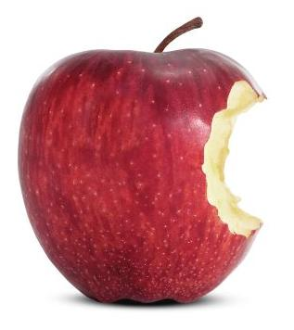
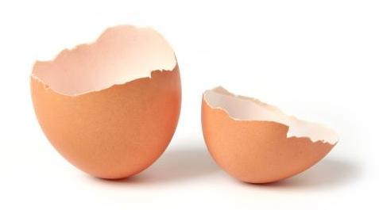
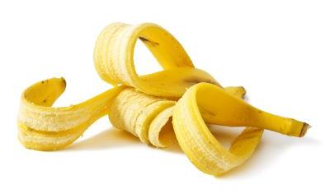
Sort the food
Which of these foods should go in the food waste bin and which could have been eaten?

Slide 30
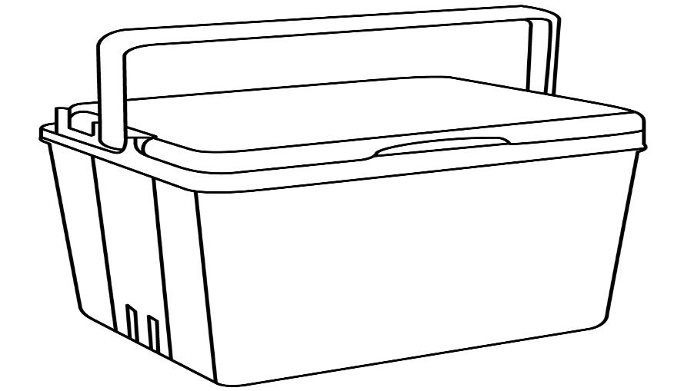
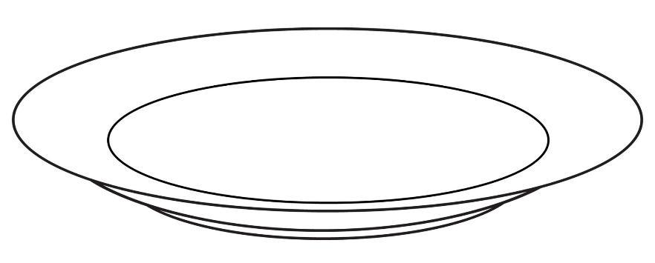



Let’s see!
Were you right?
Could have been eaten
Food waste

Slide 31



Sort the food
Which of these foods should go in the food waste bin and which could have been eaten?

Slide 32



Let’s see!
Were you right?
Could have been eaten
Food waste

Slide 33

Saving food
What could we do with these foods so they are not wasted?

Slide 34
How can we save food?
We could wrap up this sandwich and put it in the fridge for later.

Slide 35

How can we save food?
We could offer these tangerine pieces to someone else.

Slide 36
How can we save food?
We could put this apple in a container and pop it in the fridge for later.
When you want to eat the apple, ask an adult can cut away any parts that have gone brown and chop the apple into slices to make a tasty snack!
If you have some lemon juice, you can put it on the part of the apple that has no skin and this will help stop it going brown!

Slide 37
For further information, go to:
www.foodafactoflife.org.uk
This resource meets the Guidelines for producers and users of school education resources about food.

