Slide 1
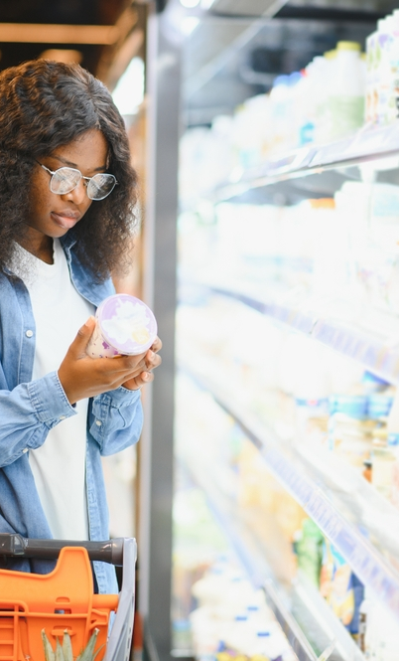
Advantages and disadvantages of different types of shopping

Slide 2
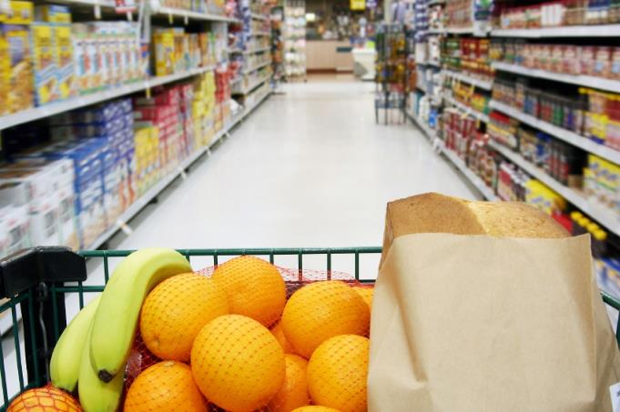
Supermarkets
Advantages
Everything in one place.
Lots of choice.
Low prices.
Disadvantages
Can be very busy.

Slide 3

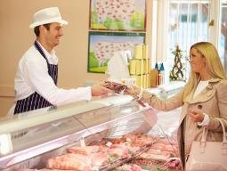
Bakers, butchers and greengrocers
Advantages
Usually local to where you live and sell locally produced food.
Disadvantages
Prices can be slightly higher.
Less choice than supermarkets.

Slide 4
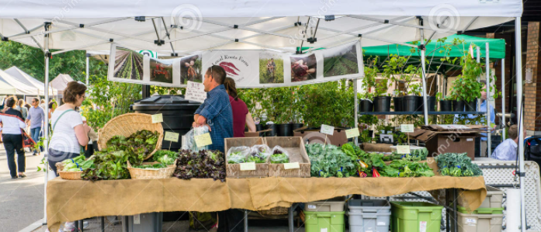
Markets
Advantages
Great for locally grown fresh seasonal produce.
Food is often less expensive.
Disadvantages
Have to shop around as not all in one place.

Slide 5

On-line
Advantages
Convenient – you can shop from anywhere at anytime.
Able to easily compare prices from store to store.
Disadvantages
When shopping for fresh food you have no control over quality.

Slide 6
Advantages and disadvantages of different types of shopping

