Slide 1
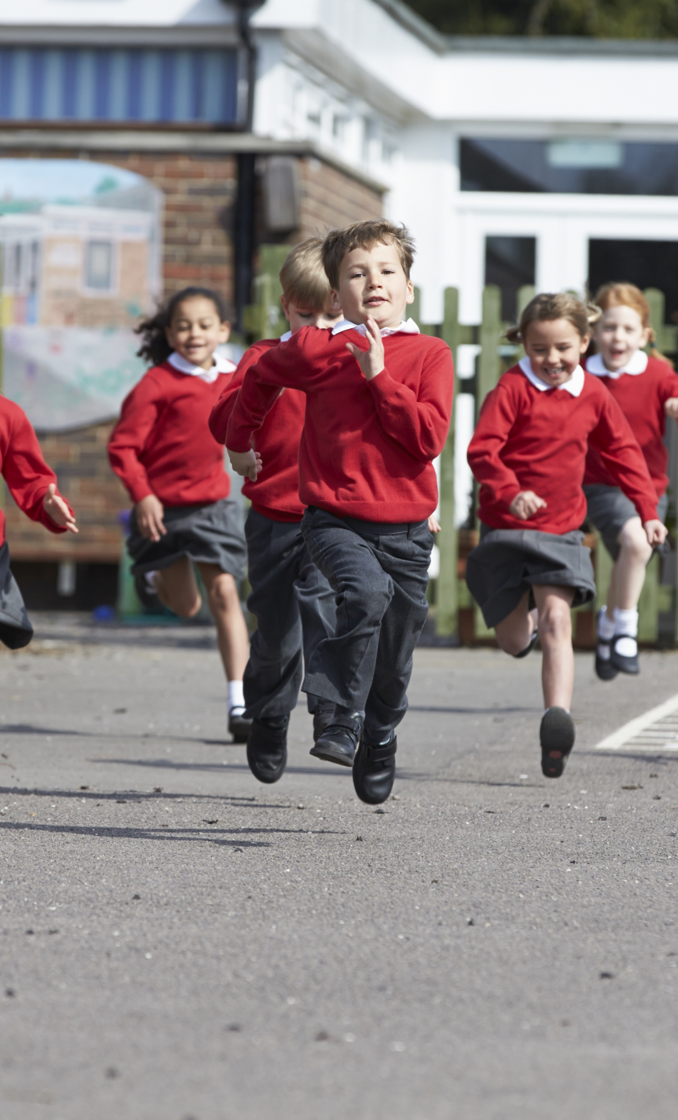
Energy

Slide 2
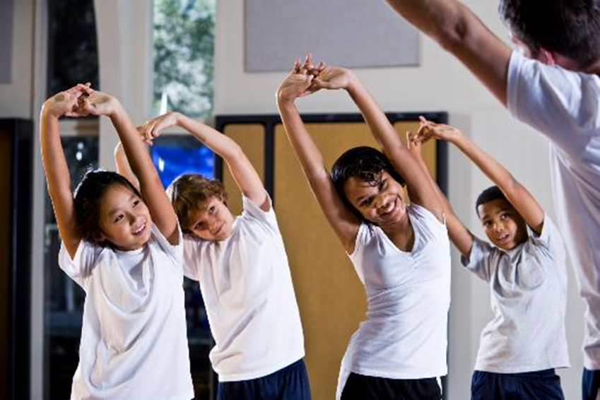
Energy
Energy is essential for life, and is required to fuel many different body processes, growth and activities.
These include:
• keeping the heart beating;
• keeping the organs functioning;
• maintenance of body temperature;
• muscle contraction.

Slide 3

Energy
Different people need different amounts of dietary energy depending on their:
• age;
• gender;
• body size;
• level of activity;
• genes.

Slide 4
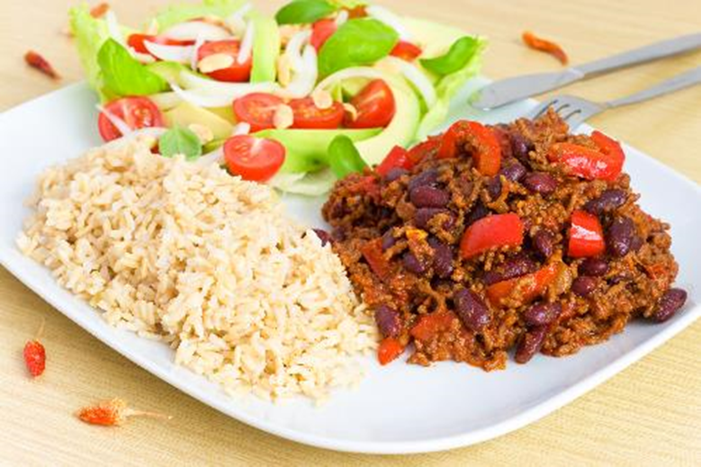
Macronutrients
Energy is provided by the carbohydrate, protein and fat in the food and drink we consume.
These are known as macronutrients.
The amount of energy that each of these macronutrients provides varies.

Slide 5
Energy measurements
Energy intake is measured in joules (J) or kilojoules (kJ), but many people are more familiar with Calories (kcal).
1 kilojoule (kJ) = 1,000 joules
1 megajoule (MJ) = 1,000,000 joules
1 kilocalorie (kcal) = 1,000 calories
To convert from one unit to another:
1 kcal = 4.184 kJ
Therefore, a 1000-kcal diet provides 4.184 MJ or 4184 kJ
1 MJ = 239 kcal

Slide 6
Energy
Carbohydrate (starch and sugars) provides 3.75 kcal (16 kJ) per gram (for the purposes of food labelling this is rounded up to 4 kcal (17kJ) per gram).
Protein provides 4kcal (17kJ) per gram.
Fat is the most energy dense nutrient, providing 9kcal (37kJ) per gram.
Energy intake can be estimated by applying these figures to the amount of carbohydrate, protein and fat we consume from food and drink.
Alcohol also provides energy at 7kcal (29kJ) per gram.

Slide 7
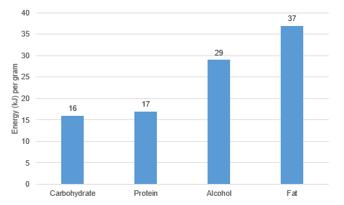
Energy in food and drinks
Per gram, fat provides more than twice the energy of carbohydrate.

Slide 8
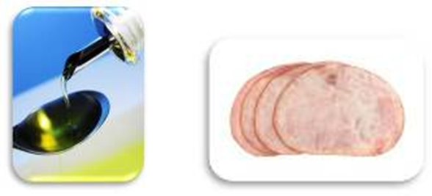
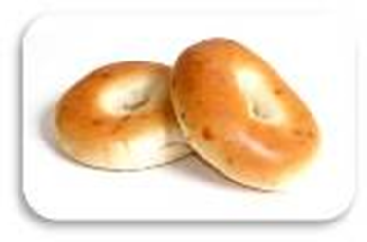
Energy
Which of these foods do you think contributes the most energy per 100g?
Bagel
Oil
Ham
Total Energy= 1161kJ
Carbohydrate 982.6kJ
Protein 170.0kJ
Fat 66.6kJ
Total Energy= 3696.0kJ
Carbohydrate 0.0kJ
Protein 0.0kJ
Fat 3696.0kJ
Total Energy= 451kJ
Carbohydrate 17.0kJ
Protein 312.8kJ
Fat 122.1kJ

Slide 9
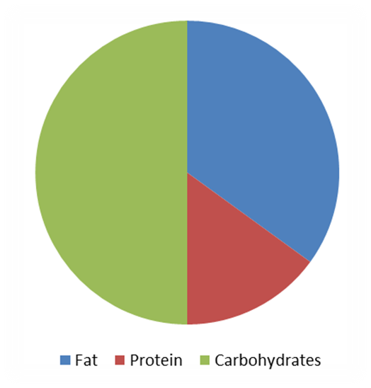
Dietary Reference Values
Experts have estimated the average requirements for energy for different types of people. These figures are known as Estimated Average Requirements (EAR) for energy.
Experts also recommend that:
about 50% of our energy intake should come from carbohydrate;
no more than 35% of our energy intake should come from fat;
around 15% of our energy intake should come from protein.

Slide 10
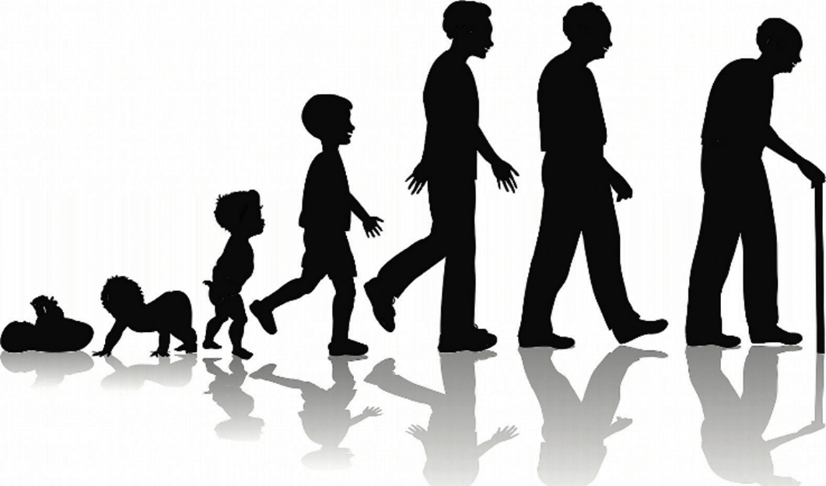
Dietary Reference Values
EARs vary throughout life.
Babies, young children and teenagers need more energy in relation to their size to grow and be active.
After the age of 18, energy requirements decrease and remain the same until 50, but actual needs depend on people’s activity levels. The EAR for women who become pregnant increases by 200 kcal/day but only in the final three months of pregnancy.
Energy requirements for older adults decrease as activity levels fall, and there is a reduction in the basal metabolic rate.

Slide 11
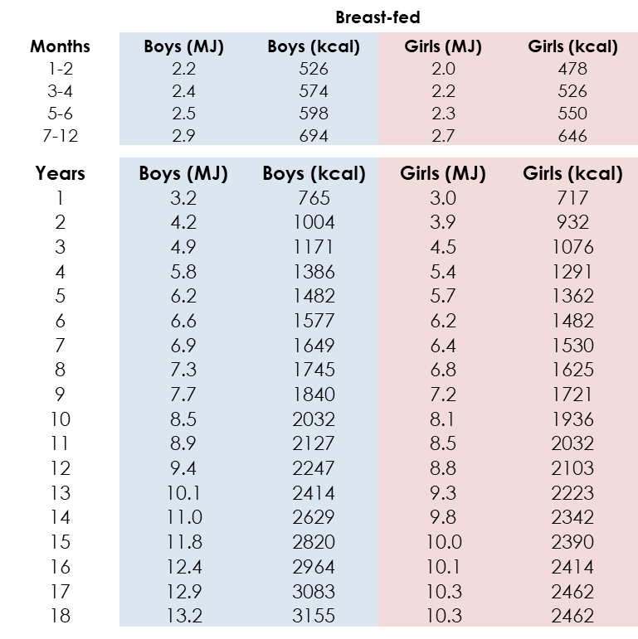
EARs - children
The Scientific Advisory Committee on Nutrition (SACN) has published reference values for daily energy requirements as follows:

Slide 12
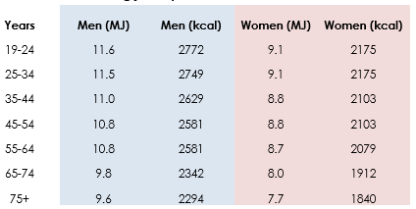
EARs - adults
Why do you think there is a difference in requirements for males and females?
What effect would increasing activity levels have on the energy requirements?

Slide 13
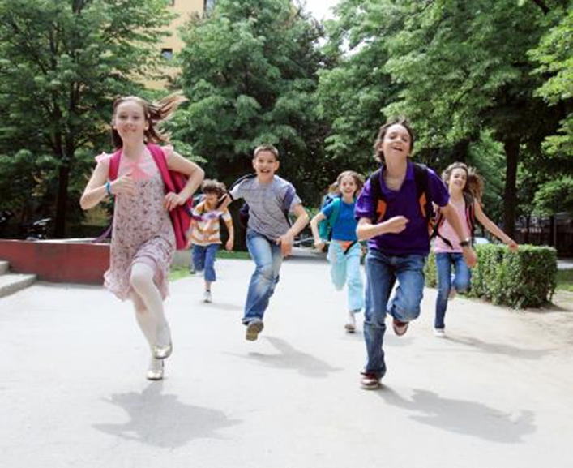
How much energy do we need
Energy requirements vary from person to person, depending on the Basal Metabolic Rate (BMR) and Physical Activity Level (PAL).
Total energy expenditure =
BMR x PAL

Slide 14

What is basal metabolic rate?
Basal metabolic rate (BMR) is the rate at which a person uses energy to maintain the basic functions of the body when it is at complete rest, such as:
• breathing;
• keeping warm;
• keeping the heart beating.

Slide 15
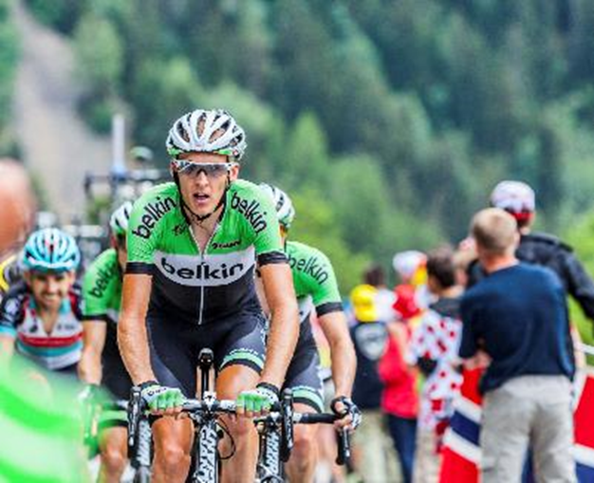
Physical activity
In addition to their BMR, people also use energy for movement of all types, expressed as Physical Activity Level (PAL).
The amount of energy a person uses to perform daily tasks varies.

Slide 16
Physical activity
Physical activity should be an important part of our daily energy expenditure.
Many different types of activity contribute to our total physical activity, all of which form part of everyday life.
What do you think physical activity includes?
• Activity at work, e.g. use the stairs not the lift.
• Household chores, e.g. vacuuming.
• Looking after others.
• Leisure-time activities, e.g. gardening.
• Transport (walking or cycling to school or work).
• Sport.

Slide 17
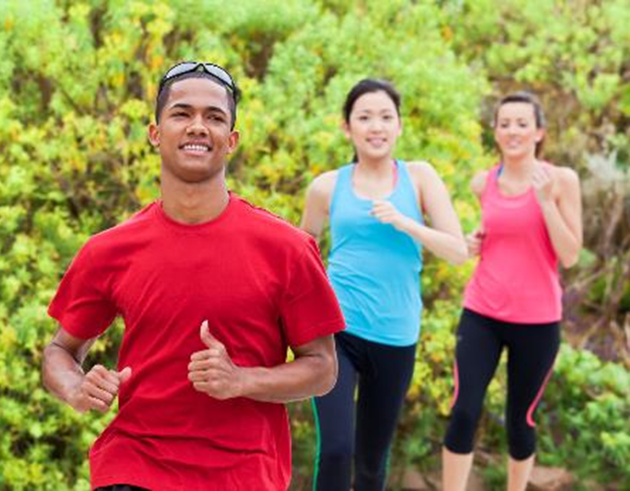
Physical activity
Children and young people are recommended to do at least 60 minutes of moderate intensity exercise every day.
Adults are recommended to do at least 150 minutes of moderate aerobic activity every week or 75 minutes of vigorous aerobic activity. They are also recommended to do strength exercises on two or more days a week that work all the major muscles.

Slide 18
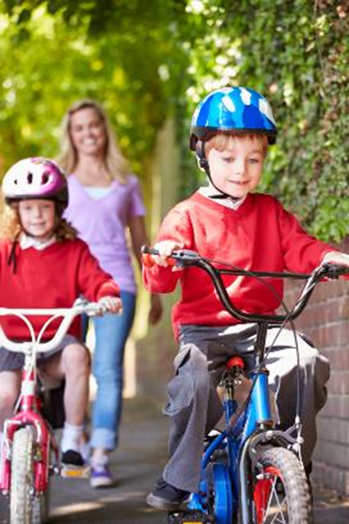
Physical activity
Average physical activity levels in the UK are lower than recommendations. Most adults, older children and teenagers do not meet the targets.
According to Statistics on Obesity, Physical Activity and Diet published in 2018, only 23% of boys and 20% girls meet the physical activity guidelines and 21% of adult men, and 25% of adult women are classified as inactive (they do fewer than 30 minutes physical activity a week).
Statistics on Obesity, Physical Activity and Diet 2018

Slide 19
Body Mass Index (BMI)
Body Mass Index (BMI) can be used to identify if an adult is a correct weight for height.
BMI can be calculated as follows:
BMI = weight (kg)/ (height in m)2
Recommended BMI range (adults):
Less than 18.5 = Underweight
18.5 to 25 = Desirable or healthy range
25-30 = Overweight
30-35 = Obese (Class I)
35-40 = Obese (Class II)
Over 40 = Morbidly or severely obese (Class III)

Slide 20
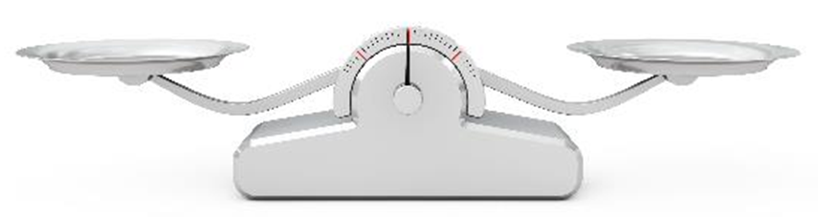
Energy balance
To maintain body weight, it is necessary to balance energy intake (from food and drink) with energy expenditure (from activity). This is called energy balance.
When energy intake is higher than energy output, over time this will lead to weight gain (positive energy balance).
When energy intake is lower than energy output, over time this will lead to weight loss (negative energy balance).

Slide 21
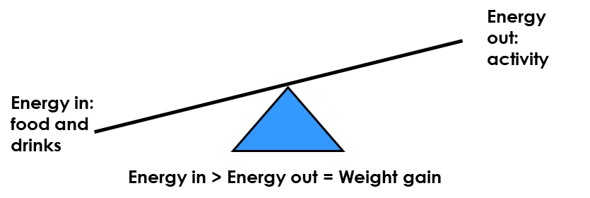
Positive energy balance
A person is said to be in positive energy balance when the diet provides more energy than is needed to meet energy demands of the body. Energy is stored as fat and the person puts on weight over time.
People who achieve a positive energy balance over an extended period of time are likely to become overweight or obese.
Being overweight or obese is associated with an increased risk of developing certain cancers, cardiovascular disease and type 2 diabetes.
Carrying a large amount of weight/fat around the waist also increases the risk of these health problems.

Slide 22
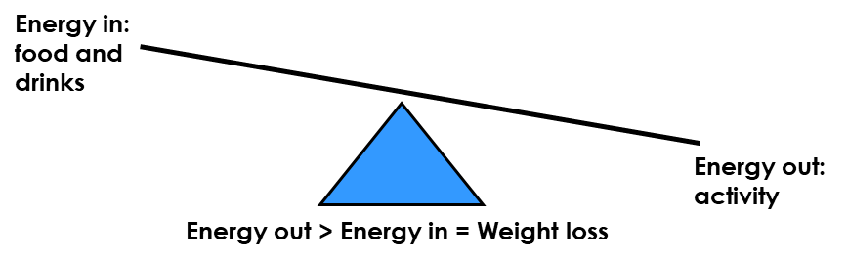
Negative energy balance
A person is said to be in negative energy balance when there is insufficient energy from the diet to meet energy demands of the body. Energy is derived from energy stores and the person loses weight.
People who achieve a negative energy balance over an extended period of time are likely to become underweight.
Being underweight is associated with health problems, such as osteoporosis (low bone mass), infertility (difficulty to conceive) and even heart failure.

Slide 23
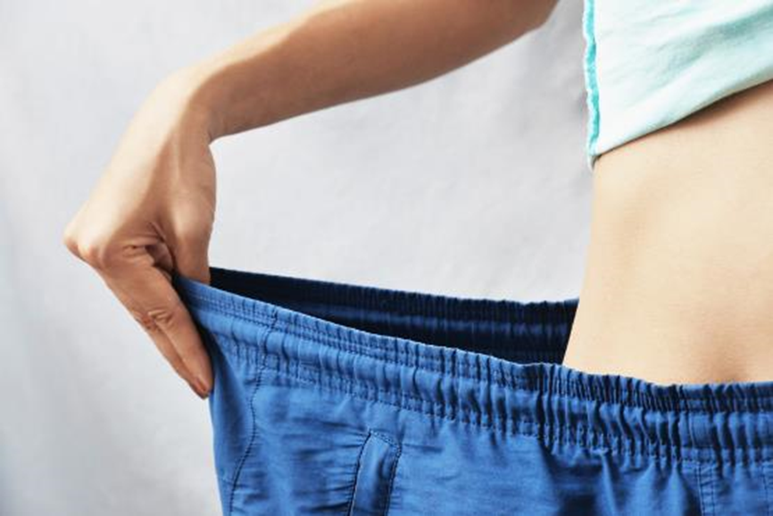
Energy balance
Energy balance can be maintained by:
• regulating energy intake through the diet;
• adjusting physical activity levels;
• a combination of both.

Slide 24
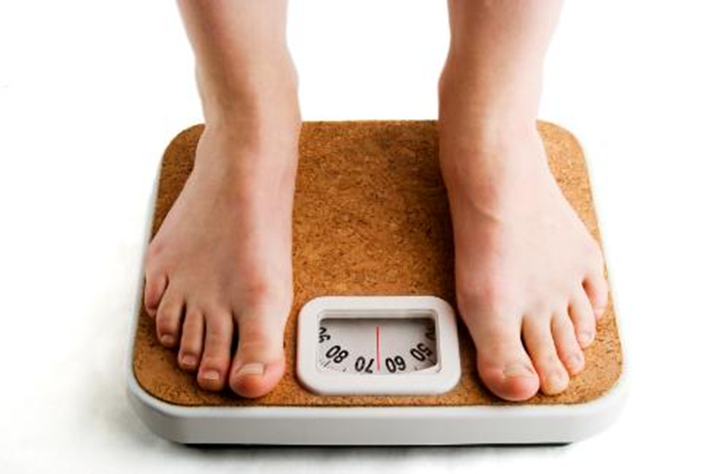
Energy balance
In the UK and many other developed countries, overweight and obesity rates in adults and children have been increasing over the years.
According to Statistics on Obesity, Physical Activity and Diet published in 2018, 57% of adult women and 66% of adult men are overweight or obese.
It is important to lead an active lifestyle and make healthier food choices.

Slide 25
Kahoot Quiz
Open the link below on the main screen and get students to log onto kahoot.it on their tablets or smartphones.
They can then enter the code (that will come up on the main screen when you start the game) and their own nickname.
They can then play along with the quiz choosing the multiple choice answers that correspond with the questions on the main screen. There will then be a leader board of the scores after each question and at the end.
https://play.kahoot.it/#/?quizId=cbee242c-a83c-40d0-9320-a6929747184f

Slide 26

Energy

