Slide 1
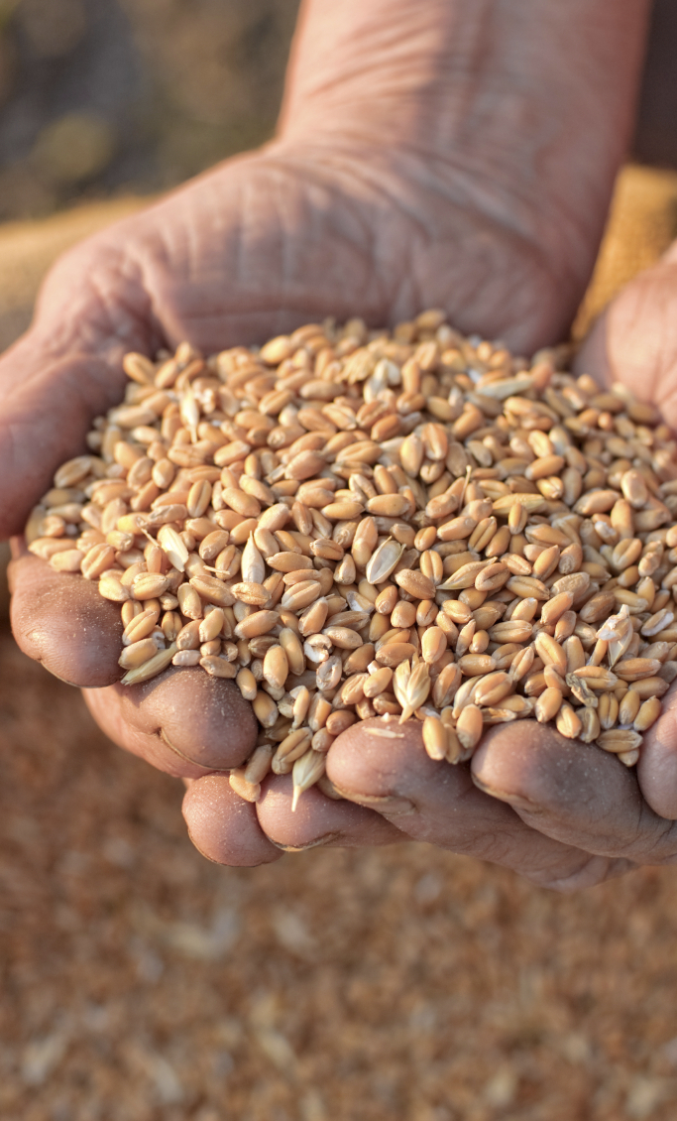
Food is produced and processed

Slide 3
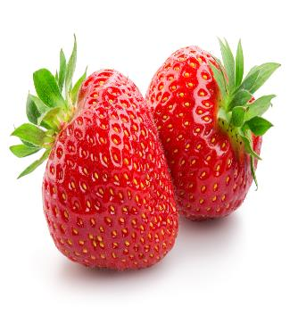
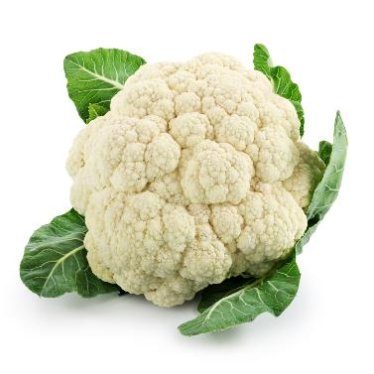
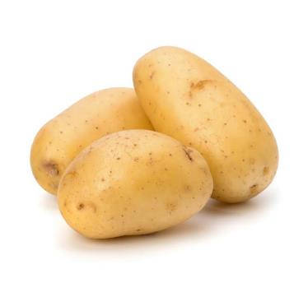
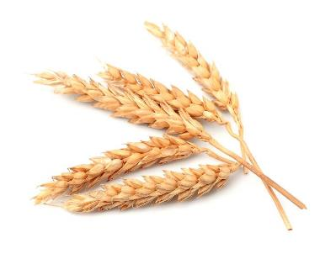
All food is from a plant or animal
Strawberries
Cauliflower
Potatoes
Wheat
Plants

Slide 4
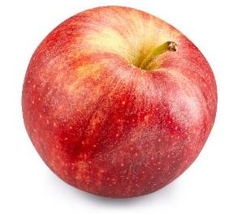
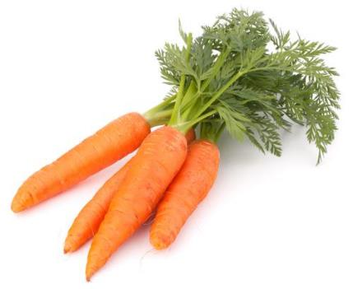
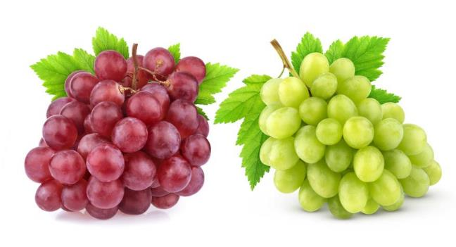
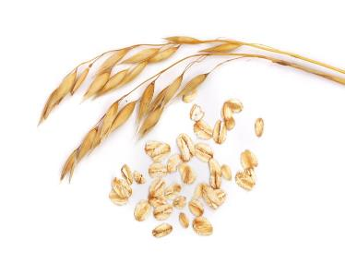
All food is from a plant or animal
Apple
Carrots
Oats
Grapes
Plants

Slide 5
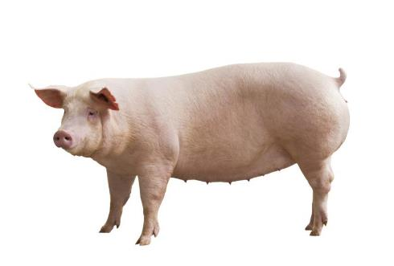
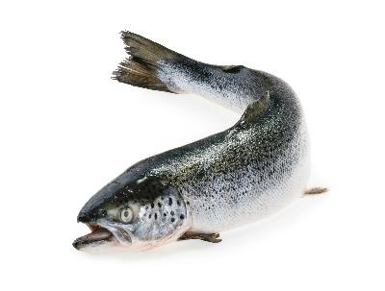
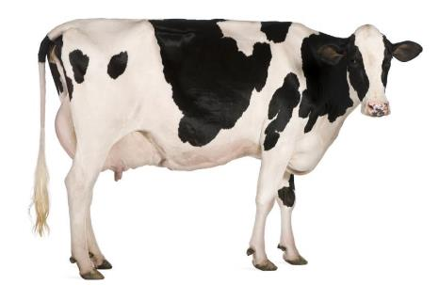
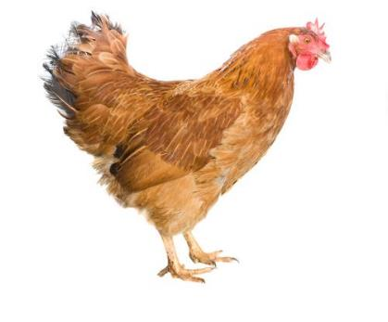
All food is from a plant or animal
Salmon
Dairy cow
Chicken
Pig
Animals

Slide 6
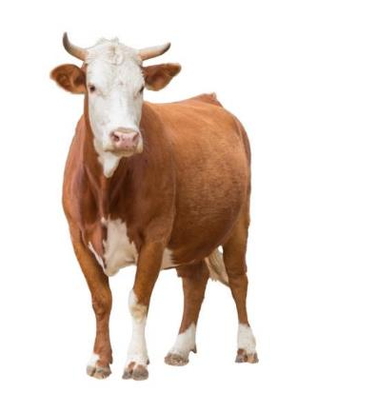
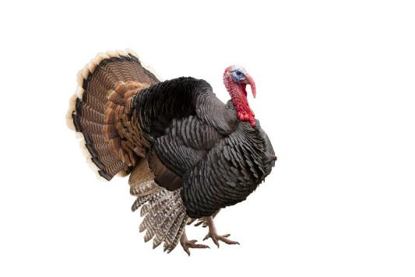
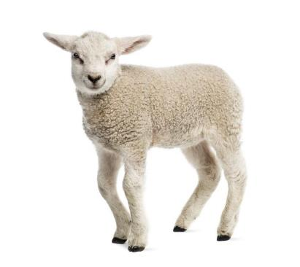
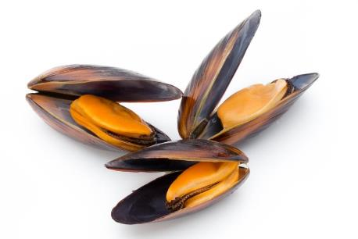
All food is from a plant or animal
Beef cattle
Mussels
Turkey
Lamb
Animals

Slide 7
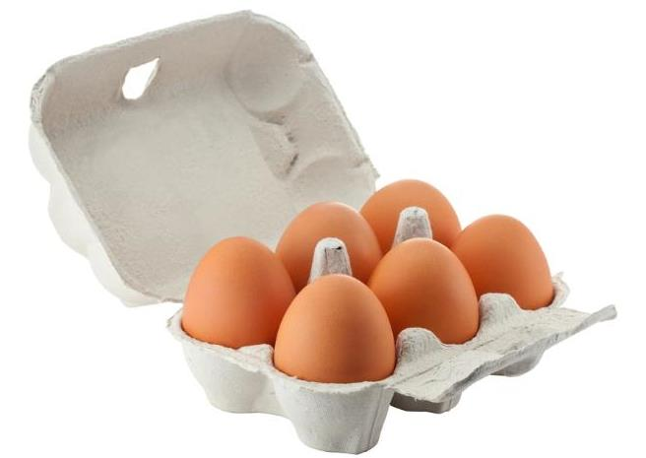

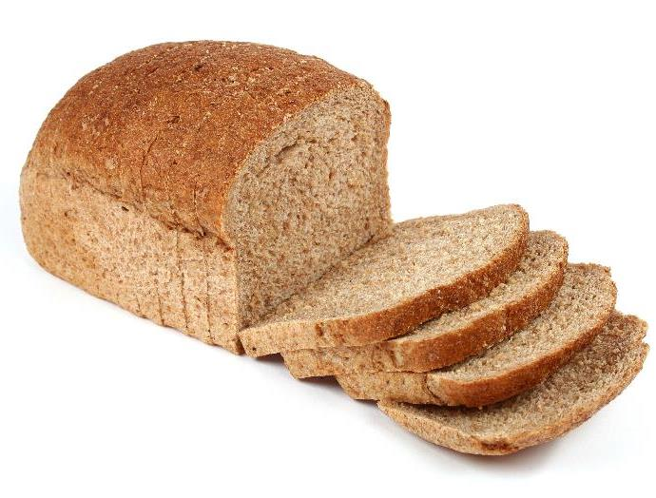
From a plant or animal?
Animal
Plant
Plant
Eggs
Apple
Bread

Slide 8

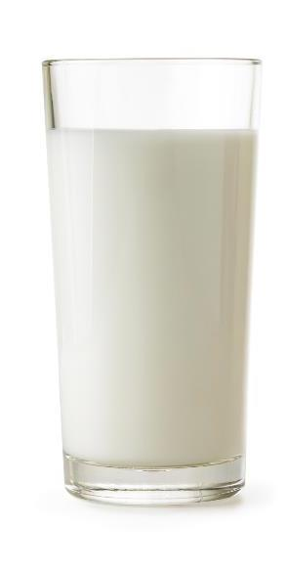
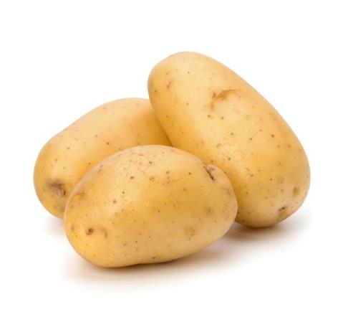
From a plant or animal?
Plant
Plant
Animal
Carrots
Potatoes
Milk

Slide 9
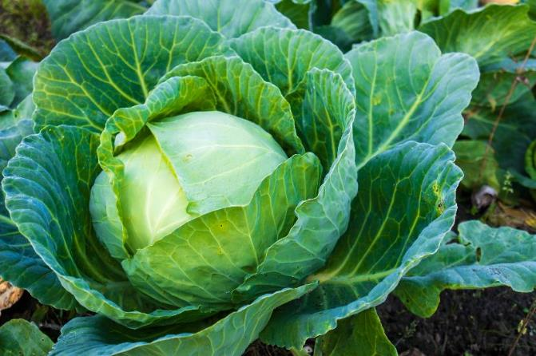
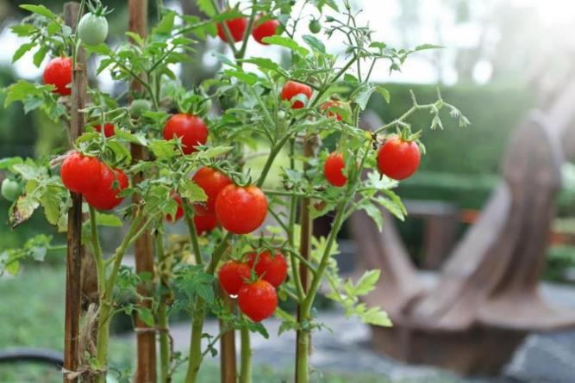
Food is produced
These plants are grown.
Cabbage
Tomatoes

Slide 10
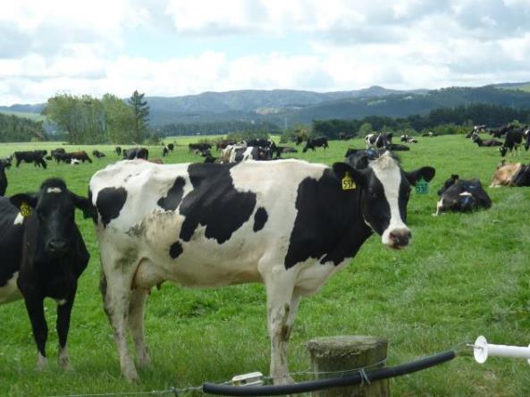
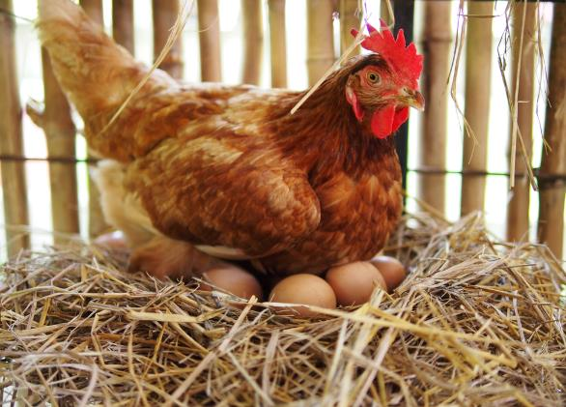
Food is produced
These animals are reared.
Dairy cow
Chicken

Slide 11
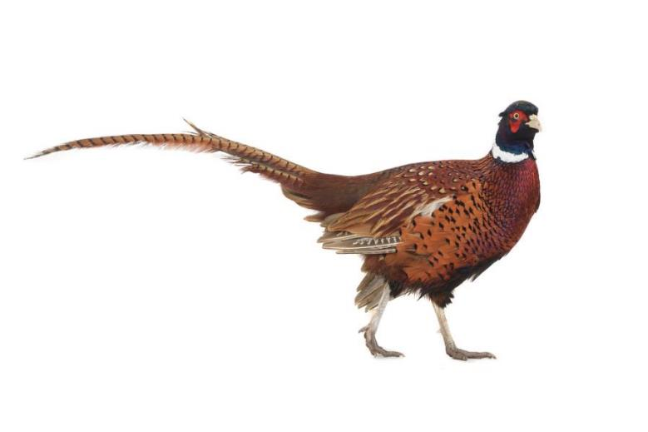
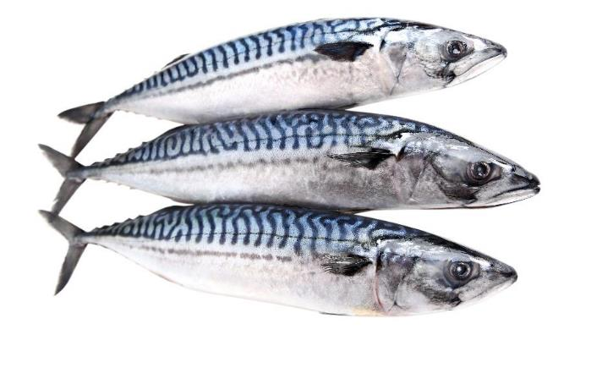
Food is processed
These animals are caught.
Fish
Pheasant

Slide 12
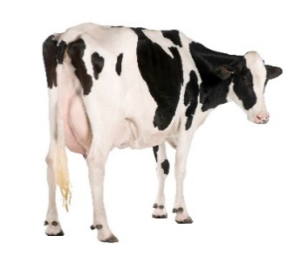
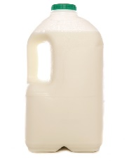
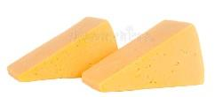
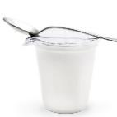
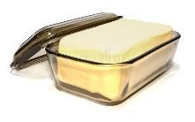
Food origins: Milk
Dairy cow
Milk
Cheese, yogurt and butter

Slide 13
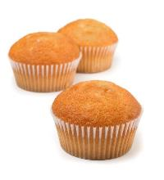
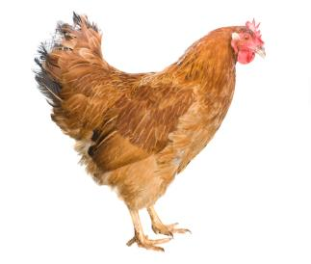
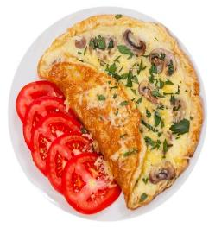
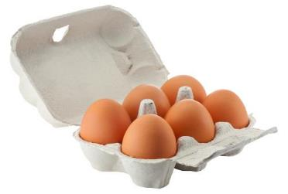
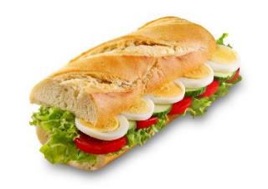
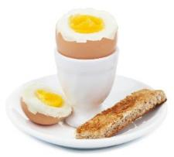
Food origins: Eggs
Hen
Eggs
Egg dishes

Slide 14
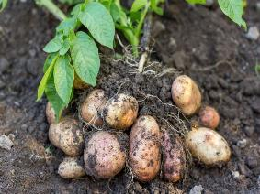
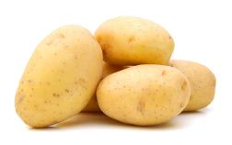
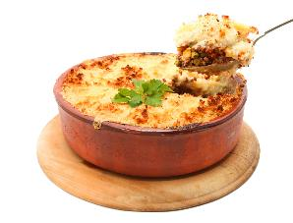
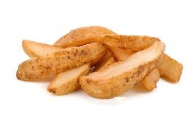
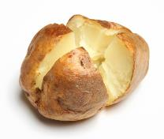
Food origins: Potatoes
Potatoes
Potato dishes

Slide 15
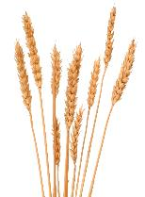
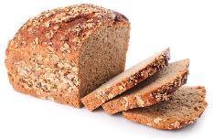

Food origins: Bread
Wheat
Bread

Slide 16
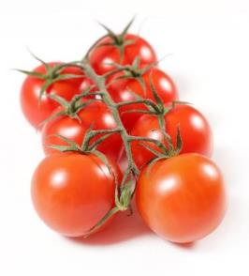

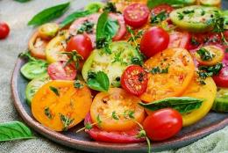
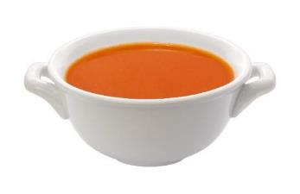
Food origins: Tomatoes
Tomatoes
Tomato dishes

Slide 17
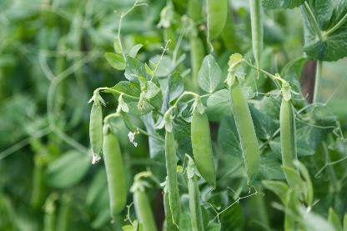
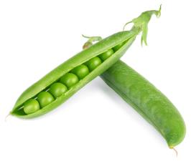



Food origins: Peas
Peas
Pea dishes

Slide 18


Food origins: Strawberries
Strawberries
Strawberry jam

Slide 19


Food origins: Fish
Cod
Fish fingers

Slide 20



Food is processed: Grilled lamb
Rearing
Processing
Grilling

Slide 21





Food is processed: Apple juice
Growing
Picking
Washing
Juicing
Apple juice

Slide 22





Food is processed: Milk
Rearing
Milking
Processing
Milk

Slide 23





Food is processed: Bread
Wheat
Grains
Flour
Bread dough
Bread

Slide 24




Food is processed: Potatoes
Potatoes
Peeling
Boiling
Potato dishes

Slide 25
Food is produced and processed

