Slide 1
Did you know?

Slide 2
Welcome
This presentation provides a number of ‘Did you know?’ statements about cattle, sheep and pig farming in the UK.

Slide 3
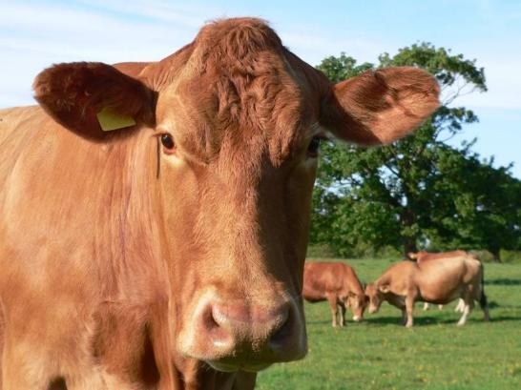
Cattle
Domestic cattle were being kept as long ago as 5,000 years ago.
Years ago, lots of people kept cattle. They would have lived in the fields near to their houses and have been a major source of food as well as their skins being used for clothing, shelter, carpets and shoes.
For thousands of years cattle or oxen were important as ‘working animals’. They helped pull carts and ploughs. Even today, in many less developed parts of the world, this is often still the case.

Slide 4
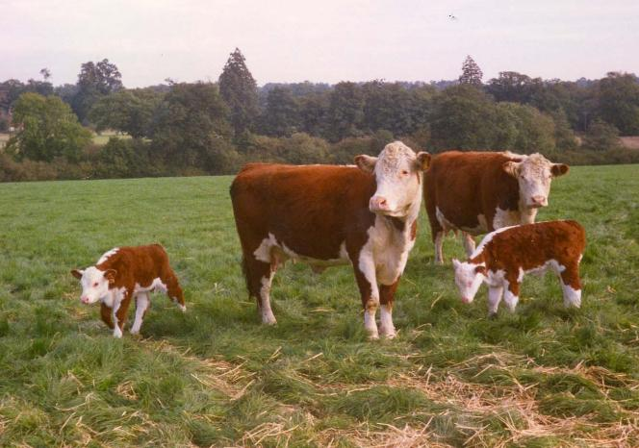
Breeds of cattle
There are over 10 million cattle (including calves, suckler cows, dairy cows and bulls) in the UK.
There are 34 native breeds of beef cattle, including Aberdeen Angus, Hereford, Shorthorn and South Devon.
We farm breeds of cattle which originate from Europe, such as the Limousin, Charolais and Simmental.
There are 14 rare breeds of cattle. Farmers who keep rare breeds play a vital role in stopping them from becoming endangered or even extinct.

Slide 5
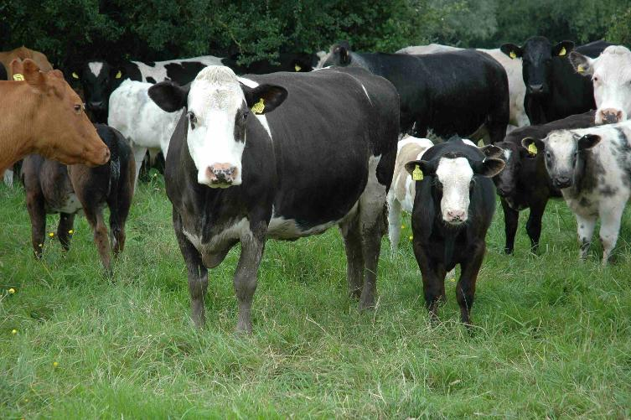
Cattle breeding
Did you know?
One bull will run with about 30-40 cows.
A cow is pregnant for about 285 days and a new born calf weighs 25 to 45 kg. Heifers (young cows) can produce their first calves when they are two years old.
Suckler cows calf in spring or the autumn.
Cows normally give birth to one calf but sometimes twins!

Slide 6
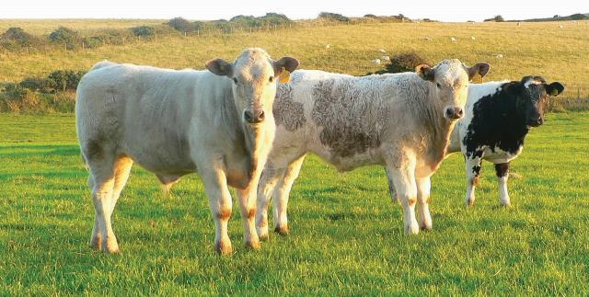
Weaned calves
Calves remain with their mothers for 6‒9 months before being weaned.
Calves are weaned when they no longer require milk from their mother and the majority of their diet is grass.
A weaned calf can weigh 200‒350 kg.
Cattle are ready to be sold for meat once they are adults - they can weigh up to 650 kg!

Slide 7
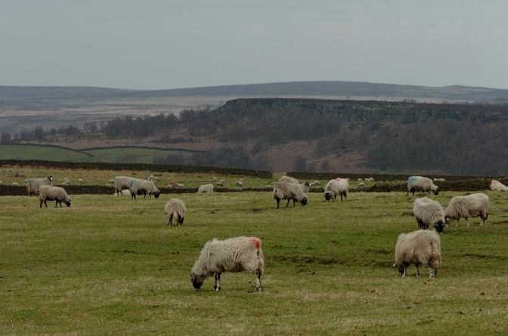
Sheep
Sheep were among the very first animals ever to be domesticated by man.
Some resources suggest that this happened between 9,000 and 11,000 years ago in the Middle East.
Sheep are an essential part of the rural scene.
Wool is now a by-product of sheep farming. Sheep are shorn so they don’t get too hot in the summer.
Sheep are able to survive where no other domestic livestock can and graze hills where no other food sources could be grown.

Slide 8
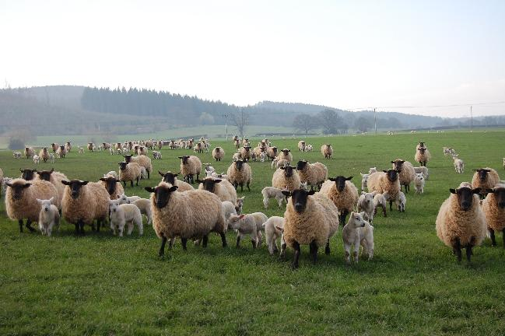
Breeds of sheep
There are 33 million sheep in the UK (including lambs and rams).
The UK has 57 native breeds of sheep, including the Swaledale, Cheviot and Suffolk.
We farm breeds of sheep which originate from Europe, such as the Texel, Charollais and Beltex.
Hill breeds - small, hardy sheep that can live in harsh conditions.
Lowland breeds - bigger, more muscular sheep that live on lower, easier ground and are often farmed where crops are grown.

Slide 9
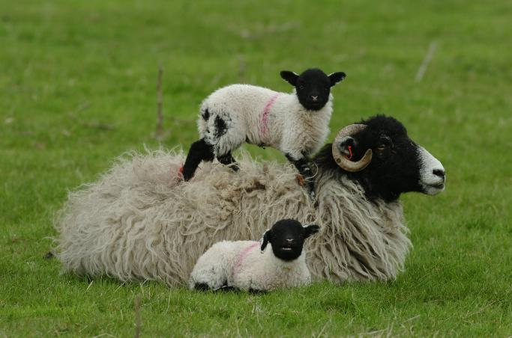
Sheep breeding
Did you know?
One ram (male) can run with up to 70 ewes.
A sheep is pregnant for about 145 days and a new born lamb weighs 3‒5 kg.
Sheep lamb in the spring, although some breeds can lamb out of season such as at Christmas time.
Sheep normally give birth to twins but can have triplets or even quads!

Slide 10
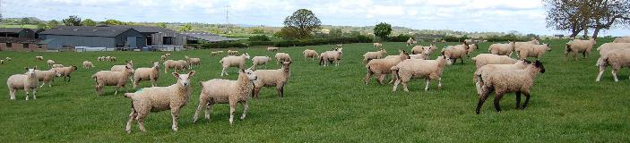
Weaned lambs
Lambs stay with their mothers for 12‒16 weeks before being weaned.
Lambs are weaned when they no longer require milk from their mother and the majority of their diet is grass.
A weaned lamb can weigh 20‒38 kg.
Sheep are ready to be sold for meat once they are 38-40 kg and well-grown.

Slide 11
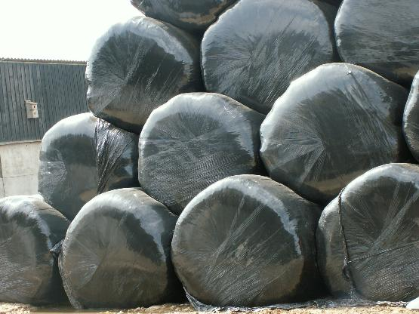
Feeding cattle and sheep
Did you know?
Cattle and sheep are ruminants - they have one stomach with four compartments.
They are able to eat grass and other plants as their primary food source.
Silage and hay are forms of conserved grass. Farmers cut the grass in the spring and summer and bale it up to feed in the winter when grass growth has slowed down.

Slide 12
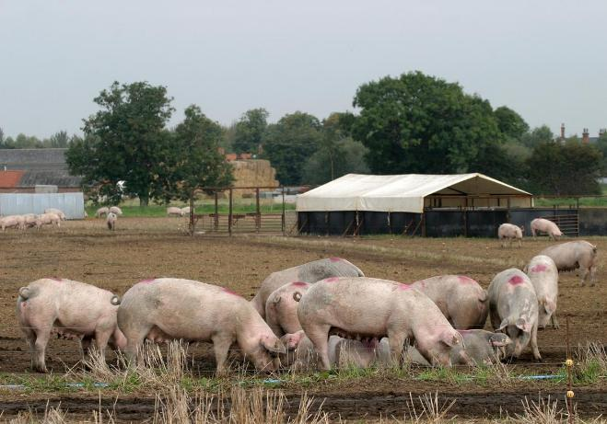
Pigs
Today's pig industry has been influenced by 6000 years of history.
From the start pigs were bred to consume waste products, fertilise the land and provide essential meat.
Both the Greeks and Romans ate pork and history books refer to ‘swine’ being kept as early as 800BC.
At one time most people in Britain would have kept a pig. Now days, pigs are generally reared on specialised pig farms.

Slide 13
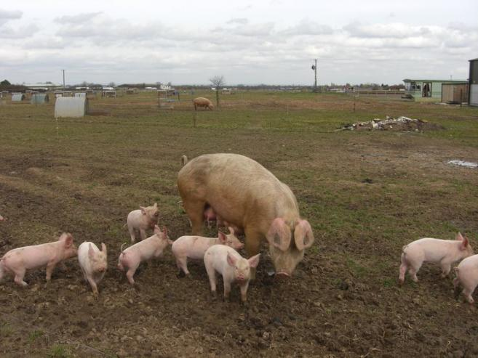
Pig breeding
Did you know?
The boar (male) or artificial insemination (AI) is used to get the sow pregnant – AI is done when the sow is ready to be mated and this is not a painful process.
A sow is pregnant for three months, three weeks and three days and a newborn piglet weighs around 1 kg!
Sows will give birth to 10-12 piglets each time.
On average each sow will have six litters in her lifetime.

Slide 14
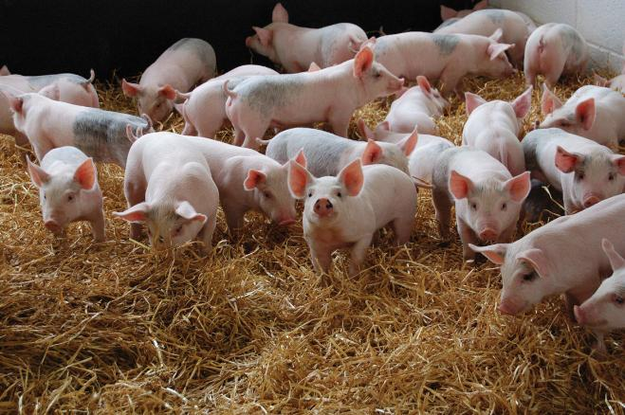
Weaned pigs
Piglets stay with their mother for four weeks before being weaned.
These piglets are now called weaner pigs.
A piglet can weigh 7 kg at weaning.
Pigs are ready to be sold for meat once they weigh 70‒110 kg.

Slide 15
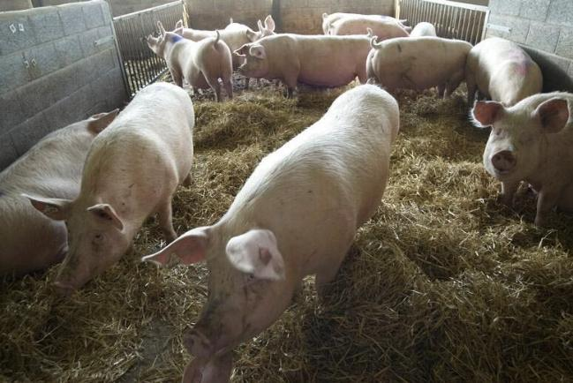
Feeding pigs
Adult pigs eat a mixed diet containing barley, wheat, corn and soya bean meal which provides them with protein and carbohydrates.
Their diet is supplemented with vitamins and minerals.
Outdoor sows are fed a similar feed but as a dry pellet.
Pigs are also fed the waste products from milk, distilleries and bakers.
It is essential that there is no meat in the waste products as this can spread disease.

Slide 16
Did you know?
For further information, go to:
www.foodafactoflife.org.uk

