Slide 1
Introduction to Sensory science

Slide 2

Introduction to sensory science
This presentation will cover the following:
The five basic senses
Why we use sensory evaluation on foods
The main types of tests used for sensory evaluation
Your teacher will be able to provide you with all the materials you need to perform these tests in the classroom.

Slide 3
Contents
Click the links on the right to jump to each topic
The senses
Sensory evaluation
Sensory tests
Key terms and definitions
Teacher’s guide

Slide 4

The senses
We have five basic senses that can tell us about the food that we cook and eat.
They are:
Taste
Hearing
Smell
Touch
Sight

Slide 5
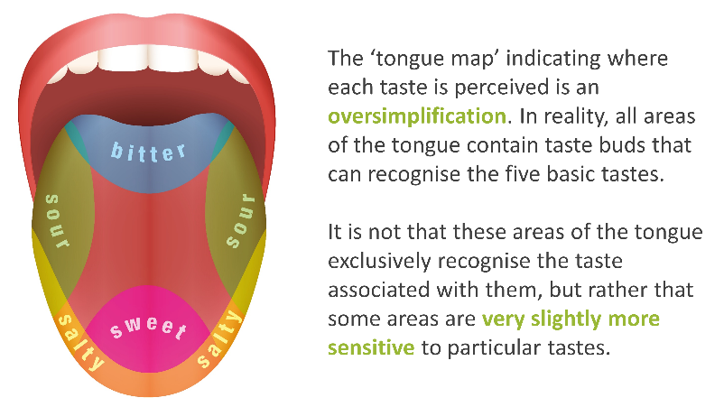
Taste
Our sense of taste is derived from the many thousands of taste buds that we have in our mouths.
Each taste bud can have between 50 and 100 taste receptors.
When certain molecules in foods come into contact with the right receptors, this sends a signal to our brain, which interprets the taste.

Slide 6
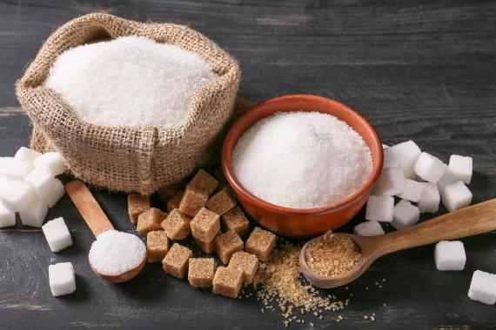
Sweet tastes
Sweet tastes are usually associated with carbohydrates (often sugars).
This may have evolved to be an important taste because sweetness can signal the presence of carbohydrate, and therefore energy that we need.
Although sweet tastes usually come from sugars, some other molecules (e.g. artificial sweeteners) may taste sweet, despite not being carbohydrates.

Slide 7
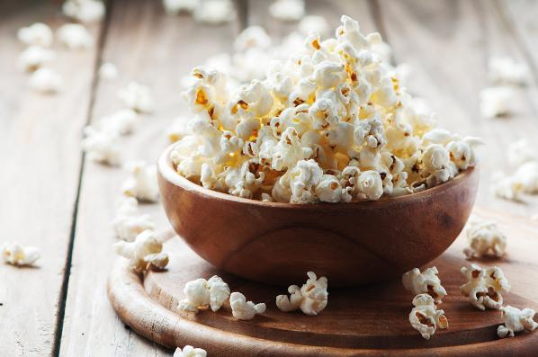
Salty tastes
Salty tastes are usually caused by sodium. Salt, as we know it in food, is sodium chloride.
When we eat salt, the sodium and chloride separate. The sodium can then enter a taste receptor and trigger a salty taste in our brain.
Some other compounds can trigger a salty taste, such as potassium chloride. This is sometimes used to reduce the amount of salt in foods.

Slide 8
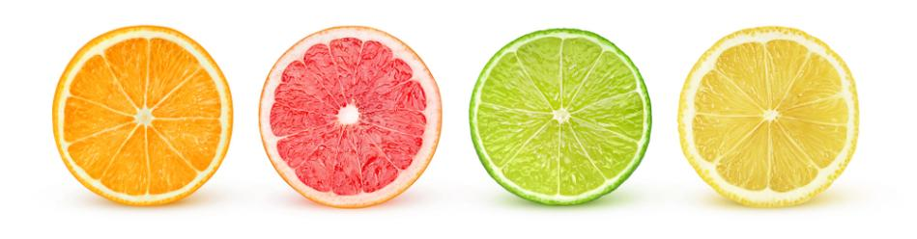
Sour tastes
Sour tastes are caused by foods that contain acids.
The mechanism for sour tastes is not as well understood as that of sweet taste.
High concentrations of sour tastes may be unpleasant, but in small amounts, they can be pleasant and can bring out other flavours in foods.

Slide 9
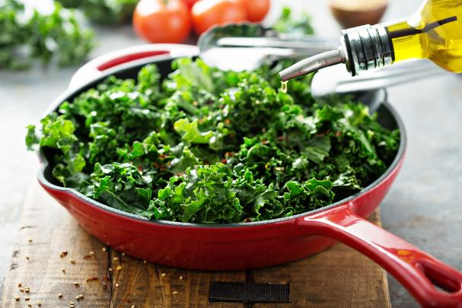
Bitter tastes
Bitter tastes are often considered unpleasant. This may be because many substances that are toxic to humans are bitter in taste and are therefore to be avoided.
However, there are some foods with bitter tastes that some people enjoy. A number of green vegetables contain compounds with a bitter taste.
This is why younger children may struggle with these foods, because they perceive bitter tastes more strongly.

Slide 10
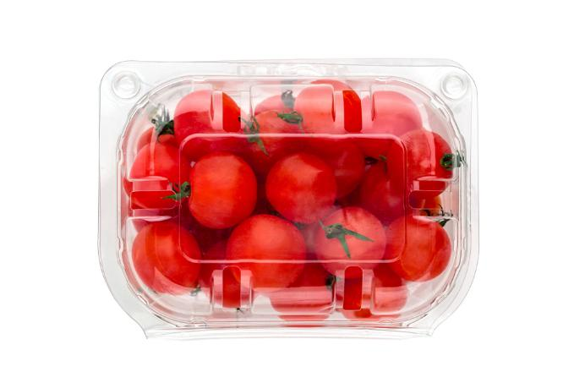
Umami tastes
Umami was the most recently discovered taste.
In 1908, Dr Kikunae Ikeda, a Japanese scientist, was researching ‘dashi’, a traditional stock used in Japanese cooking.
He identified a ‘savoury’ taste, that we now know as umami.
Umami is present in a number of foods, including tomatoes, meats and parmesan cheese.

Slide 11
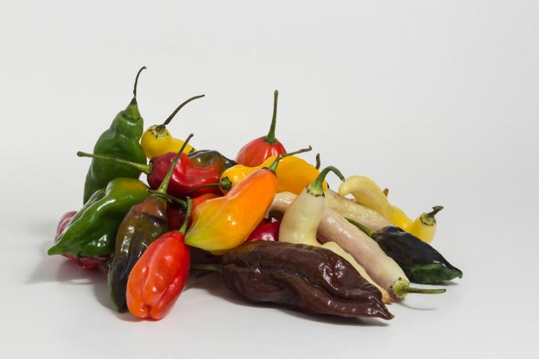
Chemesthesis (hot and cold)
Some compounds in foods can trigger receptors in our mouths other than the taste receptors.
For example, capsaicin, found in hot chilli peppers, triggers a response in pain receptors, creating a feeling of ‘hotness’.
Some compounds can also make the mouth feel cooler (e.g. menthol, found in some gums and sweets).
These are not true tastes but are physical responses from other receptors in the mouth.

Slide 12
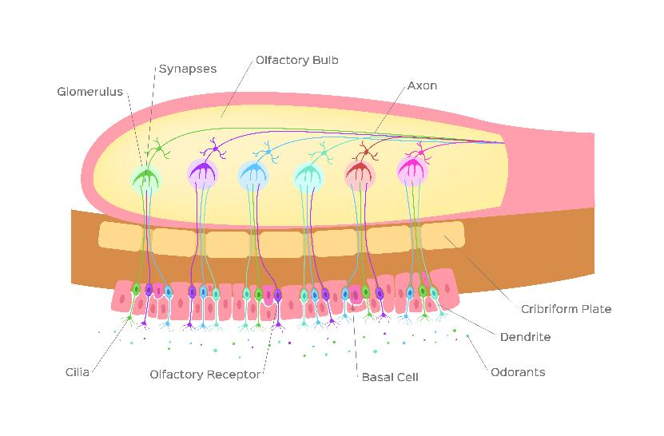
Smell
Our sense of smell is important for identifying whether we want to eat a food or not.
An appetising aroma can stimulate the production of saliva and induce hunger, whilst an unappetising smell can warn us not to eat a food that may have gone off.
In order to smell a food, an odourant (particle that we can smell) enters through the nostril and comes into contact with an ‘olfactory receptor’.
A signal is then passed from this receptor to the brain, where the smell is identified.

Slide 13

Taste + smell = flavour
The combination of smell and taste creates the perception of a ‘flavour’.
On its own, taste can detect whether something is sweet, salty, sour, bitter or umami, but smell is needed for a more complex understanding of what the food is.

Slide 14
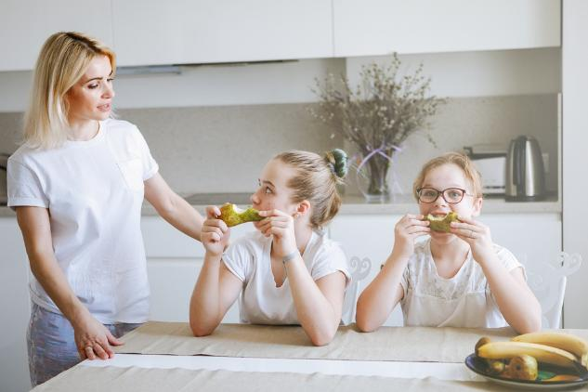
Flavour experiment
Use this experiment to understand how flavour is created as a combination of taste and smell:
Eat a small sample of pear, while holding your nose.
After you start chewing the pear, release your nose. The flavour should suddenly become more noticeable.
Repeat with different foods, such as ginger biscuits or raspberries.

Slide 15
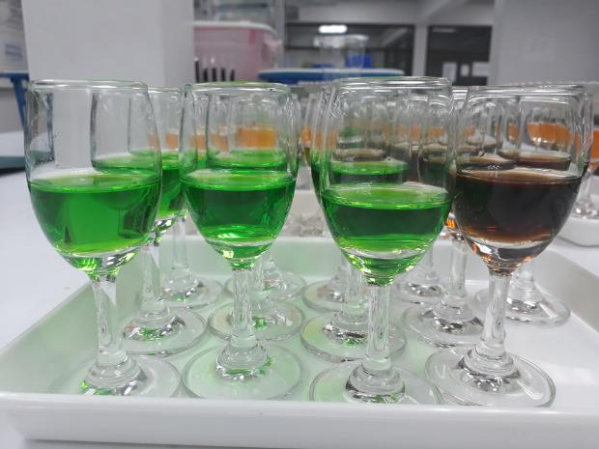
Sight
Looking at a food, we can form an opinion on what the food might smell, taste, or feel like.
When we have eaten certain foods before, we can imagine how the food should taste if we see it a second time.
Experiments have shown that dying juices different colours can make it more difficult to identify their flavours, because the brain expects a different kind of flavour based on the colour of the drink.
What kind of flavours would you expect these drinks to have?

Slide 16
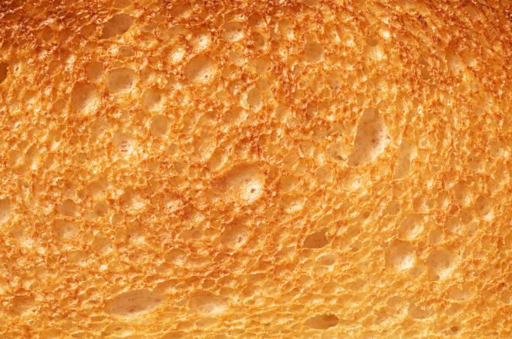
Touch and texture
The texture (or mouthfeel) of a food can play an important role in how we perceive it.
For example, consider a slice of bread and a slice of toast. The toast not only smells and tastes different, but it develops a ‘crunchy’ texture and a rougher surface.
Texture can influence flavour by changing how a food feels in the mouth. For example, the fats in foods such as chocolate allow it to coat the mouth, which adds to the eating experience.

Slide 17
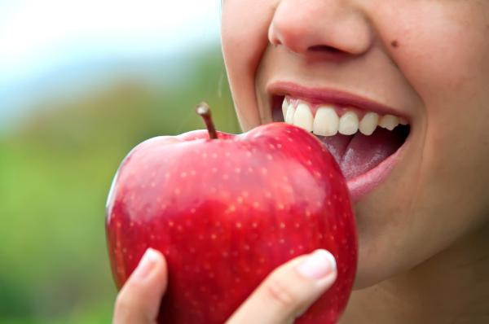
Sound
Although it probably plays a smaller role than the other senses in perceiving food, sound also plays a role in how we perceive food.
For example, the satisfying ‘crunch’ or ‘snap’ when we eat foods like apples, carrots or crisps can add to the eating experience.

Slide 18
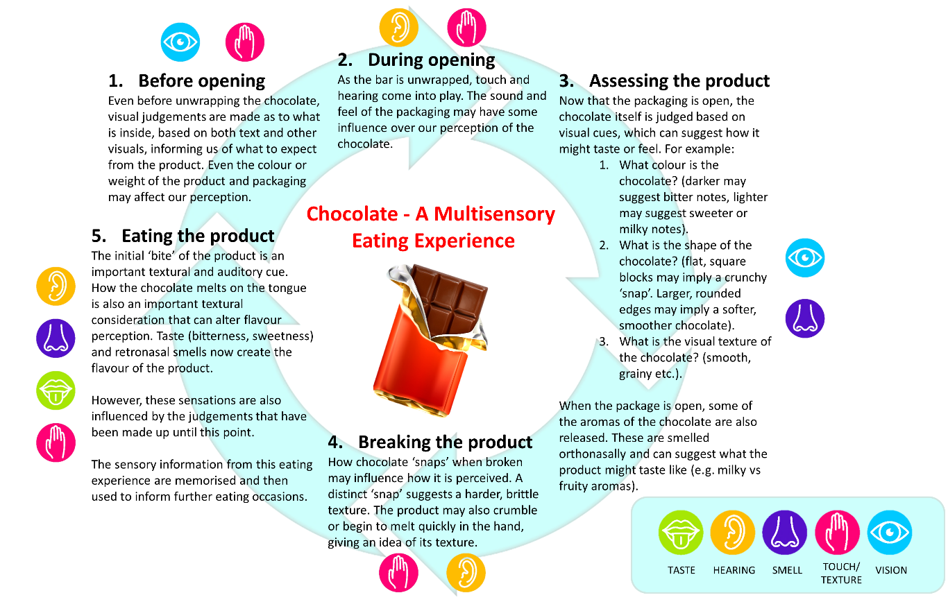
Interactions between the senses (chocolate)
This example shows how all five basic senses interact when consuming a bar of chocolate, from the moment we first see it, to the moment we begin to eat it.

Slide 19
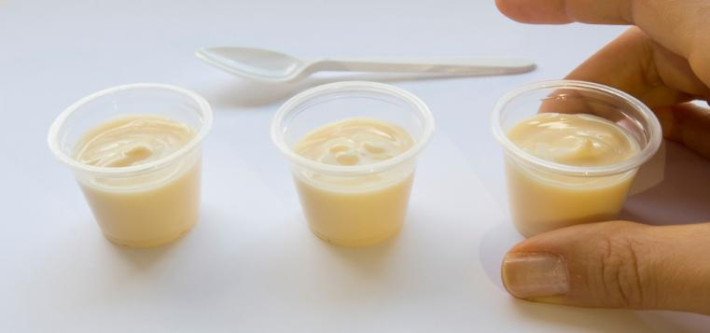
Why use sensory evaluation?
Researchers and food companies use the knowledge of the five basic senses to test and evaluate their products.
In order to understand what a food tastes like, and whether people actually want to eat it, sensory evaluation is used before it is sold to the public.

Slide 20
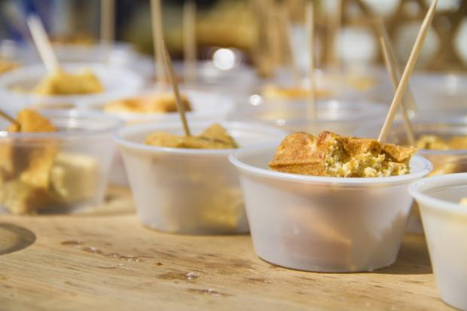
Why use sensory evaluation? (continued)
Sensory evaluation is used to measure two things:
The objective information about a food or drink (e.g., level of saltiness, sweetness)
The subjective opinions about the food or drink (e.g., how much the food is liked or disliked or if it is too salty, too sweet etc.)
Different types of tests are used to obtain this information, and they may be adapted differently to suit different types of food.

Slide 21
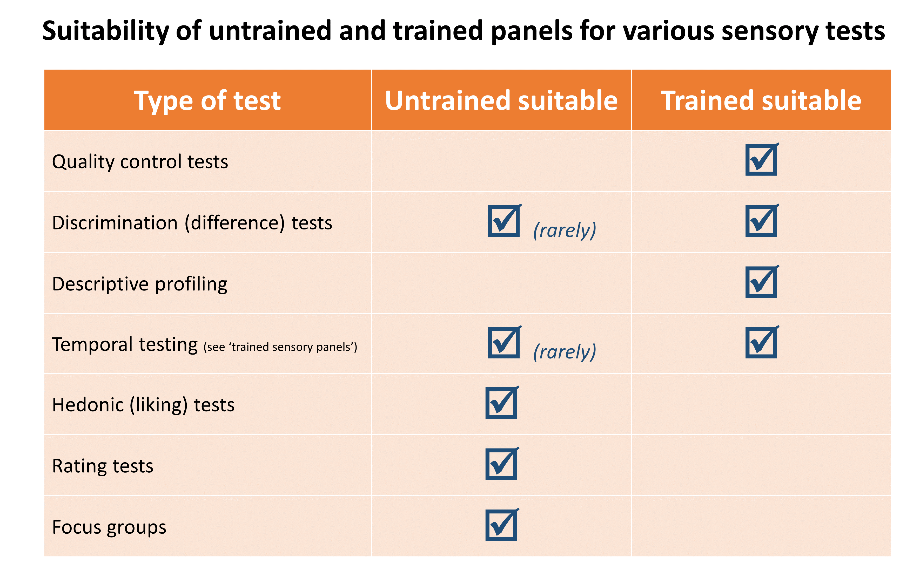
Sensory panels
In order to get the information about a particular food, a sensory panel is required.
A sensory panel could be a team of trained or untrained individuals.
A trained panel is usually used to measure the ‘objective’ information about the food, whilst an untrained panel is usually used to see if they ‘like or dislike’ the food.

Slide 22
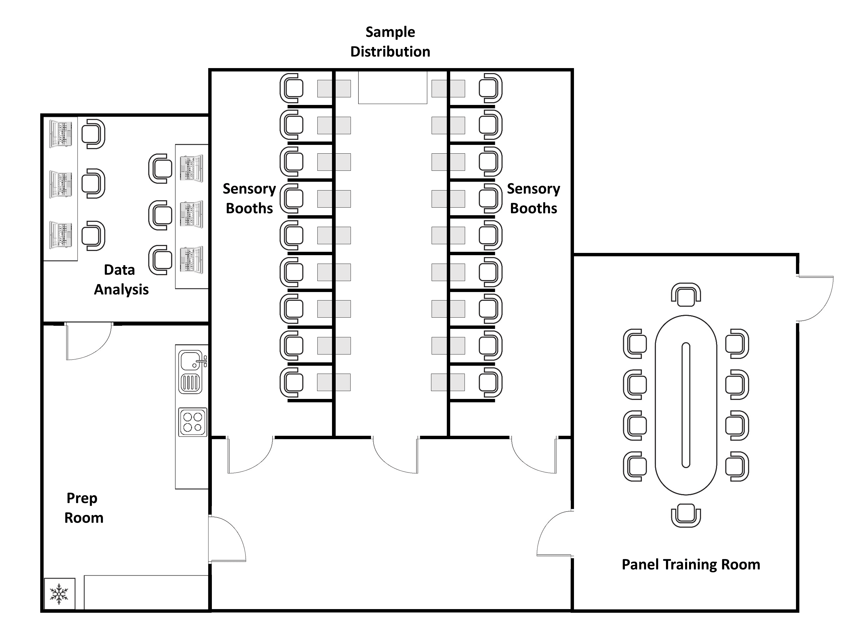
Sensory lab layout
Panellists undertake any relevant training in the panel training room, before entering individual sensory booths. These booths have controlled temperature and lighting, and prevent panellists from seeing each other. Booths will often contain a computer as a convenient way to quickly record results.
Meanwhile, researchers or staff prepare samples in the prep room. These samples are brought into a sample distribution room which is hidden from panellists to reduce bias and distractions, where the samples are organised and presented through hatches (grey rectangles on plan). The hatches are designed to prevent panellists from seeing any preparation which might bias them. The feedback from panellists is then analysed by the researchers in a data analysis room.

Slide 23
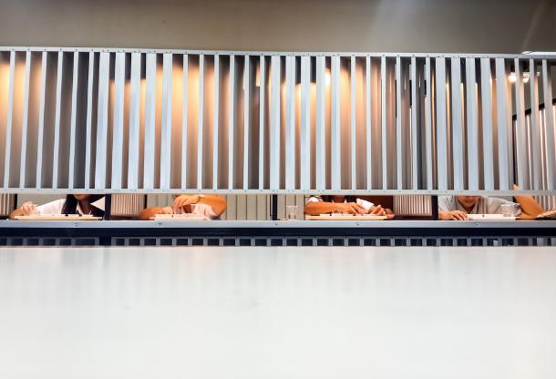
Trained sensory panels
Trained sensory panels are not used for ‘liking’ tests, as they will have a bias from their increased knowledge and experience.
Instead, they are selected and trained to identify differences between products, or to identify different attributes of a food.
These panels typically:
perform quality checks
detect differences between products
provide detailed descriptions of a food

Slide 24
Running a sensory test
When arranging a sensory test, it is important to reduce the risk of bias. To do this, precautions are often taken, such as:
not allowing tasters to talk to each other during the test
serving samples in identical containers, without any written information
providing water and a neutral food (e.g. crackers) to cleanse the palate between samples
making sure the testing area is clean and free of distracting odours.

Slide 25
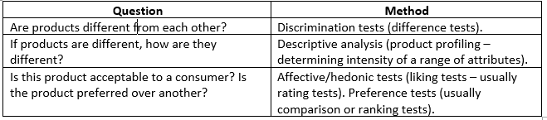
Different types of sensory tests
In this section, we will look at different kinds of sensory tests that can be used to find out about foods.
There are three different types of test that will be used:
Discrimination tests
Descriptive analysis
Affective/hedonic tests

Slide 26
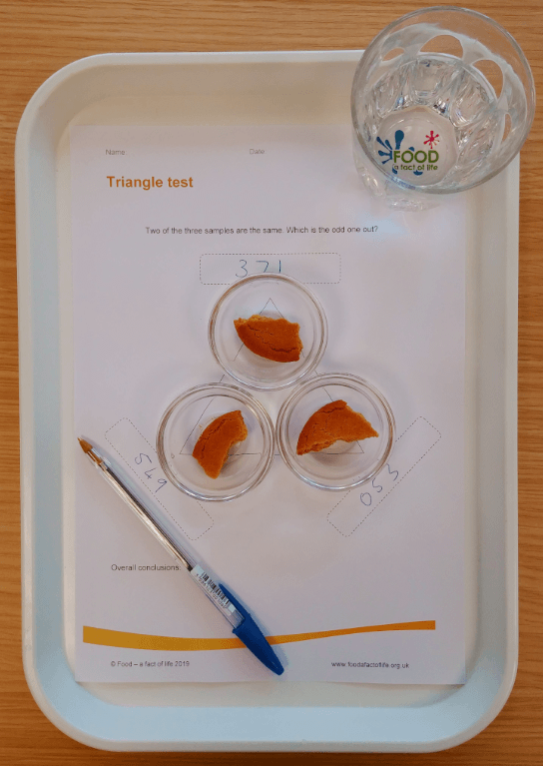
Discrimination tests
Discrimination tests are tests that are to do with telling the difference between samples.
For some foods, it can be beneficial if the food tastes different (e.g., when competing with a product from another manufacturer) or the same (e.g., when reformulating a food to reduce sugar, salt, fat).
Common discrimination tests include:
Triangle tests
Duo-trio tests
Paired comparison tests*
*paired comparison tests can also be used as an affective/hedonic test

Slide 27

Descriptive analysis
Descriptive analysis (or product profiling) is a more in depth look at attributes of one or more foods.
Aspects of the food’s appearance, aroma, flavour and texture may be taken into account.
Panellists will agree on words to use during profiling, and will then rate these on a previously agreed scale (e.g., 1 to 10)

Slide 28

Affective tests
Affective (or hedonic) tests are often called ‘liking tests’.
These tests usually involve either ranking tests (rating a food against other, similar foods) or rating tests (where a food is rated on a scale).

Slide 29
Triangle tests
A triangle test is a type of discrimination test.
Three tasting samples are placed in a triangle shape and given to a panellist. Two samples are the same, and one is different.
The panellist tastes all three samples and then tries to identify which sample is different.

Slide 30
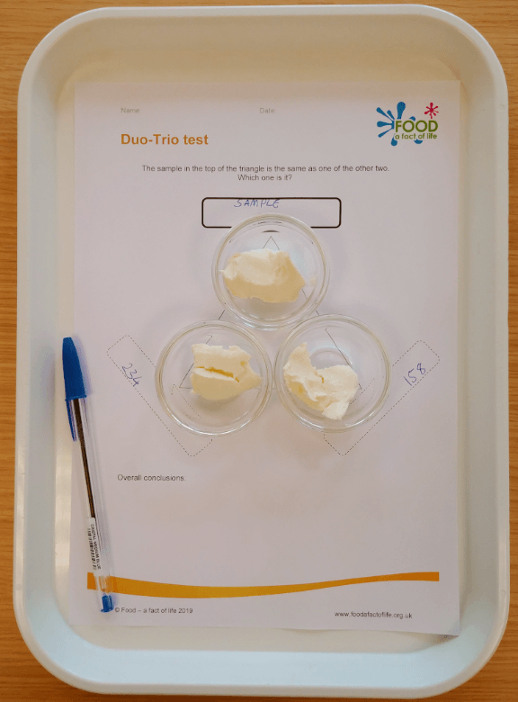
Duo-trio tests
A duo-trio test is similar to a triangle test, except that the sample at the top of the triangle is a ‘reference’ sample food.
One of the other two samples is identical to the reference sample, and one is not.
The panellist should try to recognise which of the bottom two samples is different to the reference sample.

Slide 31
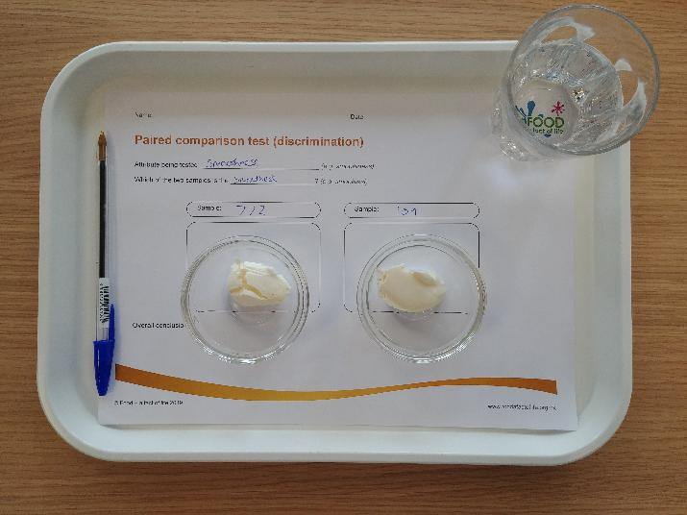
Paired comparison tests
Paired comparison tests can be either discrimination or affective tests.
A paired discrimination test involves two samples and an accompanying question (e.g., which of these two samples is sweeter?)
A paired affective test also involves two samples, but the question is about which sample is preferred over the other.

Slide 32
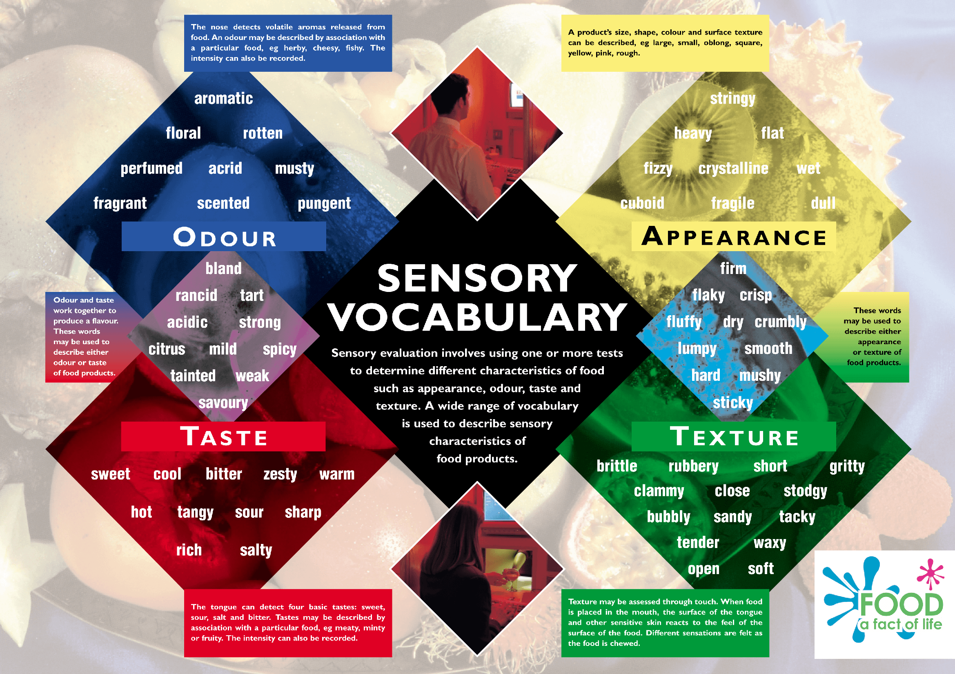
Descriptive analysis tests
Descriptive analysis tests are designed to assign and rate a number of ‘sensory attributes’ of a food. This is usually done in four steps:
The panel holds a session where they create a ‘sensory vocabulary’ of agreed words to describe the food.
A reference is set against each of the words the panellists have agreed upon.
The main testing takes place. Panellists are now separated to taste the product and rate each of the words in their sensory vocabulary.
Finally, the results are interpreted (usually using a computer) and charts and analyses are created.

Slide 33
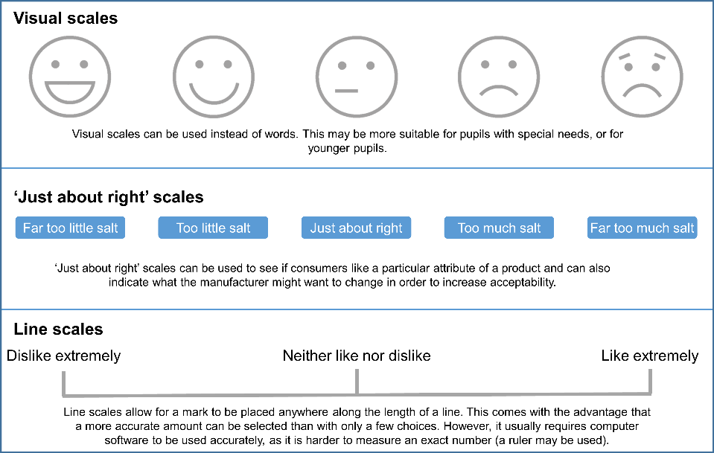
Rating tests
Rating tests usually use a ‘hedonic scale’, which uses descriptive language,
for example:
Like very much
Like slightly
Neither like nor dislike
Dislike slightly
Dislike very much
You can see more examples of different scales in the image to the right.

Slide 34
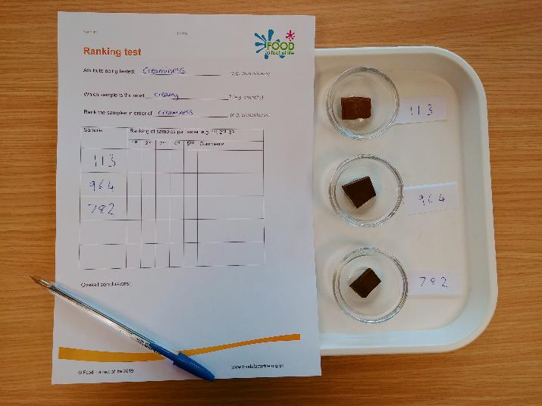
Ranking tests
Ranking tests are used to compare how much a food is liked against other, similar foods.
Comparing two products in this way is essentially the same as a paired preference test.
Ranking tests can also be used to rank foods based on an attribute (e.g., rank these foods in order of sweetness).

Slide 35
Key words
Key word | Meaning
Acid | Any substance that increases the concentration of hydrogen (H+) ions when added to a water solution (pH 1-6).
Affective (hedonic) test | Tests to determine ‘liking’ of a food. Usually rating or ranking tests.
Bias | A bias affects a person’s judgement, or affects data collection, leading to an unfair result to a test.
Capsaicin | A molecule found in chilli peppers, that causes a burning sensation in and around the mouth when eaten.
Carbohydrate | A component of food which includes sugars, fibres, and starches.
Chemesthesis | A response to compounds in food that affect receptors other than taste receptors (e.g. menthol, capsaicin)
Descriptive analysis | A detailed analysis of a food, usually by a trained sensory panel. Assigns vocabulary to a food and then rates these attributes on a scale.

Slide 36
Key words
Key word | Meaning
Discrimination tests | Sensory evaluation tests that aim to determine whether a difference between samples is noticeable, e.g., triangle tests
Duo-trio test | Two different samples are compared to a known reference sample. Panelists are asked to determine which of the other two samples is identical to the reference.
Olfactory receptor | Receptors that detect odours and send signals to the brain to identify aromas.
Paired comparison test | A test that asks a question of two compared products (e.g. which sample is sweeter, or which product do you prefer?)
Ranking test | A comparison of 3 or more samples, which are ranked in order of preference, or in order of a specific attribute.
Rating test | An affective (hedonic) test where samples are rated on a scale (e.g. strongly dislike to strongly like)
Sensory panel | A panel of individuals, that can be trained or untrained, who analyse the sensory attributes of foods.

Slide 37
Key words
Key word | Meaning
Sensory tests | The process of testing food, using the senses to assess the qualities or attributes of food products.
Sodium chloride | The chemical name for table salt.
Taste buds | Clusters of taste receptors and nerve endings that detect the taste of foods.
Taste receptor | Specific types of taste receptors sense different taste (e.g. sour, sweet, salty).
Triangle test | A discrimination test with two identical samples and one different samples. Panelists are asked to determine which sample is the odd one out.

Slide 38
Teachers’ guide

Slide 39
Teaching about sensory science:
Explain how all five senses interact to give us an impression of a food.
Explain what sensory analysis is used for.
Describe the differences between trained and untrained sensory panels.
Describe the different types of sensory test and why/when they are used.
Define the five basic senses.
Explain how taste and smell can combine to produce flavour.

Slide 40
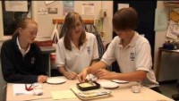
Setting up sensory tests in school
In order for a sensory evaluation to be fair and accurate, the following 6 steps should be followed as closely as is possible:
Decide on the type of test you want to perform – suitable for what you want to find out.
  preference test - asks whether people like or dislike a product (e.g. hedonic scale);
  discrimination test - asks people to describe a particular attribute of a product (e.g. paired comparison test).
Find a clear area to hold the sensory test. Try to make sure that it is away from noise and cooking smells which may distract the people taking part in the test. This can be difficult in a busy classroom. Some schools have created areas within the food room for tasting to be held.

Slide 41

Setting up sensory tests in school - continued
Place as many samples in serving containers as there are people taking part in the test. Code each sample with a random number, letter or symbol.
Check that you have enough glasses of water for the people taking part. This is for tasters to cleanse their palate after tasting each food sample.
Make sure the people taking part know what is expected from them (i.e. they understand which test they are taking and what they have to do).
Ask each person to taste one sample at a time, and record their responses. Allow time between samples so that tasters can record their opinions.

Slide 42
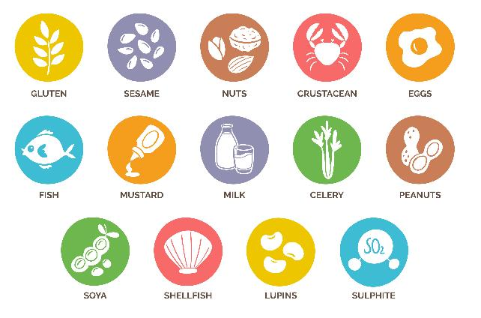
Setting up sensory tests in school - continued
As well as the previous 6 rules, it is important to observe the usual due diligence practices expected when working in a food environment. Proper food storage practices and hygiene rules should be enforced as they would be in any other practical food-based session.
Of particular importance are any allergies that pupils may suffer from. Be sure to check any tasting samples for allergens and have a record of the pupils taking part and any allergies that you should be aware of.

Slide 43
Reducing bias
One important feature of a sensory evaluation test is that bias is not introduced. Therefore, when setting up a sensory test, certain conditions should be met to ensure that this does not occur.
During the test, tasters should not be allowed to talk to each other, as this could distract them or influence their judgement.
Samples should be served in an identical manner, with no way of identifying them.
Any containers or utensils should be uniform and plain.
Water and crackers should be provided to cleanse the palate between samples.
A limit should be placed on the amount of samples given. Too many samples makes it hard for panellists to identify differences.
Any identifiable branding on a product should be removed.
Products should not be named, but randomly coded (often by a 3-digit number or letters).
The tasting space should be clean, but odour free.

Slide 44
Supporting resources – discrimination tests
To help with the test, you can print off copies of the Triangle test worksheet, which will help with placement of the samples and remind pupils of their objective. Then, the Triangle test spreadsheet will allow the results to be automatically calculated and see whether pupil’s identified the ‘odd one out’ correctly.
You can download the Duo-Trio test worksheet, where you can place the samples for pupils to try. The Duo-Trio test spreadsheet will allow the results to be filled in and automatically calculate the percentage of pupils who selected the correct sample.
You can use the Paired comparison test (discrimination) sheet to help you set up this test and the Paired comparison (discrimination) test spreadsheet to fill in and calculate the results.

Slide 45
Supporting resources – descriptive analysis
In a school environment, it is likely to be easier for the teacher to determine what the attributes are that the pupils will measure. Pupils can then rate these attributes on a scale of 0-10, where 0 is undetectable and 10 is extremely intense. You can provide them with copies of the Star chart/diagram worksheet to help them visualise their ratings. For individual pupils, Food – a fact of life also provides spreadsheets where pupils can score up to 3 different products for the same attributes and automatically generate a star chart.
For 1 product, click here. For comparing 2 products, click here. For comparing 3 products, click here.
If you are working with a larger group of pupils and wish to collate their information, there are also worksheets where you can input data for up to 10 pupils and automatically generate a star chart based on their average scores:
Analysis of 1 product
Analysis of 2 products
Analysis of 3 products

Slide 46
Supporting resources – affective tests
You can give the Hedonic scale worksheet to your pupils to measure their liking for up to five samples. You can also use the Hedonic scale spreadsheets to automatically calculate data for your class for either three, four or five products.
You can provide pupils with the Paired comparison test (preference) worksheet and two samples to be compared. You can also use the Paired comparison (preference) spreadsheet to fill in data for up to 10 panellists (pupils).
You can perform a ranking test with pupils by providing them with up to five products and asking them to fill out the Ranking test worksheet. You can record their results in the Ranking test analysis spreadsheet which can be used to rank between two and five products.

Slide 47
Introduction to Sensory science
For further information, go to:
www.foodafactoflife.org.uk
This food science pack is one of a series of resources produced for the pHood Futures project, supported by the Royal Society of Chemistry.
This resource meets the Guidelines for producers and users of school education resources about food.

