Slide 1
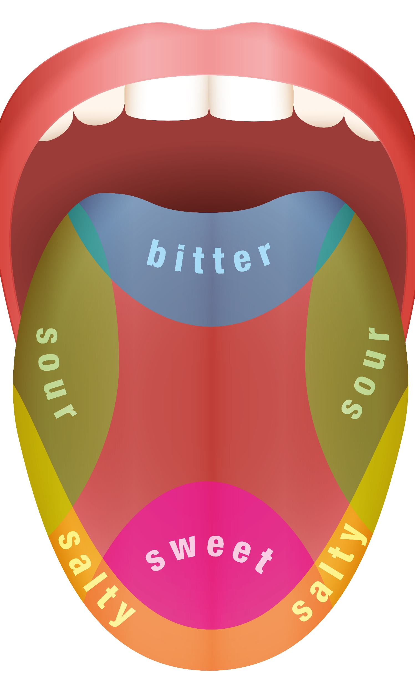
The senses and food

Slide 2

Which senses do we use?
A range of senses are used when eating food.
These senses are:
  sight;
  smell;
  hearing;
  taste;
  touch.
A combination of these senses enables you to evaluate a food.

Slide 3
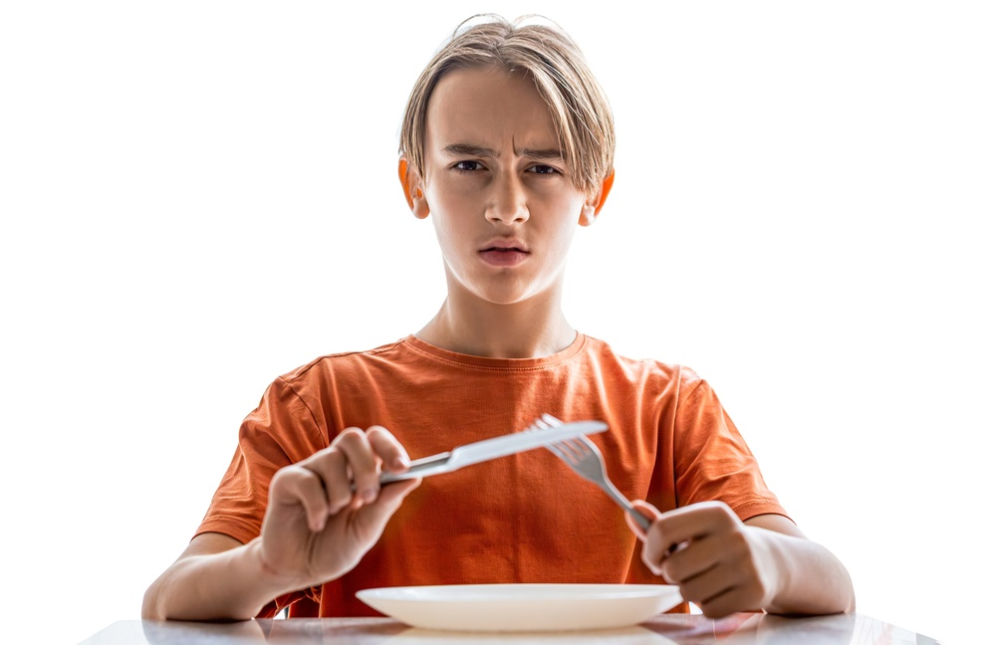
Appearance
The size, shape, colour, temperature and surface texture all play an important part in helping to determine your first reaction to a food.
Often if a food does not look appetising, then you will not eat it.
Appearance is therefore vitally important if you want your food to be eaten and enjoyed.

Slide 4
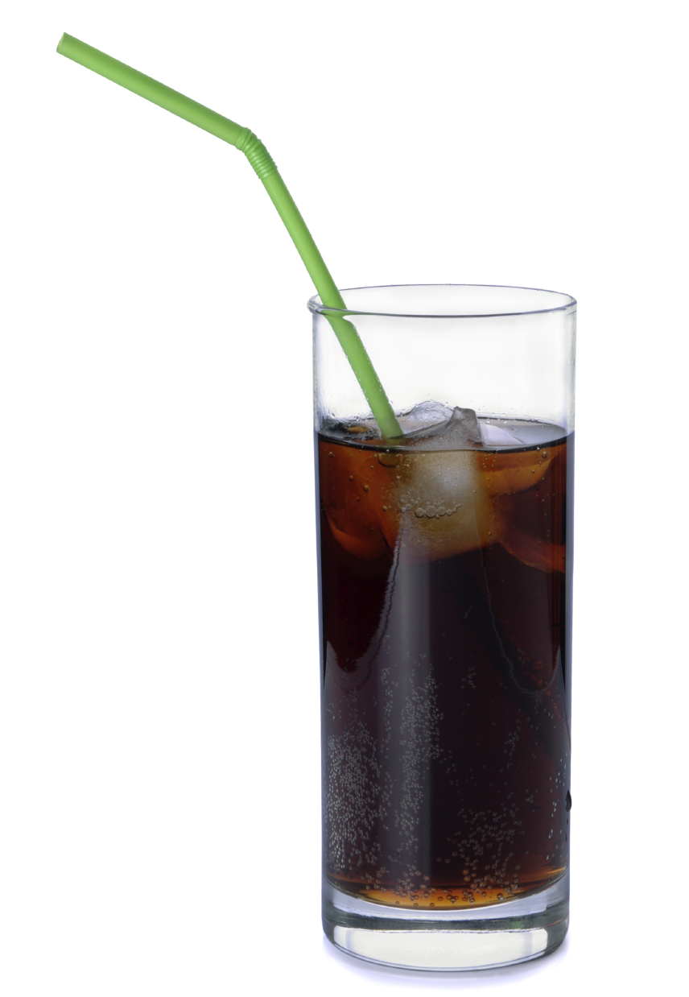
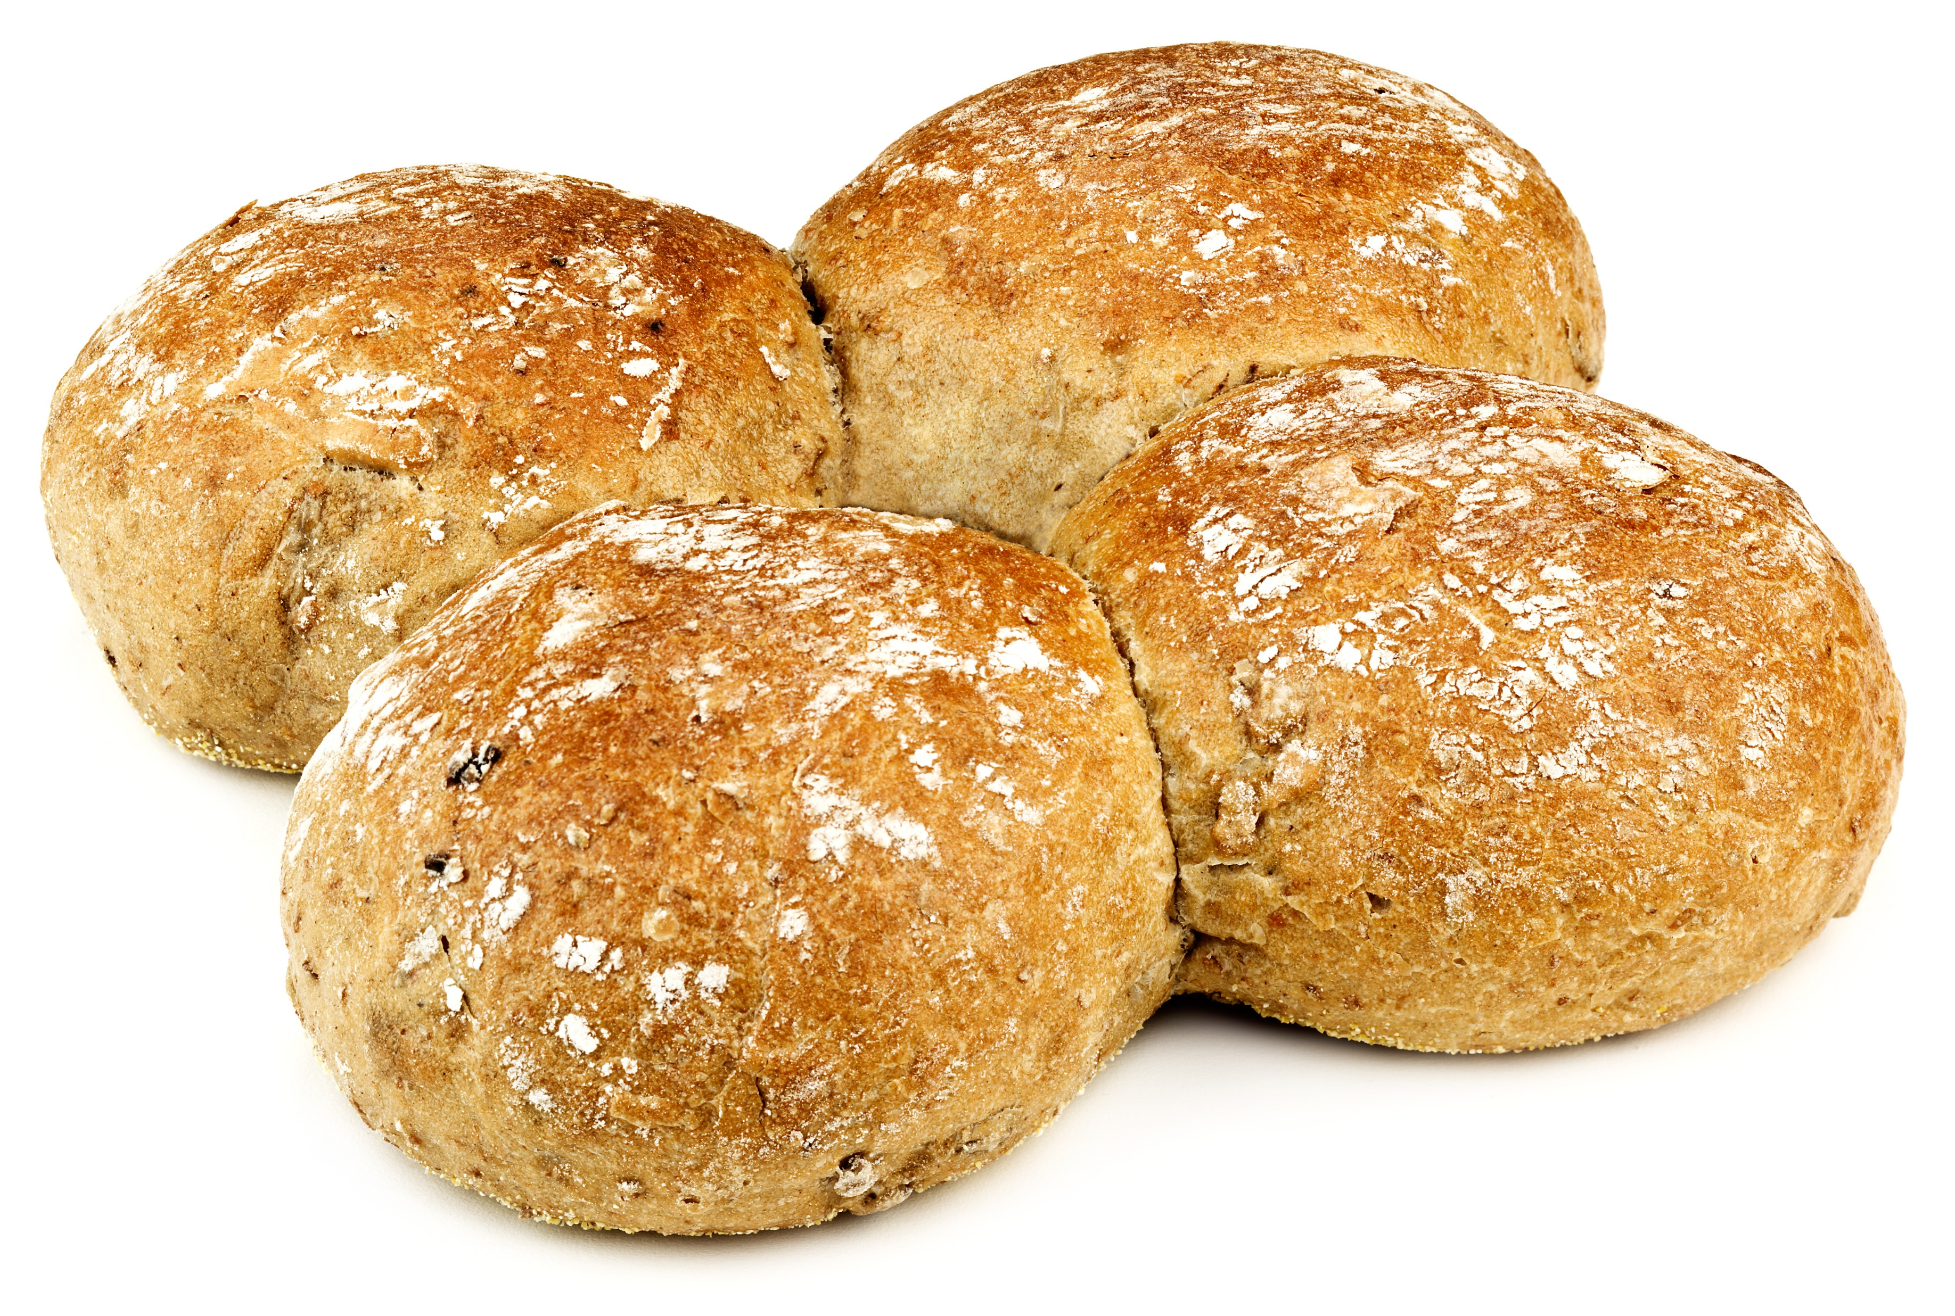
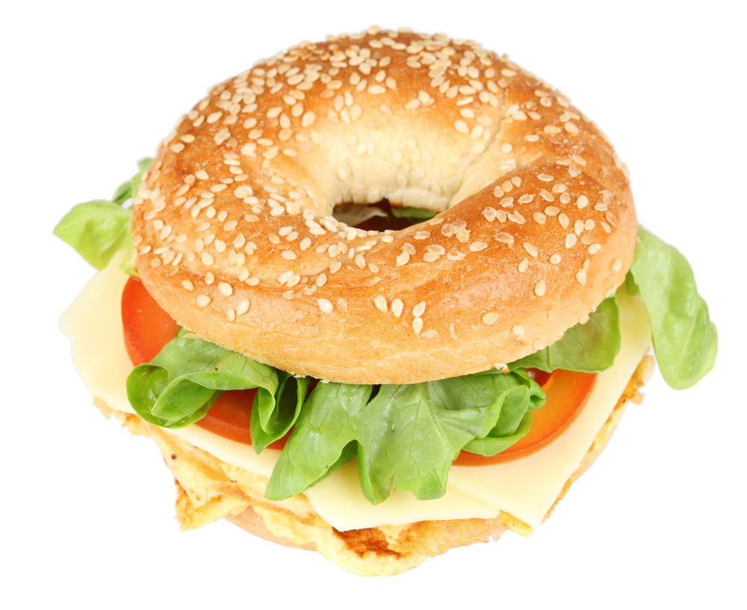
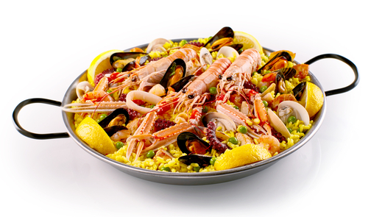
Appearance
Useful words to describe appearance:
What words would you use to describe these foods?
Stringy | Dull | Crystalline
Heavy | Firm | Fragile
Flat | Flaky | Dry
Fizzy | Lumpy | Crumbly
Hard | Smooth | Crisp
Mushy | Sticky | Fluffy

Slide 5

Smell (odour or aroma)
The nose detects volatile aromas released from food. An odour may be described by association with a particular food, e.g. herby, cheesy, fishy. The intensity can also be recorded.
Odour and taste work together to produce flavour. This is the reason why people with a blocked nose find it difficult to determine the flavours of foods.

Slide 6
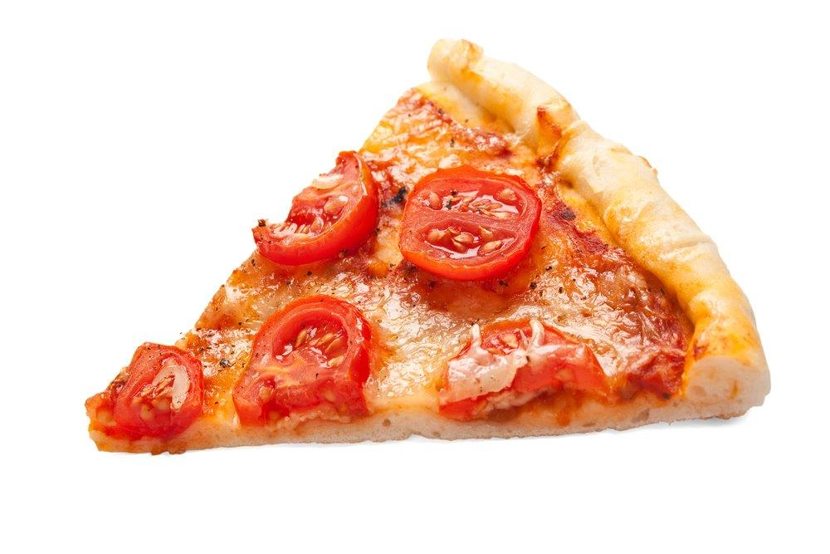
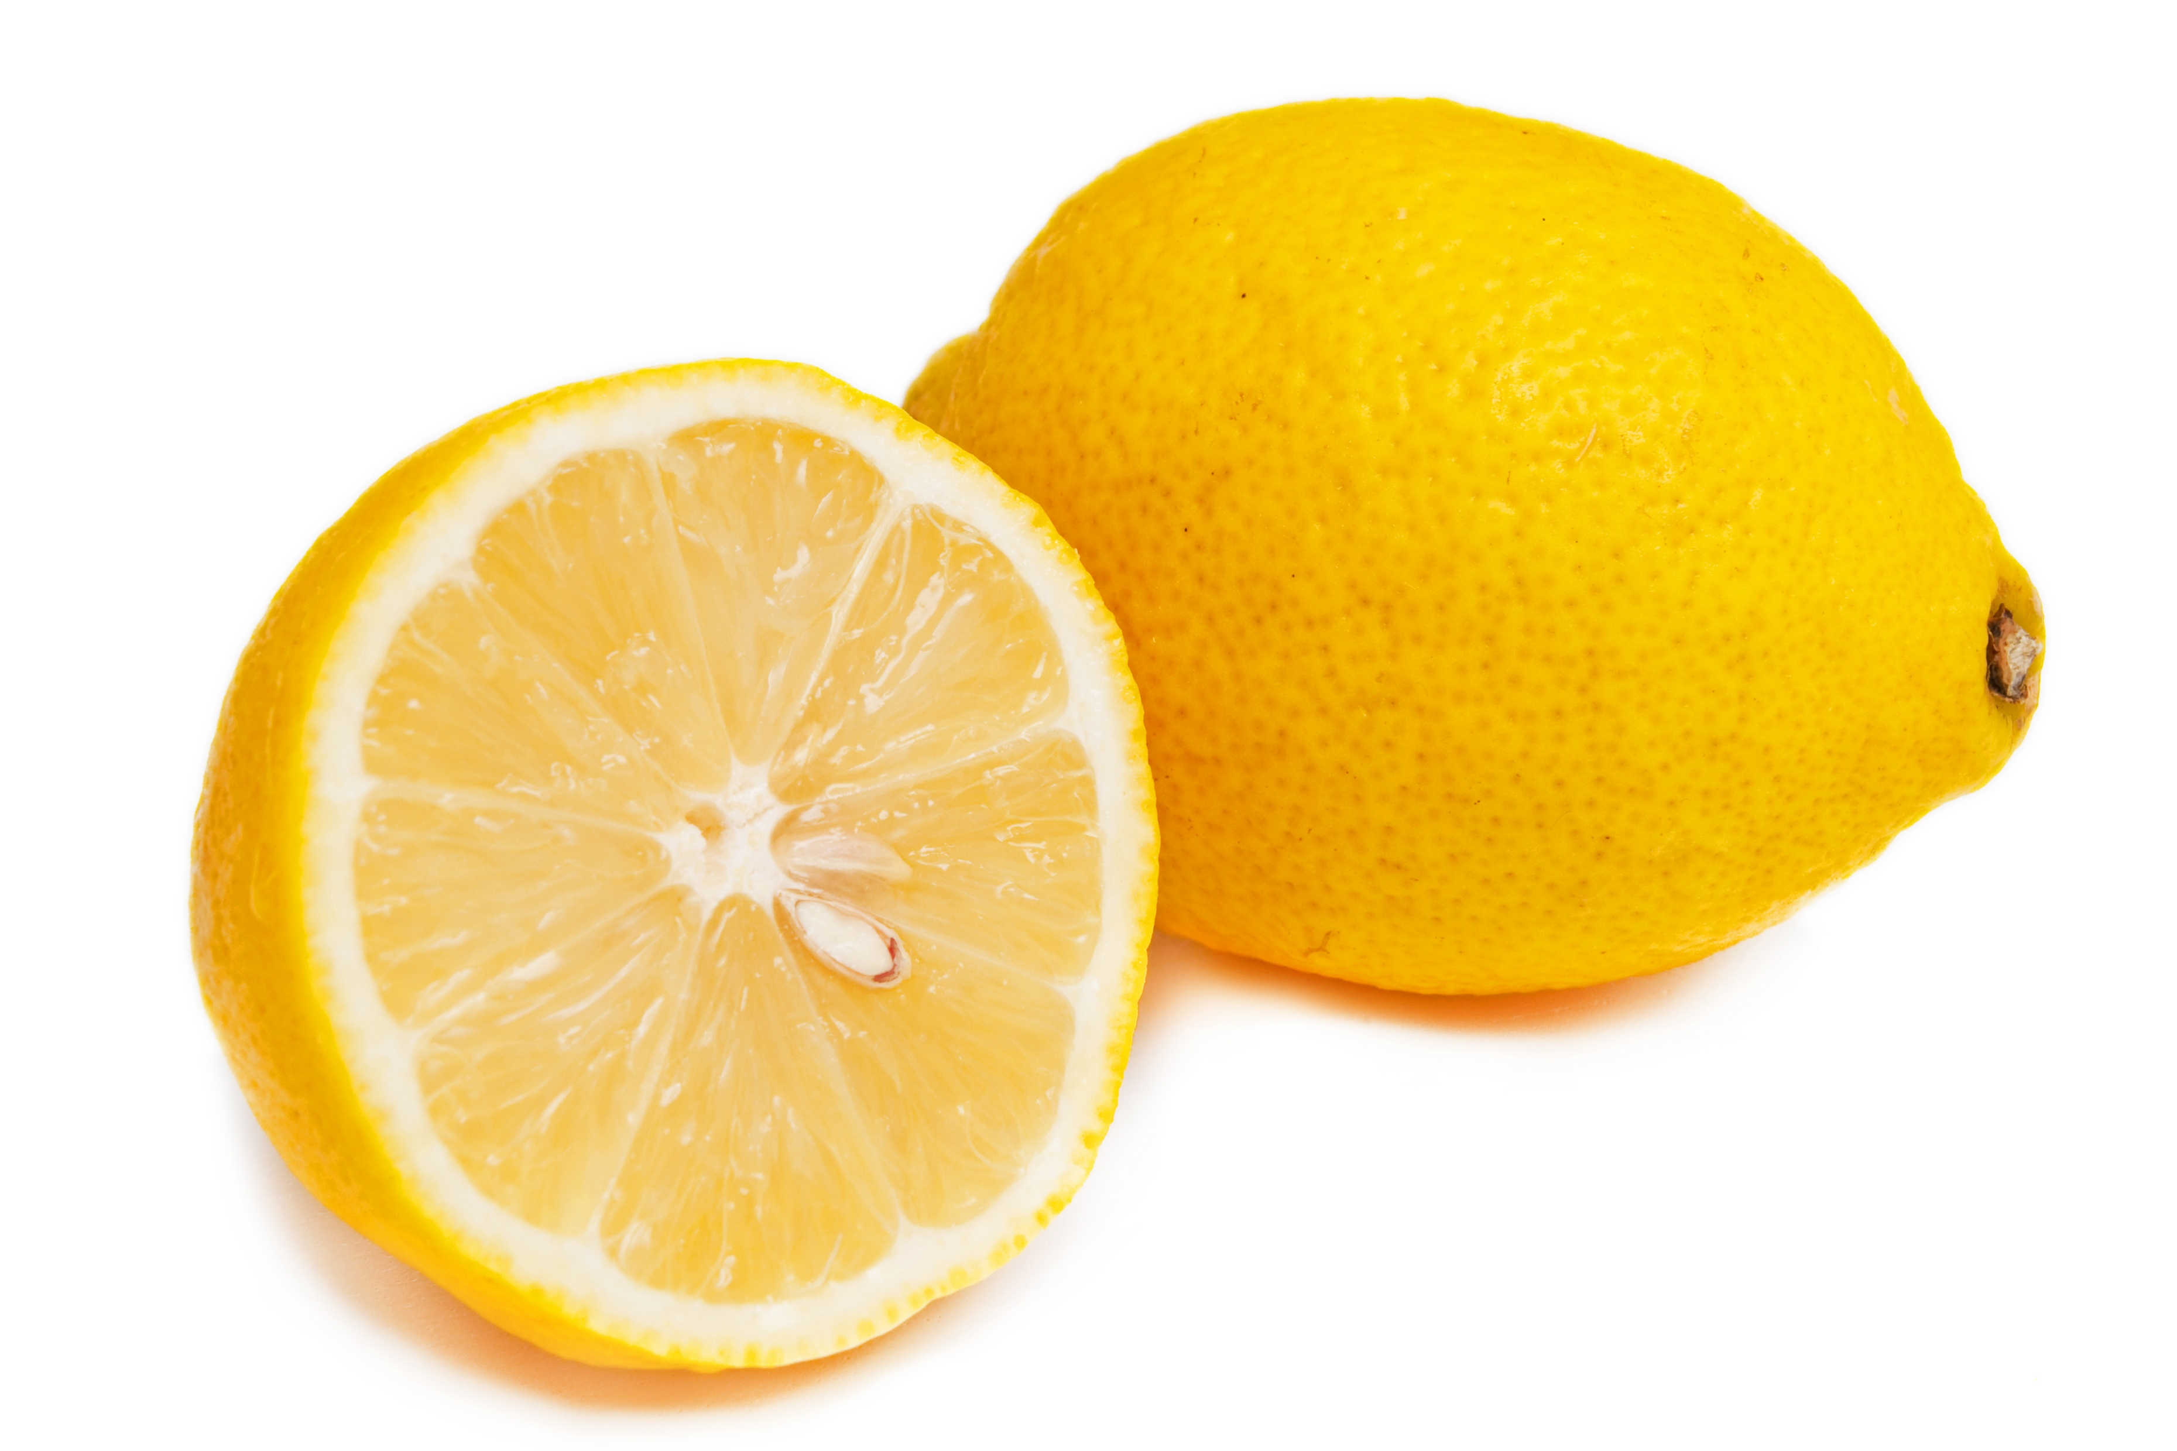
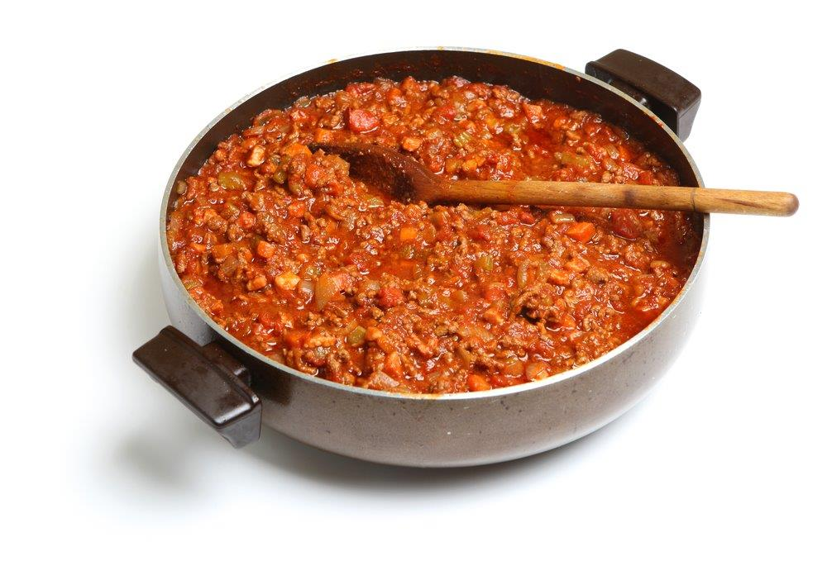
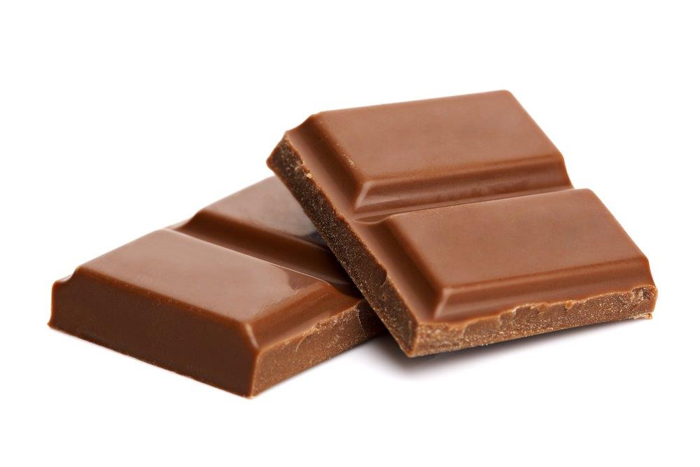
Odour
Useful words to describe odour:
aromatic pungent tart
spicy floral citrus
bland tainted strong
perfumed rancid mild
savoury rotten
What words would you use to describe these foods?

Slide 7
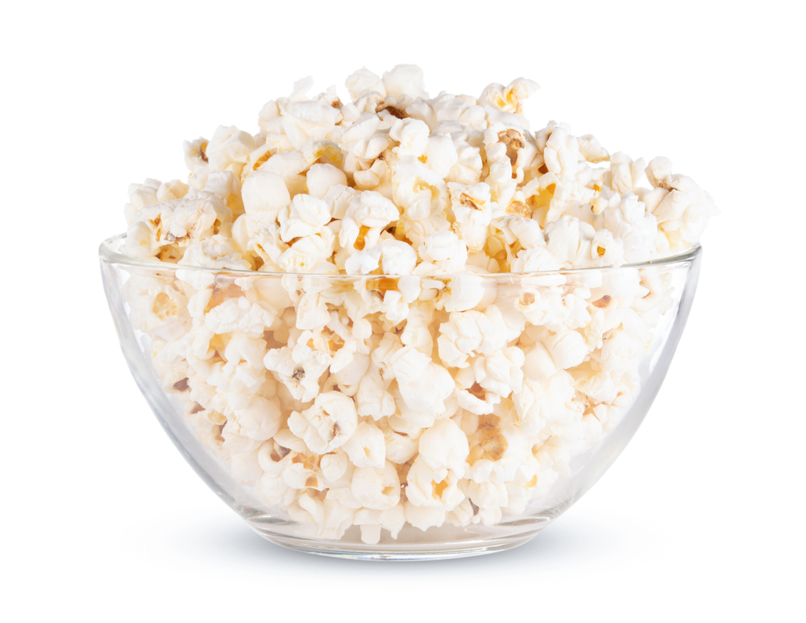
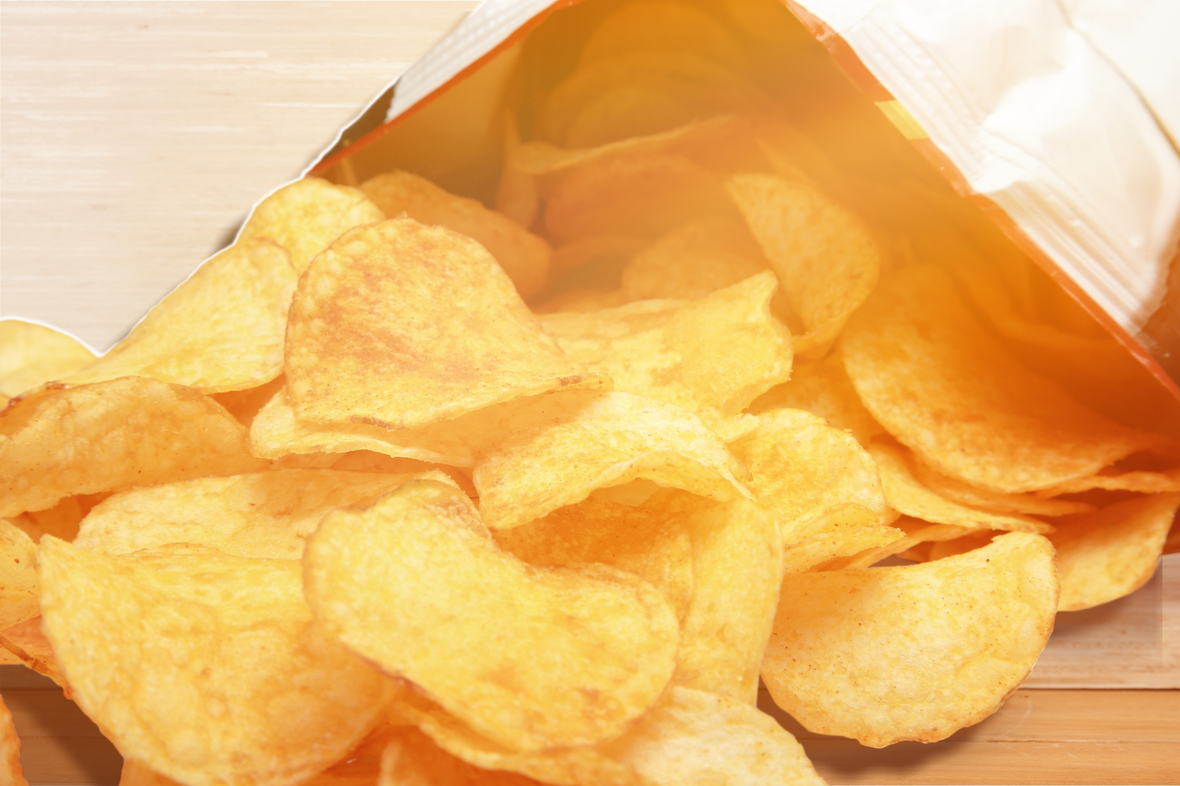
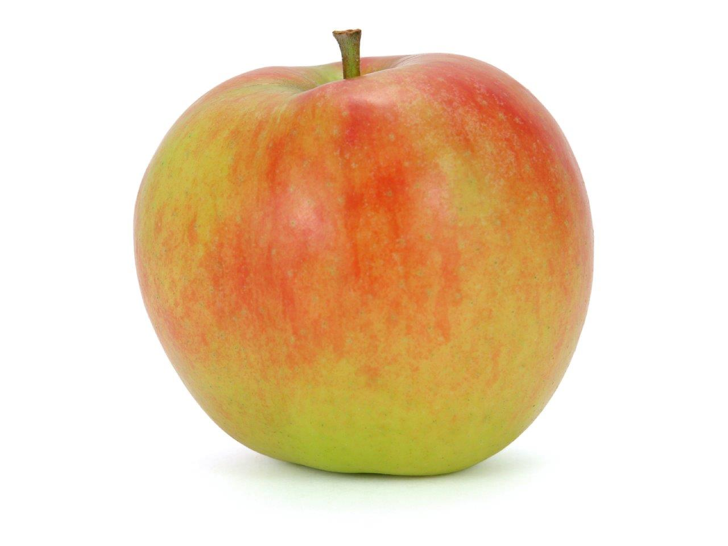
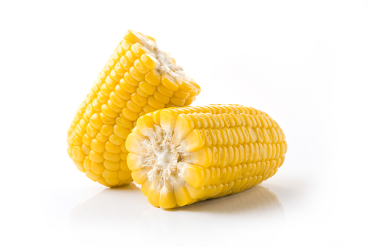
Hearing (sound)
The sounds of food being prepared, cooked, served and eaten all help to influence our preferences.
The sound of eating food can alter our perception of how fresh a food is (e.g. crunchy carrots).
What words would you use to describe these foods?

Slide 8

Taste
The tongue can detect five basic tastes:
bitter;
salt;
sour;
sweet;
umami.
Taste may be described by association with a particular food, e.g. meaty, minty or fruity.
The intensity can also be recorded, e.g. mild or strong Cheddar.

Slide 9
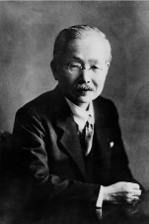
What is umami?
Umami is a savoury taste, often known as the fifth taste. It is a subtle taste and blends well with other tastes.
It was discovered by Dr Kikumae Ikeda, from Tokyo Imperial University, Japan, in 1908. He undertook research into Dashi, a traditional Japanese stock made from kombu (kelp).
Umami has its own distinct savoury taste, often associated with ripe tomatoes, soy sauce and cheese.

Slide 10
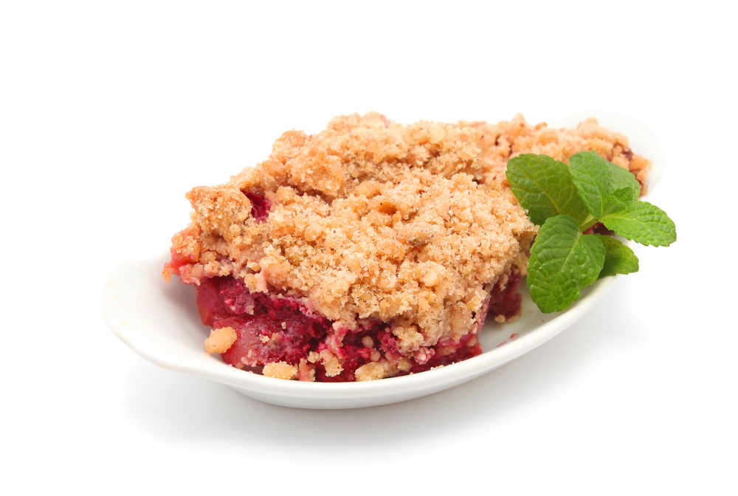
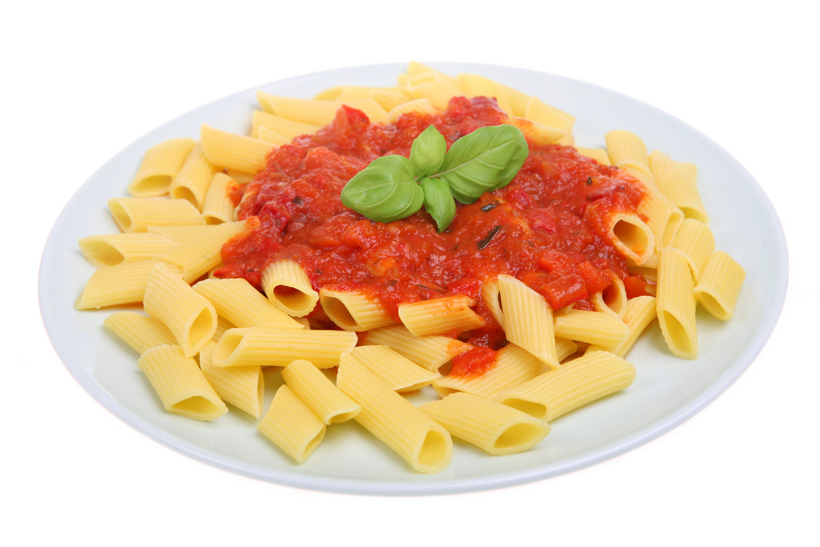
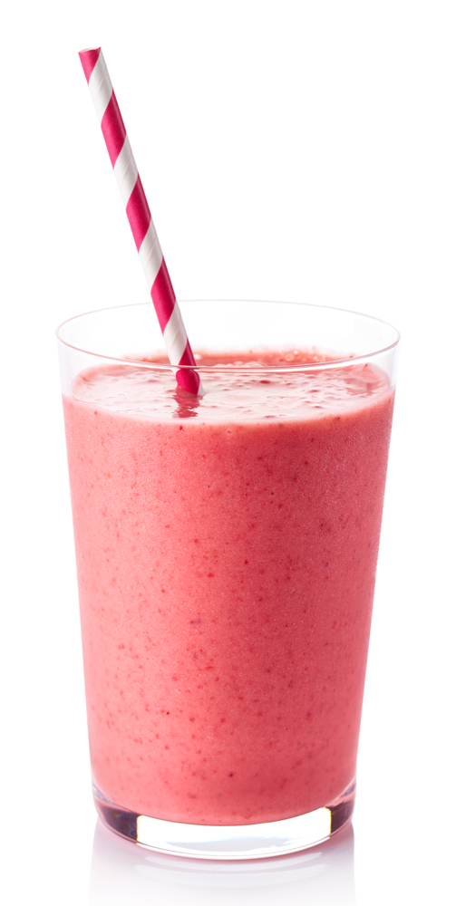
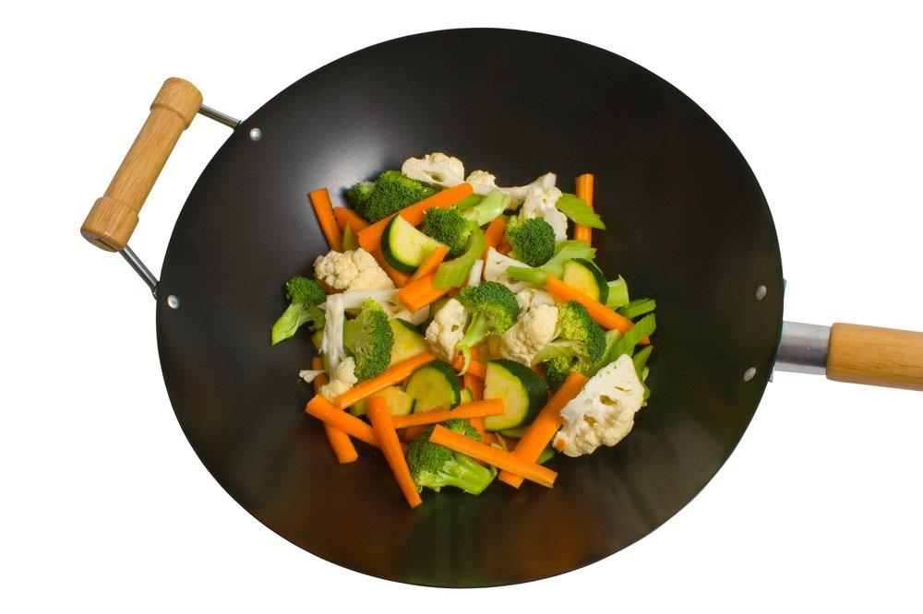
Taste
Useful words to describe taste:
sweet cool bitter
umami zesty warm
hot tangy sour
sharp rich salty
bland rancid tart
acidic strong citrus
mild spicy savoury
tainted weak
What words would you use to describe these foods?

Slide 11

Touch (texture)
Texture can be assessed through touch.
When food is placed in the mouth, the surface of the tongue and other sensitive skin reacts to the feel of the surface of the food. The sensation is also known as mouth-feel.
Different sensations are felt as the food is chewed. The resistance to chewing also affects texture, e.g. chewiness, springiness. The viscosity is also a factor, e.g. runny, thick.
The mouth also detects temperature, which plays an important stimulus, e.g. cold ice cream, warm bread, hot soup.

Slide 12
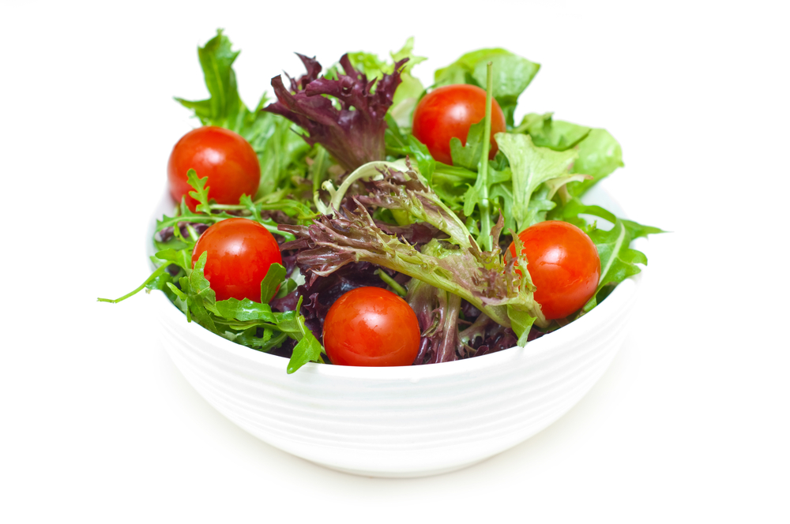
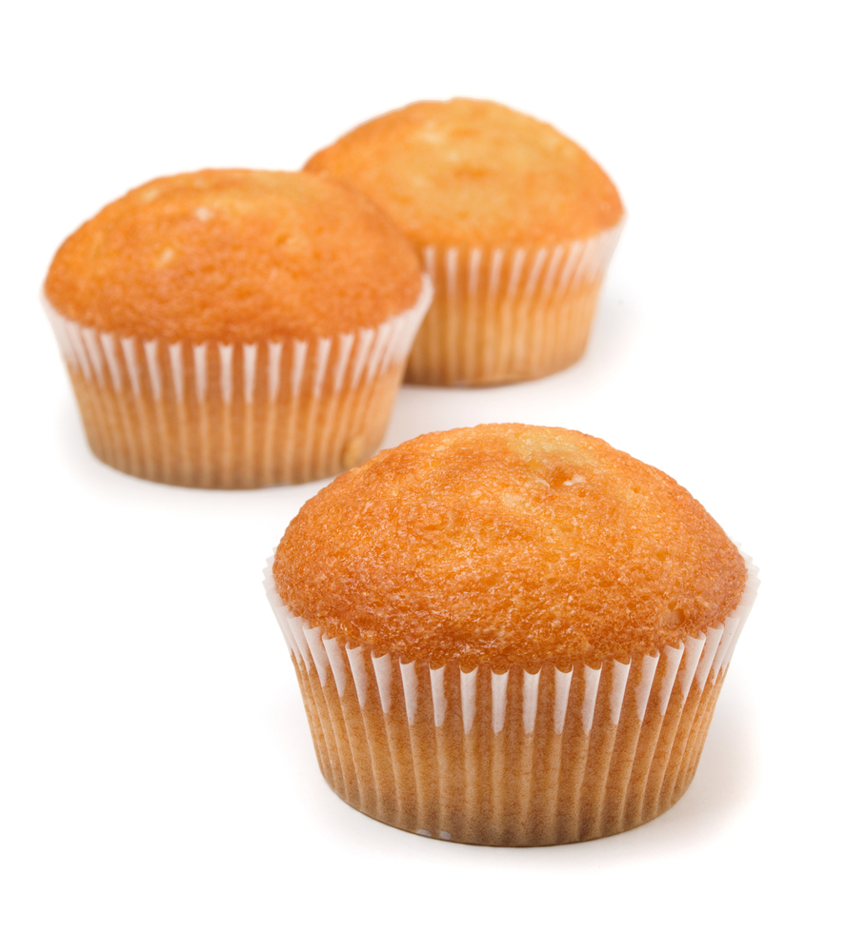
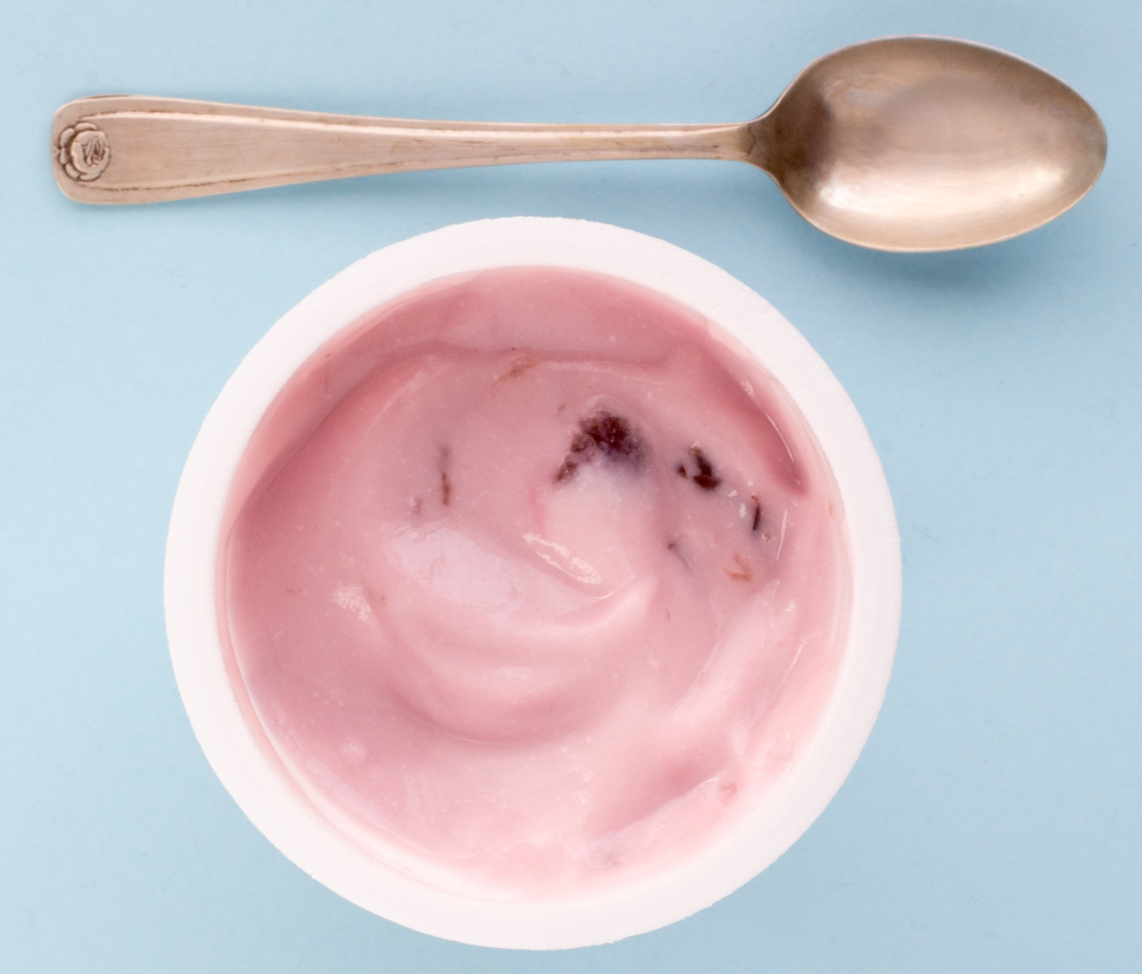
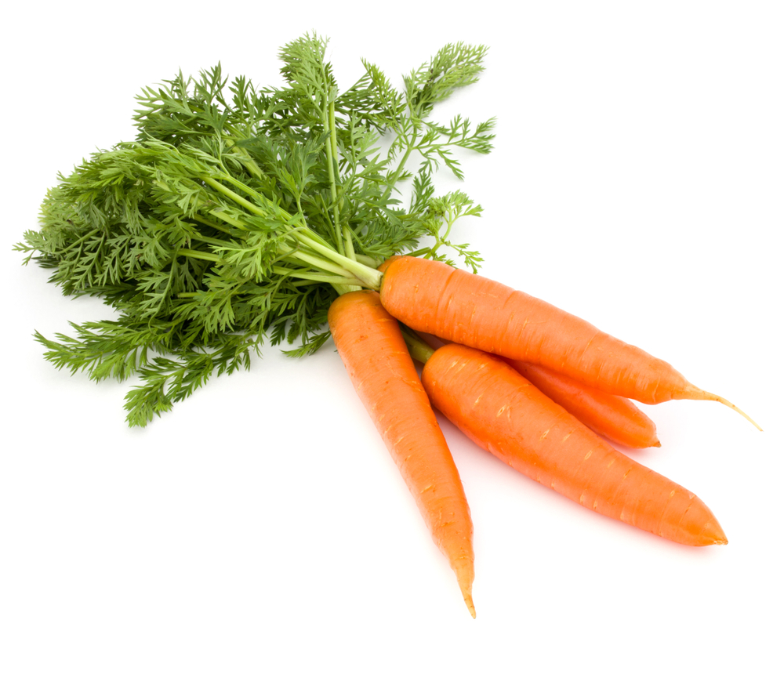
Texture
Useful words to describe texture:
brittle rubbery short crisp fluffy
dry crumbly smooth tender waxy
hard mushy sticky soft firm
flaky gritty close stodgy lumpy
sandy tacky bubbly sticky
What words would you use to describe these foods?

Slide 13

Other factors
Although the senses play an important role in determining our food preferences, and helping us to evaluate food, other factors are also involved.
These include:
previous experiences with food;
hunger and satiety;
mood;
where you eat, e.g. home, canteen, picnic;
beliefs and values, e.g. religion, culture and tradition;
social aspects, e.g. special occasions, events.

Slide 14
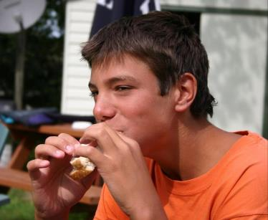
Using your senses
The senses help to;
develop personal food preferences (likes/dislikes);
evaluate foods, either through preference or discrimination tests.

Slide 15
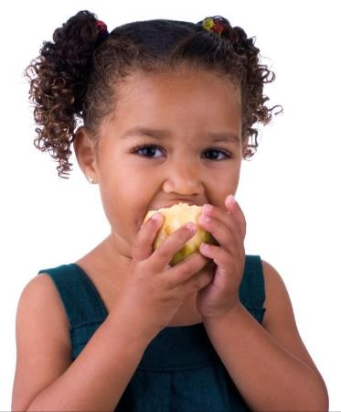
Summary
There are 5 senses used when tasting food and drink, e.g. sight, hearing, smell, taste and touch.
There are 5 basic tastes – salt, sweet, bitter, sour and umami.
A range of sensory vocabulary should be used when describing food.

Slide 16
The senses and food

