Slide 1
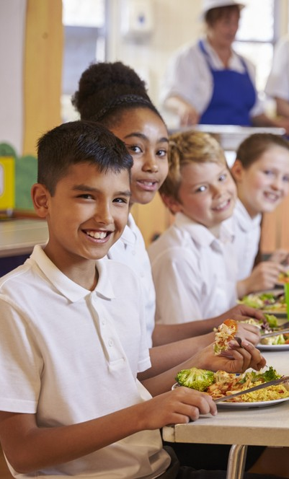
Meals and snacks

Slide 2
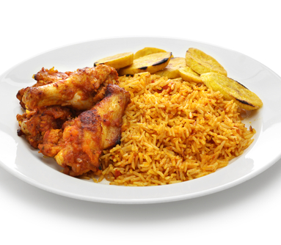
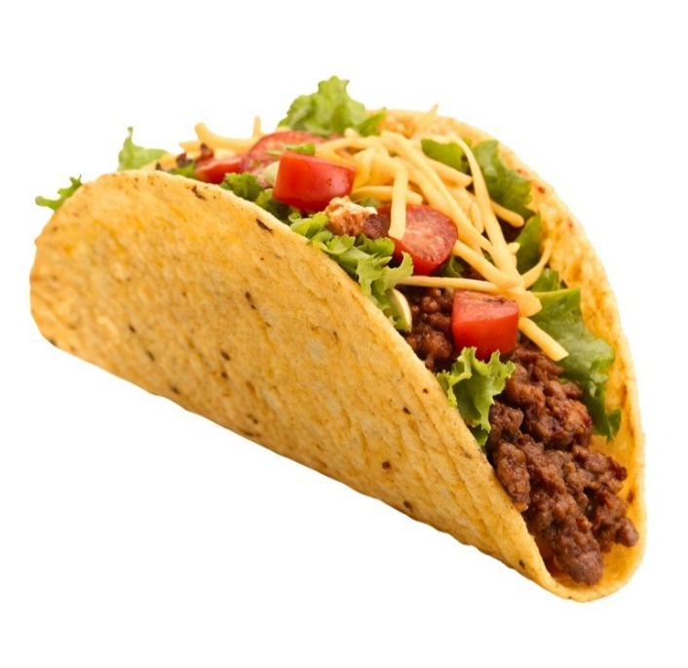
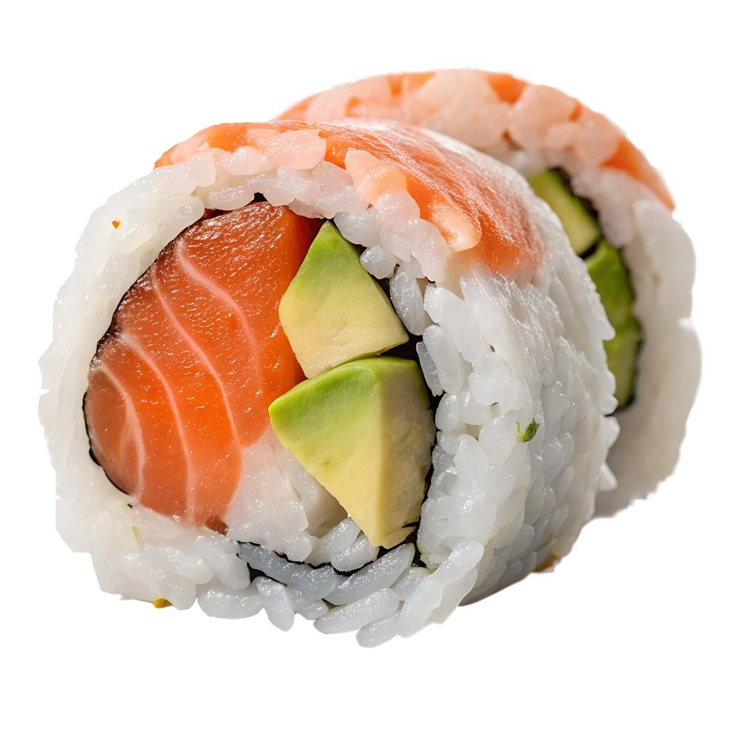
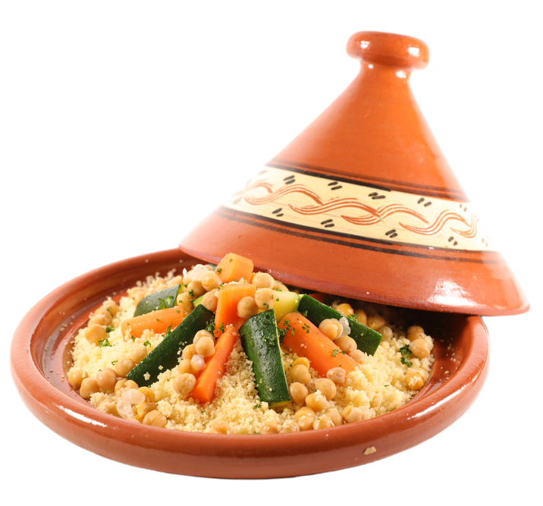
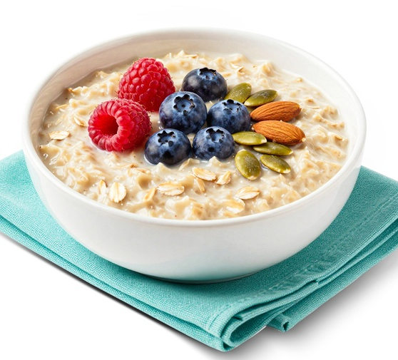
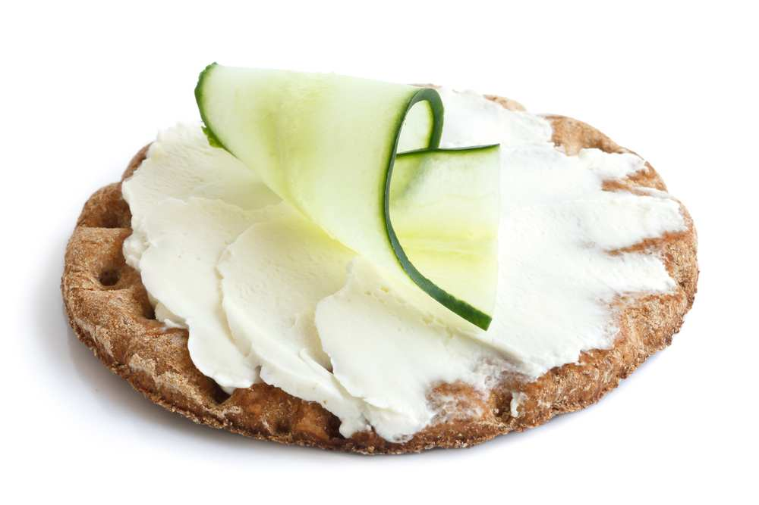
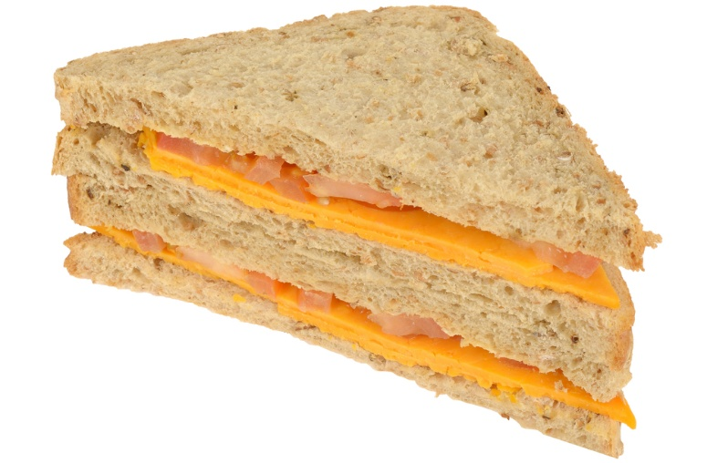
Meals and snacks
Meals and snacks are made with foods from different food groups.
Can you name these different dishes?

Slide 3
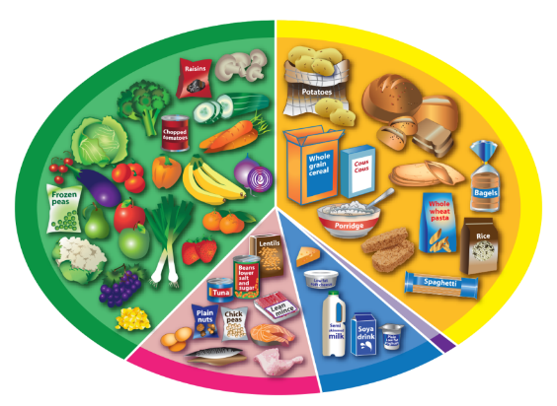
Jollof rice
What foods can you see in this dish?
Chicken
Rice
Plantain
Where would they belong on the
Eatwell Guide?

Slide 4

Taco
What foods can you see in this dish?
Minced beef
Corn taco shell
Tomato
Lettuce
Cheese
Where would they belong on the
Eatwell Guide?

Slide 5
Sushi
What foods can you see in this dish?
Rice
Salmon
Avocado
Where would they belong on the
Eatwell Guide?

Slide 6
Tagine
What foods can you see in this dish?
Couscous
Chickpeas
Courgettes
Carrots
Where would they belong on the
Eatwell Guide?

Slide 7

Sandwich
What foods can you see in this dish?
Bread
Cheese
Tomato
Where would they belong on the
Eatwell Guide?

Slide 8
Porridge
What foods can you see in this dish?
Pumpkins seeds
Raspberries
Blueberries
Almonds
Oats
Milk
Where would they belong on the
Eatwell Guide?

Slide 9
Cracker
What foods can you see in this dish?
Rye crispbread
Soft cheese
Cucumber
Where would they belong on the
Eatwell Guide?

Slide 10
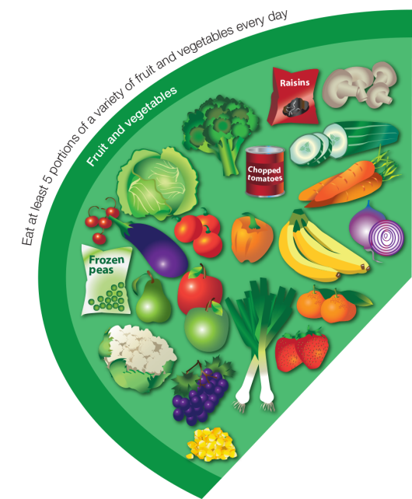
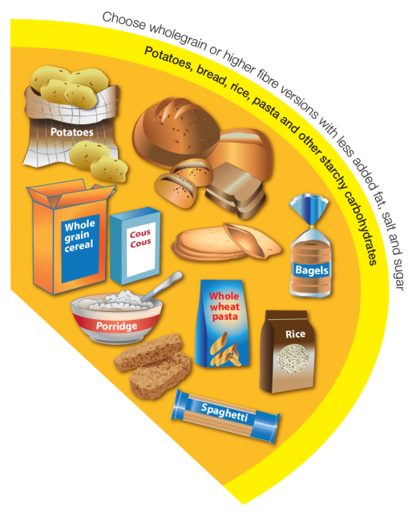
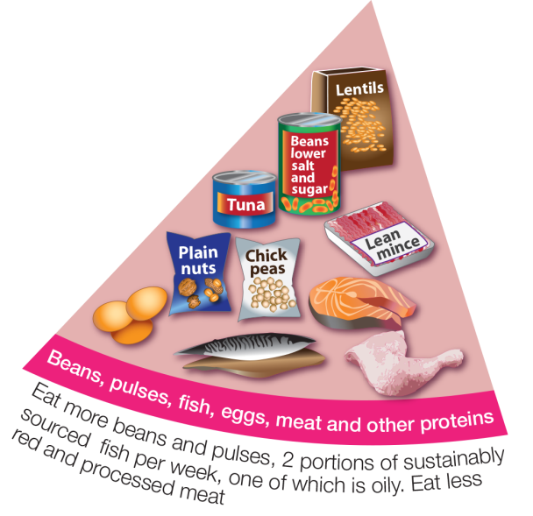
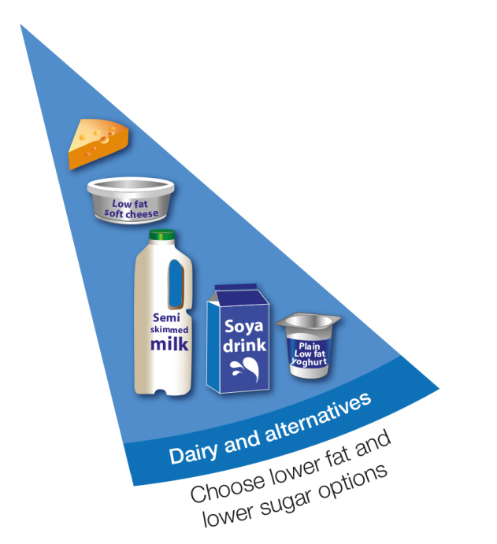
Were you right?
Avocado
Cucumber
Corn taco shell
Chickpeas
Cheese
Lettuce
Courgettes
Rice
Pumpkins seeds
Milk
Tomato
Plantain
Couscous
Almonds
Soft cheese
Blueberries
Tomato
Bread
Salmon
Raspberries
Carrots
Oats
Minced beef
Rye crispbread
Chicken

Slide 11
Meals and snacks

