Slide 1
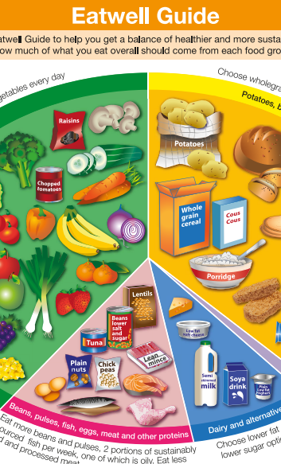
The Eatwell Guide

Slide 2

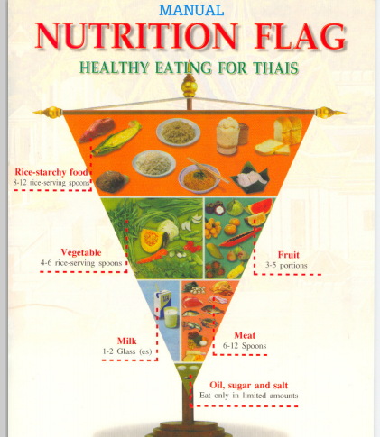
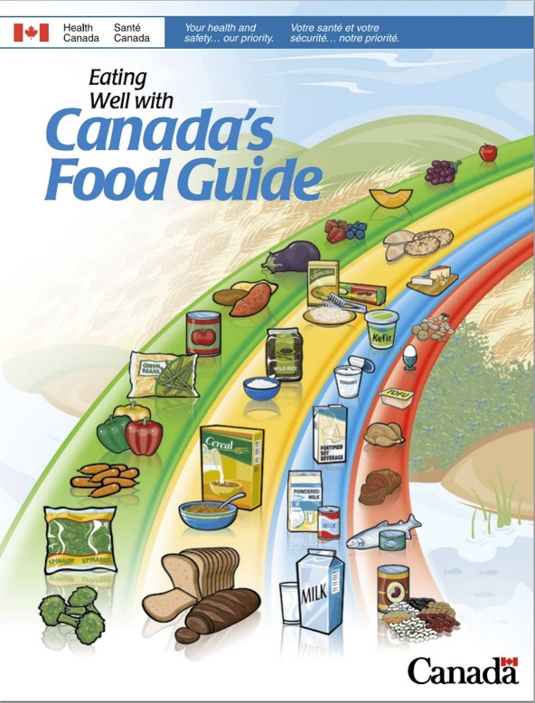
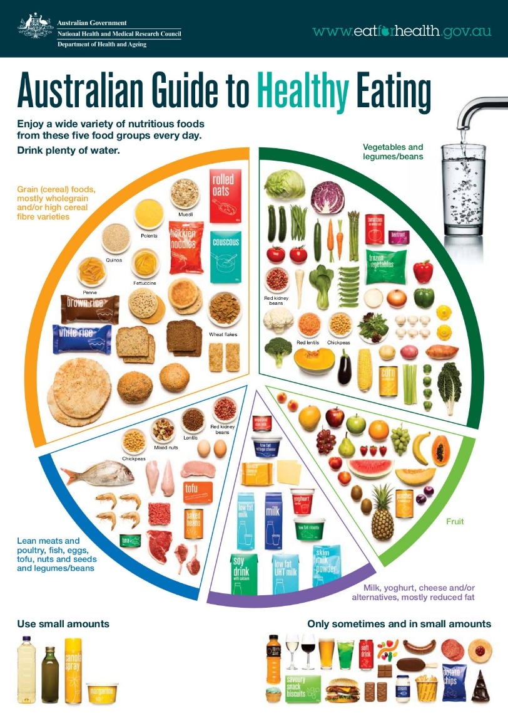
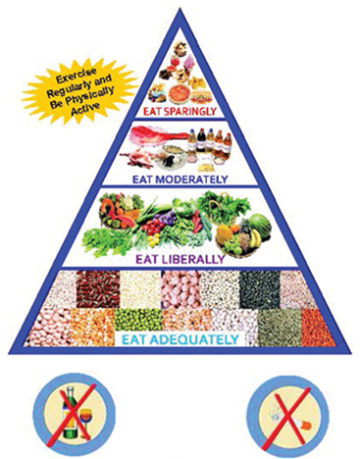
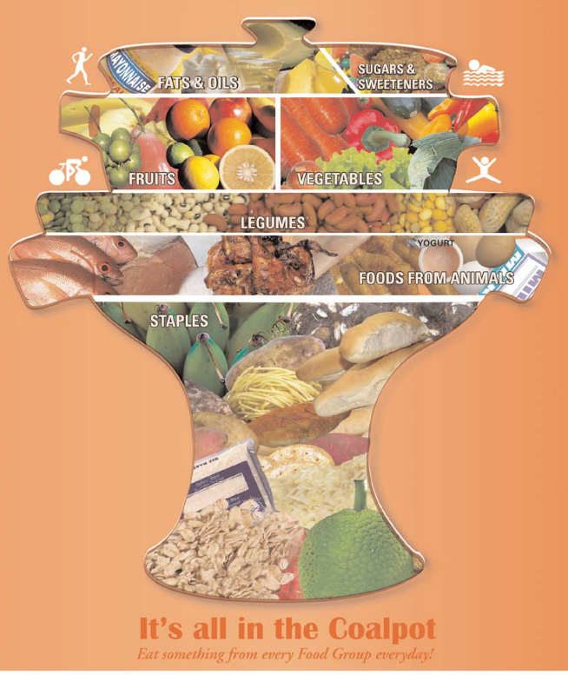
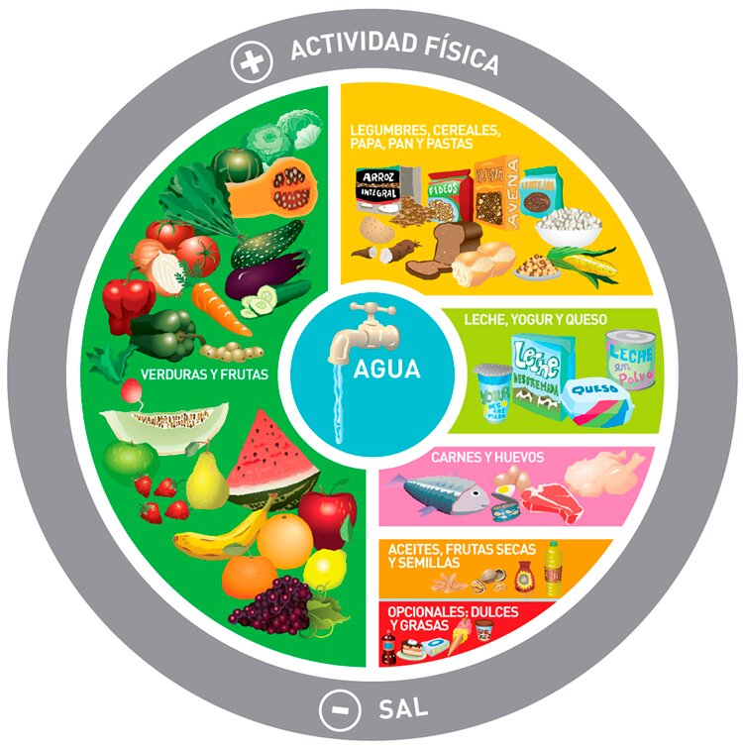
Eatwell models throughout the world
Spain
Thailand
Canada
Australia
India
St Lucia
Argentina

Slide 3
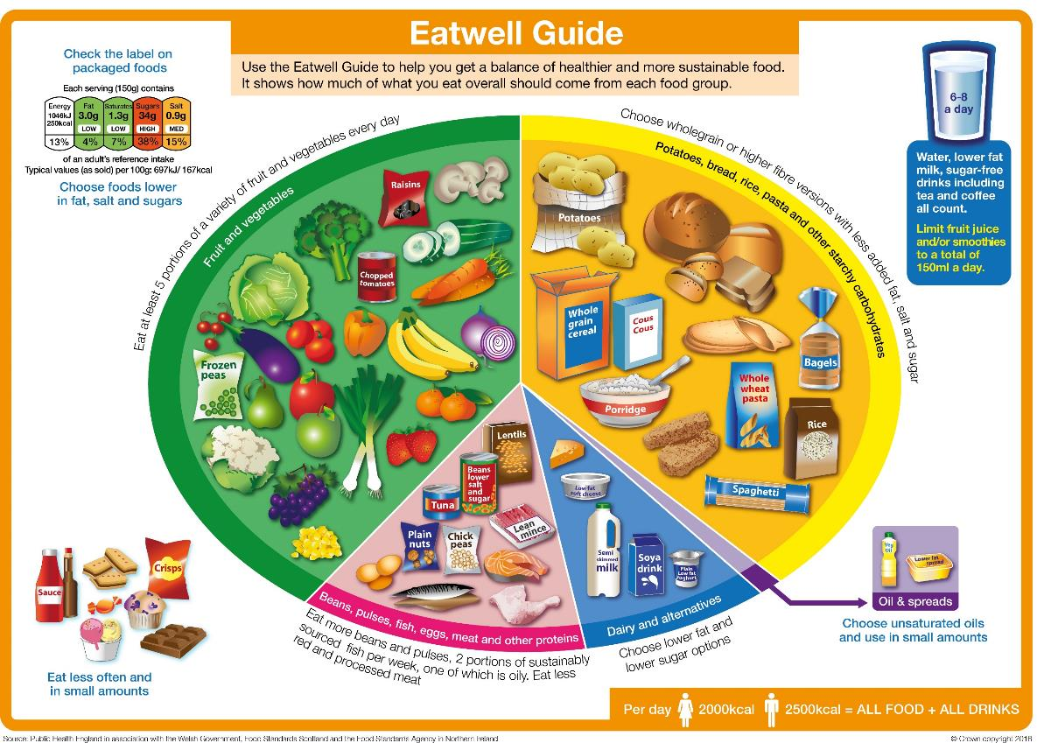
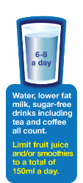
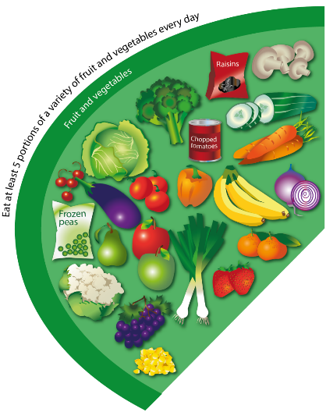
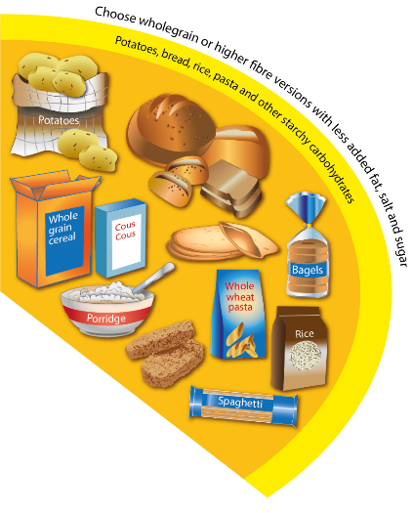
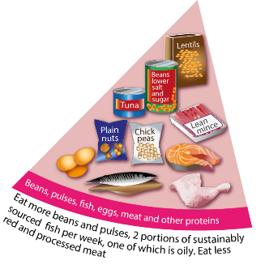
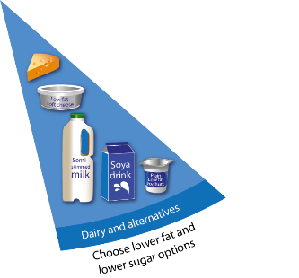
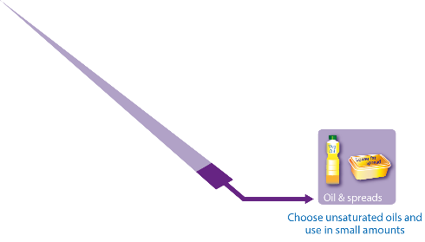
The Eatwell Guide
In the UK, the healthy eating model is
known as the Eatwell Guide.

Slide 4
Key messaging
The Eatwell Guide shows the proportions in which different groups of foods are needed in order to have a well-balanced and healthy diet.
The proportions shown are representative of food eaten over a day or more, not necessarily at each mealtime.
Choose a variety of different foods from each food group to help get the wide range of nutrients the body needs to stay healthy.

Slide 5
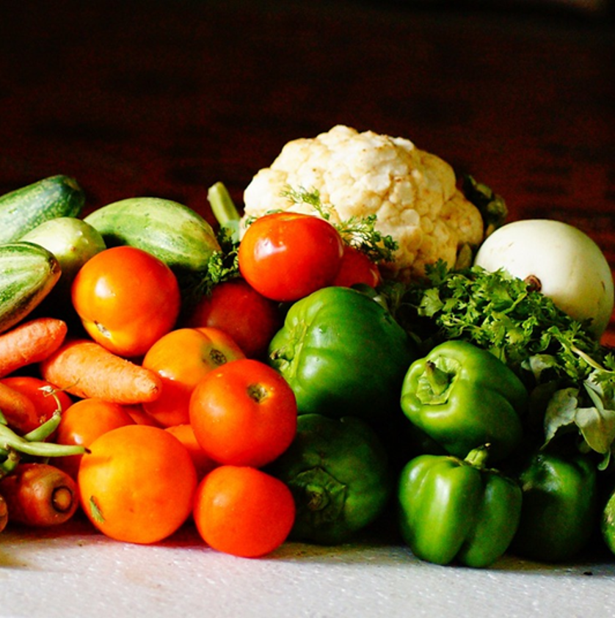
Key messaging
The Eatwell Guide applies to most people regardless of weight, dietary restrictions/preferences or ethnic origin.
It doesn’t apply to children under two years because they have different nutritional needs.
Children aged two to five years should gradually move to eating the same foods as the rest of their family, in the proportions shown on the Eatwell Guide.

Slide 6
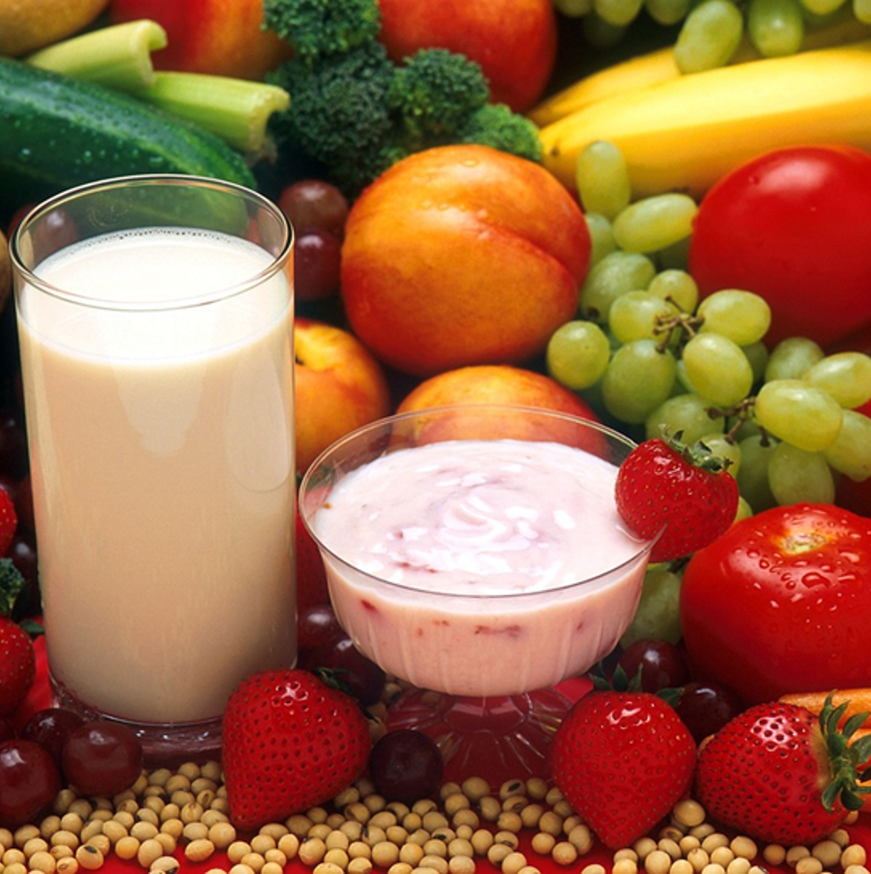
Key messaging
Anyone with special dietary requirements or medical needs might want to check with a registered dietitian on how to adapt the Eatwell Guide to meet their individual needs.
The Eatwell Guide divides foods into groups, depending on their nutritional role and shows the proportions of each of the groups needed for a healthy, varied diet.

Slide 7
The food groups
Let’s take a closer look at each
food group.

Slide 8
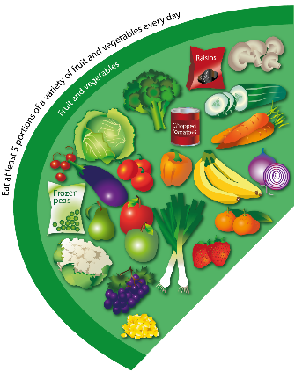


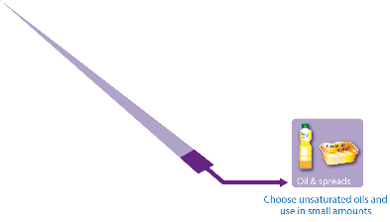

The food groups
Fruit and vegetables
Potatoes, bread, rice, pasta, and other starchy carbohydrates
Beans, pulses, fish, eggs, meat and other proteins
Oil and spreads
Dairy and alternatives

Slide 9
Key messages
Eat at least 5 portions of a variety of fruit and vegetables every day.
Base meals on potatoes, bread, rice, pasta or other starchy carbohydrates; choosing wholegrain versions where possible.
Eat some beans, pulses, fish, eggs, meat and other proteins (including 2 portions of fish every week, one of which should be oily).
Have some dairy or dairy alternatives (such as soya drinks); choosing lower fat and lower sugar options.
Choose unsaturated oils and spreads and eat in small amounts.
Drink 6-8 cups/glasses of fluid a day.
If consuming foods and drinks high in fat, salt or sugar have these less often and in small amounts.

Slide 10

Fruit and vegetables
Fruit and vegetables should make up just over a third of the food we eat each day.
Aim to eat at least five portions of a variety of fruit and vegetables each day.
Choose from fresh, frozen, canned, dried or juiced.
A portion is 80g or any of these:
1 apple, banana, pear, orange or other similar-size fruit;
3 heaped tablespoons of vegetables;
a dessert bowl of salad;
30g of dried fruit
(counts as a maximum of one portion a day);
150ml glass of fruit juice or smoothie
(counts as a maximum of one portion a day).

Slide 11
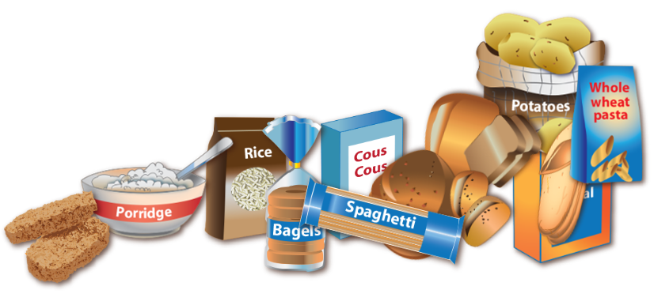
Potatoes, bread, rice, pasta and
other starchy carbohydrates
Starchy food should make up just over a third of the food we eat.
Choose higher-fibre, wholegrain varieties when you can by purchasing wholewheat pasta, brown rice, or simply leaving the skins on potatoes.
Base your meals around starchy carbohydrate foods:
• start the day with a wholegrain breakfast cereal - choose one lower in salt and sugars;
• have a sandwich for lunch;
• round off the day with potatoes, pasta or rice as a base for your evening meal.

Slide 12
Potatoes, bread, rice, pasta and
other starchy carbohydrates
Why choose wholegrain?
Wholegrain food contains more fibre than white or refined starchy food, and often more of other nutrients. We also digest wholegrain food more slowly so it can help us feel full for longer.
Remember, you can also purchase high fibre white versions of bread and pasta which will help to increase your fibre intake.
Wholegrain food includes:
• wholemeal and wholegrain bread, pitta and chapatti;
• wholewheat pasta;
• brown rice;
• wholegrain breakfast cereals and whole oats.

Slide 13
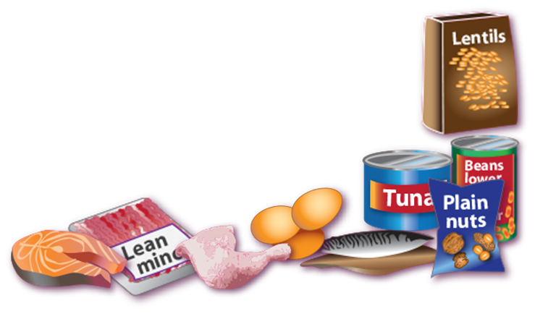
Beans, pulses, fish, eggs, meat
and other proteins
These foods are sources of protein, vitamins and minerals, so it is important to eat some foods from this group.
Beans, peas and lentils (which are all types of pulses, sometimes called ‘legumes’) are good alternatives to meat because they’re naturally very low in fat, and they’re high in fibre, protein and vitamins and minerals. Other vegetable-based sources of protein include tofu, bean curd and mycoprotein.
Aim for at least two portions (2 x 140g) of fish a week, including a portion of oily fish. Most
people should be eating more fish, but there are recommended limits for oily fish, crab and
some types of white fish.*
*Please see www.nhs.uk/Livewell/Goodfood/Pages/fish-shellfish.aspx
Also www.msc.org/ for more guidance on sustainably sourced fish.

Slide 14
Beans, pulses, fish, eggs,
meat and other proteins
Some types of meat are high in fat, particularly saturated fat. So, when you’re buying meat, remember that the type of cut or meat product you choose, and how you cook it, can make a big difference.
If you eat more than 90g of red or processed meat per day, try to cut down to no more than 70g per day. The term processed meat includes sausages, bacon, cured meats and reformed meat products.
To cut down on fat:
• choose lean cuts of meat and go for leaner mince;
• cut the fat off of meat and the skin off of chicken;
• try to grill meat and fish instead of frying;
• have a boiled or poached egg instead
of fried.

Slide 15
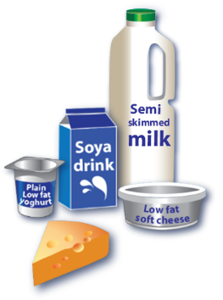
Dairy and alternatives
• Try to have some milk and dairy food (or dairy alternatives) such as cheese, yoghurt and fromage frais.
• These are good sources of protein and vitamins, and they’re also an important source of calcium, which helps to keep our bones strong.
• Some dairy food can be high in fat and saturated fat, but there are plenty of lower-fat options to choose from.
Go for lower fat and lower sugar products where possible. For example, try:
• 1% fat milk which contains about half the fat of semi-skimmed milk without a noticeable change in taste or texture;
• reduced fat cheese which is also widely available;
• have a smaller amount of the full-fat varieties less often;
• going for unsweetened, calcium-
fortified versions when buying
dairy alternatives.

Slide 16
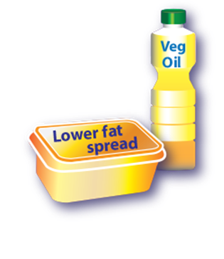
Oils and spreads
Although some fat in the diet is essential, generally we are eating too much saturated fat and need to reduce our consumption.
Unsaturated fats are healthier fats that are usually from plant sources and in liquid form as oil, for example vegetable oil, rapeseed oil and olive oil.
Swapping to unsaturated fats will help to reduce cholesterol in the blood, therefore it is important to get most of our fat from unsaturated oils.
Choosing lower fat spreads, as opposed to butter, is a good way to reduce your saturated fat intake.
Remember that all types of fat are high in energy and should be limited in the diet.

Slide 17
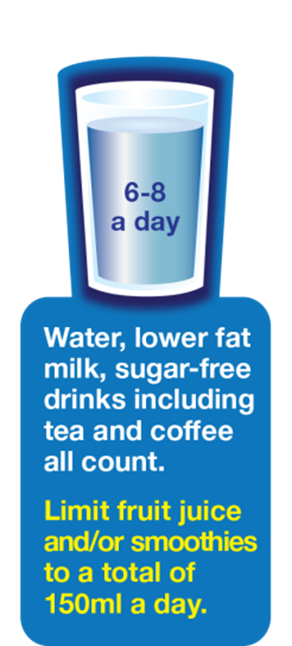
Hydration
Aim to drink 6-8 glasses of fluid every day.
Water, lower fat milk and sugar-free drinks including tea and coffee all count.
Fruit juice and smoothies also count towards your fluid consumption, although they are a source of free sugars and so you should limit consumption to no more than a combined total of 150ml per day.
Sugary drinks are one of the main contributors to excess sugar consumption amongst children and adults in the UK.
Swap sugary soft drinks for diet, sugar-free or no added sugar varieties to reduce your sugar intake in a simple step.

Slide 18

Foods high in fat, salt and sugars
This includes products such as chocolate, cakes, biscuits, full-sugar soft drinks, butter and ice-cream.
These foods are not needed in the diet. If they are included, have infrequently and in small amounts.
If you consume these foods and drinks often, try to limit their consumption so you have them less often and in smaller amounts. Food and drinks high in fat and sugar contain lots of energy, particularly when you have large servings.
Check the label and avoid foods which are high in fat,
salt and sugar!

Slide 19

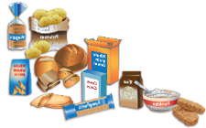
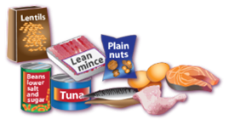


Key messages summary
Eat at least 5 portions of a variety of fruit and vegetables every day.
Base meals on potatoes, bread, rice, pasta or other starchy carbohydrates; choosing wholegrain versions where possible.
Eat some beans, pulses, fish, eggs, meat and other proteins (including 2 portions of fish every week, one of which should be oily).
Have some dairy or dairy alternatives (such as soya drinks); choosing lower fat and lower sugar options.
Choose unsaturated oils and spreads and eat in small amounts.
Drink 6-8 cups/glasses of fluid a day.

Slide 20
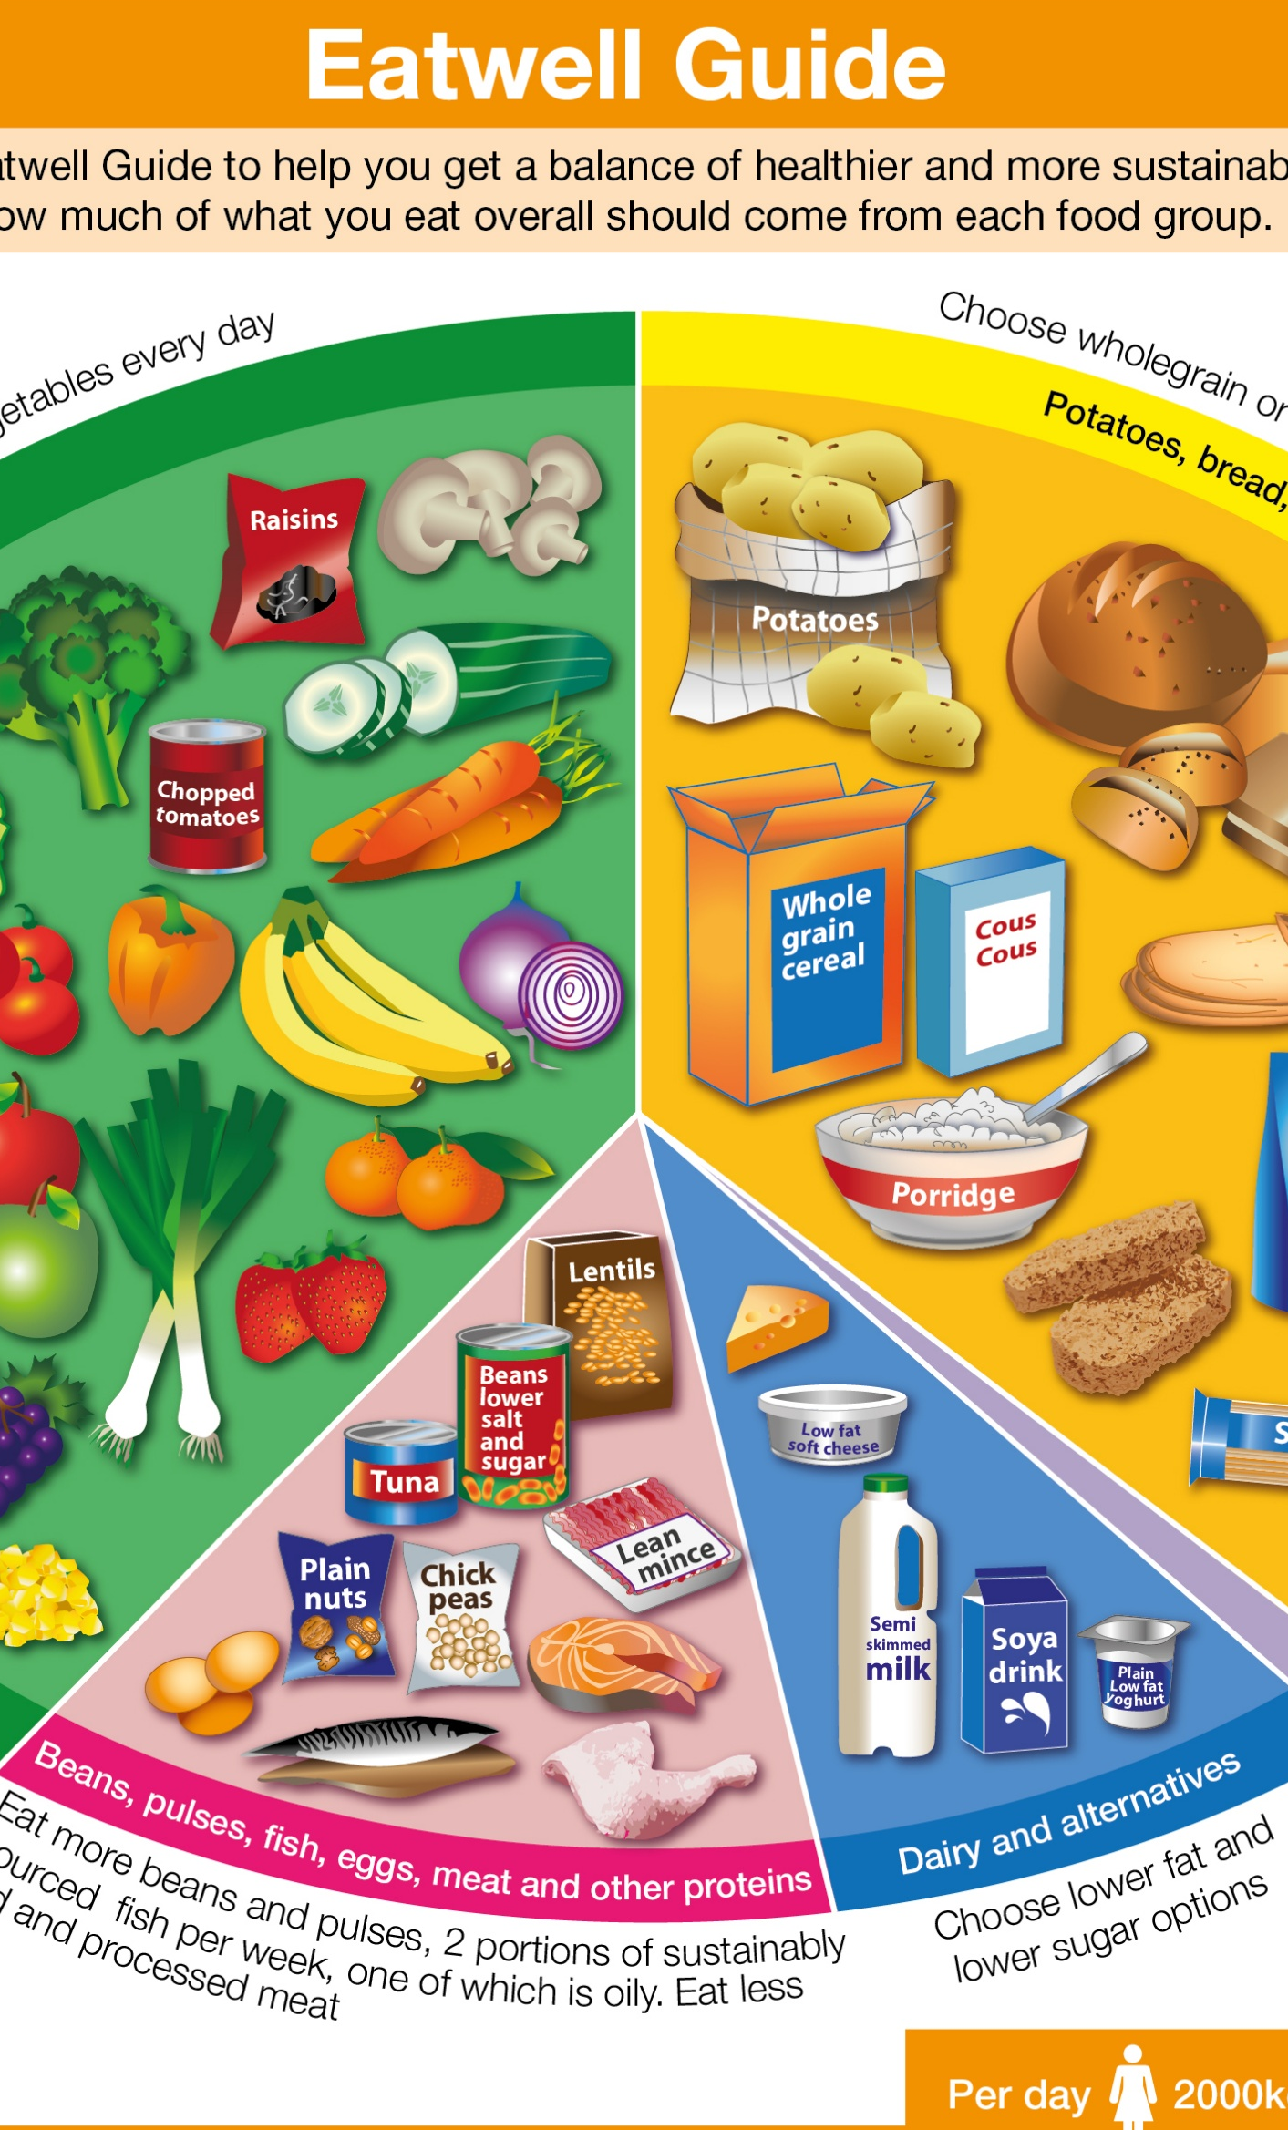
The Eatwell Guide

