Slide 1
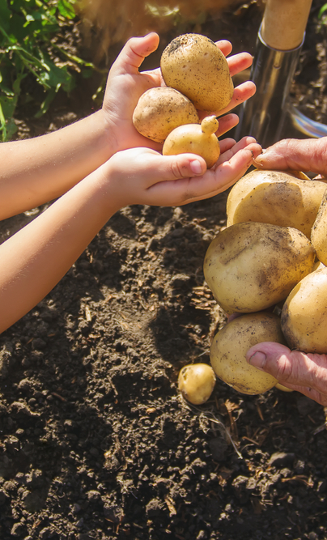
Can I eat this?

Slide 2
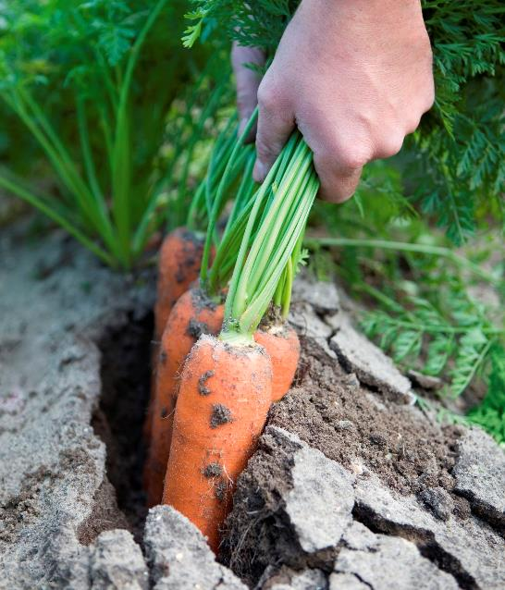
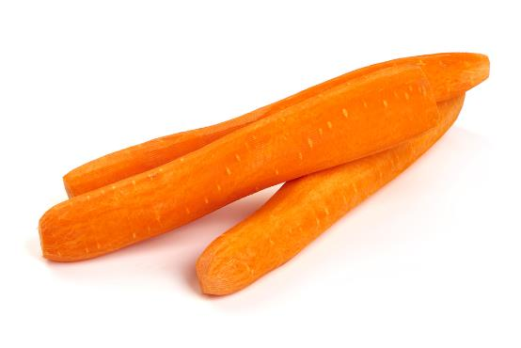
Can I eat these carrots?
Not yet, they need to be washed.

Slide 3
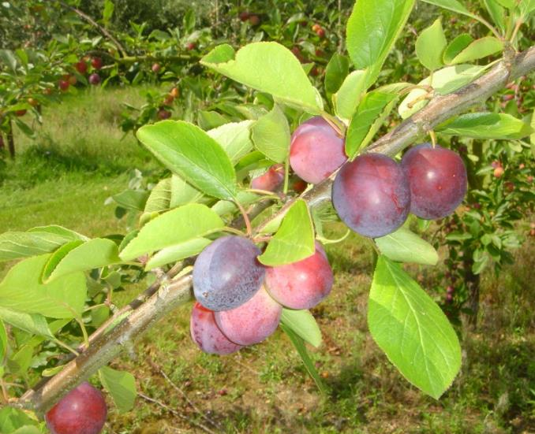
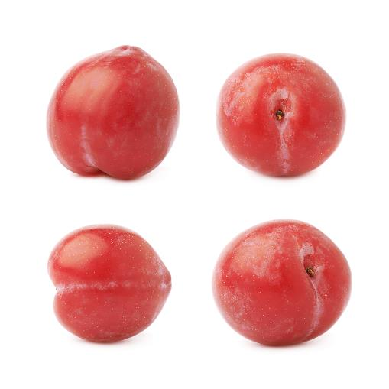
Can I eat these plums?
Not until they have been picked and washed.

Slide 4
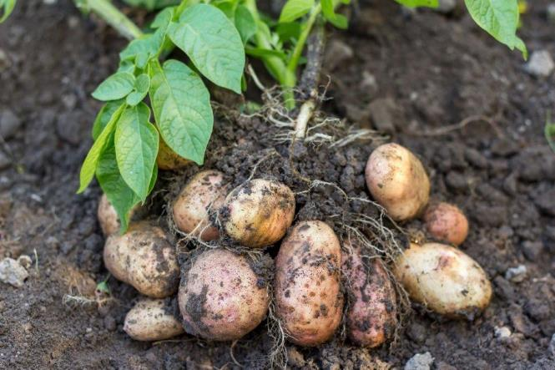
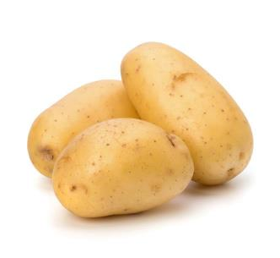
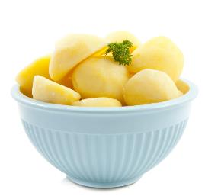
Can I eat these potatoes?
No, they need to be washed and cooked.

Slide 5
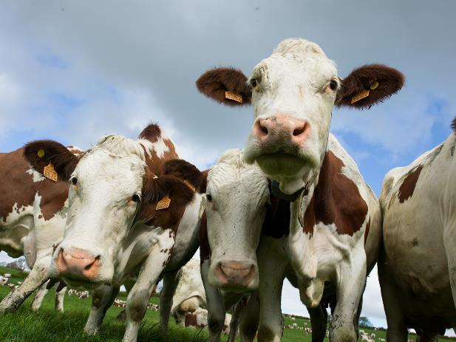
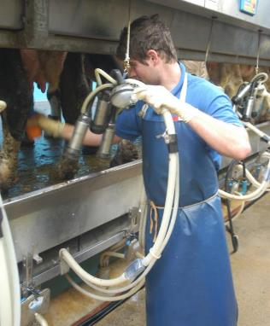
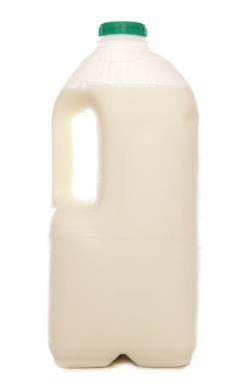
Can I have a glass of milk from here?
No, the cows have to be milked. Then the milk has to be heat treated.

Slide 6
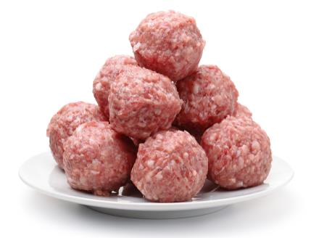
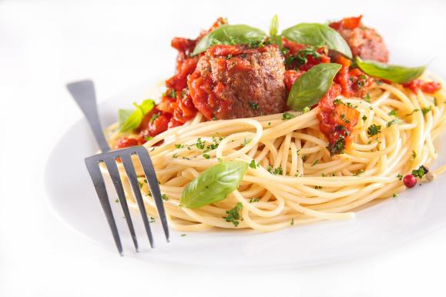
Can I eat these meatballs?
No, they need to be cooked.

Slide 7
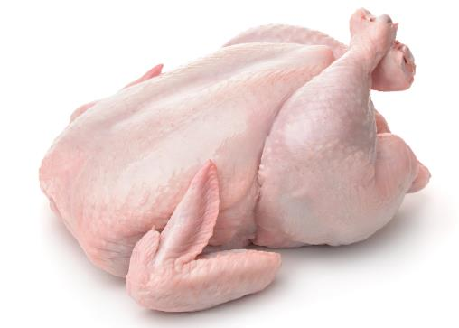
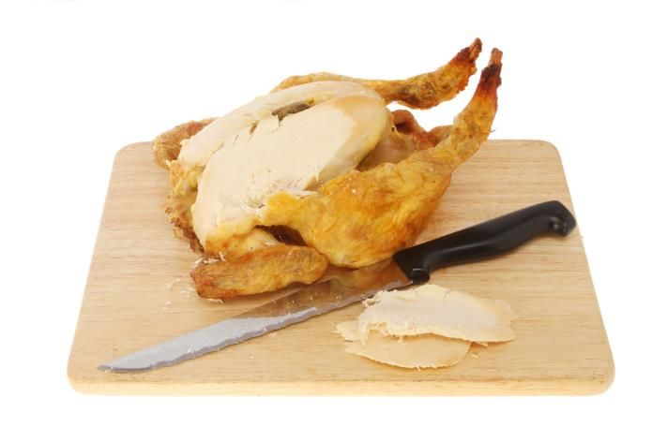
Can I eat this chicken?
No, it needs to be cooked and carved.

Slide 8
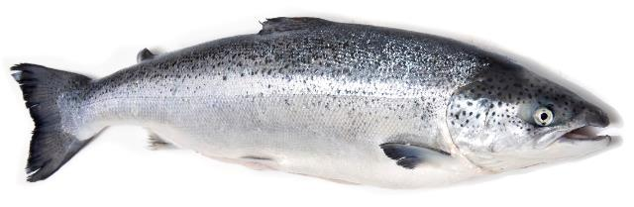
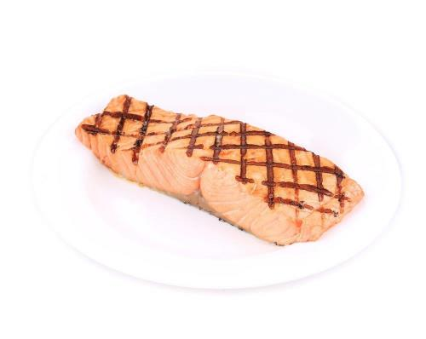
Can I eat this salmon?
No, it needs to be filleted and cooked.
No, it needs to be filleted and cooked.

Slide 9
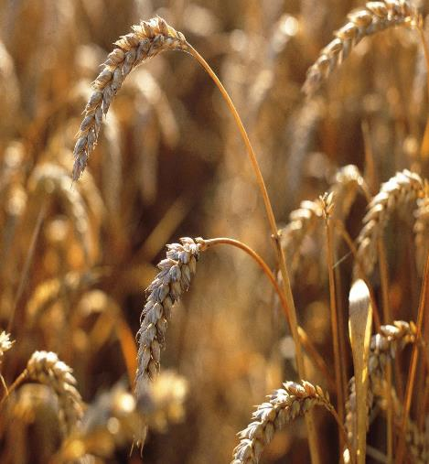
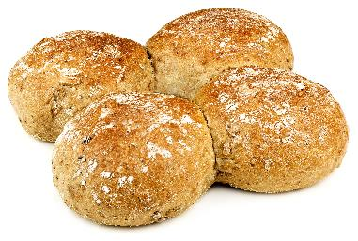
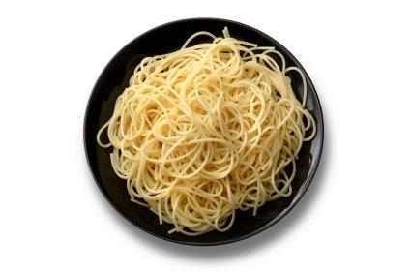
Can I eat this wheat?
Not yet, it needs to be harvested, milled, made into a food and cooked.

Slide 10
Can I eat this?

