Slide 1
Rearing animals

Slide 2
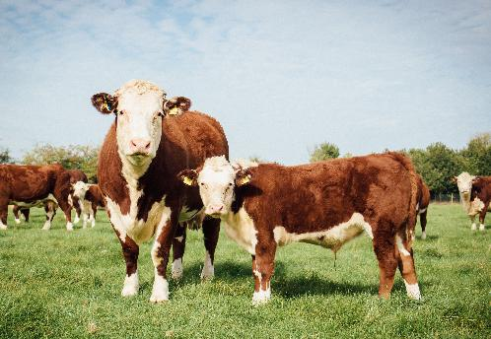
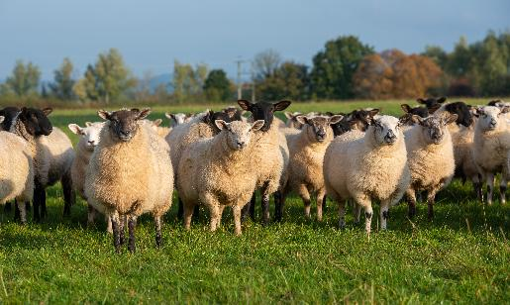
Farming
Livestock farming for meat has been happening throughout the UK for centuries.
Animal health and welfare, and sustainability are high priorities for farmers.
Animals have been reared to produce leaner meat which has a positive impact on our diet and health.

Slide 3
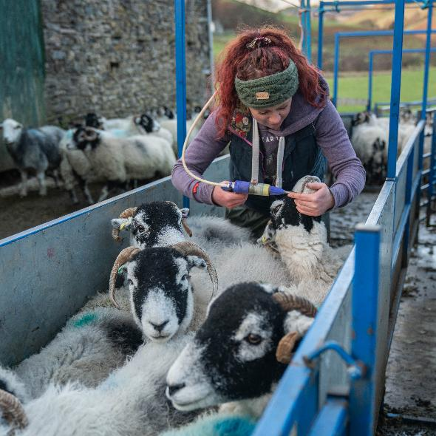
Health and welfare
Farmers spend a lot of time with the livestock monitoring their health and welfare and producing feed, such as silage and maize.
Farmers will also maintain fences, farming equipment and other areas of the farm.
Vets and animal nutritionists will often work with farmers to provide expert advice on improving and maintaining animal health.

Slide 4
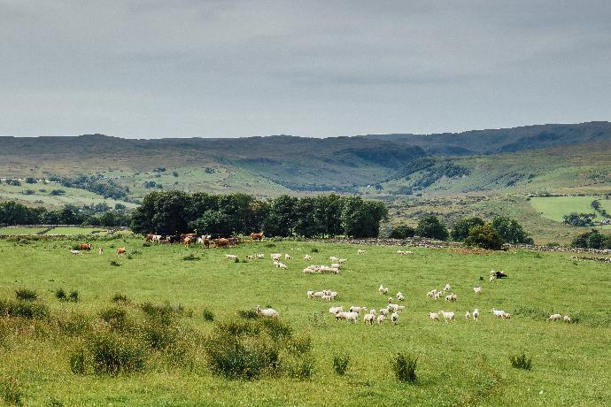
The environment
Another priority for farmers is managing and maintaining the hedgerows and field boundaries, which are also wildlife habitat.
Existing wetlands are preserved and managed for wildlife.
Not only are trees and shrubs attractive landscape features but they are important habitats for the diversity of wildlife.
Grazing cattle and sheep play an important part in managing our natural grasslands.

Slide 5
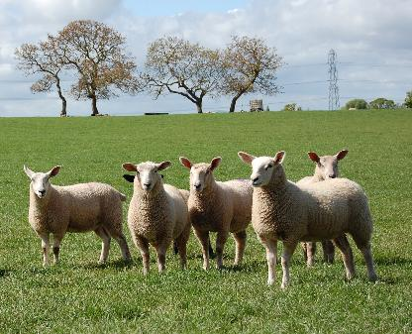
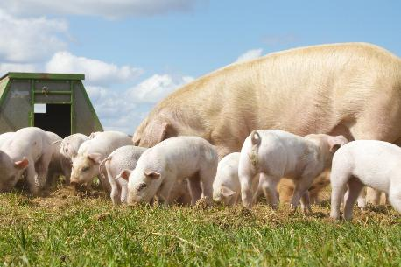
Housing
Most cattle and sheep spend the summer months in fields grazing on pasture and many are housed in large barns in the winter when the grass has stopped growing and the weather can turn bad.
Pigs can be indoors or outdoor reared.

Slide 6
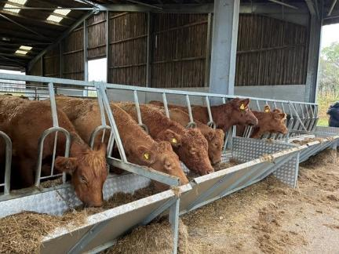
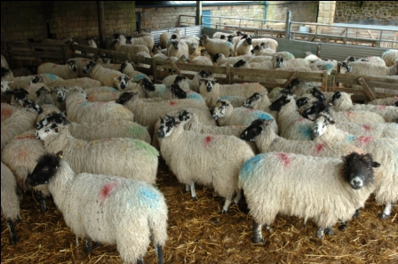
Housing
Housing for livestock must meet specific regulations allowing good ventilation, animals the freedom to move and socialise and access to food and water.

Slide 7
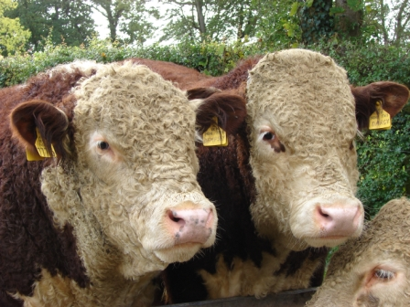
Traceability
There are national records and systems in place to ensure animals can be traced back to the farms they were born on.
For example, cattle receive a passport and an ear tag which records where the animal was born. This passport travels with it and aids traceability within the industry.

Slide 8
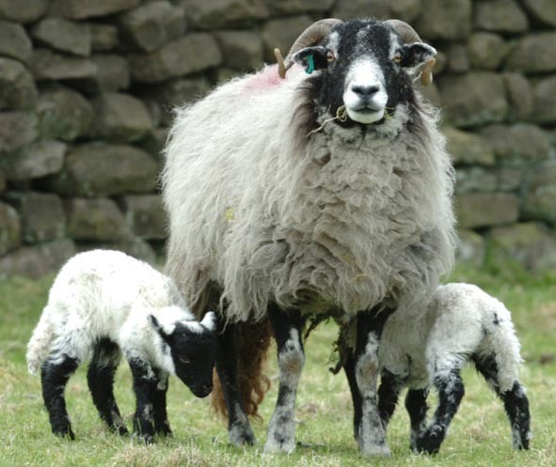
Traceability
Sheep are tagged with ear tags when they are young and cannot be moved from the farm without a movement licence.
Pigs will either be tagged or tattooed with an individual number to track their origins.

Slide 9
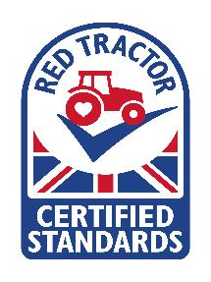
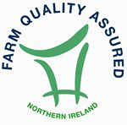

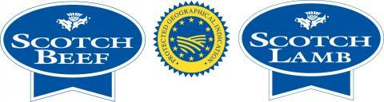
Assurance schemes
Food assurance schemes certify the production of food products to a quality management system based on certain criteria, including food safety principles.
Red Tractor, Protected Geographical Indication and Farm Quality Assurance are Food assurance schemes which cover red meat produced in Northern Ireland, Wales and Scotland.

Slide 10
Rearing animals
For further information, go to:
www.foodafactoflife.org.uk
This resource meets the Guidelines for producers and users of school education resources about food.

