Slide 1
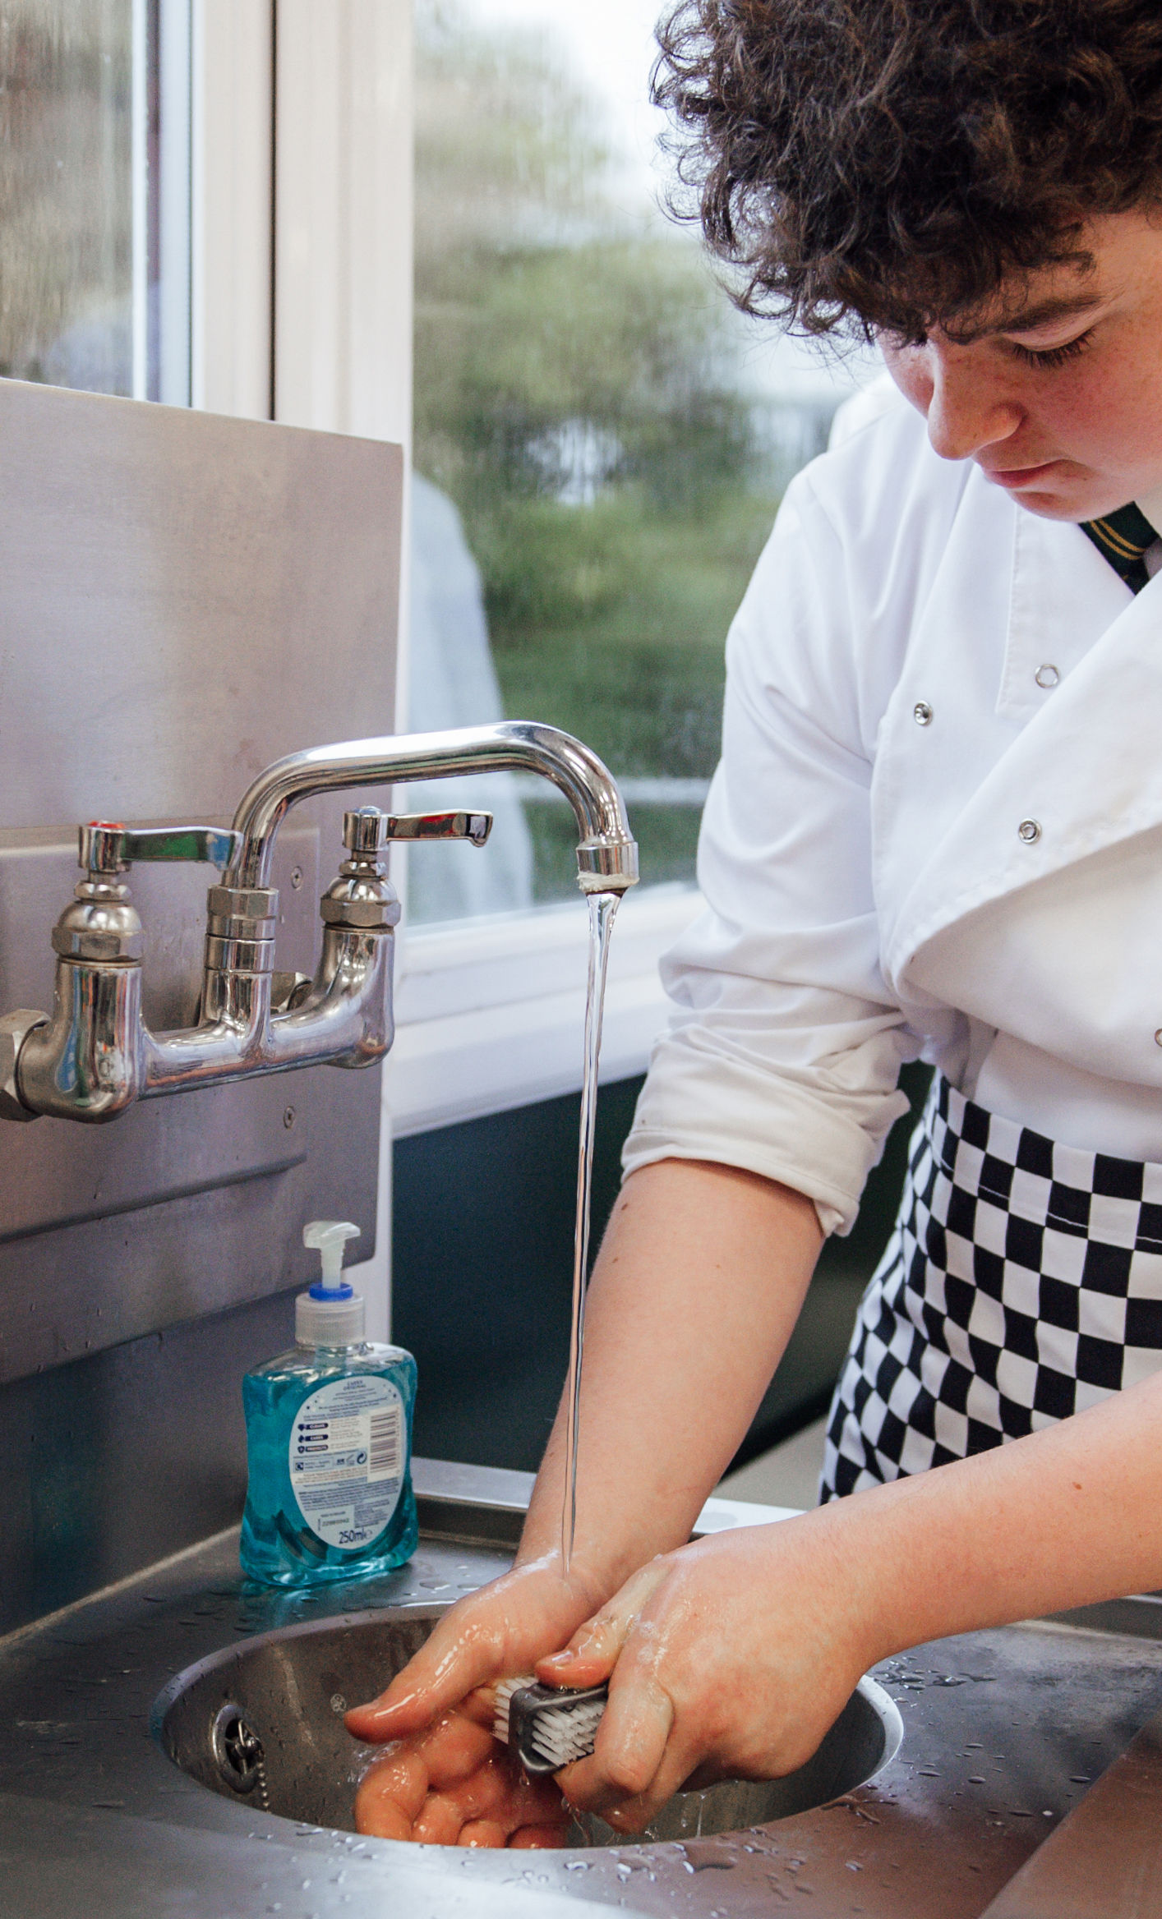
Food hygiene and safety

Slide 2

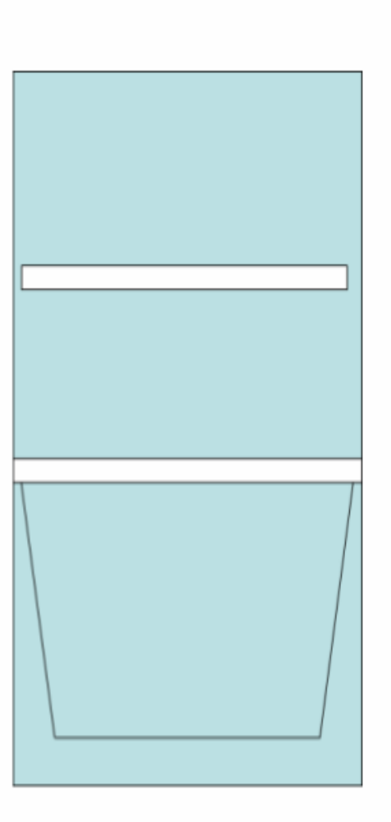

Storing food
Store food in the right place.
Cupboard
Fridge
Freezer

Slide 3
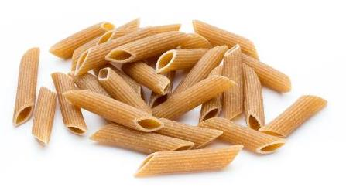
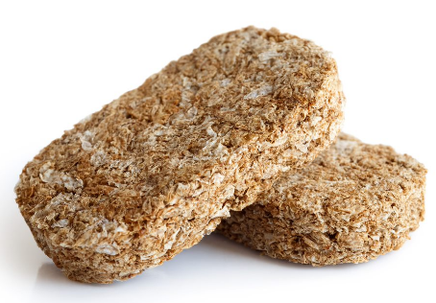
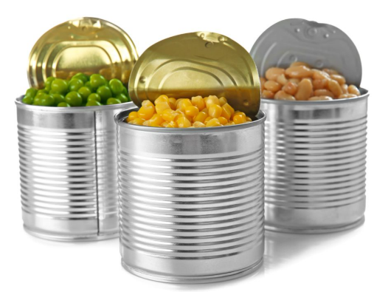
What should be stored in a cupboard?
Dried pasta
Breakfast cereals
Canned vegetables

Slide 4
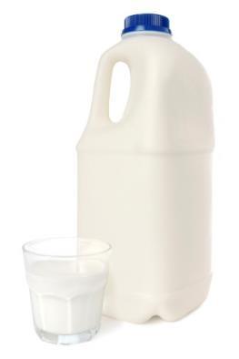
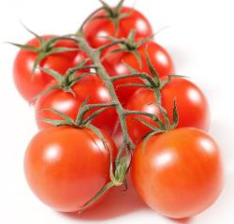
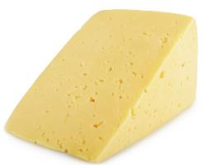

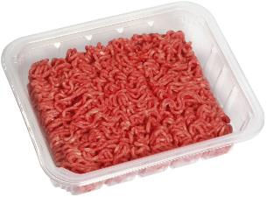
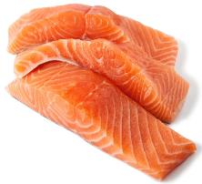
What should be stored in the fridge?
Milk and cheese
Vegetables and fruit
Fish and meat

Slide 5


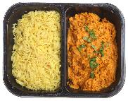


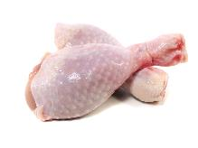
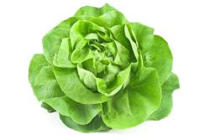
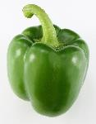


Where in the fridge?
Top/middle shelf
Bottom shelf
Salad drawer

Slide 6
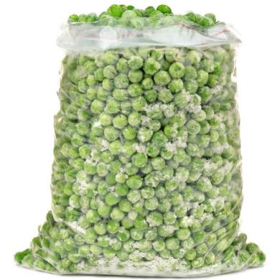

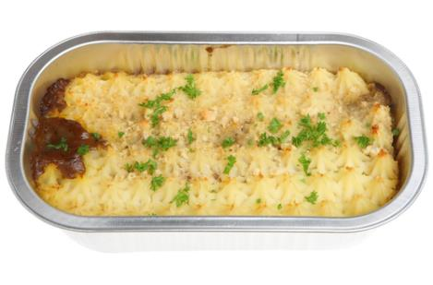
What should be stored in the freezer?
Frozen vegetables
Ice cream
Frozen meals

Slide 7

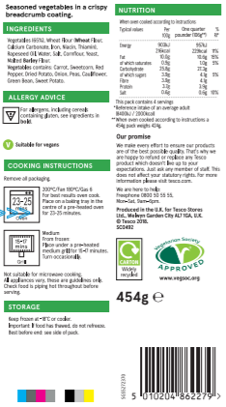
Food labels
Food packaging shows information.
Ingredients
Name
Nutrition
Allergens
How to cook
When to eat by
How to store

Slide 8
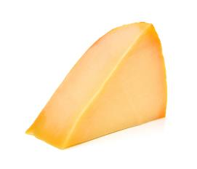
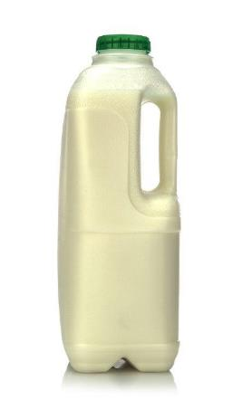
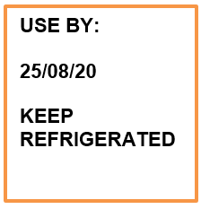

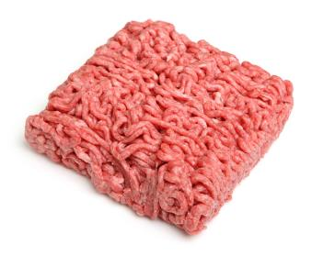
Date marks: ‘Use by’
Cheese, meat and milk
Eat by this date or it might make you ill.

Slide 9
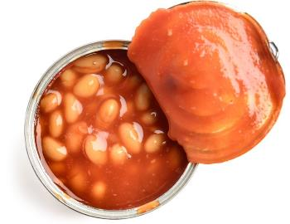
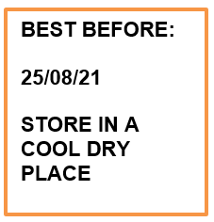

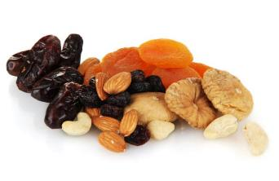
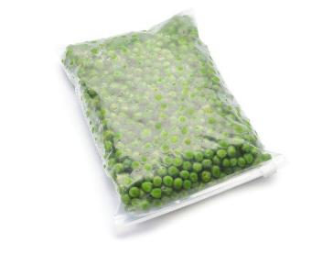
Date marks: ‘Best before’
Canned, dried and frozen food
Can be eaten after this date

Slide 10
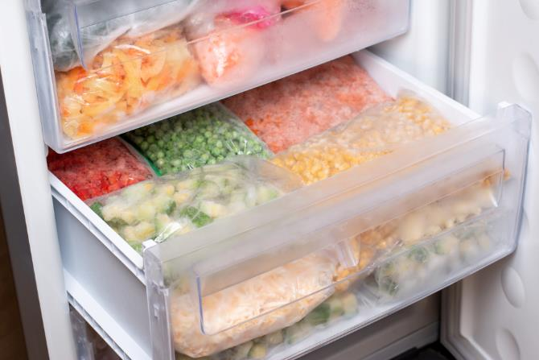
Storage instructions
Store in the freezer

Slide 11
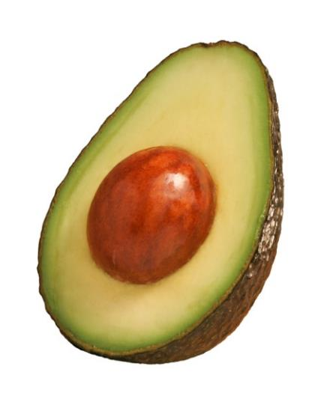
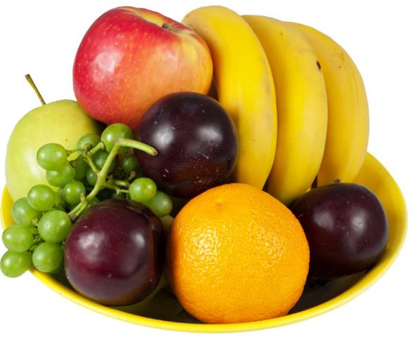

Foods that do not have labels
Some foods do not have labels.

Slide 12
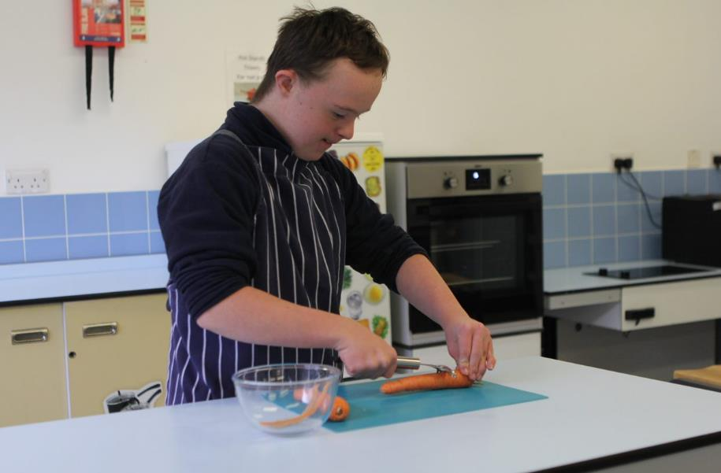
Food hygiene and safety
There are rules which need to be followed.

Slide 13
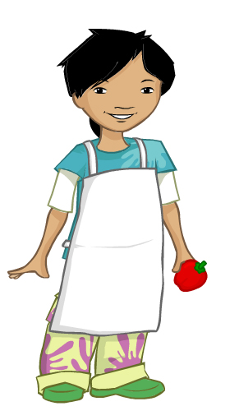
Before cooking – getting ready to cook
Tie long hair at the back of your head.
Remove jewellery.
Remove nail varnish.
Roll up long sleeves.
Put on an apron.
Wash and dry hands.

Slide 14
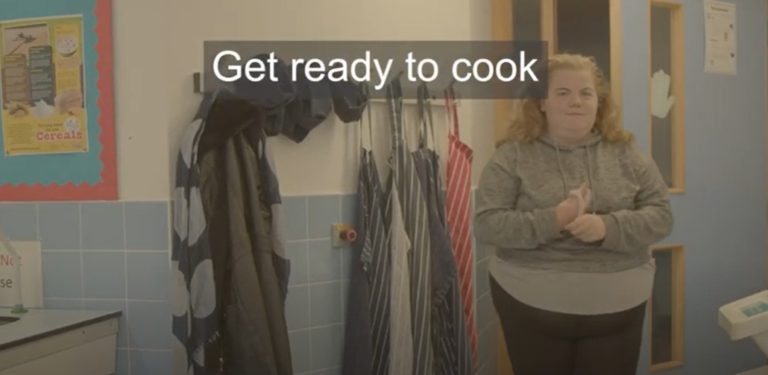
Getting ready to cook
Click on the image to watch a video about getting ready to cook.

Slide 15
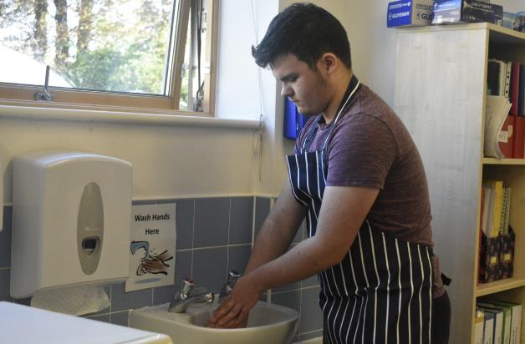
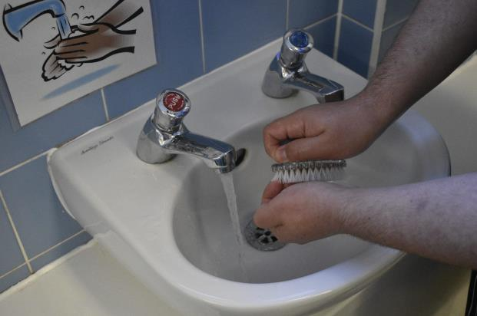
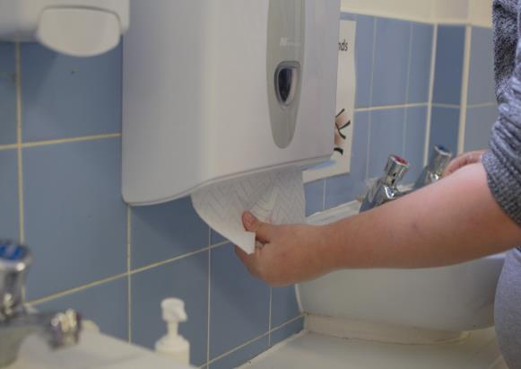
Before cooking – washing hands
Wash and dry hands

Slide 16
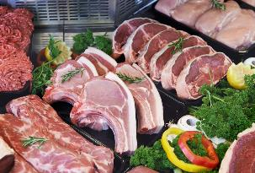
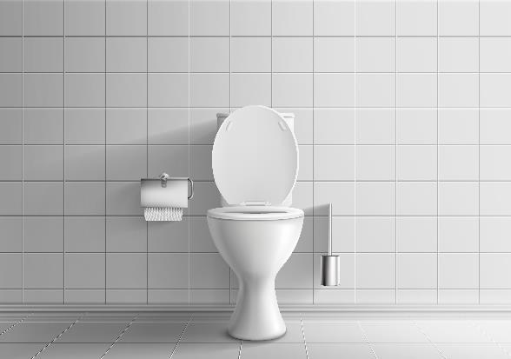
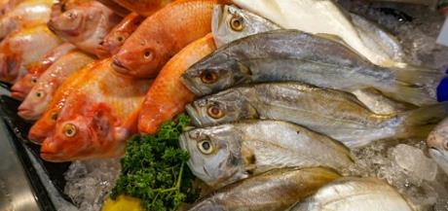
Washing hands – after …
Touching raw meat or fish
Going to the toilet

Slide 17

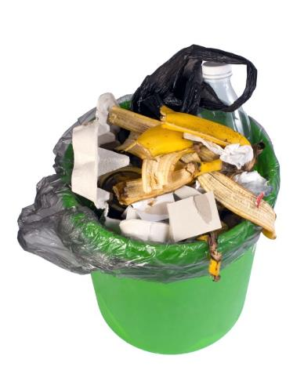

Washing hands – after …
Blowing your nose
Touching rubbish or the bin
Touching pets

Slide 18
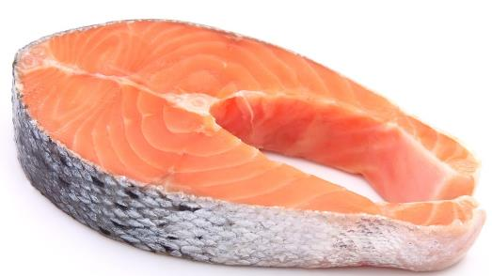
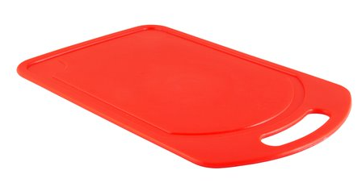
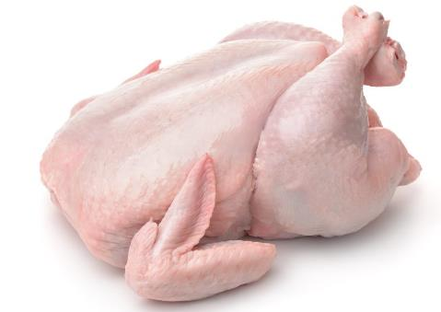
During cooking – using the right equipment
Use a red board for raw meat or fish.

Slide 19
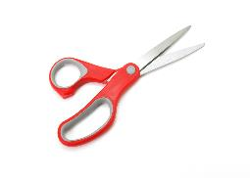
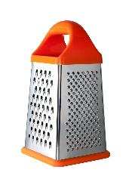
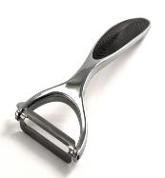
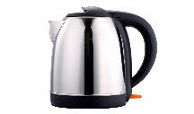
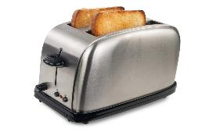
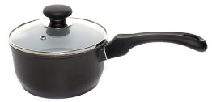
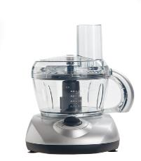

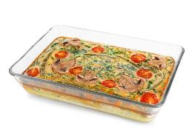
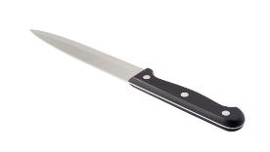

During cooking – working safely
Be careful of sharp equipment.
Be careful of hot equipment and food or drink.

Slide 20

Be safe - use oven gloves

Slide 21



During cooking – is it cooked?
Cook food so that it does not make us ill.
Food becomes solid or hard
Food changes colour

Slide 22



During cooking – is it cooked?
Use a timer.
25 minutes

Slide 23


During cooking – do not burn food!
Cooked for too long
Just right – about 90 seconds!

Slide 24


During cooking – recycling and composting
Recycling
Composting

Slide 25

After cooking – wiping down

Slide 26



After cooking – washing up
Add washing up liquid
Use warm water
Dry well

Slide 27

After cooking – putting away

Slide 28



After cooking – putting food away

Slide 29
Food hygiene and safety

