Slide 1
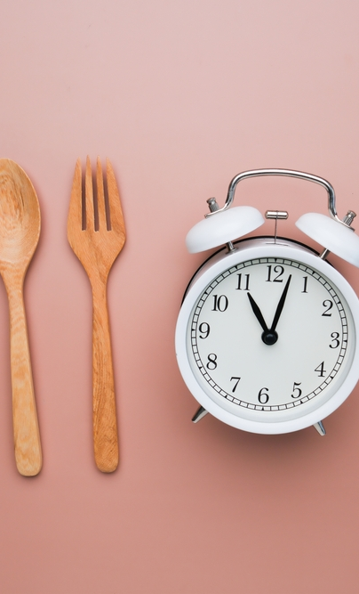
How long does it take to cook?

Slide 2
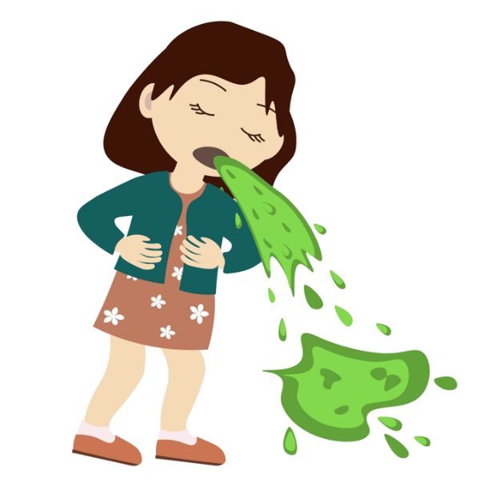
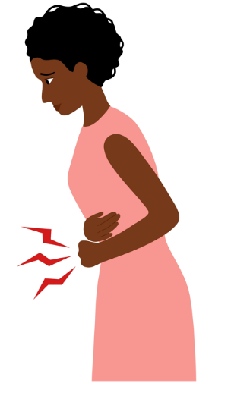
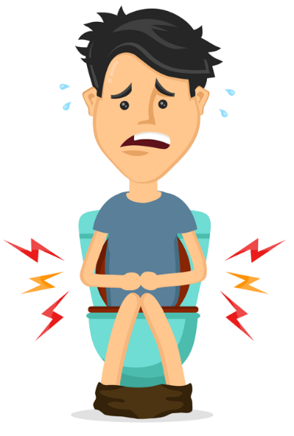
Why cook food?
Cook food so that it does not make us ill.

Slide 3

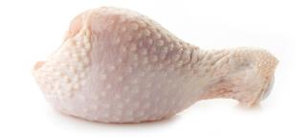
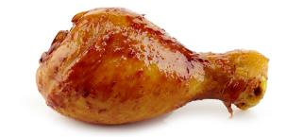
Why cook food?
Cook food so it is safe to eat.
Raw chicken
Cooked chicken

Slide 4
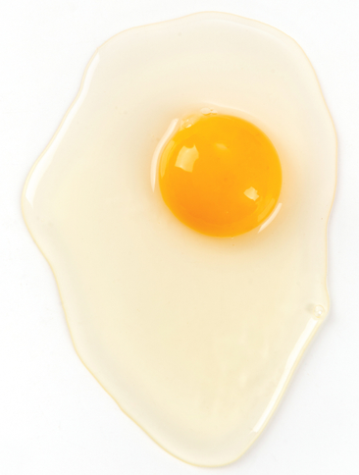
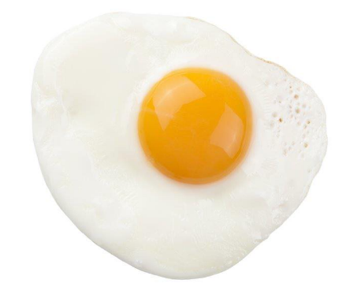
Is food cooked?
Food changes as it cooks.
Food becomes solid or hard

Slide 5
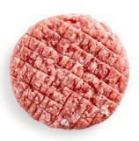
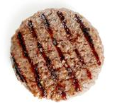
Is food cooked?
Food changes as it cooks.
Food changes colour

Slide 6
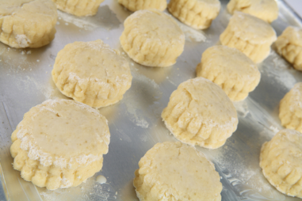
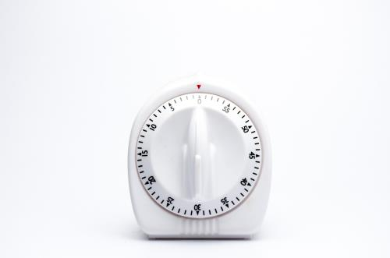
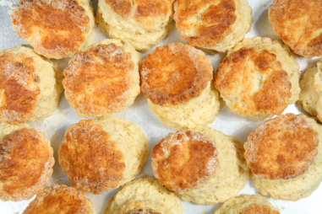
Is food cooked?
Use a timer
25 minutes

Slide 7
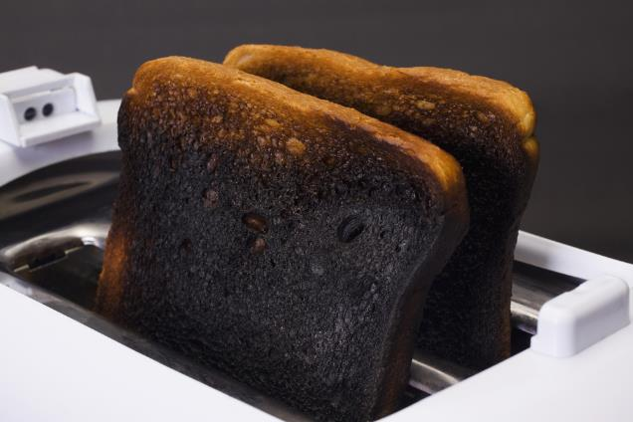
Cooking for too long
Food can burn

Slide 8
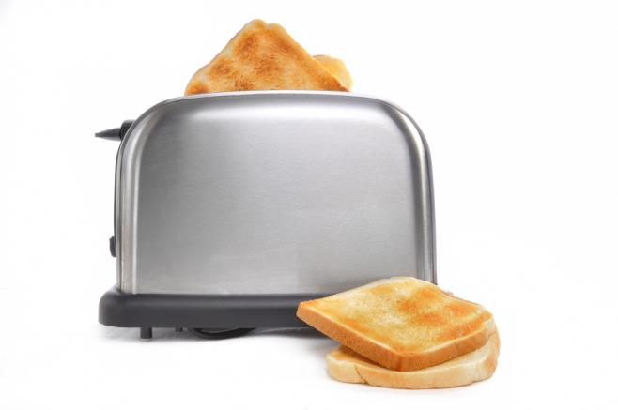
Just right
Just right – about 90 seconds!

Slide 9
How long does it take to cook?

