Slide 1
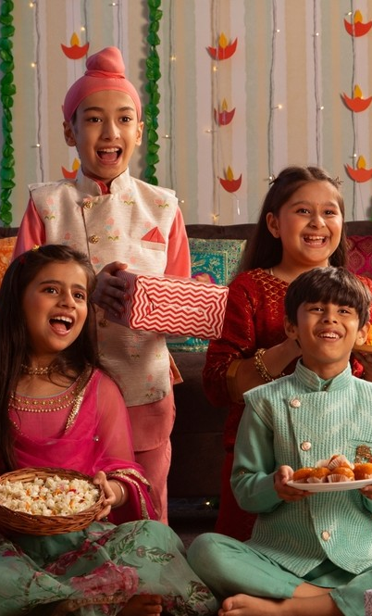
Special occasions

Slide 2
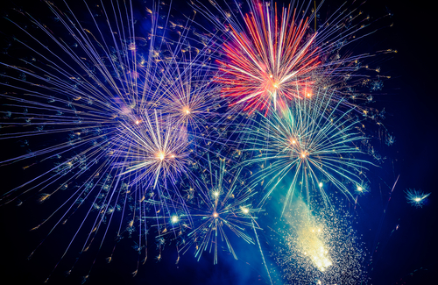
Special occasions
People often eat different food on special occasions.
What is a special occasion?

Slide 3
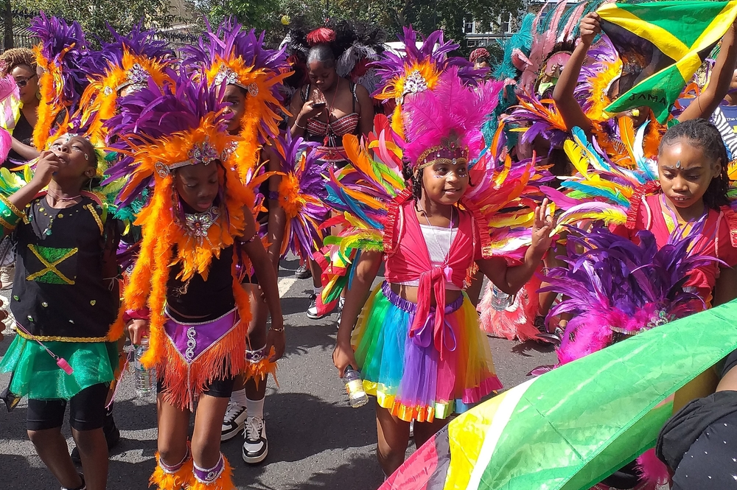
Special occasions
What special occasions do you celebrate?
What do you do?
What do you eat?

Slide 4
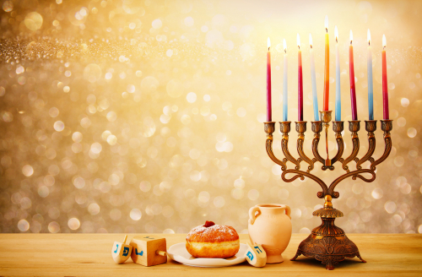
What is this special occasion?
What might people eat?
Jam filled doughnuts
Potato pancakes
Hanukah

Slide 5
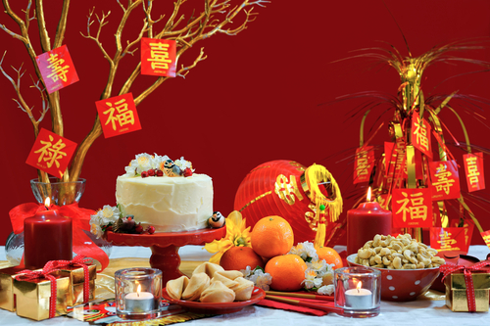
What is this special occasion?
What might people eat?
Dumplings
Tangerines
Chinese New Year

Slide 6
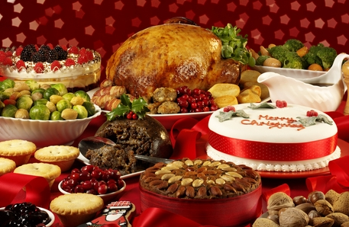
What is this special occasion?
What might people eat?
Turkey
Mince pies
Christmas

Slide 7
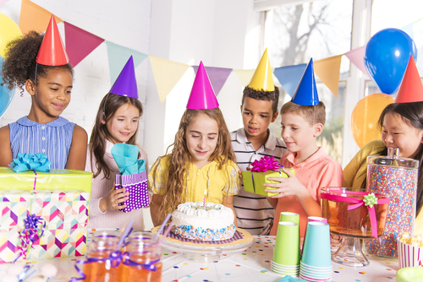
What is this special occasion?
What might people eat?
Cakes
Crisps
Birthday party

Slide 8
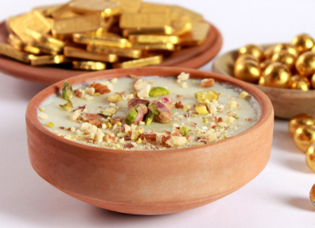
What is this special occasion?
What might people eat?
Special rice pudding
Sweets and chocolates
Eid al-Fitr

Slide 9
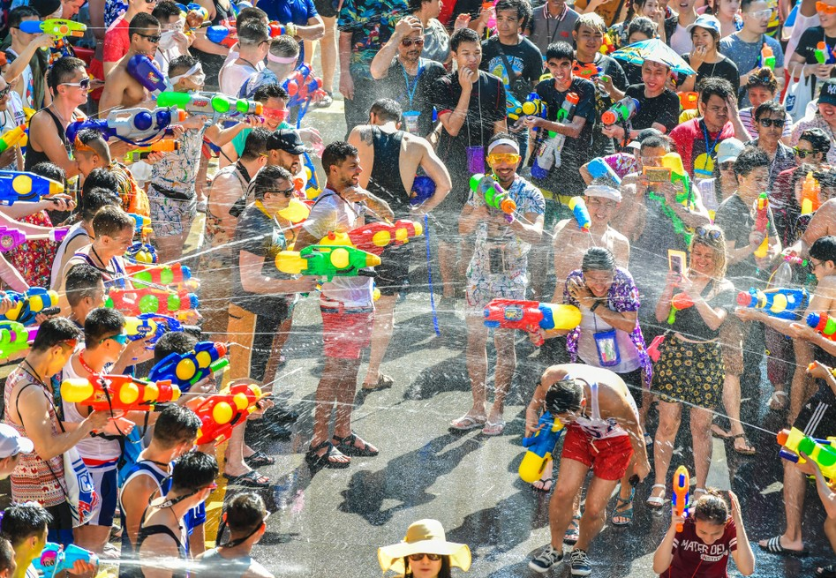
What is this special occasion?
What might people eat?
Mango sticky rice
Spicy and sour soup
Songkran

Slide 10
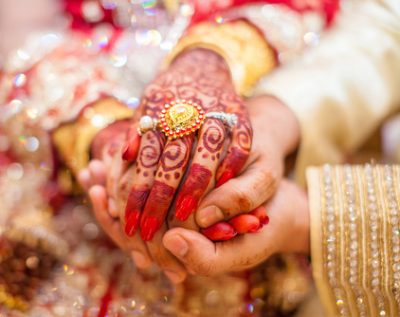

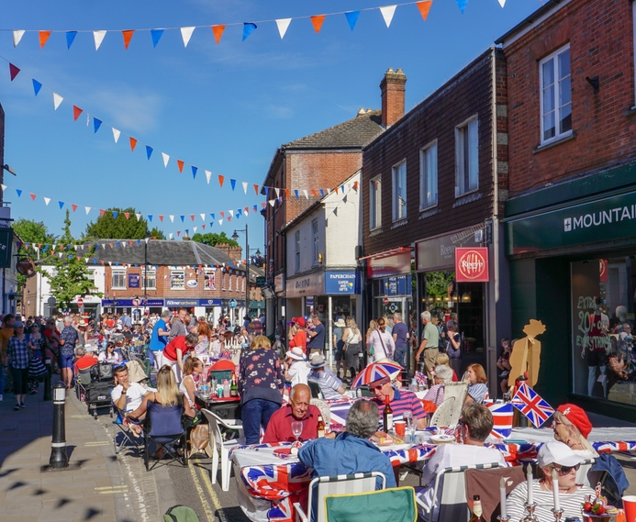
What special occasions can you think of?
What might people eat?

Slide 11
Special occasions

