Slide 1
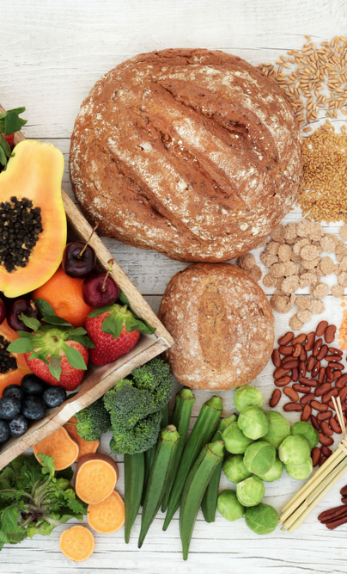
Dietary fibre

Slide 2
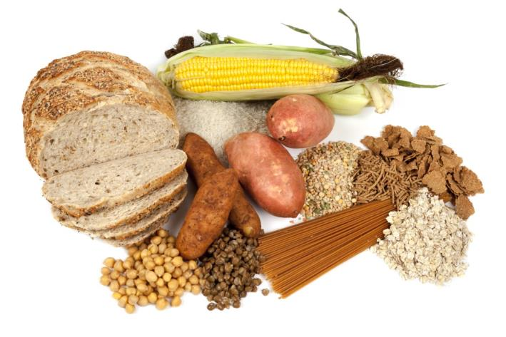
Dietary fibre
Dietary fibre is a diverse group of carbohydrate found almost exclusively in plants, including non-starch polysaccharides such as cellulose, pectin and lignin.
Unlike other types of carbohydrate, these are not absorbed in the small intestine to provide energy.
Some fibre can be fermented in the large intestine by gut bacteria, producing short chain fatty acids and gases (methane, hydrogen and carbon dioxide). Dietary fibre provides 2kcal/8kJ per gram on average.

Slide 3
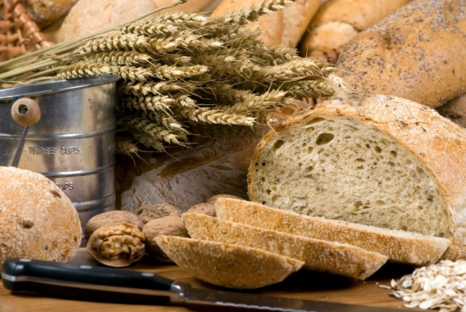
Sources of dietary fibre
Components of dietary fibre are found in different proportions in food, therefore it is important to eat a variety of fibre-containing foods.
Sources of fibre include:
wholegrain breakfast cereals, wholewheat pasta, wholegrain bread and oats, barley and rye, brown rice
peas, beans and pulses
nuts and seeds
potatoes with skin
dried fruits

Slide 4
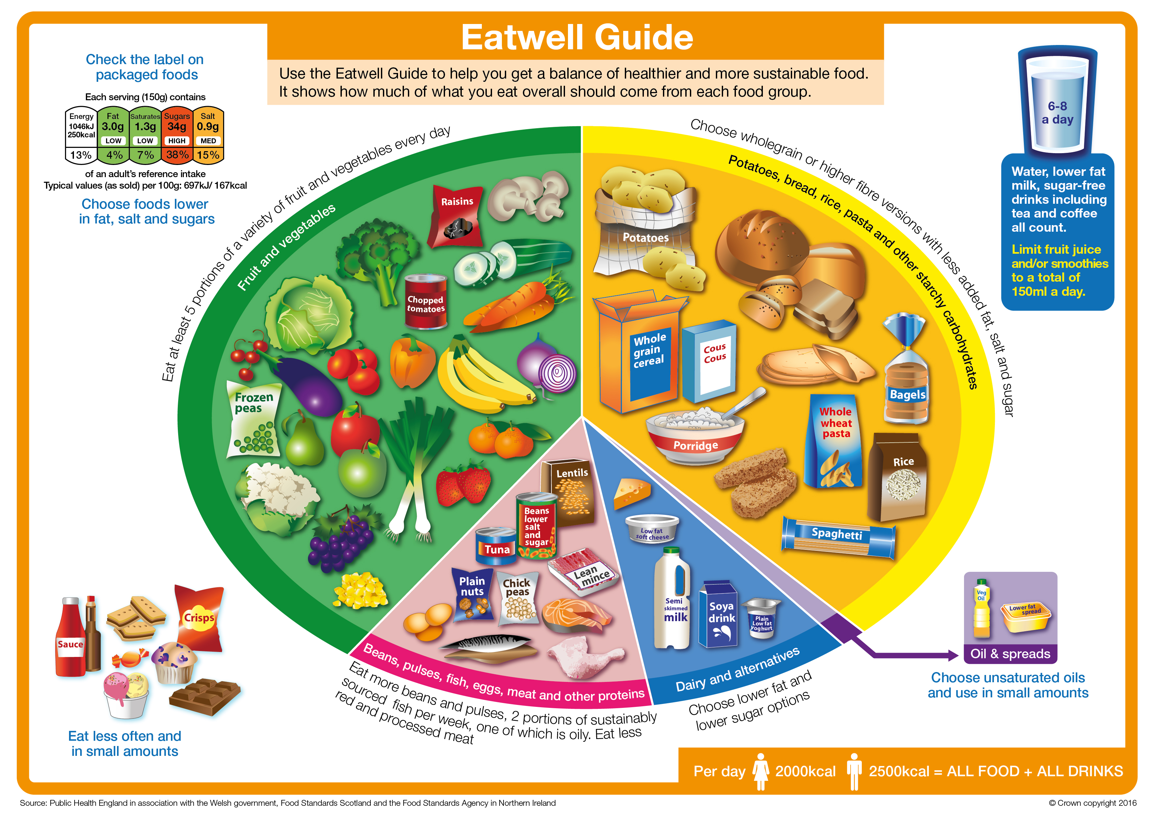
The Eatwell Guide
The Eatwell Guide recommends that you choose higher-fibre, wholegrain varieties when you can by purchasing wholewheat pasta, brown rice, or simply leaving the skins on potatoes.
Wholegrain food contains more fibre than white or refined starchy food, and often more of other nutrients.
We also digest wholegrain food more slowly so it can help us feel full for longer.

Slide 5

Fibre in the diet
Fibre helps to keep our digestive system healthy and can help to prevent constipation. Including foods that have fibre in a healthy, balanced diet may help us keep a healthy bodyweight.
Dietary fibre can also reduce risk of Cardiovascular disease (heart disease and stroke) and type 2 diabetes and bowel cancer.

Slide 6
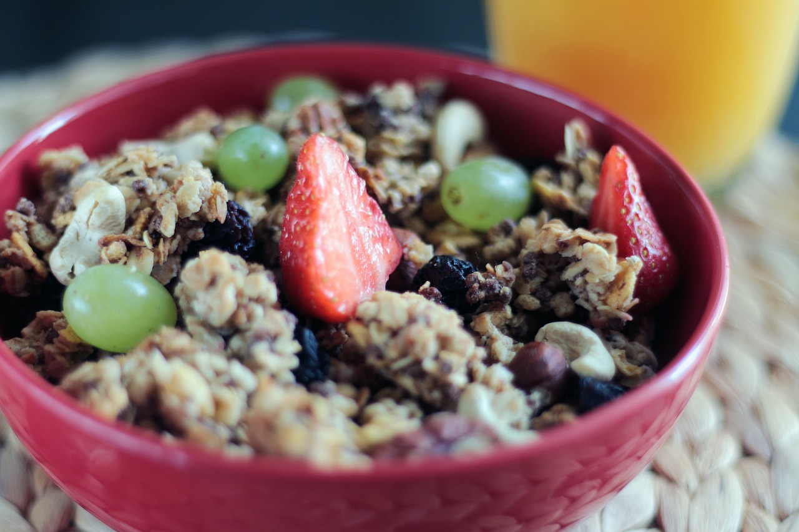
How much fibre do we need?
Most people do not eat enough dietary fibre.
The recommended average intake for dietary fibre is 30g per day for adults. Children need proportionately less.
Current intake of fibre is below the recommendations for all of the age groups.

Slide 7
How can fibre be increased in the diet?
Choose a high fibre breakfast cereal e.g. bran flakes, or porridge.
Go for wholemeal or granary breads instead of white bread.
Choose wholegrains like wholewheat pasta, bulgur wheat or brown rice.
Go for potatoes with skins e.g. baked potato or boiled new potatoes.
For snacks try fruit, vegetable sticks, rye crackers, oatcakes, unsalted nuts or seeds.
Include plenty of vegetables with meals – either as a side dish or added to sauces, stews or curries.
Add pulses like beans, lentils or chickpeas to stews, curries and salads.
Have some fresh or dried fruit, or fruit canned in natural juice for dessert.

Slide 8
Kahoot Quiz
Open the link below on the main screen and get students to log onto kahoot.it on their tablets or smartphones.
They can then enter the code (that will come up on the main screen when you start the game) and their own nickname.
They can then play along with the quiz choosing the multiple choice answers that correspond with the questions on the main screen. There will then be a leaderboard of the scores after each question and at the end.
https://play.kahoot.it/#/k/9b3ef412-b4e4-47d7-9c04-0d6db549ff2d

Slide 9
Dietary Fibre

