Slide 1
Nutritional needs through life

Slide 2
Key stages in life
The key stages in life include:
pregnancy;
infancy;
childhood;
adolescence;
adulthood.
Energy and nutrient requirements change through life and depend on many factors, such as:
age;
gender;
body size;
level of activity;
genes.

Slide 3

Pregnancy
A varied diet, providing adequate amounts of energy and nutrients, is essential before and during pregnancy.
The mother’s diet can influence the health of the baby. Having a healthy body weight is important.
Being underweight can make it more difficult to become pregnant and make it more likely for the baby to have a low birth weight, leading to a greater risk of ill health.
Being overweight increases the risk of complications, such as high blood pressure and diabetes during pregnancy.

Slide 4
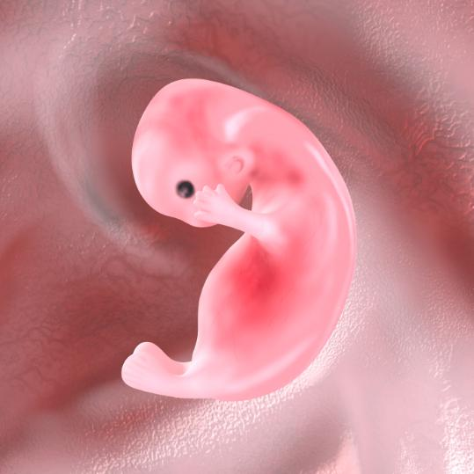
Early Pregnancy – folate/folic acid
Folic acid is a synthetic form of the B vitamin, folate.
Folate is needed for rapid cell division and growth of the foetus. It is particularly important during the first 12 weeks.
Folate is important for the development of the neural tube (the start of the brain and the spinal cord).
An adequate intake of folate is essential to protect against neural tube defects such as cleft palate and spina bifida.

Slide 5

Early Pregnancy – folate/folic acid
Women who are pregnant or thinking of having a baby are advised to take a daily supplement containing 400 microgram (μg) folic acid daily.
This supplement should be continued for the first 12 weeks of pregnancy.
Folate is naturally found in oranges, bananas, green leafy vegetables, fortified breakfast cereals and bread.

Slide 6

During pregnancy
During pregnancy, some extra nutrients are needed (mainly in the last three months) to:
help the development of the uterus, placenta and other tissues;
meet the needs of the growing foetus;
lay down stores of nutrients and energy (as fat) for the growth of the foetus and ready for breastfeeding.

Slide 7

Breastfeeding / lactation
The process of producing breast milk and delivering it to the baby is called lactation.
A mother who is breastfeeding requires extra energy and nutrients. There are also increased demand for nutrients, such as calcium, phosphorous, vitamins A and C.
Breast milk provides all the energy and nutrients a baby needs for growth and maintenance during the first 6 months of life.

Slide 8

Breast milk
Breast milk provides special proteins, antibodies and white blood cells which help to protect the baby against infection.
In the first three days after birth, the mother produces a special form of breast milk called colostrum.
It contains less fat, more protein and is rich in antibodies, proteins that play a key role in the baby’s immune system.

Slide 9

Complementary feeding
At around 6 months, babies will start showing signs of wanting to try new foods. Solid foods can be gradually introduced in addition to breast milk or infant formula.
This is called complementary feeding. Solids must be semi-fluid and soft, since the baby has no teeth and cannot chew.
Complementary feeding too soon (before 4 months) can increase the risk of infections and allergies, as your baby's digestive system and kidneys are still developing.

Slide 10

Complementary feeding
Infants under six months should not be given:
wheat or other cereals to avoid risk of a reaction to gluten, which results in coeliac disease;
eggs;
fish and shellfish;
soft and unpasteurised cheeses.
Throughout complementary feeding, babies should not be given foods with added salt. Sugar-containing foods and drinks (e.g. biscuits, some rusks, fruit juices) between meals should be limited.

Slide 11

Complementary feeding
Supplements of vitamins A, C and D in the form of drops are recommended for children aged from 6 months to 5 years. This is particularly important if they do not eat a varied diet. For some, these are available free via the Healthy Start scheme.
Cows’ milk is not suitable as a drink before 12 months of age because it is low in iron, but can be used in small amounts in cooking from 6 months.
Low-fat varieties of milk, as a main drink, are not suitable for babies and young children until at least 2 years of age.

Slide 12

Childhood
The energy requirements of children increase rapidly because they:
grow quickly;
become more active.
Children have a higher energy requirement for their body size compared with adults.
They need foods that provide sufficient energy but are also rich in nutrients.
Foods should be eaten as part of small and frequent meals.

Slide 13
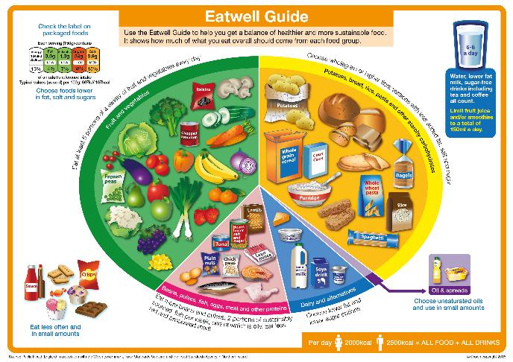
Childhood
Children’s diets from the age of 2-5 years should be based on the principles of the Eatwell Guide and include plenty of starchy carbohydrates, fruit and vegetables, and some protein and dairy foods.
Children should be encouraged to remain a healthy weight with respect to their height.
A healthy family lifestyle can help to maintain a healthy weight, such as being active together or sharing meals.

Slide 14

Childhood
Childhood is an important time for growth and development.
Children need a good supply of protein, and other nutrients including calcium, iron and vitamins A and D.
Children begin to take responsibility for their own food choices around this time.
It is therefore important to encourage them to eat a healthy, varied diet which is rich in fruit, vegetables and starchy foods.

Slide 15

Dental hygiene
Dental hygiene is very important. Children should pay attention to dental hygiene and ways to prevent dental caries.
Teeth should be brushed twice a day, for at least 2 minutes at a time, with a fluoride-containing toothpaste.
If food and drinks high in sugar are consumed occasionally, this should be done at mealtimes and not in between meals.

Slide 16
Adolescence
Adolescence is a period of rapid growth and development and is when puberty occurs.
The demand for energy and most nutrients are relatively high.
Boys need more protein and energy than girls for growth.
Girls need more iron than boys to replace menstrual losses.
It is important to encourage an active lifestyle with a healthy, balanced diet during this time.
This is because good habits practised now are likely to benefit their health for the rest of their lives.

Slide 17
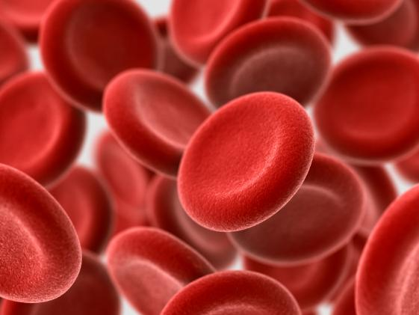
Adolescence – iron
Teenage girls and women require 14.8mg of iron each day.
Teenage boys need 11.3mg of iron daily but this reduces to 8.7mg for men aged 19 or over.
Iron from meat sources, is readily absorbed by the human body.
Did you know?
Vitamin C helps to absorb iron from non-meat sources, such as green leafy vegetables, nuts, pulses, dried fruits, wheat flour and breakfast cereals.

Slide 18

Adulthood
Nutritional requirements do not change much between the ages of 19 to 50 years, except during pregnancy and lactation.
On average, UK adults are eating too much saturated fat and salt from food, and not enough fruit and vegetables.
A poor diet can lead to diseases such as obesity, cardiovascular diseases, cancer and diabetes.

Slide 19

Adulthood
To reduce the risk of developing these diseases, it is important to:
eat a balanced diet;
eat plenty of fruit and vegetables;
drink alcohol in moderation;
stay active;
not smoke.

Slide 20

Older adults
Older adults is the term usually refers to people over the age of 65.
Requirements for energy gradually decrease after the age of 65 as activity level falls.

Slide 21

Older adults
To maintain good health, it is important that older adults:
enjoy their food;
keep active;
have adequate nutrient intakes.
It is also important they keep hydrated by drinking plenty of fluid. Even minor dehydration can lead to health problems.

Slide 22

Older adults
After menopause (when menstruation stops), women gradually lose bone strength.
Osteoporosis may occur when bones become weak, brittle and break easily. This may lead to fractures in the wrist, back and hip.
Older adults should have plenty of calcium intake from milk and dairy products, green leafy vegetables, beans, pulses, and products made from flour.
They should also remain active and have adequate vitamin D from foods such as oily fish, or through the action of sunlight on the skin. Adults over 65 years who are housebound should take a daily supplement of vitamin D as skin synthesis of this vitamin requires sunshine.

Slide 23
Summary
There are various key stages in life of importance nutritionally: pregnancy, infancy, childhood, adolescence, adulthood and older adulthood.
Differing amounts of energy and nutrients are required at different life stages.
It is important to maintain a healthy weight throughout life by eating a healthy diet and taking regular physical activity.

Slide 24
Nutritional needs through life
For further information, go to:
www.foodafactoflife.org.uk
This resource meets the Guidelines for producers and users of school education resources about food.

