Slide 1
5 A Day- What counts and what is a portion?

Slide 2
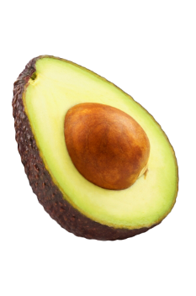
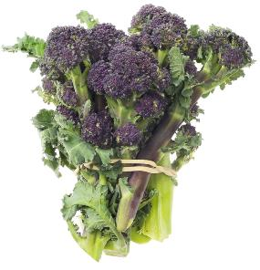
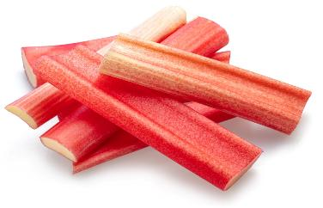
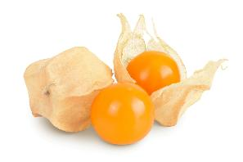
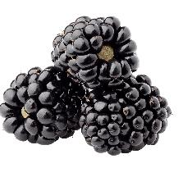
5 A Day
We need to eat at least five portions of fruit and vegetables a day.
1. Name 5 fruit and vegetables you like to eat.
2. Name these fruit and vegetables.
Avocado
Purple sprouting broccoli
Cape gooseberry
Blackberry
Rhubarb

Slide 3
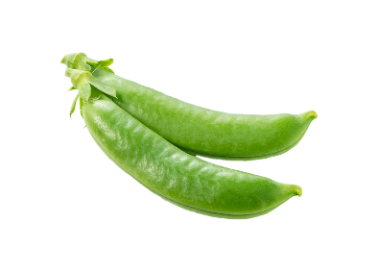
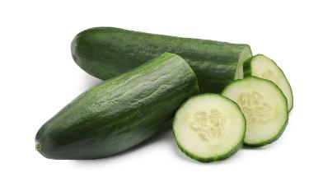
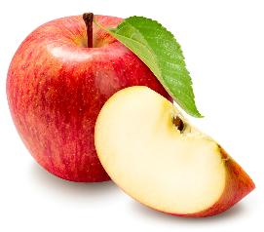
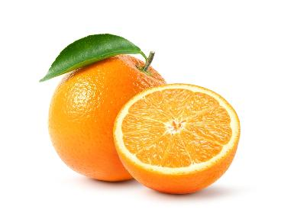
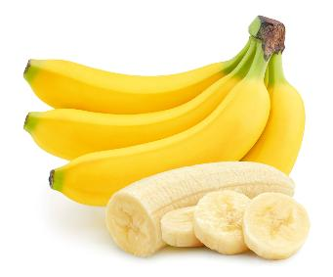
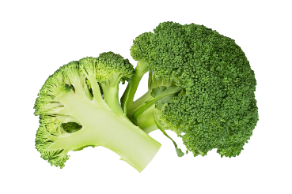
What counts as a portion of 5 A Day?
We can say a portion is about a handful.
What do you think a portion would be for different types of fruit and vegetables, e.g. dried or juiced?

Slide 4
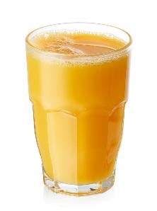
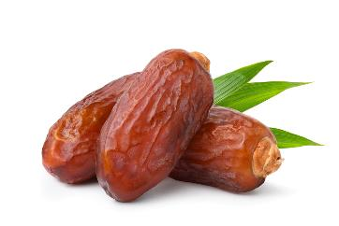
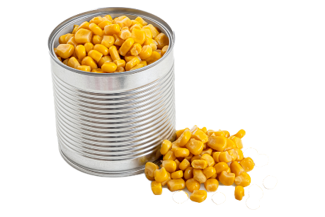
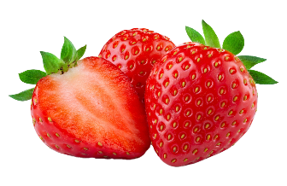
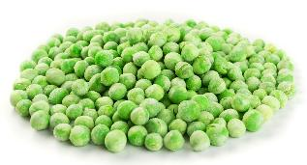
Types
We should aim to have a variety of different types of fruit and vegetables each day.
Name these fruit and vegetables and say what type they are? For example, frozen or dried.

Slide 5
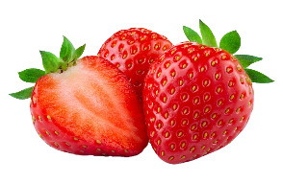



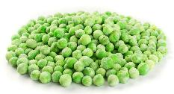
Types
Were you correct?
Strawberries
Peas
Sweetcorn
Orange juice
Dates
Fresh
Frozen
Canned
Juiced
Dried

Slide 6
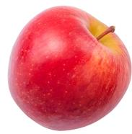
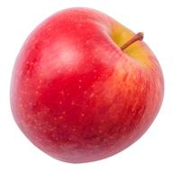
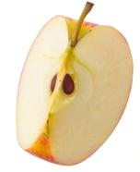
Portion size - fresh
Which of these would count as a portion of apple?

Slide 7
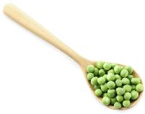
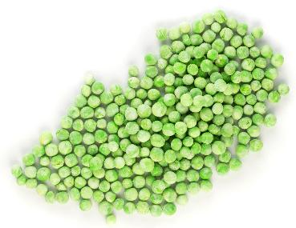


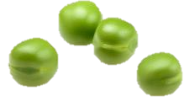
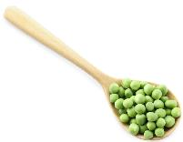
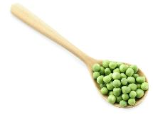
Portion size - frozen
Which of these would count as a portion of peas?
Name another example of a frozen fruit or vegetable.
80g is a portion of fresh or frozen fruit or vegetables

Slide 8
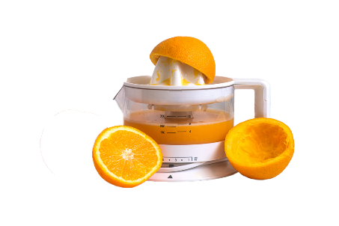
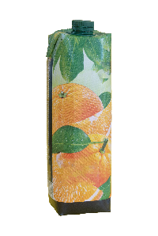

Portion size - juiced
Which of these would count as a portion of juice?
Name another example of a juiced fruit or vegetable.
A portion size of juice or smoothie is 150ml.
Fruit juices and smoothies can be high in free sugars so 150ml is the maximum amount that should be consumed in a day.

Slide 9
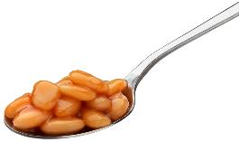
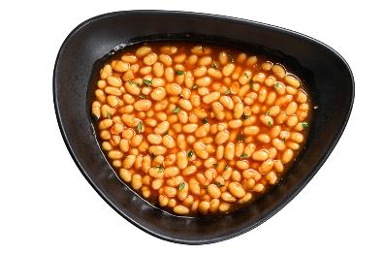
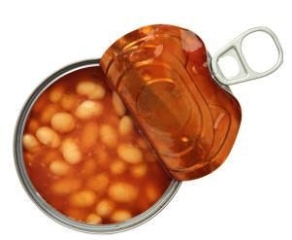
Portion size - canned
Which of these would count as a portion of baked beans?
Name another example of a canned food which would count towards your 5 A DAY.

Slide 10
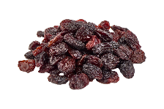

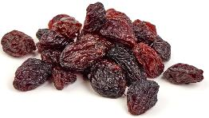
Portion size - dried
Which of these would count as a portion of raisins or sultanas?
Name another example of a dried fruit.
30g is a portion of dried fruit.
To reduce the risk of tooth decay, dried fruit is best enjoyed as part of a meal – as dessert, for example, not as a between meal snack.
Remember, dried fruit can also be added to savoury cooking.

Slide 11
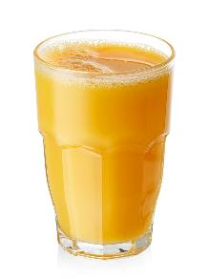
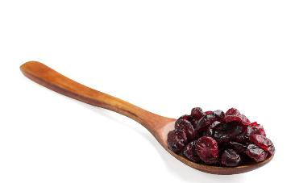

What counts as a portion?
1 heaped tablespoon
(15ml spoons) of dried fruit
1 glass (150ml)
of juice
1 medium sized
piece of fruit
3 heaped tablespoons
(15ml spoons) of vegetables
3 heaped tablespoons
(15ml spoons) of beans or pulses

Slide 12

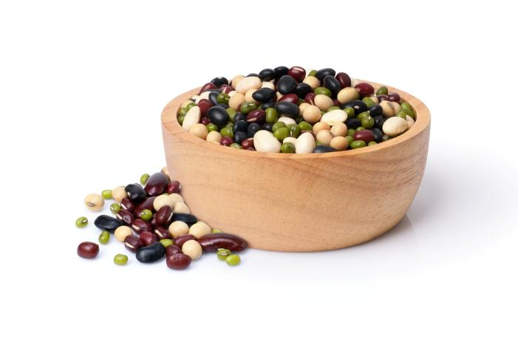
What counts as a portion?
Fruit/vegetable juice and smoothies
Only counts once a day no matter how much or how many different varieties you have you have, e.g. pineapple, orange.
Pulses
Only counts once a day no matter how many types you have, e.g. beans, lentils.

Slide 13
5 A Day diary task
Add at least 5 portions of fruit and vegetables to this food diary.
Breakfast | Bowl of cereal
Break-time
Lunch | Chicken sandwich Yogurt
After school | Crackers and cheese
Evening meal | Pasta and bolognaise sauce

Slide 14
5 A Day- What counts and what is a portion?
For further information, go to:
www.foodafactoflife.org.uk
This resource meets the Guidelines for producers and users of school education resources about food.

