Slide 1
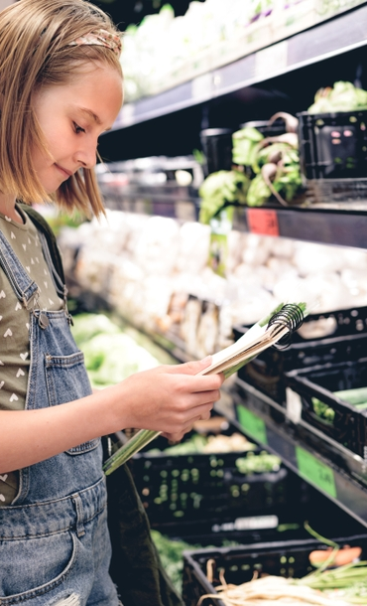
Going shopping

Slide 2
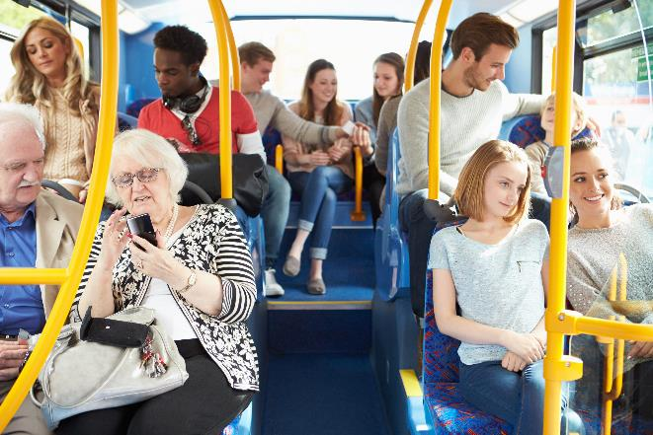
Travelling to the shop
If you are getting public transport you could ask:
“Good morning, how much does the bus cost?”
“Is this the bus that goes to…?”

Slide 3
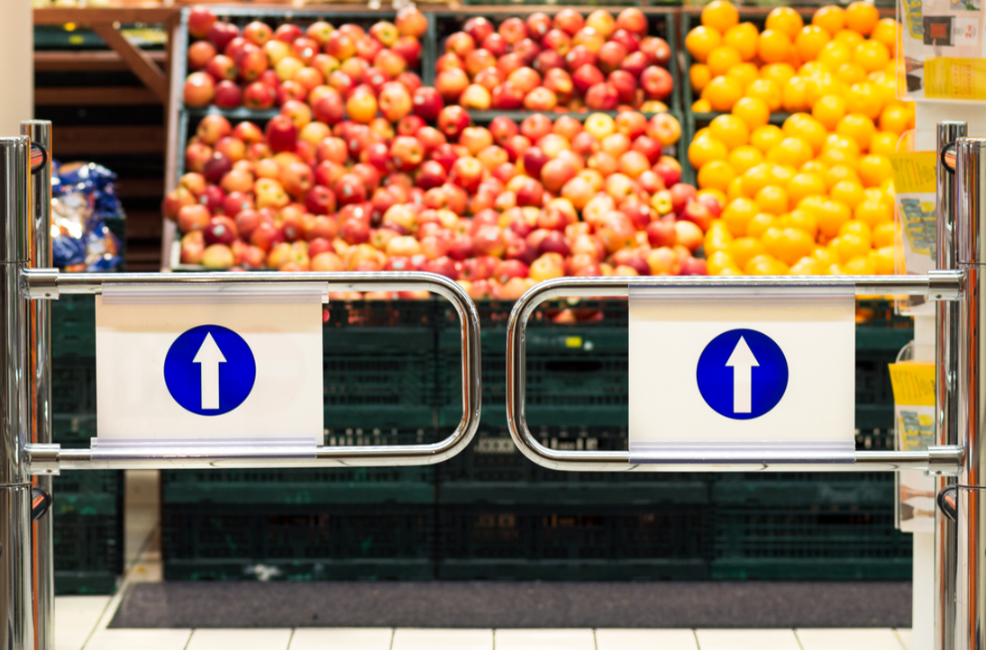
Arriving at the shop
When arriving at the shop you could say:
“Good morning!“
“Could I have a basket/trolley please?”

Slide 4
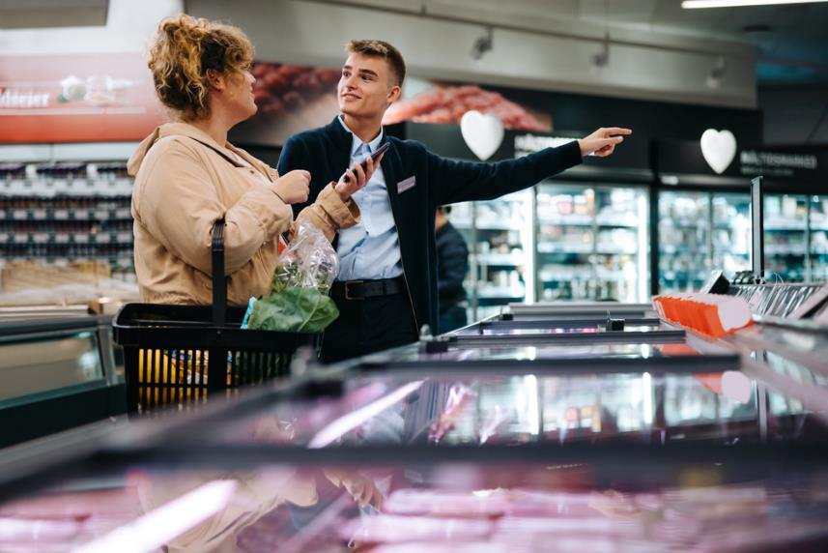
Looking around the shop
When looking around you could say:
“Could you please help me reach…?”
“Could you please help me find…?”

Slide 5
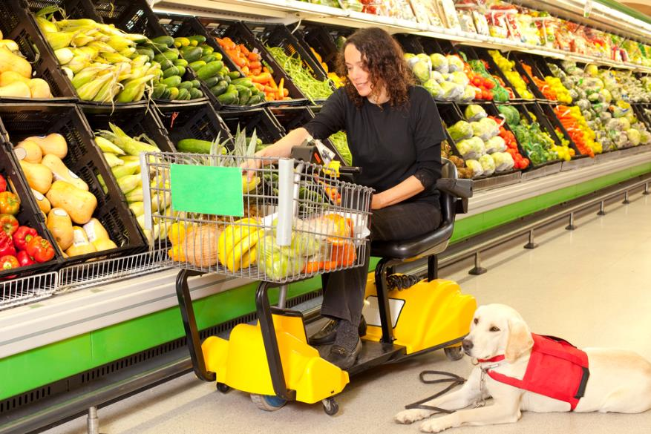
Arriving at the place where the food is
When in the area the food is, you could say:
“Could you please help me reach…?”

Slide 6
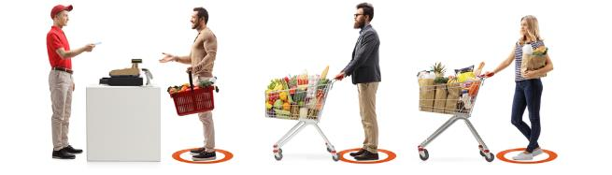
Queuing up
When queueing make sure to:
Give the person in front space.
Wait until your turn to put your food on the counter.

Slide 7
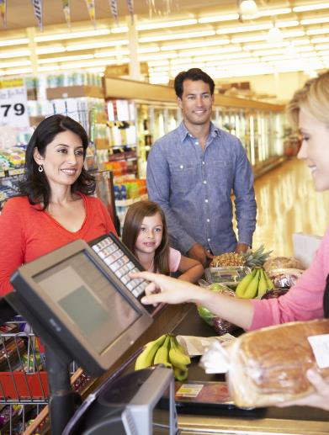
Paying
When paying for the shopping you could say:
“How much is this?”
“Can I pay by cash/card please?”

Slide 8
Going shopping

