Slide 1
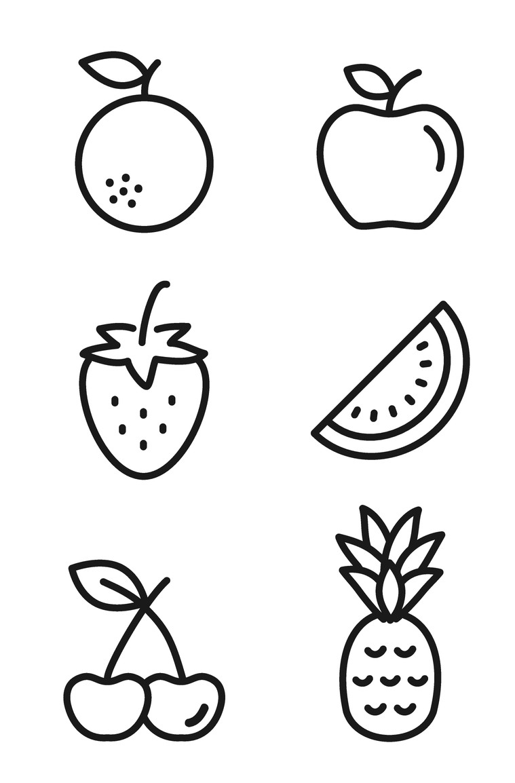
My food book
My name is:

Slide 2
I like these foods.

Slide 3
My likes .
My
likes .

Slide 4
I’m not sure if I like these foods so I’ll need to taste them again.

Slide 5
I have tried these foods.
I have coloured in a face to show what I think of each food.

Slide 6
I need different foods and drinks to be healthy.
Here is a drink.
Here is a food from each of the four main food groups.

Slide 7
When I eat well, I feel healthy.
This is me feeling healthy!

Slide 8
When I feel healthy, I can…

Slide 9
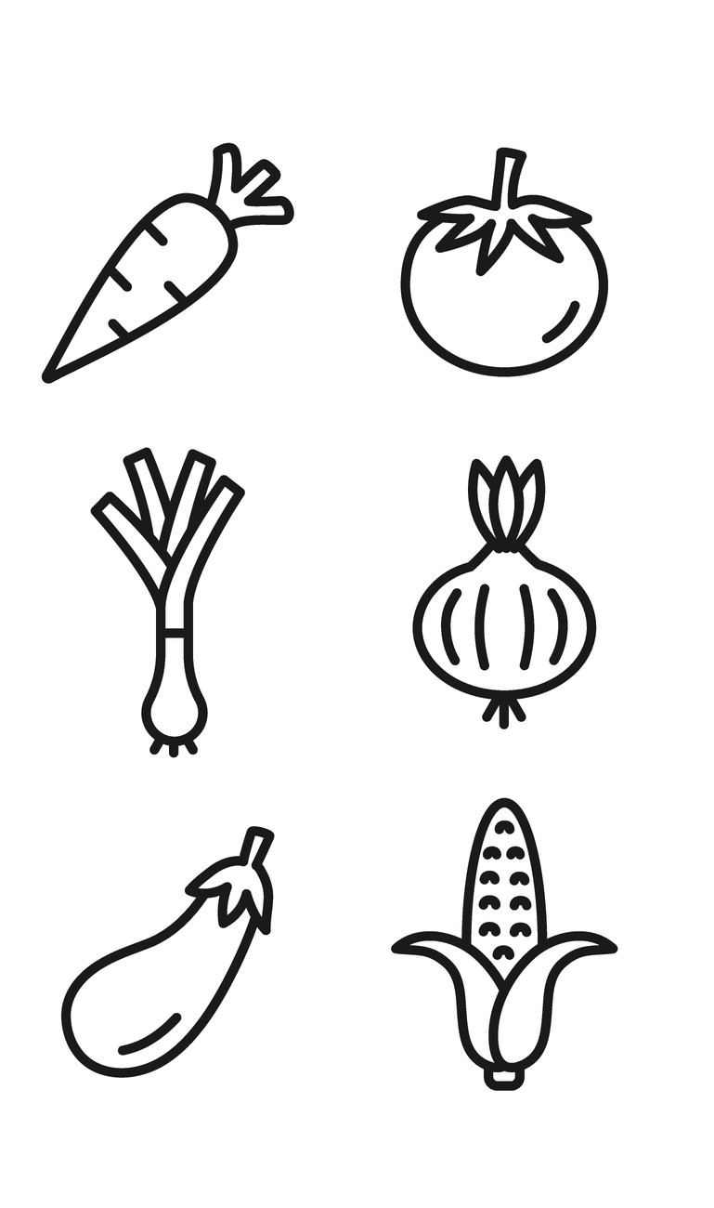
My food book

